Slide 1
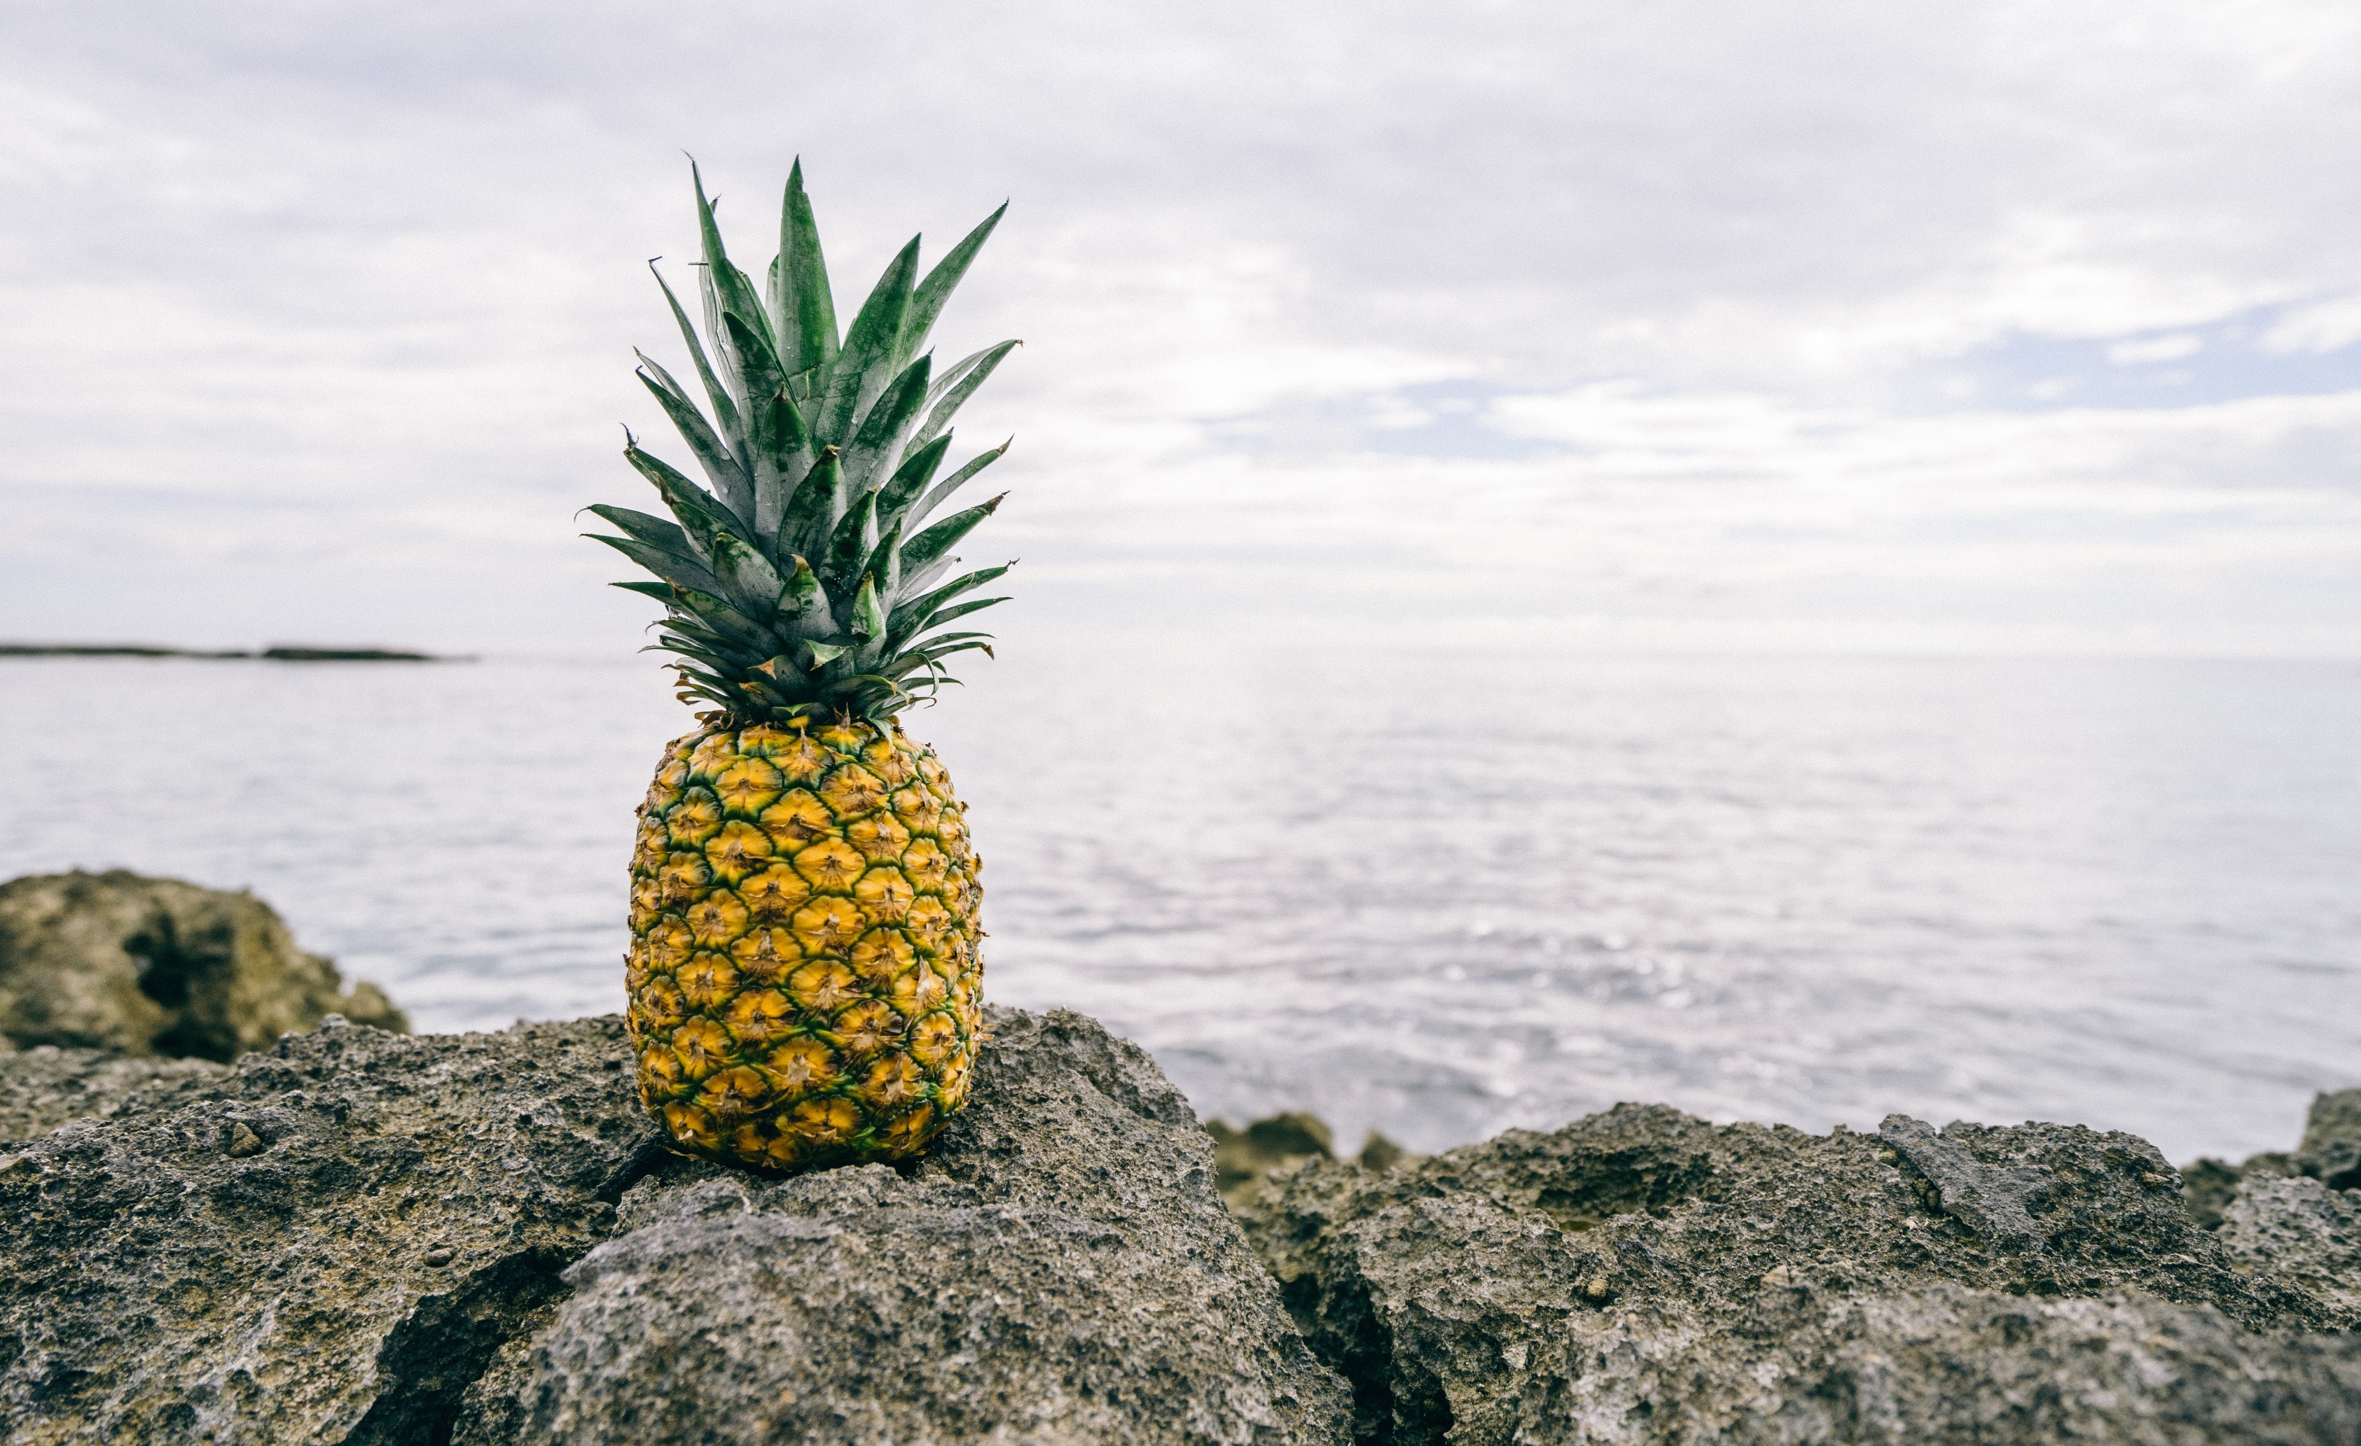
www.saarvasri.com
WELCOME TO THE WELLNESS WORLD OF SAARVASRI

Slide 2
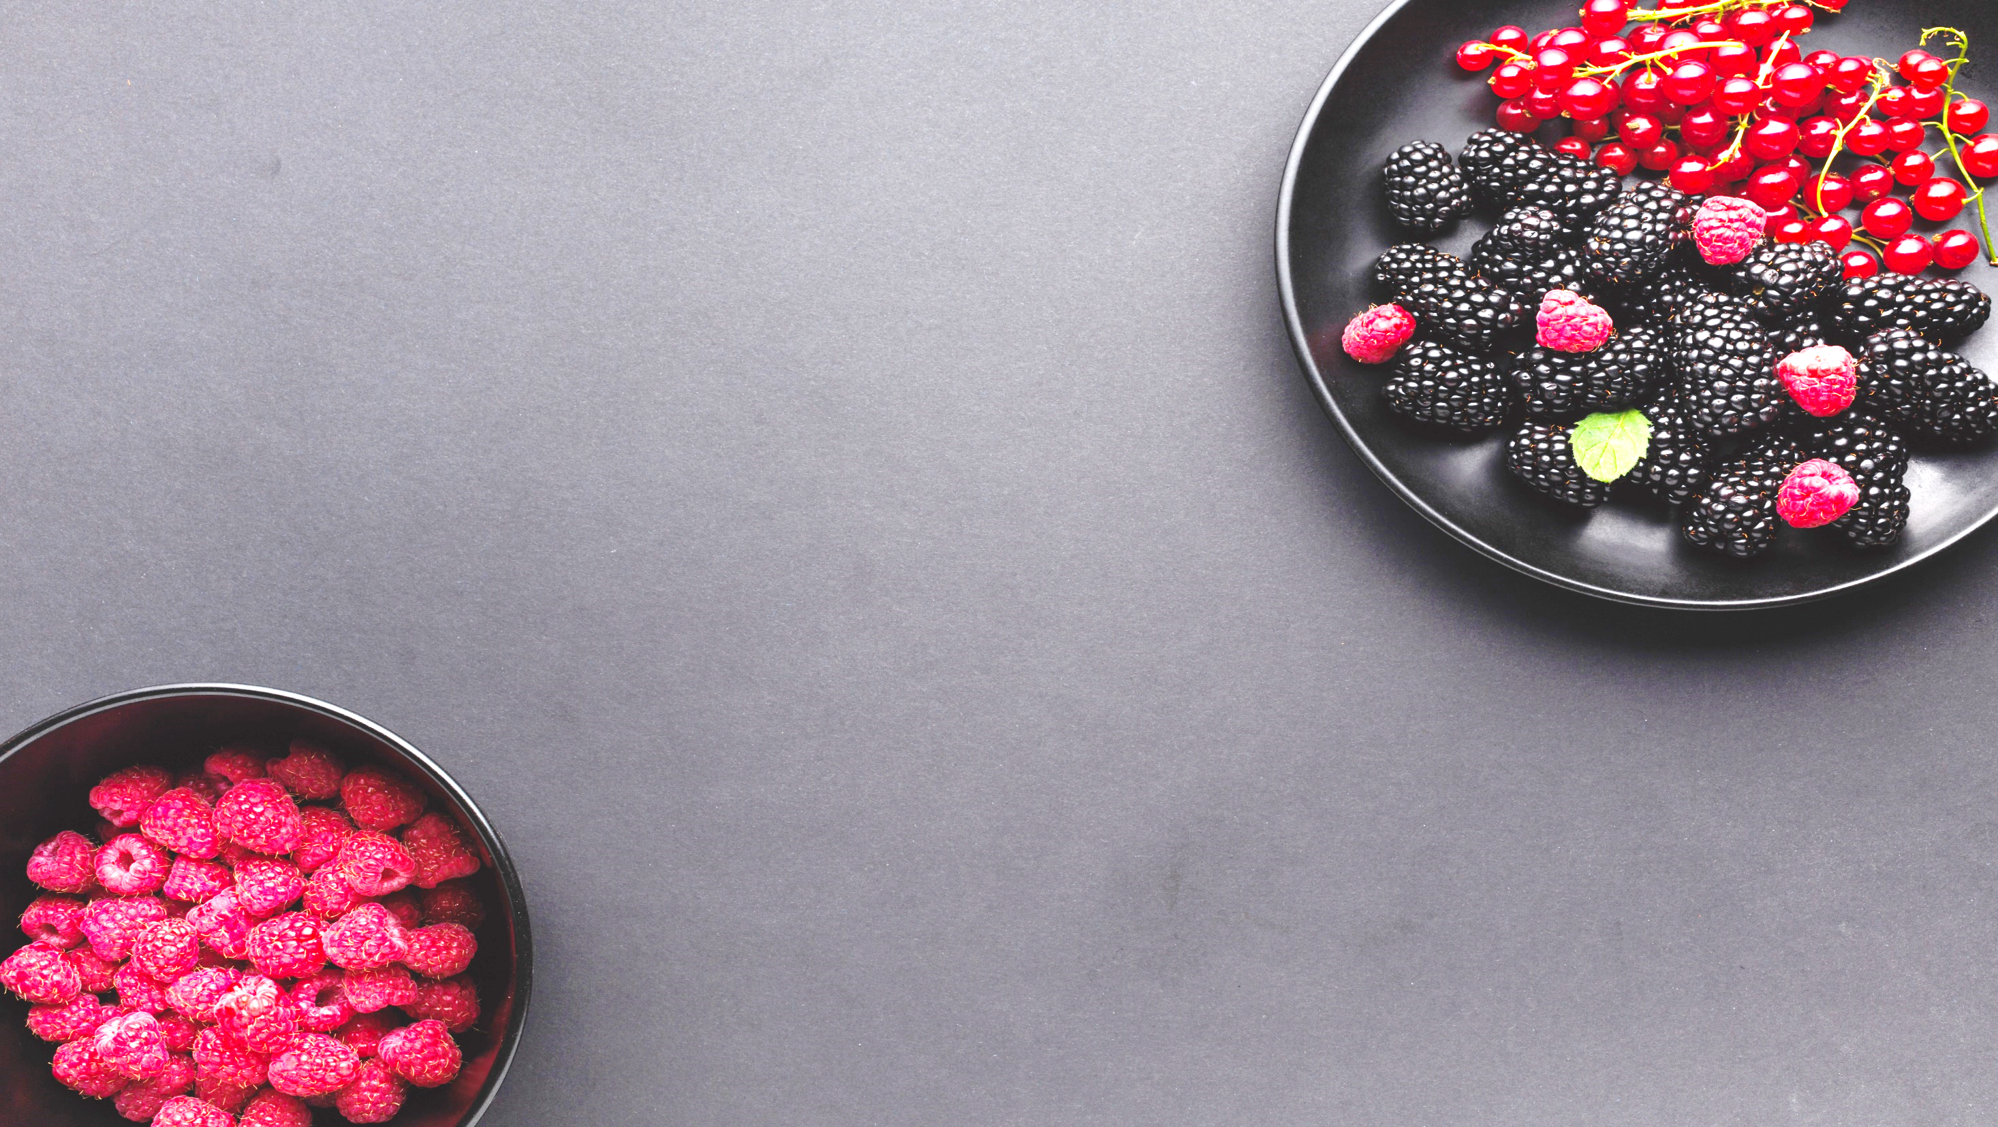
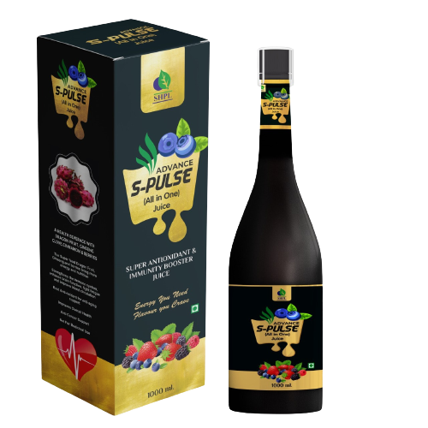
www.saarvasri.com
ADVANCE
S-PULSE
All In One Juice

Slide 3
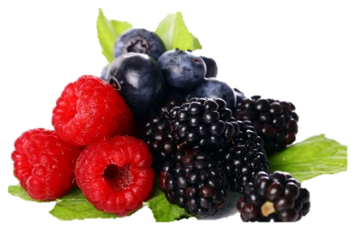
INTRODUCTION
SHPL introduces Advance S- PULSE (All in One) Juice:
A Panacea and Omnipotent product with synergistic combination of Indian Ayurvedic Herbs along with some European Berries and herbal ingredients.
Saarvasri Herbs has fulfilled the demand across the country for restorative health supplement to protect health.
Advance S-Pulse encourages alternative remedy to health and wellness in future days.
Advance S-Pulse closely evaluates the evidence of nutrition based benefits with special emphasis of on building immunity, strengthening, and repairing our body.
Advance S-Pulse meets all criteria of a dietary supplement to fight ailments.
Advance S-Pulse has enormous medicinal properties with science based approach for the science of longevity.

Slide 4
INGREDIENTS
Acai Berry
Banana
Green Apple
Pineapple
Dragon Fruit
Grape Seed
Pomegranate
Blueberry
Blackberry
Strawberry
Cranberry
Cherry
13. Sea Buckthorn
14. Mulberry
15. Orange
16. Pear
17. Ginseng
18. Shilajit
19. Cinnamon
20. Clove
21. Beet Root

Slide 5
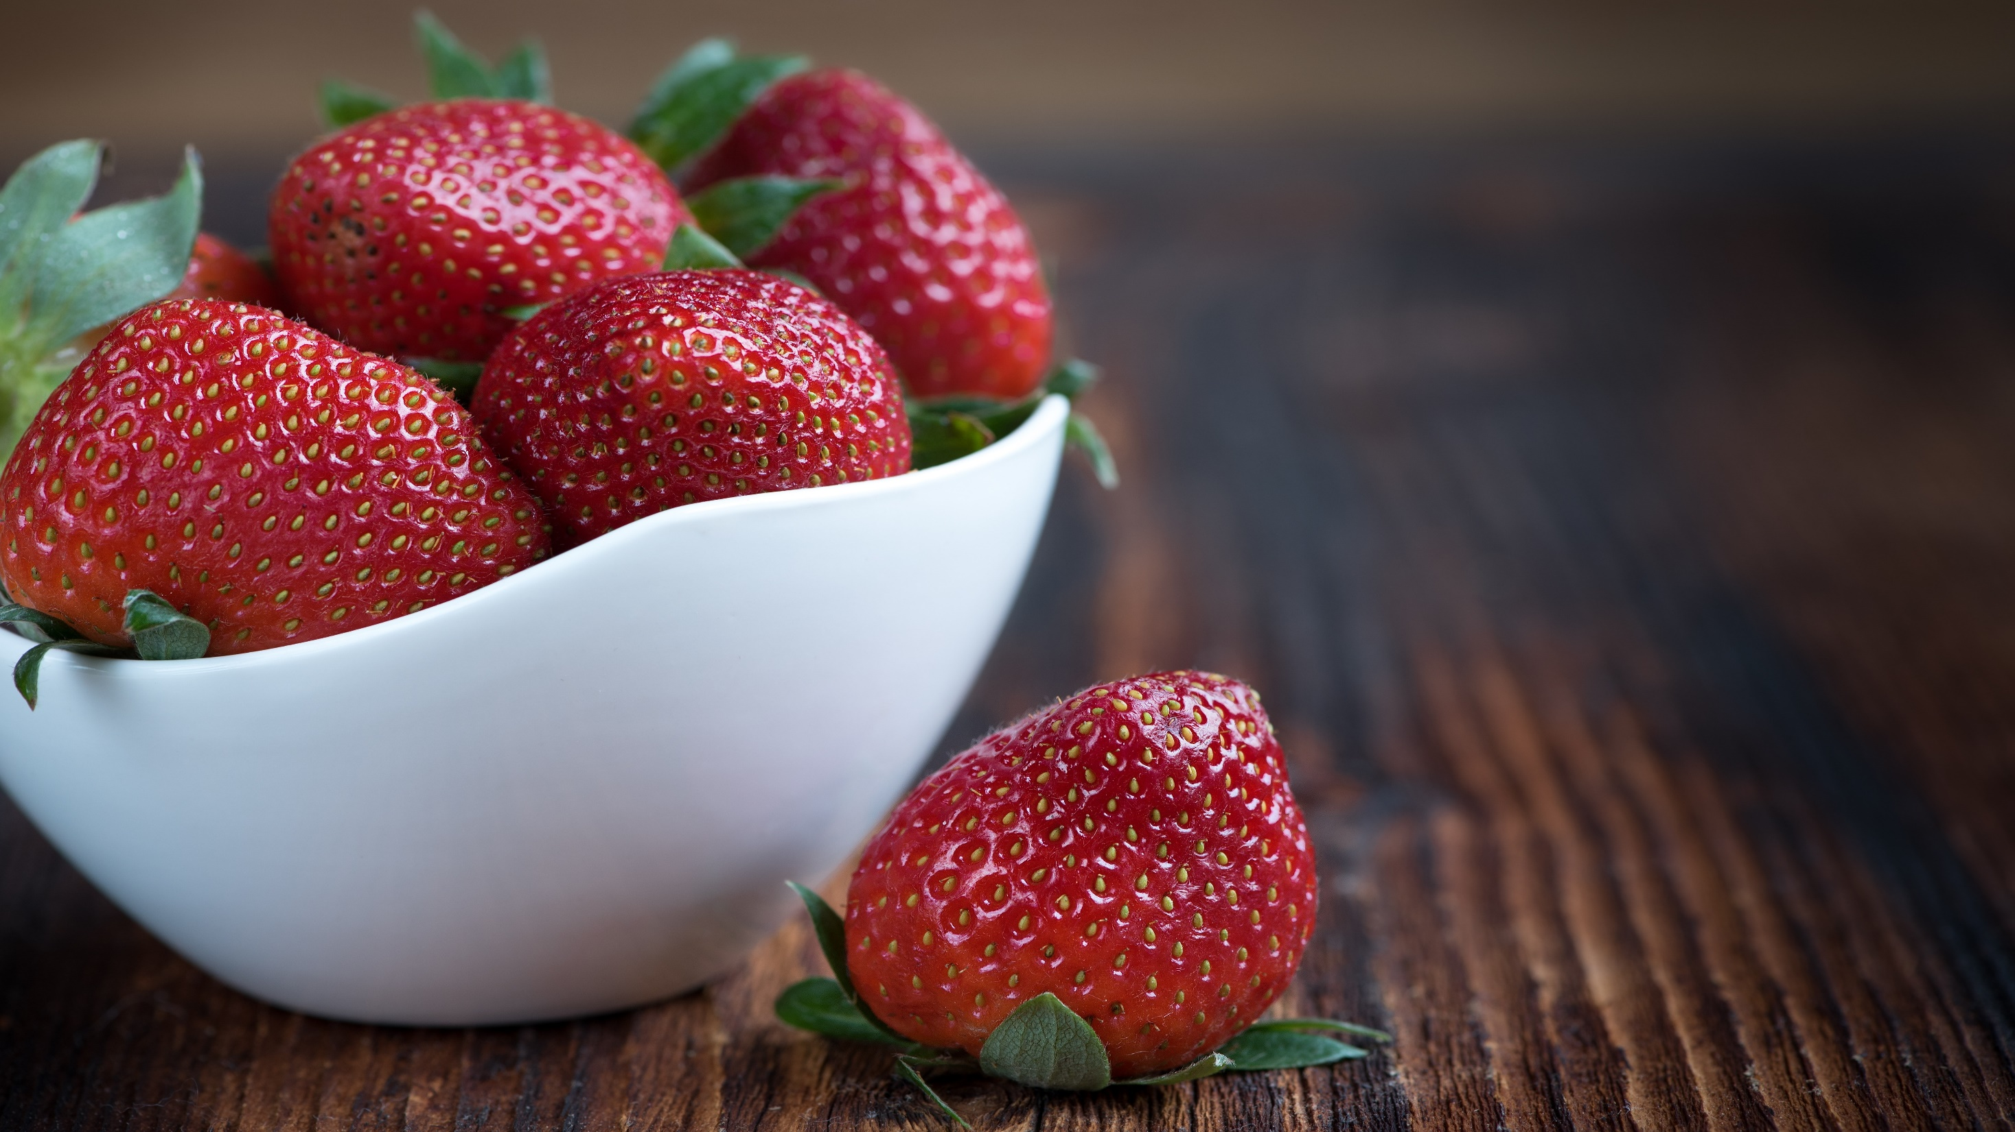
INGREDIENTS

Slide 6
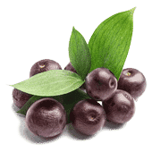
ACAI BERRY
Acai berries (Euterpe oleracea) have been consumed by people to improve their health for thousands of years.
It contains two essential fatty acids known as Omega-3, Omega-6, Omega-9 such as Alpha-linolenic Acid (ALA) and Oleic Acid
Is full of antioxidants including Anthocyanins, Polyphenols
Rich in Vitamins A, C, and E.
Acai Berry, hailed as a super food among health professionals, has been linked to incredible health benefits.

Slide 7
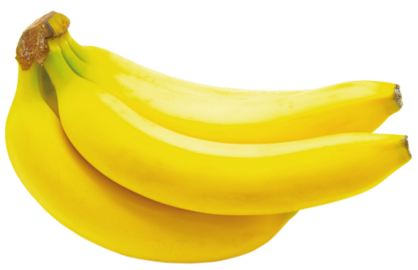
BANANA
Bananas are respectable sources of Vitamin C.
Resistant starch, the type of fiber found in unripe bananas, is a prebiotic (food for healthy bacteria).
Potassium in bananas is good for your heart health and blood pressure.
Bananas can aid digestion and help beat gastrointestinal issues.
The flavonoids and amines in bananas reduce risk of heart disease and degenerative illnesses
Pectin- a fiber found in both ripe and unripe bananas, may help prevent constipation and soften stools.

Slide 8
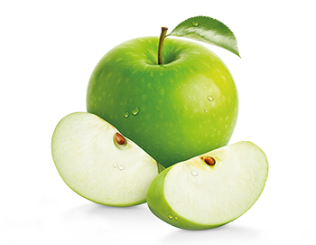
GREEN APPLE
Green Apples contain pectin, a fiber source that works as a prebiotic to promote the growth of healthy bacteria in gut.
The high fiber content in green apples have heart protective properties.
Green apples have less sugar and carbs, and more Fiber, Protein, Potassium, Iron, and Vitamin K. ​

Slide 9
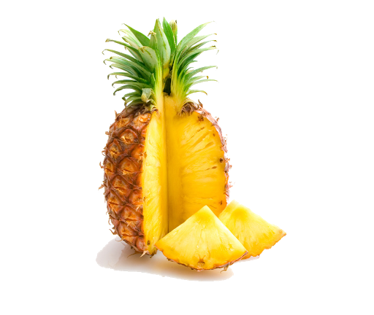
PINEAPPLE
Pineapple is extremely rich in vitamin C. This vitamin is vital for the proper functioning of the immune system, preventing recurrent colds, fever and flu.
It also fights bigger problems like heart disease and joint pain.

Slide 10
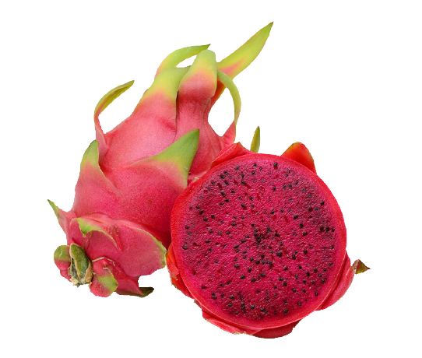
DRAGON FRUIT
Dragon fruit is high in vitamin C and other antioxidants, which are good for your immune system.
It can boost your iron levels. Iron is important for moving oxygen through your body and giving you energy. Also, the vitamin C in dragon fruit helps your body take in and use the iron.

Slide 11
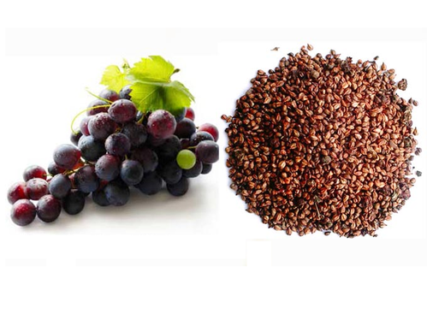
GRAPE SEED
As per reports, since ancient Egyptians and Europeans used grapes and grape- seed extract for medicinal purposes.
Today we know that, grape seed extract contains mainly Oligomeric proanthocyanidin (OPC) that have been used to improve blood flow, reduce symptoms of diabetes, and to ease swelling in the joints.
Contains other essential compounds such as Tannins, Epicatechins, and Catechins that help prevent cell damage
Grape seed extract also contains Vitamin E and Linoleic acid all are been used to improve many health conditions.

Slide 12
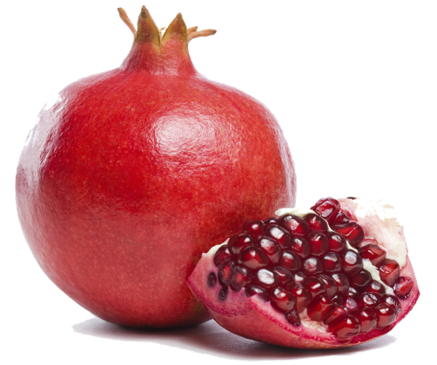
POMEGRANATE
Pomegranates are loaded with important nutrients. They contain two plant compounds with powerful medicinal properties- phenolic compounds and fatty acids.
They have impressive anti-inflammatory effects.
Pomegranate may help fight prostate cancer. They may also be useful against breast cancer.
They may lower blood pressure.

Slide 13
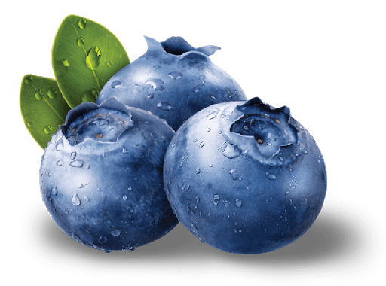
BLUE BERRY
Blue Berries may quite literally keep the doctor away, contributes essential nutrients, including Vitamin C, Vitamin K, Dietary Fiber.
Blueberries contain one of the highest antioxidant levels of all common fruits and vegetables.
Rich in polyphenols called flavonoids (anthocyanins).
Blueberries are low in calories but high in nutrients with impressive wellness benefits.

Slide 14
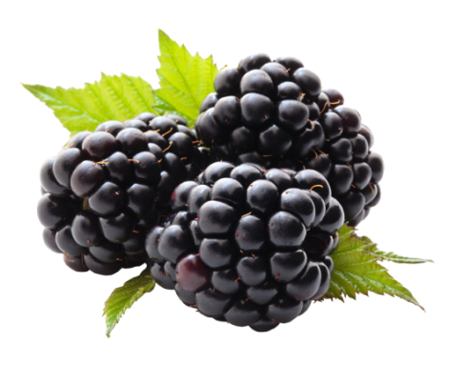
BLACK BERRY
Blackberries, (Rubus Fruticosus) have been used for their medicinal values for more than 2000 years. It is a nutritional powerhouse with full of vitamins and minerals, and also contribute unique advantages to overall health.
Vitamins provided by blackberries include Vitamin A, B1, B2 , B3 , B6, C , E , and K .
The mineral wealth of Black Berries includes Calcium, Iron, Magnesium, Phosphorous, Potassium, and Zinc.
Black berries are also a good source of amino acids and essential dietary fiber.

Slide 15
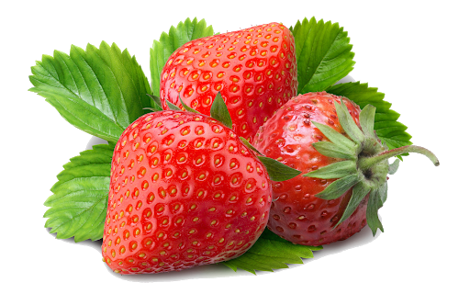
STRAWBERRY
Strawberry is rich in Vitamins, Minerals, and Antioxidants, which are beneficial for health.
Strawberries are the world’s most popular berry for being sodium-free, fat-free, cholesterol-free and low-calorie.
Good source of Manganese and Potassium.

Slide 16
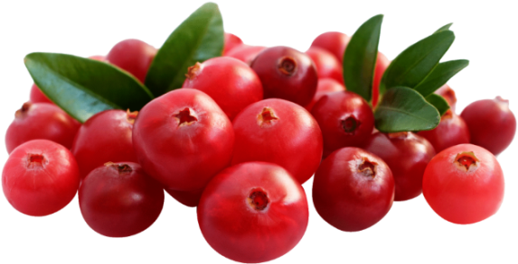
CRANBERRY
Cranberries due to its high nutrient and crucial antioxidant (including vitamins A and E), and a good source of vitamin C.
Protects cells from damage and boost collagen production, helping with wound healing and skin integrity.
The berries possess several properties that have been known to improve our overall health.

Slide 17
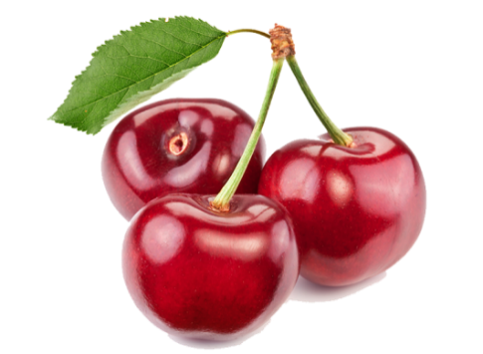
CHERRY
Cherries are low in calories and full of fiber, vitamins and minerals.
Rich in Vitamin C, A, and K.
Contains potassium, magnesium, and calcium.
They also bring antioxidants, like beta-carotene, and the essential nutrient Choline.

Slide 18
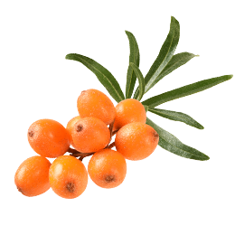
SEA BUCKTHORN
Sea buckthorn (Hipphophae rhamnoides) contains:
Essential fatty acids
Antioxidants such as Lycopene
Anthocyanins
Vitamins: A, B12, C, E, K
Minerals: Potassium, Calcium, Magnesium, Iron, Phosphorus
Flavonoids- Hippophaeosides, Hippophins, Catechin, Epicatechin, Gallocatechin, Epigallocatechin.
Fatty Acids: Alfa Linoleic Acid (Omega 3), Linoleic acid (Omega 6), Palmitoleic acid (Omega 7), Oleic Acid (Omega 9) are greatly beneficial for human health.

Slide 19
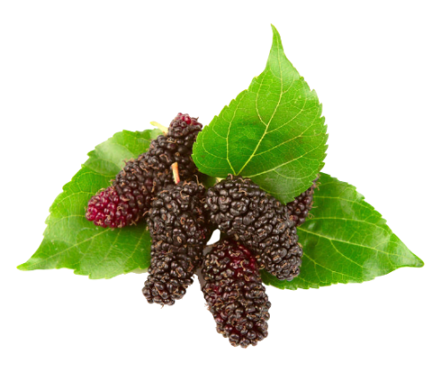
MULBERRY
Mulberries (Morus Indica) are rich in important nutrients like Iron, Vitamin C, Vitamin K, Potassium, and Calcium.
It contain Fibers, Sugars, Carbohydrates, Proteins, Lipids.
Mulberries are also a reservoir of antioxidants, called Resveratrol is found abundantly.
Mulberries are also a rich source of polyphenols like Anthocyanin, Flavonoids, Lutein, Zeaxanthin, α-Carotene, and β-Carotene.

Slide 20
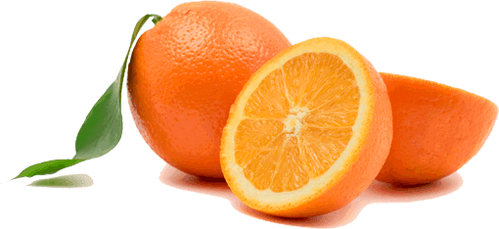
ORANGE
Vitamin C- potent free radical scavenger- Prevents degenerative diseases.
Oranges contain the flavonoids- Hesperetin, Naringenin and Carotenoids which are antioxidant, anti-inflammatory, blood lipid and cholesterol lowering compounds.
Contains B-complex vitamins such as Niacin (vitamin B3), Folate (B9) and Thiamine (B1) which are co-factors of many biochemical reactions.

Slide 21
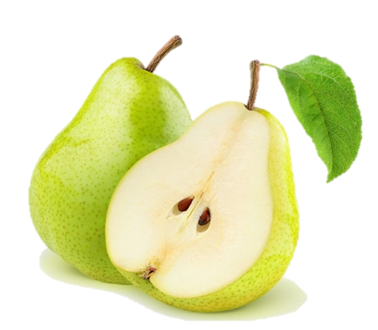
PEAR
Pears are rich in essential antioxidants, plant compounds, and dietary fiber.
As part of a balanced, nutritious diet, consuming pears could support weight loss and reduce a person's risk of cancer, diabetes, and heart disease.

Slide 22
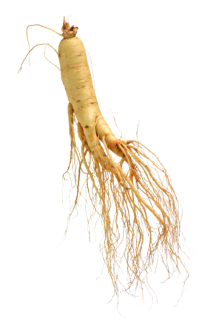
GINSENG
Ginseng has been used for improving overall health.
It is helpful to strengthen the immune system and help fight off stress, unclear thinking, diabetes, and male Erectile Dysfunction (ED).
Ginseng is effective in memory improvement, and in the direct prevention of degenerative brain diseases such as Alzheimer's disease.
The neuroprotective effect of ginseng may be useful in the prevention of depression.

Slide 23
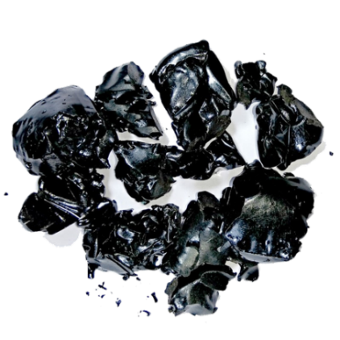
SHILAJIT
Shilajit is a sticky substance found primarily in the rocks of the Himalayas. It develops over centuries from the slow decomposition of plants.
It contains fulvic acid and more than 84 minerals , and offers several health benefits.
It can function as an antioxidant to improve your body's immunity and memory, an anti-inflammatory and an energy booster.
It is an aphrodisiac, helps sustain penile erection and calms the mind. Effective in treating male infertility by increasing total sperm count and motility.

Slide 24
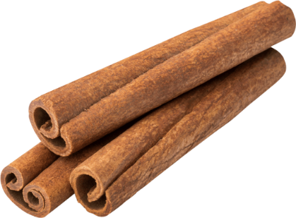
CINNAMON
Cinnamon is one of the most delicious and healthiest spices on the planet.
Helps lower blood sugar levels, reduce heart disease risk factors.
Antioxidant
Anti-inflammatory
Anti-diabetic
Antimicrobial properties.
Might offer protection from cancer and cardiovascular disease, among other conditions.

Slide 25
CLOVE
Clove can boost your immune system and protect you against infections and cases of flu.
Is an excellent source of healthy vitamins and minerals that can promote your health and immunity.
It is also a great source of Manganese, vitamin K, vitamin C, Calcium, and Magnesium.

Slide 26
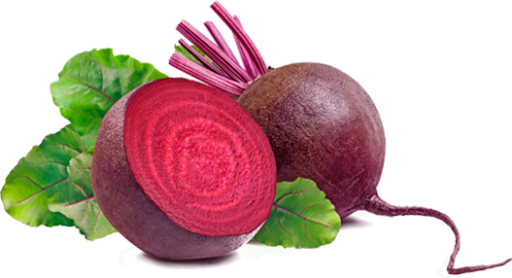
BEET ROOT
Beetroots are a great source of fiber, manganese, potassium, iron, and vitamin C.
Beetroots and beetroot juice help improve blood flow, lower blood pressure, and increased exercise performance.
Beets are rich in folate (vitamin B9) which helps cells grow and function, as well as helps control damage to blood vessels, which can reduce the risk of heart disease and stroke,
High nitrate content, which is turned into nitric oxide in the body, thus helping with blood flow and blood pressure.
Betaine is an antioxidant found in beets.

Slide 27
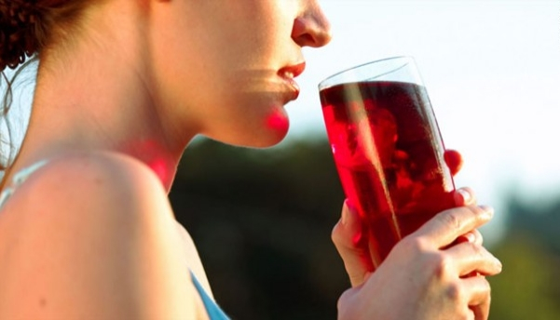
BENEFITS OF S-PULSE

Slide 28
INCREASING IMMUNITY
Advance S-Pulse helps build, restore and improve immune function.
Flavonoids and bioactive ingredients in Advance S-Pulse have properties to regulate secretion of digestive enzymes, remove toxic substance from body through antioxidant effect and other benefits.
Studies have confirmed the immuno-modulatory effects of the ingredients used. It helps modulate production and level of signaling molecules associated with immune function and inflammation.

Slide 29
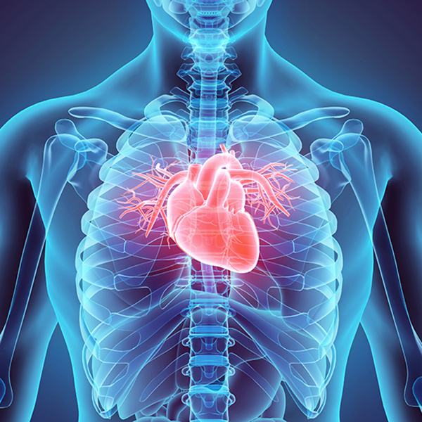
IMPROVES CARDIOVASCULAR HEALTH
Advance S-Pulse reduces blood pressure and cholesterol levels.
Flavonoids in Advance S-Pulse are believed to regulate blood pressure, prevent heart disease, improve heart function and reduce stress on heart tissue.

Slide 30
PREVENTS CEREBROVASCULAR DISEASES
Helps protect brain tissues from the damaging effect of free radicals and toxins.
It is believed to prevent diseases like cerebral ischemia, cerebral thrombosis, cerebral infarction and cerebral arteriosclerosis.
Rich in Vitamin C and other nutrients, it reduces headache, dizziness and increases mental attention.
Advance S-Pulse juice is good for people recovering from hemiplegia, aphasia, dementia and other symptoms.

Slide 31
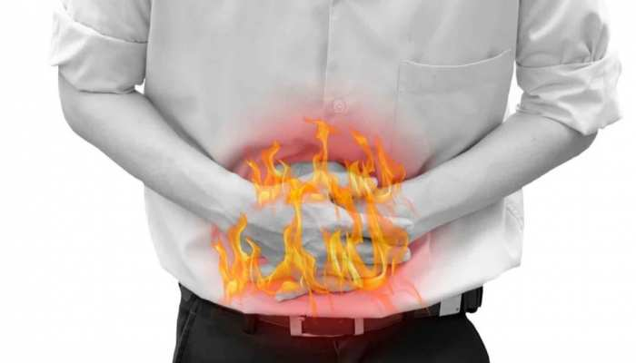
RELIEVES GAS AND ACIDITY
Drinking Advance S-Pulse juice may give you relief from gastric acidity and heartburn.
The compounds present in Advance S-Pulse help control secretion of acid in your stomach.
The effects have even been shown to combat gastric ulcers and keep them from getting larger.

Slide 32
HEALTHY SKIN
Vitamin A, Vitamin E and Omega 7 fatty acids present in Advance S-Pulse are considered essential nutrients for skin.
They help protect skin cells from photo-aging, i.e. damage and aging due to Ultraviolet radiation.
It promotes tissue and collagen regeneration; reduce skin wrinkles and premature skin aging.
It is also helpful in management of various skin diseases like atopic dermatitis, ulcers, acne, other infections, eczema, psoriasis, frostbite, mucositis, itchy skin, rosacea and skin inflammation.

Slide 33
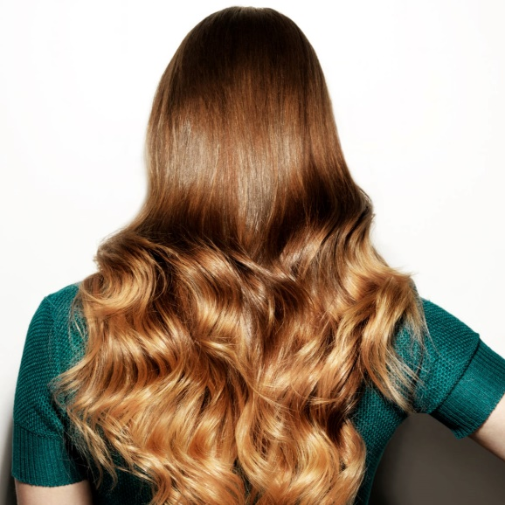
HEALTHY HAIR
Advance S-Pulse is considered good for hair growth and healthy scalp. It strengthens hair roots and improves hair luster.
Betulinic acid, present in berries is a component that is considered good for hair growth.
Advance S-Pulse also offers anti fungal properties for treating dermatitis and dandruff.
Advance S-Pulse helps ward off Demodex Folliculorum, a parasite in hair follicles, which is reason for hair loss, graying and rosacea.

Slide 34
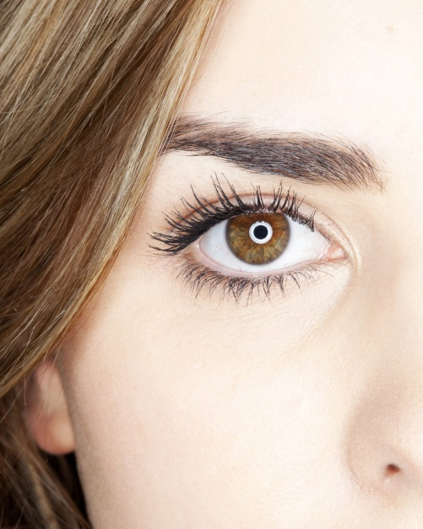
BENEFITS
EYE CARE
Vitamin A, Vitamin E and other fatty acids in Advance S-Pulse are considered to support eye health.
It has protective effect on mucous membranes of tissues in the eye. (protective membranes that function like moisturizer and lubrication)
It reduces inflammation and research has proven the role of these potent nutrients in treating eye disease like trachoma, protruding eyes, goiter, keratitis bubble, eyelid burn, conjunctivitis etc.

Slide 35
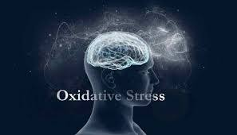
A POWERFUL ANTI-OXIDANT
Antioxidants present in Advance S-Pulse, like Vitamin C, E and Selenium have been proven to offer protection against mental aging.
It protects tissues of vital organs like brain and heart form oxidative stress of free radicals.
It detoxifies the body as well.

Slide 36
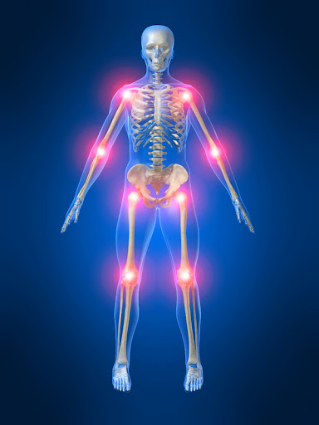
ANTI-INFLAMMATORY
Inflammation is the root cause of disease.
Advance S-Pulse offers anti-inflammatory properties and thus assists in treatment of several disease symptoms.
These properties can be attributed to high Vitamins and flavonoids.
Advance S-Pulse can be used for healthy cardio vascular system, relieving joint pains, fibromyalgia and arthritis.

Slide 37
Overall Health Benefits
Protect Cells.
Scavenges Free Radicals.
Strengthen cell membrane.
Build proteins.
Strengthen Immune System.
Enhances Cellular Communication.
Strengthens Nervous System.
Reduces the risk of cancer.
Relieves Inflammation.
Fights with Bacteria and Viruses.
Combats with the effects of Diabetes.
Strengthens Vision.
Takes care of the Prostrate.
Strengthens the Heart.
Fights with cellular mutation.
Helps in Digestion.

Slide 38
HOW TO USE
Daily 15 ml in the morning (empty stomach) and 15 ml two hours after dinner or as directed by the experts.

Slide 39
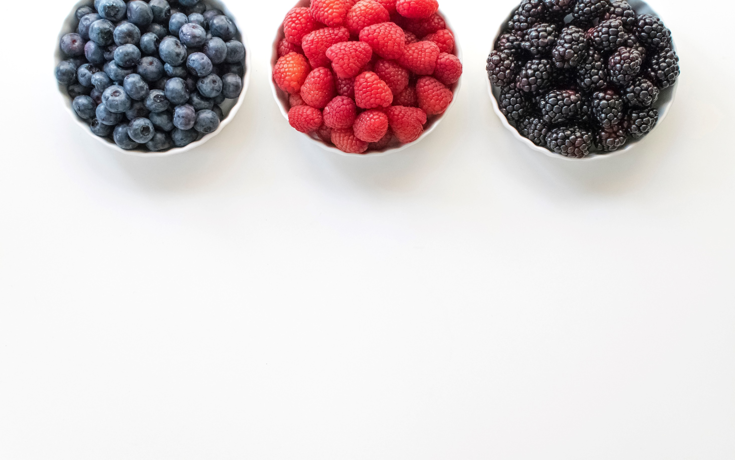
THANK YOU.

