Slide 2
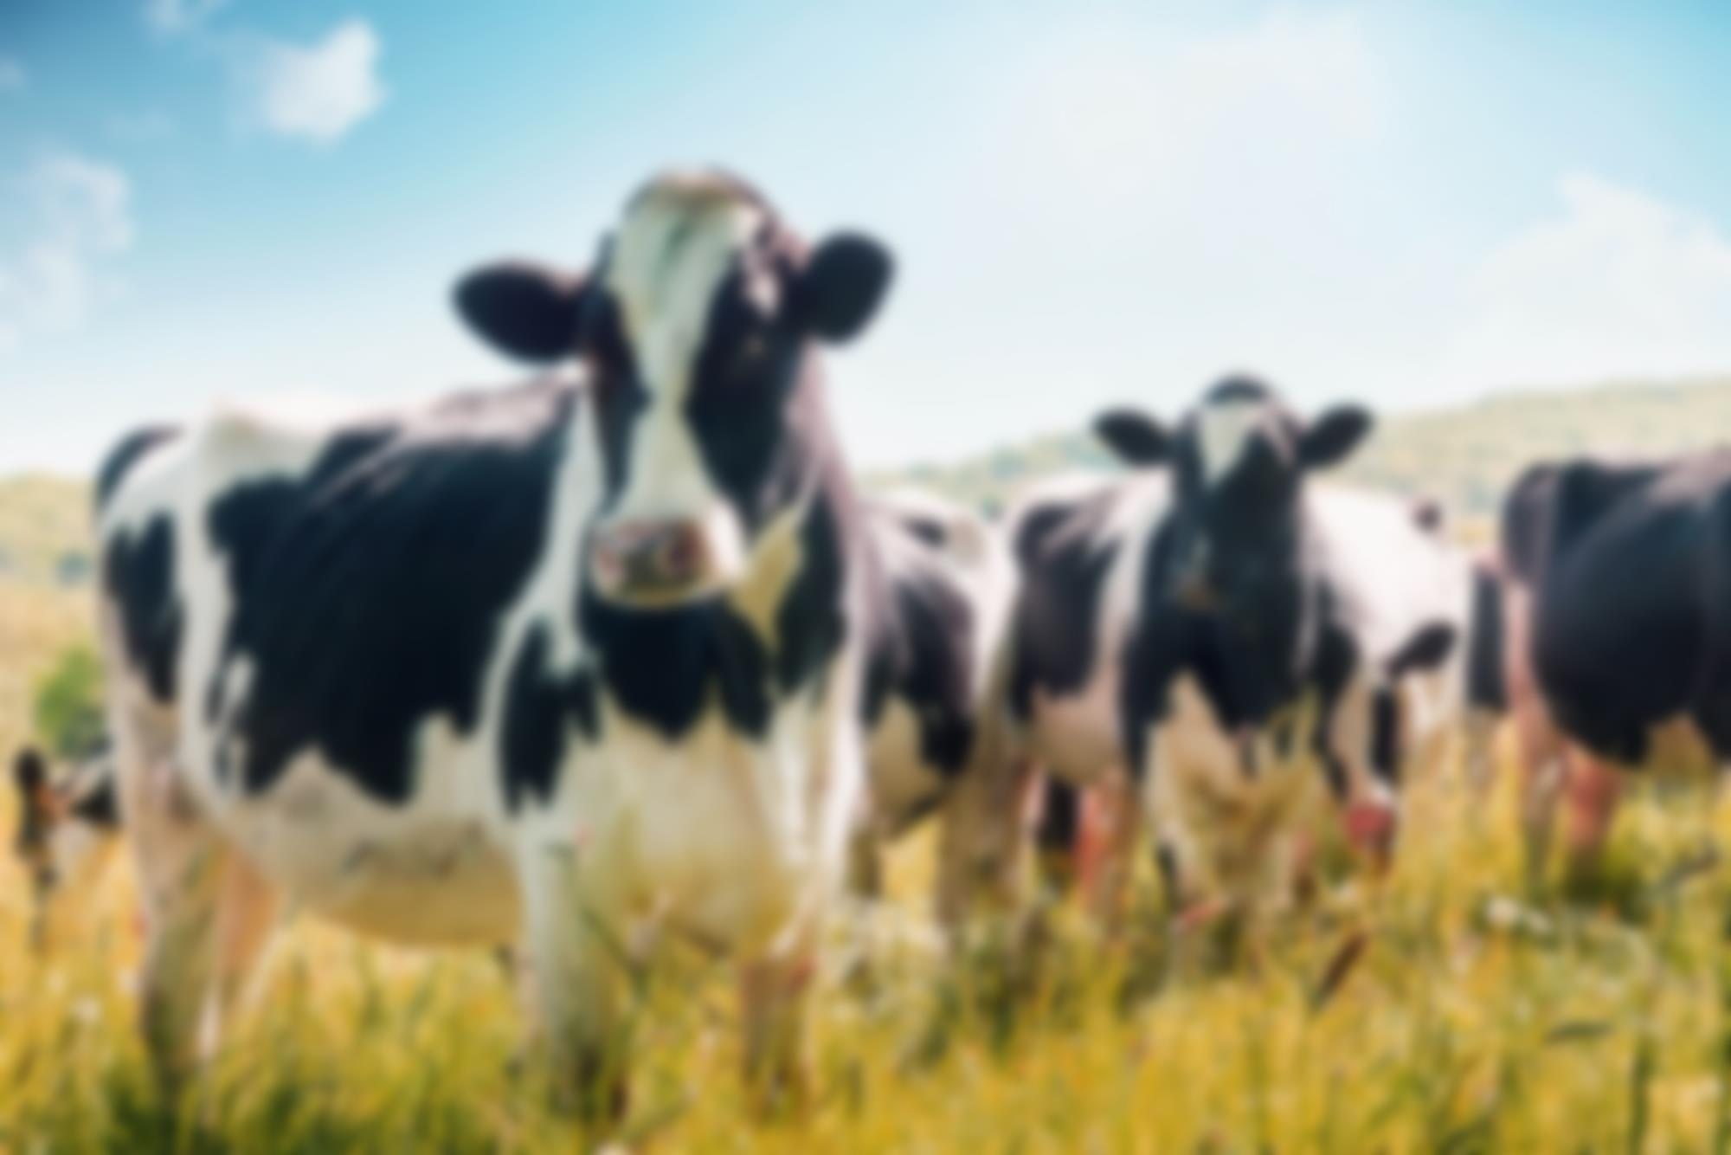
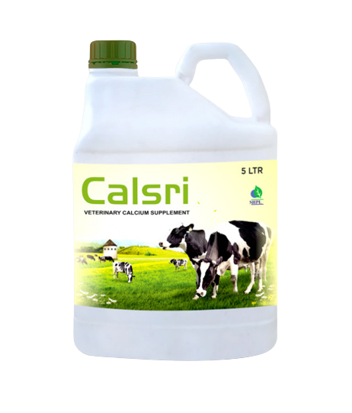
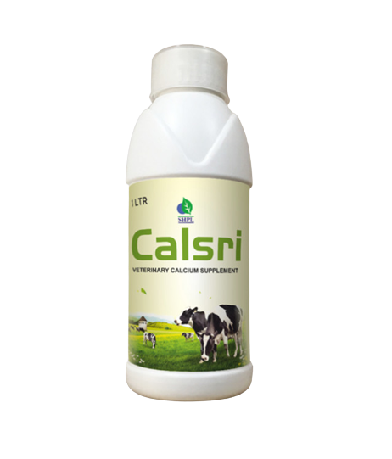
Calsri
VETERINARY CALCIUM SUPPLEMENT
INGREDIENTS
Calcium , phosphorus, vitamin D3 & B12, Satavari and jivanti.
BENEFITS
Improving milk yield in cattle Buffalo.
Formulation of strong bones in growing animals.
Improving calcium deficiency.
It increases milk output & fat percentage.
It help for the formation of strong bones in growing animals.
DOSAGE
Cattle & Buffalo: 100 ml daily and for Calves: 20 ml twice daily.
Product Type: Liquid Pack Size: 1 ltr. / 5 ltr. MRP: Rs. 400/- / Rs. 1500/-

Slide 3
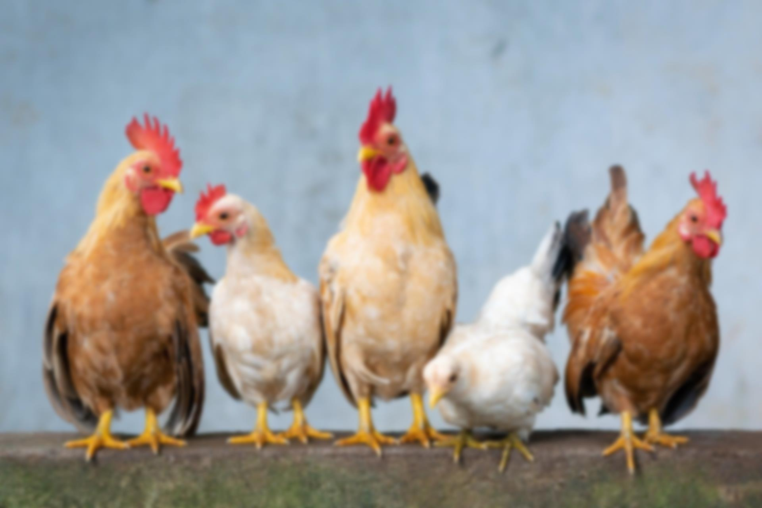
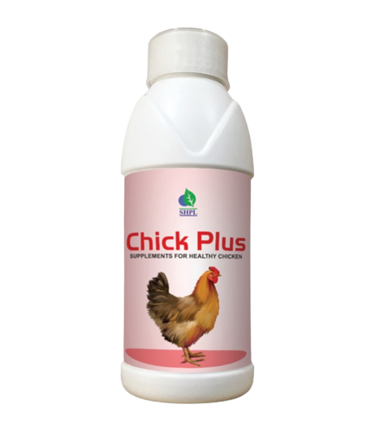
CHICK PLUS
SUPPLEMENTS FOR HEALTHY CHICKEN
INGREDIENTS
Arginin, Cystine, Glycine, Histadine, Isolucine, Leucine, Lysine, Methionine, Phynyle alanine, Serine, Thyrosine, Threonine, Tryptohan, Valine, L-Iysine hcl, Sodium, Magnesium, Chloride, Manganese, Zinc, Iron, Copper, Iodine, Cobalt, Papain, Yeast extract, Sucrose.
BENEFITS
DOSAGE
Boost the quality of production
Improve laying duration
Keep them healthy and active
Parasite resistance
Bring stability of gut microflora
Prevent bacterial diseases
Builds bone health
Prevent them from seasonal illness
Improve metabolism
Ensure the quality of eggs & meat
Maintains healthy liver & kidney functions
Decrease mortality rate
15 ml per 100 Chicken daily
Product Type: Liquid
Pack Size: 500 ml
MRP: Rs. 750/-

Slide 4
Dog Care
SUPPLEMENTS FOR DOG’S HEALTH
INGREDIENTS
Papaya Leaf Ext., Giloy, Ashwagandha, Aloevera, Calcium, Iron, Folic Acid, Copper, Cobalt, Vitamin B12 & C
BENEFITS
To boost platelets count in anemia, thrombocytopenia and tick fever (haemoprotozon infection)
To regulate liver function & immunomodulation
Supportive in the treatment of flu and fever
Useful for shiny hair
DOSAGE
Product Type: Liquid
Pack Size: 500 ml
MRP: Rs. 500/-
Up to 12.5kg =3-5ml daily
12.5-25kg = 5-10ml daily
25kg and above = 10=20ml daily, or as directed by veterinarian.

Slide 5
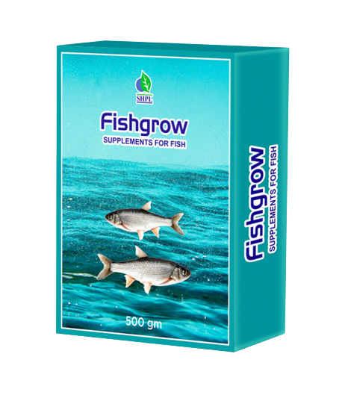
FISHGROW
SUPPLEMENTS FOR FISH
INGREDIENTS
Vitamin: D3, A, E, K, B1, B2, B3, B5, B6, B12, B7, B9
Minerals: Manganese, Zinc, Iron, Copper, Iodine, Selenium, Cobalt
BENEFITS
Enhances the liver performance and reduces toxicity of liver
Prevents and treats the diseases of shrimp and fish like as hepatitis diseases, rotten liver diseases, white liver disease, liver-kidney disease, swelling liver disease etc
Promotes low feed conversion ratio (FCR) and weight gain
Makes crude protein and Amino acid digestible
Improves absorption of calcium phosphorus
Corrects disorders of liver and spleen
DOSAGE
Product Type: Powder
Pack Size: 500 gm
MRP: Rs. 750/-
500g fish grow mix with 500kg fish food.

Slide 6
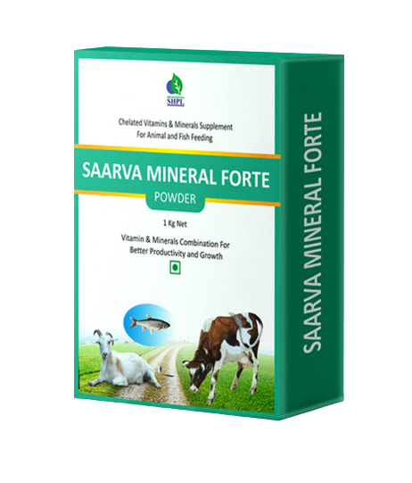
SAARVA MINERAL FORTE
VITAMIN & MINERAL COMBINATION FOR BETTER PRODUCTIVITY AND GROWTH
An ideal growth promoter for aquaculture and animal husbandry. It compensates the mineral deficiencies of fish, shrimp and livestock, providing them with proper nutrition.
INGREDIENTS: Vitamin A, Vitamin D3, Vitamin E, Nicotinamide, Cobalt, Iodine, Iron, Magnesium, Manganese, Potassium, Sodium, Sulphur, Zinc, Calcium, Phosphorus
CATTLE:
Cow and Buffalo
lmproves fertility
Improves growth rate
Improves milk production
Improves fat content milk
Keep cattle healthy.
DOSAGE:
50 gm per cow/Buffalo per day to be mixed in the feed
AQUA:
Fish and Zinga for better survival and growth
For better endo and exo skeleton system.
Better productivity.
Better growth and weight gain.
Better FCR (feed conversion ratio)
DOSAGE:
1kg to be mixed in 100kg of feed.
Product Type: Powder Pack Size: 500 gm MRP: Rs. 500/-

