Slide 1
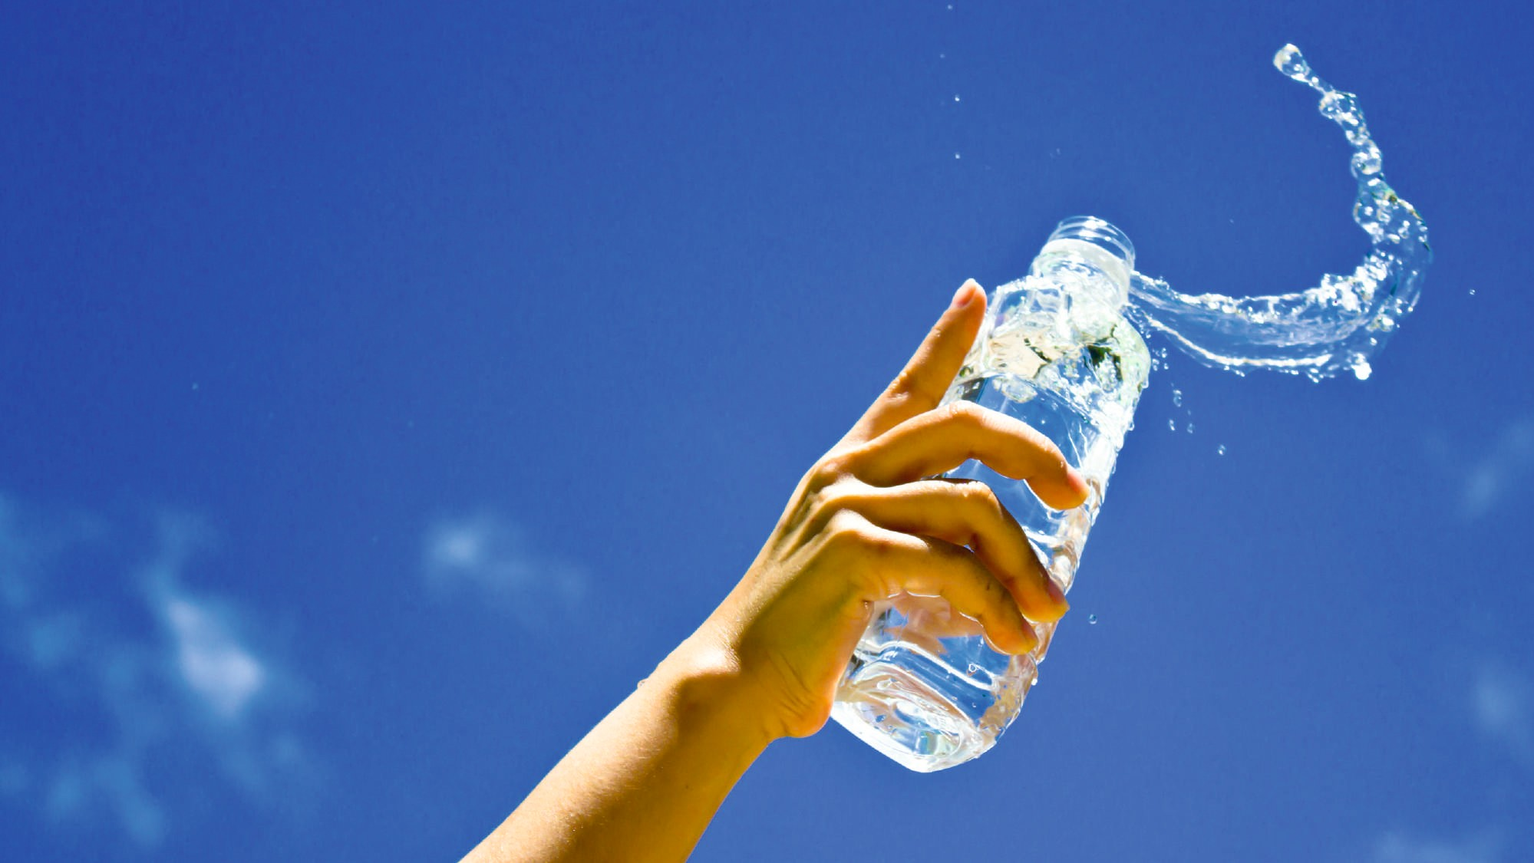

EVERYTHING YOU NEED TO KNOW ABOUT AQUA POTENS WATER IONIZER.

Slide 2

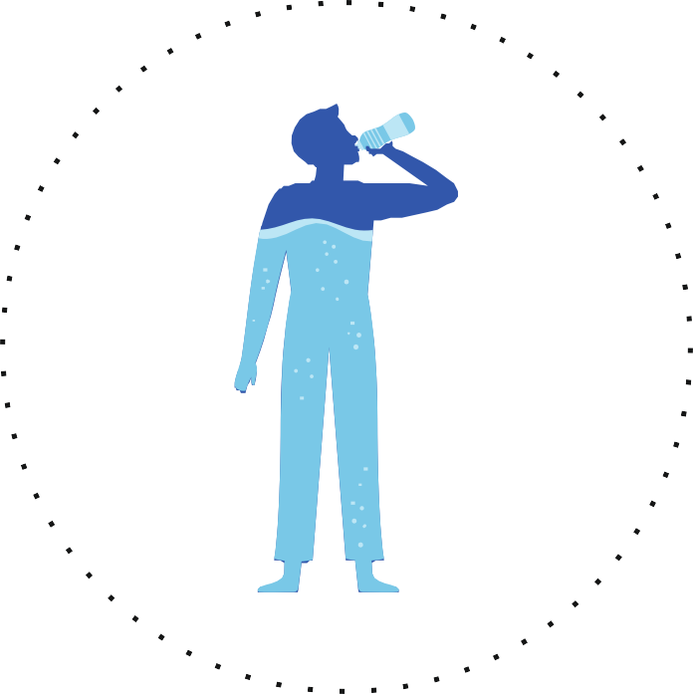




AMOUNT OF WATER IN VARIOUS BODY PARTS
Brain - 73%
Heart - 73%
Lungs - 83%
Kidneys - 79%
At Birth - 78% 1 Year - 65%
1 Year - 65% Adult Women - 65% Adult Men - 65%
Muscles - 79%
Bones - 31%
Skins - 64%

Slide 3

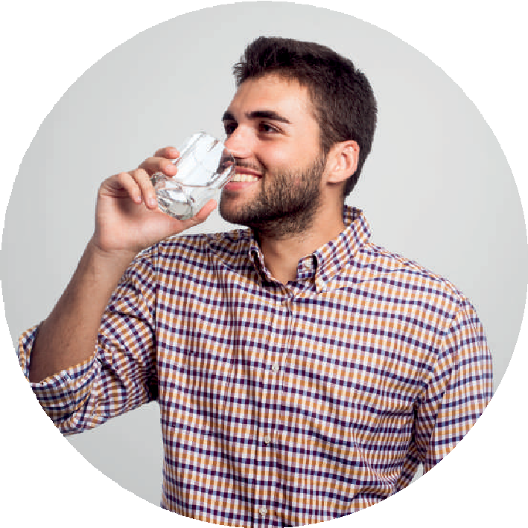

MOST IMPORTANT FUCTIONS OF WATER IN OUR BODY
Maintain proper body temperature
Common skin problems like dry skin and acne
Increases the
Strengthens the hair follicles and reduces hair fall
metabolism
Blood circulation in the body
Flushing the toxins
out of body
Circulation of oxygen
Improves overall digestion of food

Slide 4

WHAT IS ALKALINE WATER?
We need to ﬁrst look at what pH scale is. pH, denoted as potential of Hydrogen or power of Hydrogen, is used in Chemistry to know about acidity or basicity (also known as Alkalinity) of an aqueous solution, on a scale of 0 to 14. Something with a pH of 1 would be very acidic and something with a pH of 13 would be very alkaline or also known as basic, 7 is for denoting neutral water.
Alkaline water has a higher pH level than regular drinking water which usually is of pH 5.5-6.5. Especially for Indians, it's helpful as we know the consumption of acidic food & drinks, for example, your morning tea or coffee, alcohol, soft drinks, food with a lot of spices, has increased like never before. And as we also know, all kinds of pollution has increased like never before. All of this has led our body's to be acidic in nature. Due to acidic body's, we have a few very common problems these days like acid reﬂux (acidity), hypertension, diabetes, gastric problems & many more health related problems.
NOURISHING HEALTHY LIFE
The importance of nature and how much it affects human life is under-rated. There have been many researches that have proven that exposure to nature can reduce complications in the body and can improve health. The very existence of humans is based on what we get from nature. To lead a healthy life, we all require Mineralised Alkaline drinking water, clean air ﬁlled with oxygen and Healthy nutritional food. Preserving nature would mean to nourish healthy life. Our actions and interactions with Mother Nature is what facilitate healthy living. And Mother Nature survives when it gets healthy water. Healthy water, thus, is the most essential source that neither humans nor nature can live without. Pure and healthy water is the basis on which everything revolves.

Slide 5
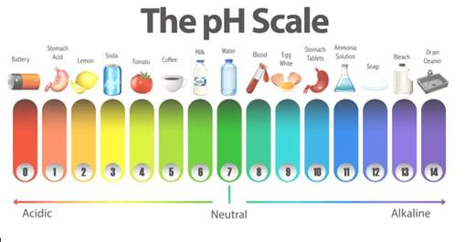

Slide 6



BENEFICIAL DRINKING WATER TO BE ANYWHERE BETWEEN 8 - 9 PH.
HOW IT IS BENEFICIAL
TO A NORMAL HUMAN BEING
Helps ﬁght acid reﬂux (acidity) Helps ﬁght gastric problems Better hydration
Helps reduce side effects of Cancer radiation treatment, radiation treatment being highly acidic.

Slide 7
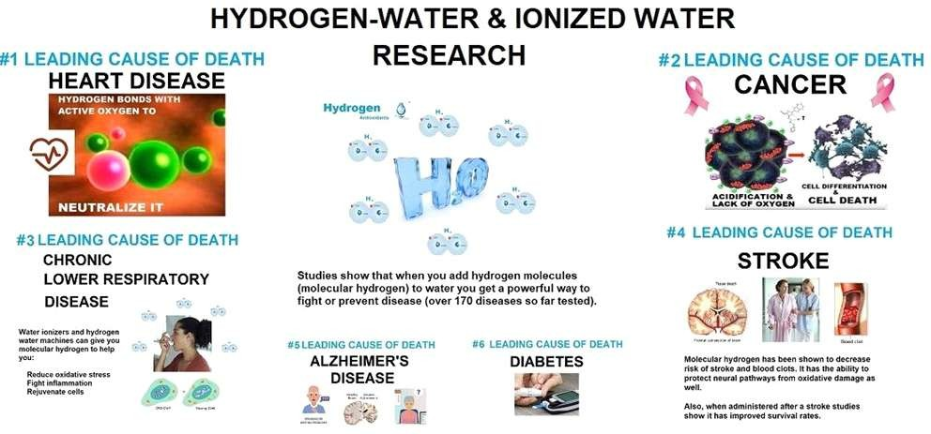


Slide 8
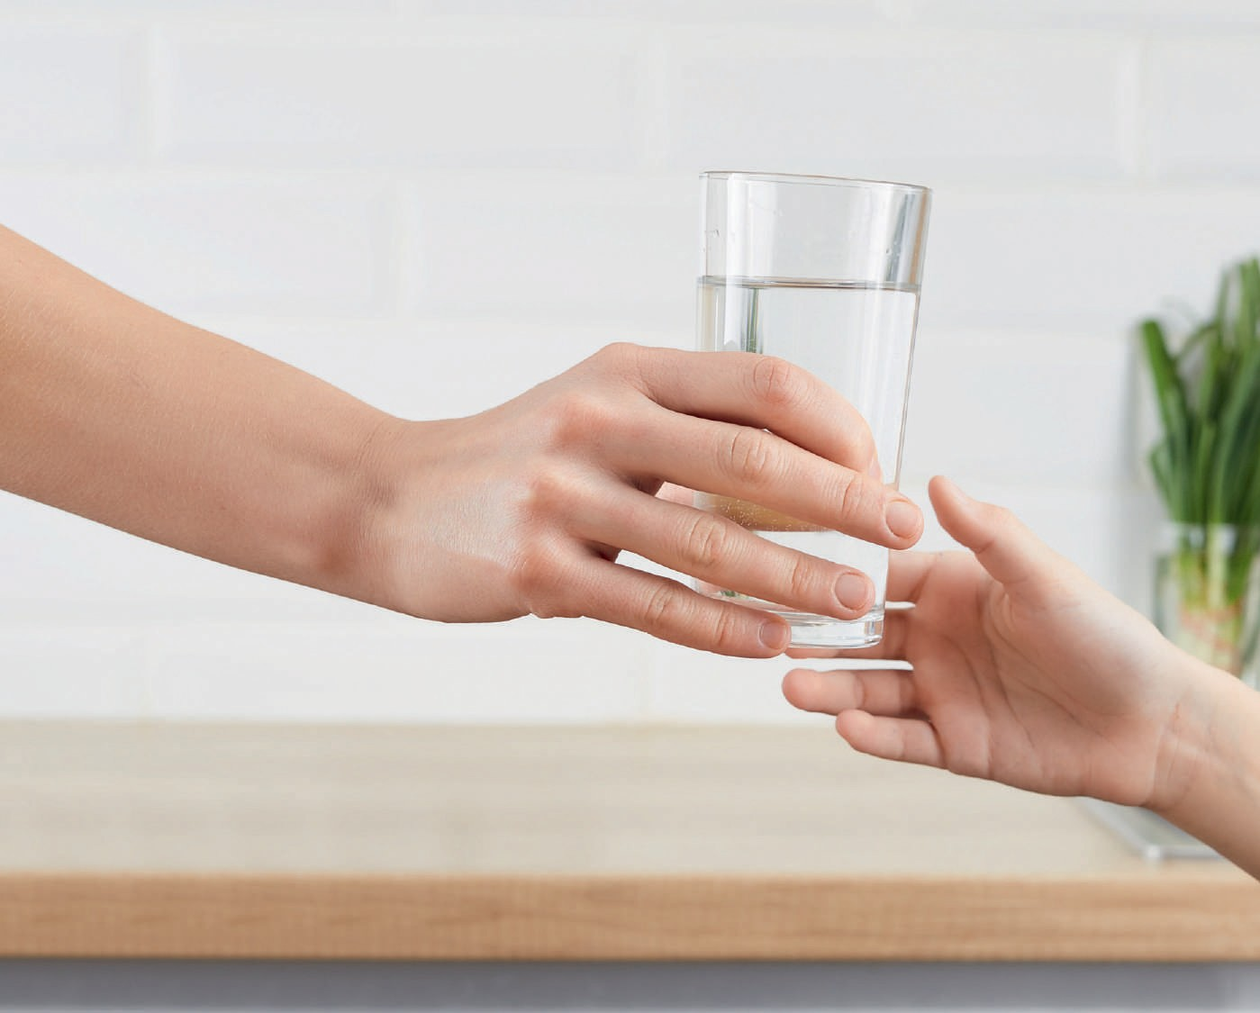

ANTIOXIDANT WATER
Antioxidants are highly recommended for people working out. Green tea is rich in Antioxidants & is highly recommended for people working out.
ORP, denoted as Oxidation Reduction Potential, defines the ability of an aqueous solution to oxidise or redox the place
where it is present. Positive ORP indicates the oxidation potential the solution has & negative ORP indicates the redox or antioxidant potential of the solution. Solution we are dealing with here is drinking water. Usually ORP of tap water, bottled water or any normal purified water has positive ORP. Ionized drinking water has negative ORP, indicating water to Antioxidant in nature.

Slide 9

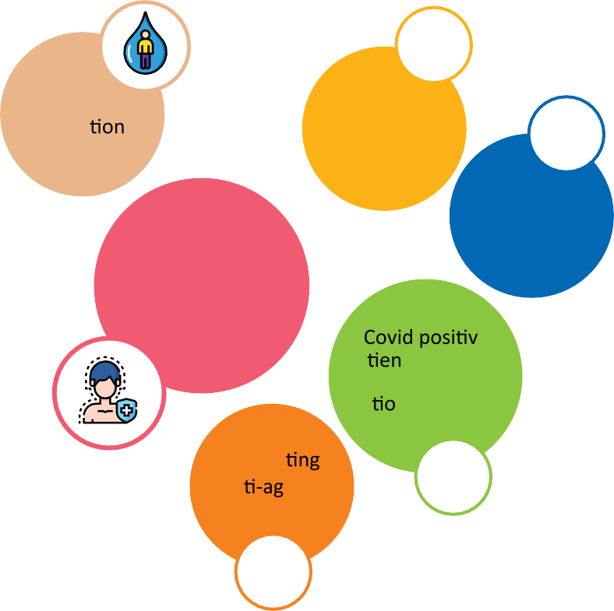




DRINKING ANTIOXIDANT WATER HAS BENEFITS LIKE
Good hydra
Removing toxic wastes from body
Help remove unwanted fat from body
Boosts immunity
e
pa ts
An xidants in it.
Facilita
an eing of skin

Slide 10

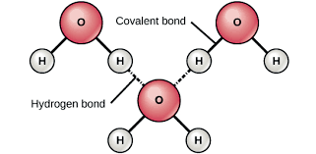
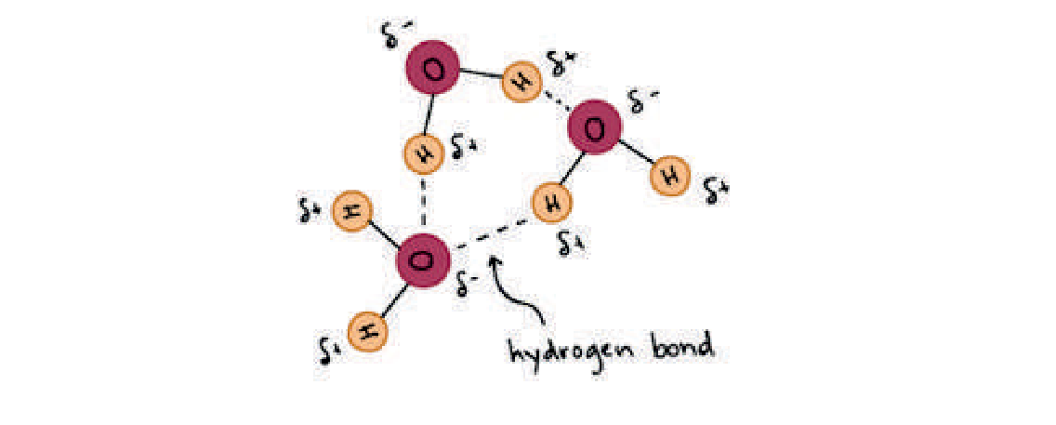
WHAT IS MICRO-CLUSTERED WATER?
Normal Water has around 16 molecules of H2O bond
Micro-clustered water has reduced
(7-8) number of moleculses of H2O bond

Slide 11
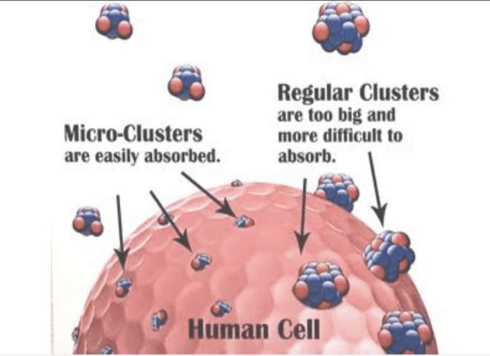


Slide 12
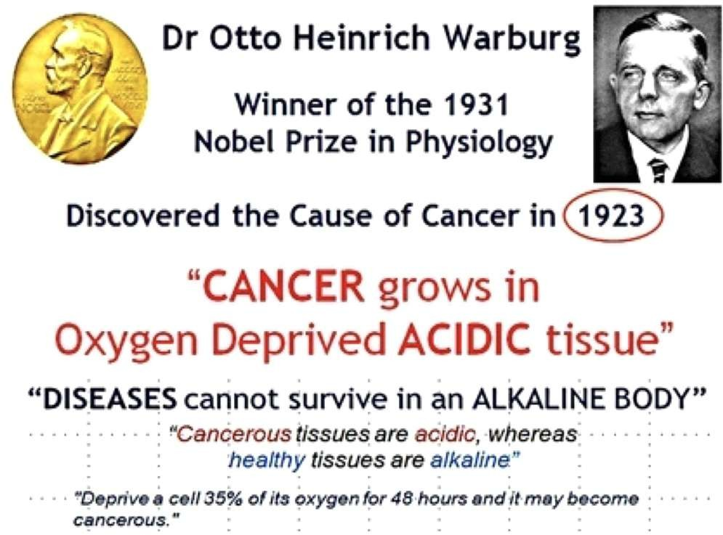


Slide 13
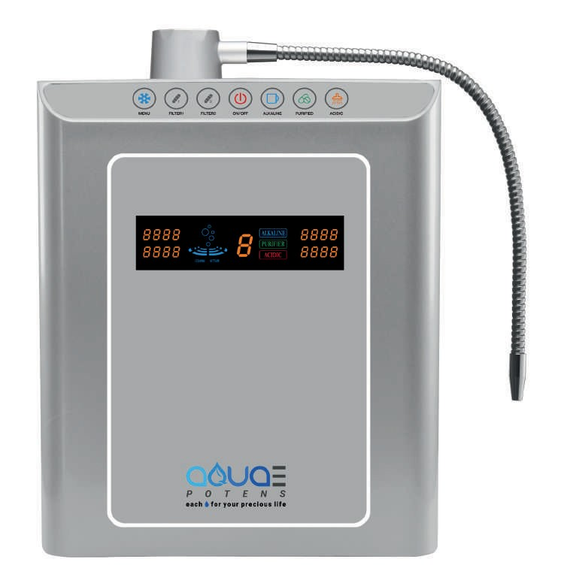

AQUA POTENS WATER IONIZER
Hydrogen rich, Alkaline, Antioxidant water
Model : 07 PLATES

Slide 14
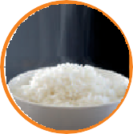


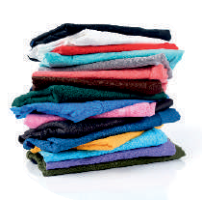



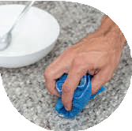


ENVIRONMENT FRIENDLY WATER
HEALTHY WATER
PH 7.5 to 9 (best for regular drinking)
pH 9 to 10 (as per individual need drinking)
WHAT ARE THE BENEFITS OF HYDROGEN RICH, ALKALINE WATER?
Drinking hydrogen rich, antioxidant, alkaline water has many benefits like fighting acid reflux (acidity), boost immune system, better hydration, help losing weight, better digestion & many more.
Over pH 10.5 (Water for cleaning)
WHAT IS STRONG IONIZED WATER ?
Strong ionized water packs an e ective cleaning e ect as a detergent preserving hygiene in your daily life.
HYDROGEN RICH, ANTIOXIDANT, ALKALINE WATER
Cooking Rice - With Ionized water make ier, gives a shine & cooks well.
ee & Tea - Remove bitternes
fragrance t
Make excellent taste.
Hangover - Alkaline water is good for hangovers, when taking It before going to sleep or when the stomach is empty in the morning.
ea.
Cocktail - An ice cocktail in alkaline water makes your drink fast softener & smoother.
Cooking with Alkaline water - Eliminate fishy smell fish & non-vegetarian foods.

Slide 15


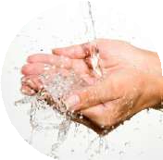
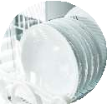



BEAUTY WATER
SANITARY WATER (Optional)
Below pH 3.0 (Disinfectant water)
WHAT IS STRONG ACIDIC WATER ?
Excellent cleaning and disinfecting power. strong acidic water has excellent disinfecting power that helps preventing food poisoning. use it to clean & sterilize your fruits, vegetables, meat and cookware.
To sanitize knives, cutting board and dish towels. To disinfect your hands.
To disinfect your toothbrushes.
It softens
ACIDIC WATER IS ESPECIALLY EFFECTIVE IN TONING THE SKIN
It helps to refresh the skin after a hot bath or shower and also works to close the pores after washing your face.
FOR BOILING PASTA & MAKING BATTERS FOR FRYING.
Noodles and pasta will take on a brilliant shine and improved texture as a result of boiling in acidic water. Acidic water will also enhance the crispy texture of fried foods.
To clean your skin.
To remove tea and coﬀee stains. To eliminate odors.
materials quickly.
It has strong power to dissolve
and draw out substances.
It has strong eﬀect to dissolve and clean materials.
AS A CLEANER
Mild acidic water can be used to clean places which aren't very dirty.
ACIDIC WATER

Slide 16

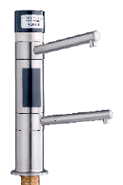
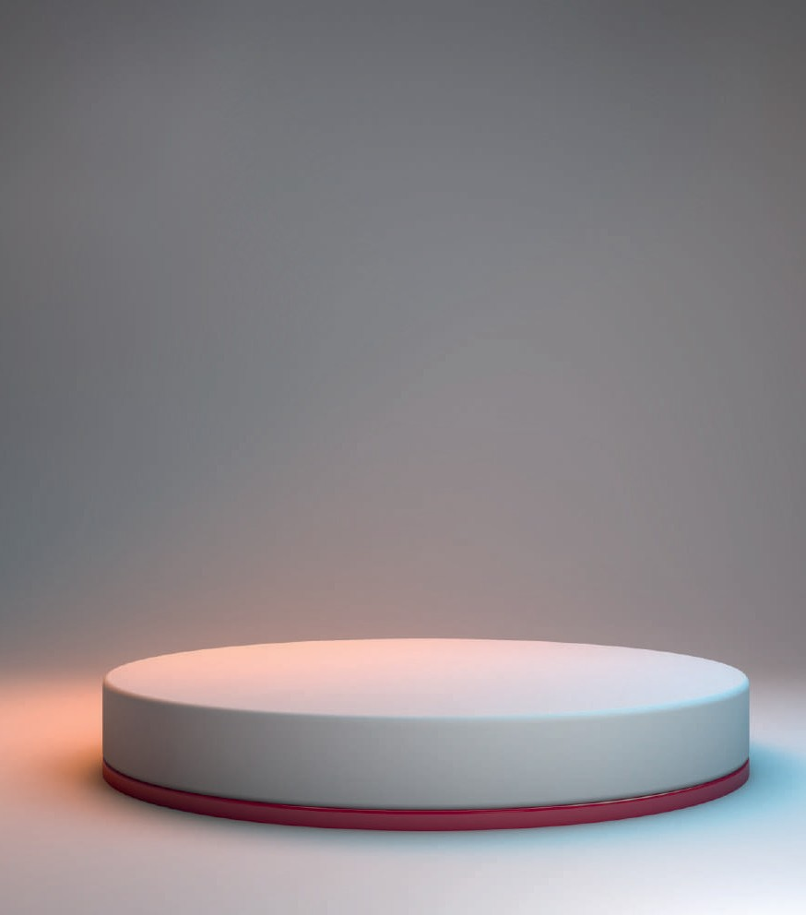

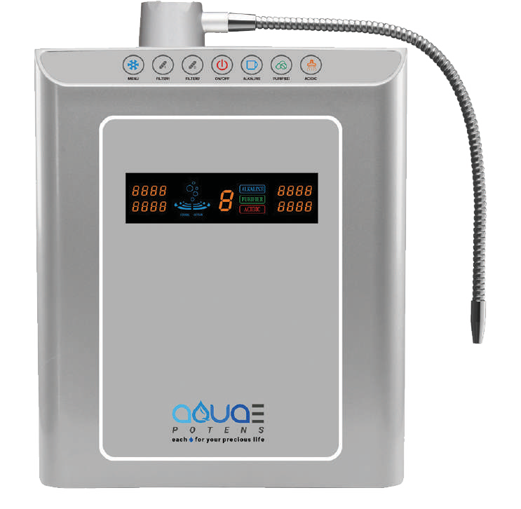







AQUA POTENS WATER IONIZER
KEY FEATURES
Hydrogen rich, Alkaline, Antioxidant water
All models compatible with Faucet
MODEL : MODEL 07 PLATES

Slide 17

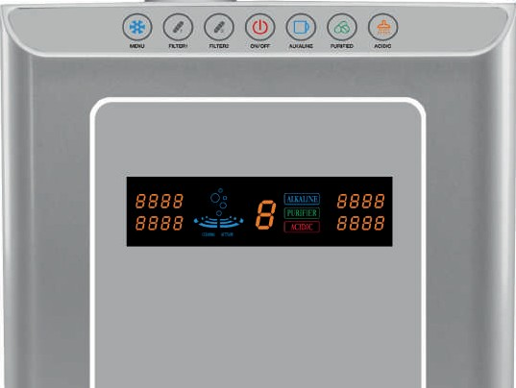
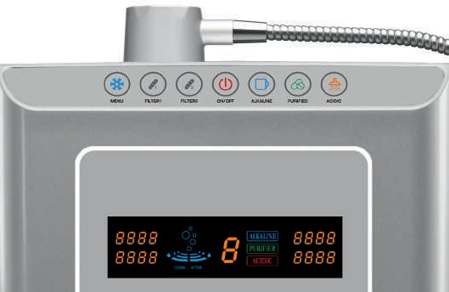








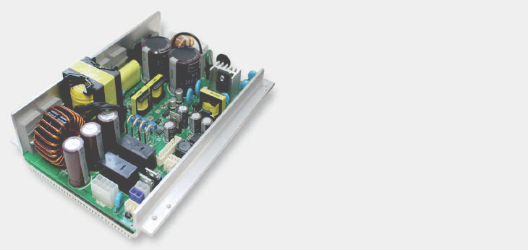
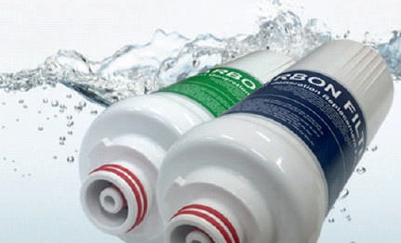

8 LANGUAGES VOICE SELECTION SYSTEM
Easy & Smart
8 Languages Available
Eight Language Audio
in Hindi, Wnglish, Chinese, Russian, Spanish French, German, Italian
FULL SIZE WIDE COLOR DISPLAY SCREEN
SMART & PREMIUM TOUCH BUTTON & FULL SIZE WIDE COLOR PANEL
Full color display of pH levels, ORP levels, auto-diagnosis system, actual number of liters of filter life left in each filter, water flow rate, and more. Our Smart touch panel is users friendly & can be customized as per you needs.
India English Chinese Russian Spanish French
(Hindi Voice)
German
Italian
POWERFUL SMPS POWER SYSTEM
MAX POWER SMPS SYSTEM
Fully Adjustable Power Up to 450 Watts ionizing power gives you the best pH and —ORP from your particular water source. SMPS provides more power, greater efficiency, and ultimate durability. Advanced Micom computer system
PREMIUM DUAL FILTRATION SYSTEM
CLEAN & FRESH MAX POWER SMPS SYSTEM
Premium Multi-Stage Media ULTRA DUAL Filtration System Dual filtration system is made up of multi level stage specialized media filter and a premium activated carbon filter. The Premium Activated Carbon filter is structured to improve the reduction of heavy metals and fluoride found in many city water sources. The silver activated carbon portion of the filter kills bacteria and keeps them from growing within the filter and
POWERFUL SMPS POWER SYSTEM is the most advanced system in the market to ensure that your water ionizer is producing the most powerful ionized water for years and years to come. Unlike the old outdated transformers, the SMPS system has been shown to last longer and run cooler. With the most up to date technology, you'll never have to worry about the pH, Hydrogen & ORP levels of your water ionizer.
being passed through to the electrolysis chamber. The multi
level stage sediment filter reduces additional sediment particles in the water maintaining the life and performance of your water ionizer. It contains OF Membrane which will removes bacteria.
0.1 micron UF Filter

Slide 18

Why choose Aqua Potens Ionizer over Other Ionizers?
pH, ORP & Molecular Hydrogen Display
•Service provided right at your home
•Pricing 7 plates machine Rs 1,50,000/- vs Rs 2,77,000
•Hindi language
•No requirement of Chemical additive
•Solid type plates for best results
•4 way auto cleaning of plates
•Faucet compatibility & pricing

Slide 19
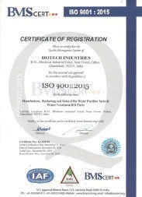

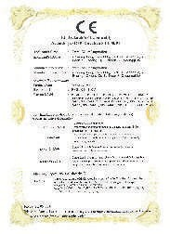

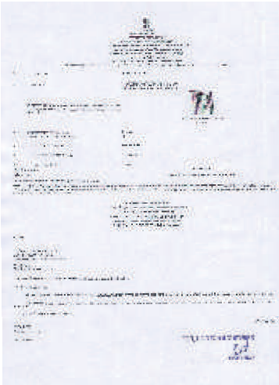
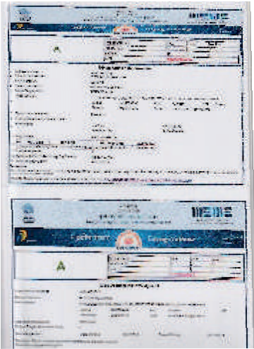

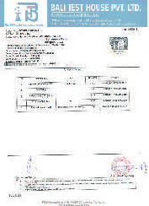
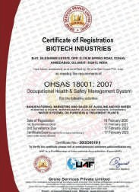
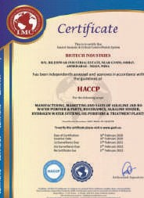
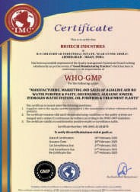

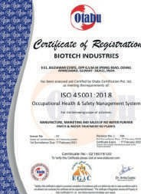
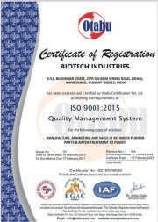
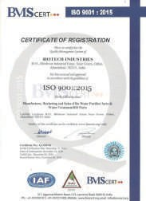







Slide 20



Slide 21

Thank you

