Slide 2
MOISTURISING
Baby Cream
Saarvasri Moisturising Baby Cream significantly improves the baby’s skin texture. This is mainly due to the presence of Aloevera, Almond Oil and Olive Oil in it. Moreover, it is packed with Vitamin E that helps in soothing the baby’s skin. It helps to reduce swelling and redness on the skin. It moisturizes the skin and keeps it soft, smooth, and gentle.
HOW TO USE
Apply this cream to the baby’s body and gently massage with your palms in a circular motion.
Product Type: Cream | Product Size: 100 ml | MRP: Rs. 150/-

Slide 3
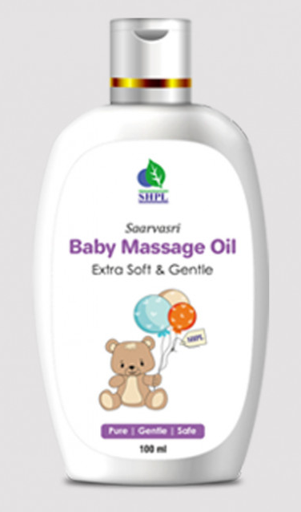
BABY BODY
Massage Oil
It is a well-known fact that massaging a baby daily is important as it helps strengthen their bones and provide nourishment. Saarvasri Baby Body Massage Oil is infused with herbs-based oil that helps nourish the baby's skin and promote overall growth and development. It deeply moisturizes and has anti-inflammatory properties to heal, soothe and helping them to have a good sleep. Use daily to protect your baby’s skin from dryness and retain moisture.
HOW TO USE
Pour oil into your hand. Rub both hands together to warm oil. Gently massage all over your baby’s body.
Product Type: Oil | Product Size: 100 ml | MRP: Rs. 150/-

Slide 4
BABY
Hair Oil
Saarvasri Baby Hair Oil helps nourish, protect and strengthen your baby's hair, keeping them soft and silky. It is a toxin-free combination of some powerful herbal oils and natural herbs like Black Til Oil, Coconut Oil, Anant Mul, Bhringraj, Amla, Nili, Indrayan, Mehendi, Chameli, Brahmi, Sankhpushpi, Bahed, Malkangi, Bavchi, Neem, Khus and Karanj to protect delicate hair from damage and dryness.
HOW TO USE
Apply oil to the baby’s scalp and gently massage with your fingertips in a circular motion.
Product Type: Oil | Product Size: 100 ml | MRP: Rs. 150/-

Slide 5
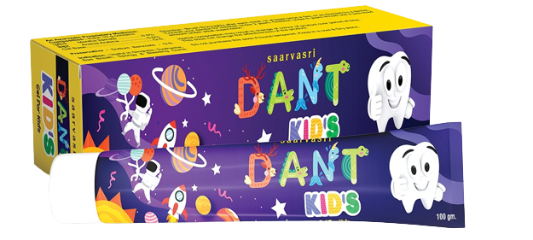
Dant Kids
TOOTHPASTE
Saarvasri Dant Kids Toothpaste contains some natural herbs that prevent cavities, bad breath and gingivitis. Its peculiarity is that if it is accidentally swallowed while brushing, it does not cause any harm.
HOW TO USE
Apply oil to the baby’s scalp and gently massage with your fingertips in a circular motion.
Product Type: Toothpaste
Product Size: 100 ml
MRP: Rs. 119/-

