Slide 1


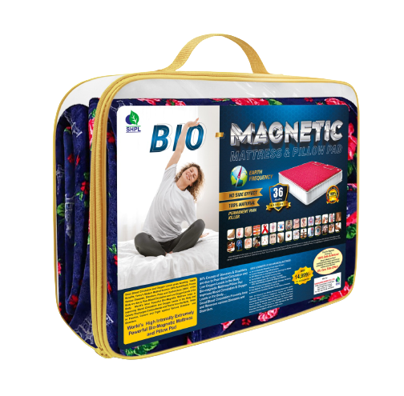
BIO-MAGNETIC MATTRESS

Slide 2
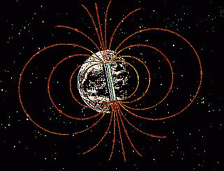
What is Magnetic Energy?
Magnetic Energy once an ancient mystery, is now recognized as the strongest natural force in the universe.
Our Earth is a giant magnet and all life developed under the influence of the earth’s magnetic field.
Magnetic Energy permeates everything in our universe, from the vast reaches of outer space to each microscopic cell in our body.

Slide 3
Our Body Needs
Magnetic Energy!
■ Each cell has a positive & a negative field in the DNA.
■ Cell division is a process responsible for keeping the body healthy & rejuvenated.
■ The force which activates the formation and division of cells is magnetic energy.
The proper function and interaction of all organs and systems in the body depend on the constant presence of adequate magnetic energy.
■ Magnetism is essential for the body’s electromagnetic activity and plays a major role in health and disease.
Your Body Is An
Electro-Magnetic System

Slide 4
Bio-Magnetism – The Science
Bio-magnetism is the science of applying a supplementary magnetic field to living organisms.
The principal of bio-magnetism dates back thousands of years and was practiced and described by ancient civilizations thousands of years ago.
Today, we are at an exciting junction in the evolution of health care as bio-magnetic therapy is fast becoming one of the most promising new therapeutic interventions.

Slide 5
SAARVASRI HAS INTRODUCED
BIO-MAGNETIC MATTRESS

Slide 6
Helps:
Regulates Blood Circulation.
Arthritis
Headache
Shoulder ache
Reduce joint pain
Reduce discomfort
Reduce waste products from the blood (i.e. Lactic
Acid, calcium, cholesterol and fat deposit)
Weight loss
Concentration
Regenerate the damage cells and increase metabolism

Slide 7
Warning/who shouldn't use bio magnetic products
Pacemaker user
Pregnant women
Electronics diflibitore insulin pump user
Keep away all electronics goods E.g. Mobiles & Laptops
Keep always liquid material like water, juice, tea & coffee etc.
Use 4 hours per day for 2 days only in case any improvement reaction occur
Keep bio mattress & pillow from water & hot objects

Slide 8
THANK YOU

