Slide 3
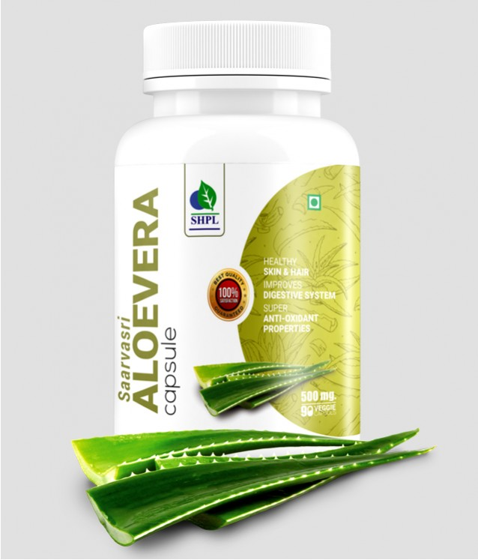
ALOEVERA CAPSULE
SAARVASRI ALOEVERA CAPSULE – Nutritional Powerhouse
DESCRIPTION
Aloevera, “the plant of immortality”, has its own medicinal value from centuries. Aloevera contains many vitamins including A, C, E, folic acid, B1, B2, B3 (niacin), B6. Aloe Vera is also one of the few plants that contains vitamin B12. Minerals found in Aloevera include: calcium, magnesium, zinc, chromium, selenium, sodium, iron, potassium, copper, manganese etc.
HEALTH BENEFITS
Improves Digestion
Prevents Constipation
Heals wounds fast
Promotes healthy skin and hair
Enhances proper functioning in the body
Detoxifies the body
Helpful in painful menstrual problems
Supports eye, bone and neural health
Product Details
KEY INGREDIENTS
HOW TO USE
Product Name : Aloevera Capsule
Product type : Capsule
Pack Size : 90 Caps
MRP : Rs. 650/-
Aloevera Barbadensis
1-2 capsules two times daily or as directed by experts.

Slide 4
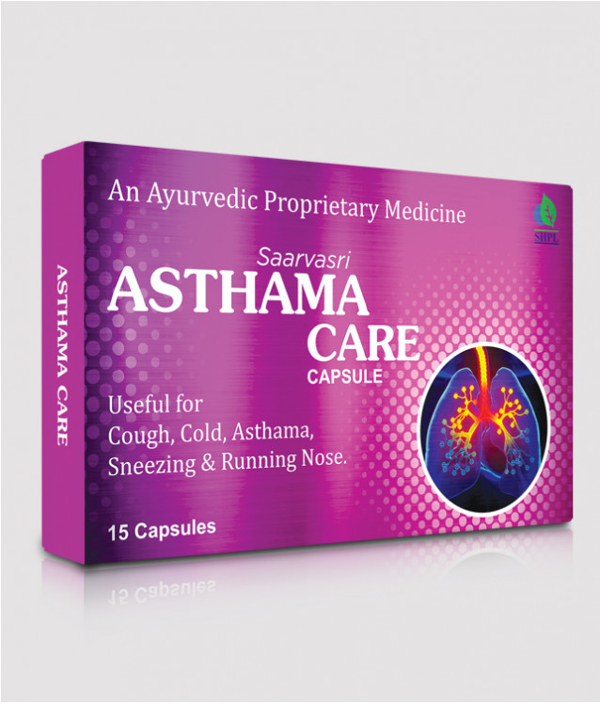
ASTHA CARE
SAARVASRI ASTHA CARE CAPSULES – Respiratory Respite
DESCRIPTION
Saarvasri Herbs Astha Care is a 100% natural product. Astha Care has different herbs & other natural ingredients that may give relief to reactions of asthma, wheezing, bronchitis, shortness of breath, coughing & tightness in chest.
HEALTH BENEFITS
Prevents asthma attacks
Maintains normal lung function
Strengthens immune system
Relaxes the muscles of breathing passages
Helps decrease the frequency of asthma attacks
Reduces asthmatic symptoms like wheezing, shortness of breath, chest tightness etc
Product Details
KEY INGREDIENTS
HOW TO USE
Product Name : Astha Care
Product type : Capsule
Pack Size : 30 Cap
MRP : 350/-
Daruhaldar, Vasaka, Tulsi, Trikatu, Kantkari, Bharangmula, Swas Kutha Ras
1-2 capsules two times daily or as directed by experts.

Slide 5
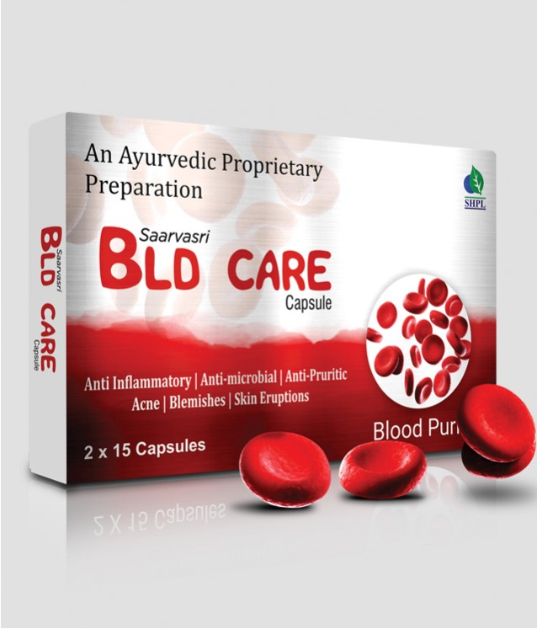
BLD CARE
SAARVASRI BLD CARE CAPSULES – Blood Purifier
DESCRIPTION
This natural blood purifier contains tannins, gallic acid, essential oils etc. for healthier tomorrow. Moreover, It possesses various medicinal properties, which may include anti-microbial, antibacterial, anti-inflammatory etc.
HEALTH BENEFITS
Purifies blood
Flush out toxins from the body.
Beneficial for allergies.
Helpful in any kind of skin disorders.
Controls pimple, acne.
Maintains good blood circulation in the body.
Maintains liver health.
Product Details
KEY INGREDIENTS
HOW TO USE
Product Name : BLD Care
Product type : Capsule
Pack Size : 30 Cap
MRP : 350/-
Senna, Ipomea Turpethum, Rosae, Dalbergia Sissoo, Santalum Album, Giloy, Terminalia Chebula, Curcuma Zedoaria, Swertia Chirata, Cassia Occidentalis, Gorakmundi, Gentiana Kurroo, Colocasia Esculenta, Neem, Tulsi, Berberis Aristata, Sharpunkha, Bacopa Monnieri, Cassia Absus.
1-2 capsules two times daily or as directed by experts.

Slide 6
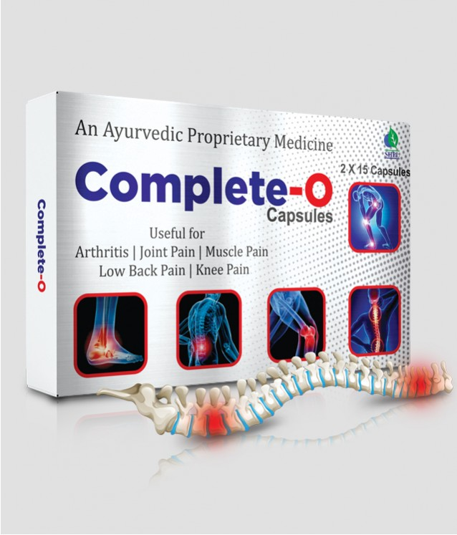
COMPLETE-O
COMPLETE-O CAPSULES – Pain Reliever
DESCRIPTION
Saarvasri Herbs Complete-O Capsule is a wonderful product for relieving pain & inflammation. It is enriched with many important natural herbs to control Arthritis, Osteo-arthritis, Muscle and Joint Pain. It is the best and complete solution for your pain.
HEALTH BENEFITS
It relieves pain.
It is very helpful in Arthritis and Osteo-Arthritis.
It is beneficial for our joint health.
It relieves muscle pain.
Product Details
KEY INGREDIENTS
HOW TO USE
Product Name : Complete-O
Product type : Capsule
Pack Size : 30 Cap
MRP : 350/-
Nirgudi Ext, Punarnava Ext, Jatamansi Ext, Shallaki Ext, devdaru, Haridra, Chopchini, Trikatu, Triphala, Maharasnadi, Sihnadi Guggul, Mahayograj Guggul, Vishtundaka Vati, Sameer Pannag Ras, Ajmodadi Churna, Sanjeevani Vati.
1-2 capsules two times daily or as directed by experts.

Slide 7
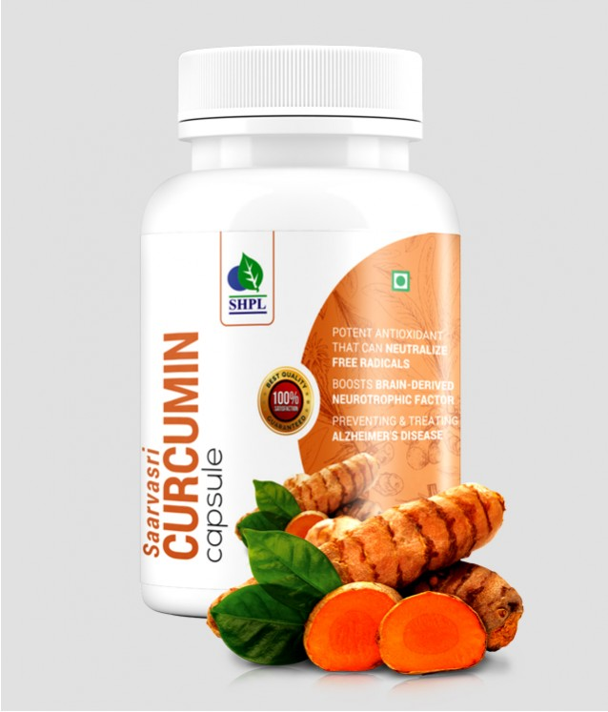
CURCUMIN CAPSULE
SAARVASRI CURCUMIN CAPSULES - Natural Protector
DESCRIPTION
Curcumin is a yellow-orange dye obtained from tumeric, the powdered root of Curcuma Longa or Turmeric. Curcumin is a natural component of the rhizome of turmeric (Curcuma longa) and one of the most powerful chemo-preventive and anticancer agents. Its biological effects range from antioxidant, anti-inflammatory to inhibition of angiogenesis and is also shown to possess specific anti-tumoral activity.
HEALTH BENEFITS
Helps your body fight foreign invaders and also has a role in repairing damage.
Neutralize free radicals.
Boosts brain-derived neurotrophic factor
Lower risk of brain diseases.
Lower your risk of heart disease.
Helpful in prevent & manage cancer
Useful in preventing Alzheimer's disease.
Helpful in Depression.
May help delay Aging
Product Details
KEY INGREDIENTS
HOW TO USE
Product Name : Curcumin Capsule
Product type : Capsule
Pack Size : 90 Cap
MRP : 650/-
Curcumin Ext.
1-2 capsules two times daily or as directed by experts.

Slide 8
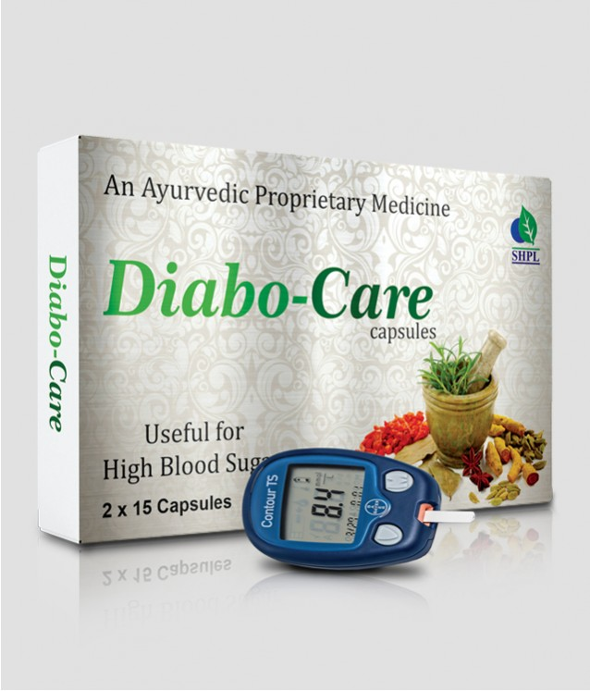
DIABO CARE
DIABO CARE CAPSULES – Diabetes Controller
DESCRIPTION
Saarvasri Herbs introduces Diabo Care Capsule, a wonderful product for diabetic patients. Diabo Care Capsule is very helpful for lowering blood sugar level, increasing the secretion of Insulin and activating the beta cells.
HEALTH BENEFITS
Helpful for lowering blood glucose level.
Detoxifies the Pancreas and activates the beta-cells.
Increasing the secretion rate of Insulin.
Karela provides polypeptide-p or p-insulin which helps to activate our body insulin.
Reduces sugar craving.
Reduces the symptoms of Diabetes like frequent thirst and urination.
Maintains general body health.
Reduces weakness.
Product Details
KEY INGREDIENTS
HOW TO USE
Product Name : Diabo Care
Product type : Capsule
Pack Size : 30 Cap
MRP : 350/-
Gudmar, Jamun, Karela, Kalmegh, Methi, Neem, Mamejava, Bilva, Kutaj, Chiraita, Vijaysar, Dalchini, Guduchi, Sarponkha, Haridra, Jeera, Triphala, Chandraprabha Vati, Yashad Bhasma.
1-2 capsules two times daily or as directed by experts.

Slide 9
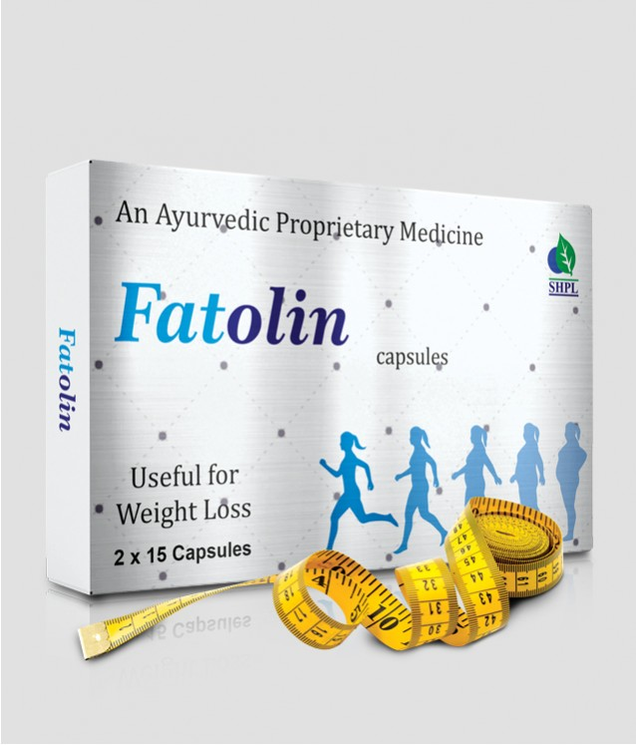
FATOLIN
FATOLIN CAPSULES – The Fat Cutter
DESCRIPTION
Saarvasri Herbs Fatolin Capsule is completely herbs based product which can effectively & naturally remove fat especially from the belly, Ankles and Arms. Thus help you to get in good shape in merely few days of use and in a natural way. It has similar results on men & women.
HEALTH BENEFITS
Enhance body metabolic rate.
Regulates body digestive system.
Helps in reducing the unnecessary fat deposition.
Aids in Fat burning from Ankles, Arms and Belly.
Help you to get in shape.
Maintains the energy level throughout day.
Naturally detoxifying the body.
Maintains normal cholesterol levels.
Reduces sugar & food craving.
Product Details
KEY INGREDIENTS
HOW TO USE
Product Name : Fatolin
Product type : Capsule
Pack Size : 30 Cap
MRP : 350/-
Kokam, Garlic, Methi, Pippali, Senna, Agnimath, Kachnar, Trikatu, Trifala, Medohar, Arogyavardhini Vati.
1-2 capsules two times daily or as directed by experts.

Slide 10
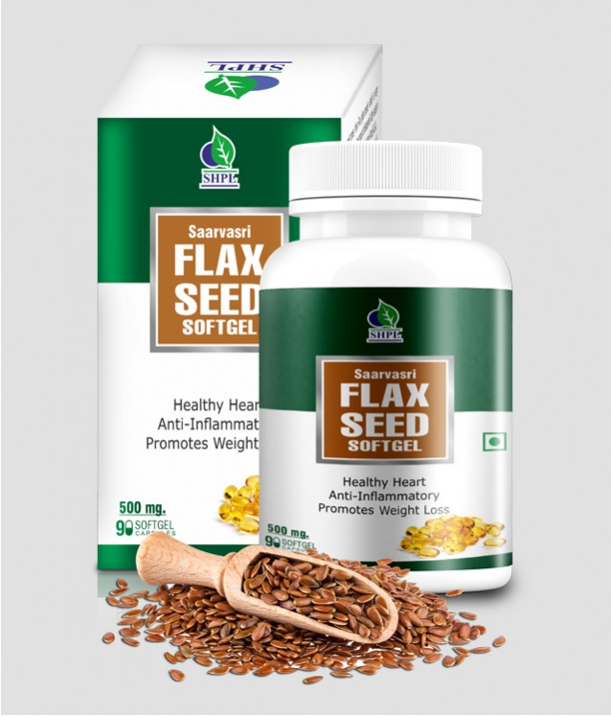
FLAXSEED
SAARVASRI FLAX SEED SOFT GEL – Vegan Source Of Omega
DESCRIPTION
Saarvasri Herbs Flax Seed Softgel is made from Flax Seeds which are a rich source of healthy fat, antioxidants, and fiber. According to the United States Department of Agriculture (USDA), the seeds contain protein, lignans, and the essential fatty acid alpha-linolenic acid, also known as ALA or omega-3. Flaxseeds have been consumed for at least 6,000 years, making them one of the world’s first cultivated super food.
HEALTH BENEFITS
Lowers the bad cholesterol.
Protects the heart.
Controls diabetes.
Very helpful for arthritis and joint pain.
Effective for improper digestion and constipation.
Prevents cancer.
Maintains skin and hair health.
Helps to loose weight.
Very effective for brain and neural health.
Detoxifies our body.
Reduces weakness and depression.
Product Details
KEY INGREDIENTS
HOW TO USE
Product Name : Flaxseed
Product type : Soft Gel
Pack Size : 90 Soft Gel
MRP : 650/-
Flax Seed Oil
1-2 Soft Gel two times daily or as directed by experts.

Slide 11
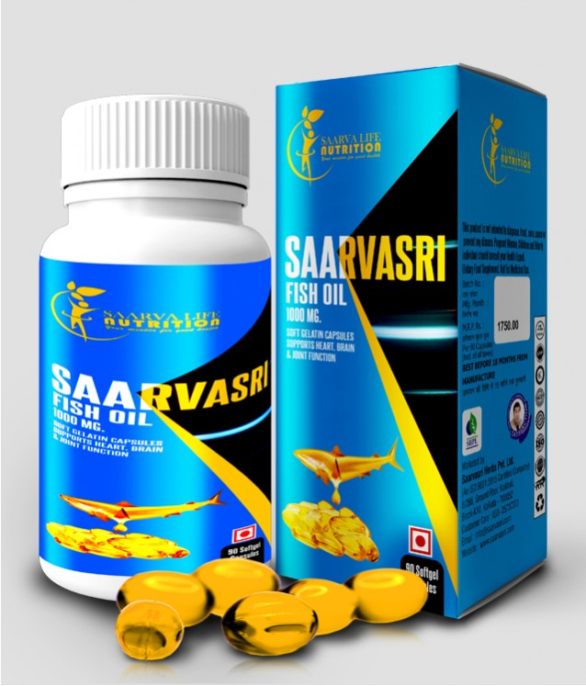
FISH OIL OMEGA 3
SAARVASRI FISH OIL SOFT GEL– Source of Fatty Acids
DESCRIPTION
Fish oils come from fatty or oily fish, such as trout, mackerel, tuna, herring, sardines, and salmon. They contain omega-3 fatty acids, and many contain vitamins A and D. Guidelines from the American College of Cardiology and American Heart Association (ACC/AHA) recommend eating fish as part of a heart-healthy diet. Indeed, having a diet rich in omega-3 fatty acids may help prevent heart disease, protect brain and eye health, and contribute to fetal development.
HEALTH BENEFITS
Can Fight Depression and Anxiety.
May help prevent depression and anxiety.
May help prevent macular degeneration
Can cause a major reduction in triglycerides.
Can reduce blood pressure.
Can raise “good” HDL cholesterol levels.
Can reduce the symptoms of ADHD in children
Can have numerous benefits for people with metabolic syndrome.
Can reduce insulin resistance
Fight inflammation and improve several heart disease risk factors.
Can reduce chronic inflammation
May help fight several autoimmune diseases
May help Alzheimer’s disease.
May protect from cancer
Can reduce liver fat
May improve bone strength and joint health
Potentially reducing your risk of osteoporosis and arthritis.
Can reduce menstrual pain
May improve the length and quality of your sleep.
Can help keep your skin healthy
Prevents premature aging and safeguarding against sun damage.
Product Details
KEY INGREDIENTS
HOW TO USE
Product Name : Fish Oil Omega 3
Product type : Soft Gel
Pack Size : 90 Soft Gel
MRP : 1750/-
Fish Oil
1-2 Soft Gel two times daily or as directed by experts.

Slide 12
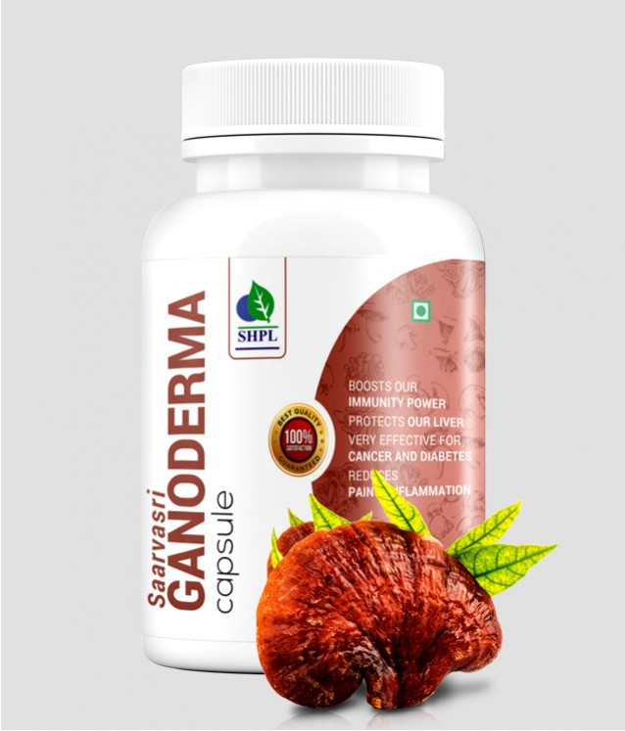
GANODERMA
SAARVASRI GANODERMA CAPSULE – Powerhouse of Protein
DESCRIPTION
Saarvasri Herbs Ganoderma Capsule is made from Ganoderma Lucidum, commonly known as Reishi Mushroom, is frequently used in traditional Chinese medicines. There are over 36 bio-active nutritional compounds present in Ganoderma. It is rich in essential amino acids, beta-glucans, antioxidants, enzymes, minerals and vitamins.
HEALTH BENEFITS
Effective for cancer and diabetes.
Boosts immunity power.
Beneficial for skin.
Reduces pain and inflammation.
Helps to maintain Heart health.
Flushes out toxins from body.
Maintains Neural and Sexual health.
Helpful for high blood pressure.
Protects our Liver.
Effective for lung infections, bronchitis and asthma.
Product Details
KEY INGREDIENTS
HOW TO USE
Product Name : Ganoderma
Product type : Capsule
Pack Size : 90 Cap
MRP : 650/-
Ganoderma Lucidium Extract
1-2 capsules two times daily or as directed by experts.

Slide 13
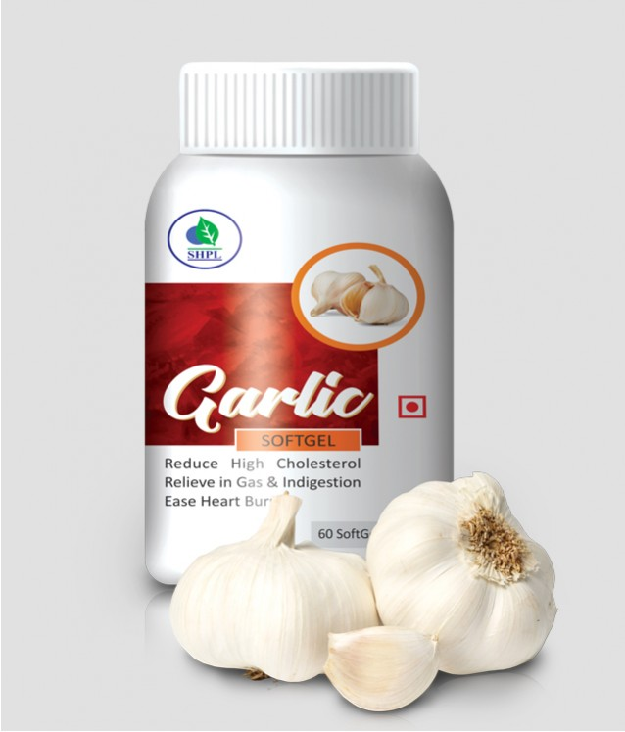
GARLIC SOFT GEL
GARLIC SOFT GEL – Daily Immunizer
DESCRIPTION
Throughout the Ancient history, Garlic has been used for its health and medicinal properties. Its use was well documented by many major civilizations, including the Egyptians, Babylonians, Greeks, Romans and Chinese. Garlic contains a wonderful compound called, Allicin which has various health benefits. Garlic is low in calories and rich in Vitamin C, Vitamin B6 and Manganese. It also contains trace amounts of various other nutrients.
HEALTH BENEFITS
Can combat sickness, including the common cold.
Can reduce high blood pressure.
Improves cholesterol levels
May lower the risk of Heart Disease.
May help to prevent Alzheimer and Demencia.
Flushes out the toxins from the body.
Increases the vitality.
Can detoxify heavy metals from the body.
Can improve bone health.
Powerful aphrodisiac, thus it can solve sexual problems.
Very good for skin and hair.
Product Details
KEY INGREDIENTS
HOW TO USE
Product Name : Garlic
Product type : Soft Gel
Pack Size : 90 Soft Gel
MRP : 500/-
Garlic Oil
1-2 Soft Gel two times daily or as directed by experts.

Slide 14
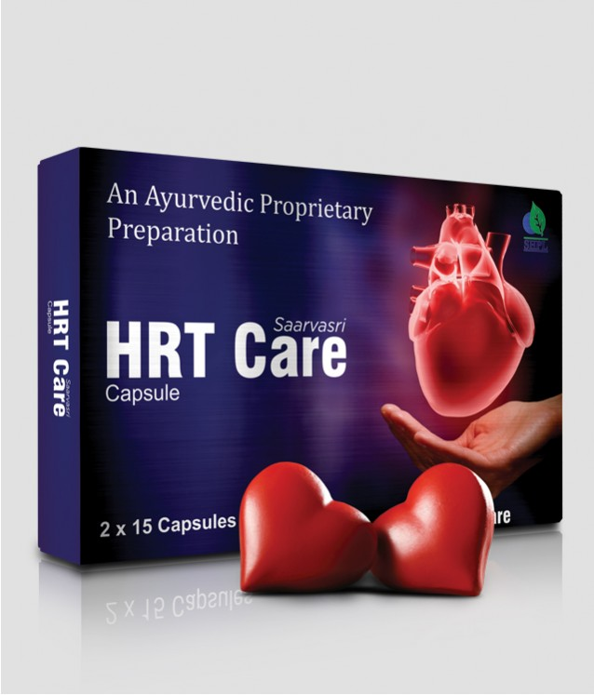
HRT CARE
SAARVASRI HRT CARE CAPSULE – Cardiac Rejuvenator
DESCRIPTION
Saarvasri Herbs HRT Care Capsule is sourced from the highest quality and is made up of a proprietary blend of 100% natural herbs that may help in providing a healthy and strong heart without a pinch of side effect. It is a cardio tonic thus providing nutrition to heart muscles and strengthening them.
HEALTH BENEFITS
It promotes Heart health.
Lowers high blood pressure level.
Aids in maintaining good cholesterol levels and lipid levels.
Helps improving HDL levels.
Helps to improve blood flow.
Promotes lowering of LDL levels.
They help in supporting heart from free radical damages caused by stress or strain.
Product Details
KEY INGREDIENTS
HOW TO USE
Product Name : HRT Care
Product type : Capsule
Pack Size : 30 Cap
MRP : 350/-
Arjun, Lahsun, Ajmoda, Dalchini, Ashwagandha, Dadim, Chitrak, Trikatu, Triphala, Prabhakar Vati, Moti Pishti, Shewaga,.
1-2 capsules two times daily or as directed by experts.

Slide 15
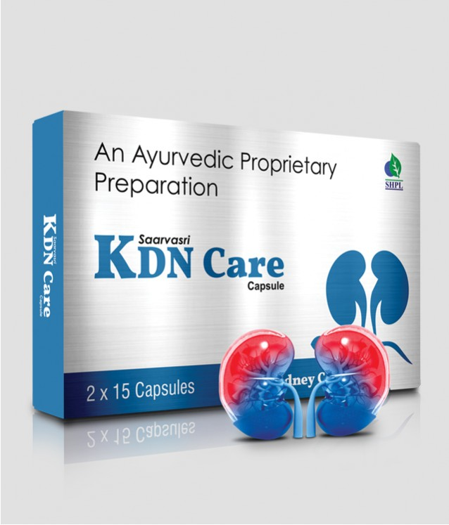
KDN CARE
SAARVASRI KDN CARE CAPSULE – Kidney Care
DESCRIPTION
Saarvasri Herbs KDN Care capsule is very effective as it is sourced from the highest quality herbs and its concentrated by 100% natural process. These are formulated using natural extracts of various medicinal plants and are highly admired for side effect free feature.
HEALTH BENEFITS
Supports healthy urinary function, kidney function
Reduces Kidney stones.
Effective in Kidney Stone
Promotes flow of urine.
Inhibits formation of phosphate & calcium precipitates.
Helpful in severe pain of kidney & urethra.
Helpful in urinary tract infections and other urinary problems.
Relieves inflammation of urethra.
Detoxifies and purifies the blood.
It prevents infection in kidney.
Helpful in Benign Prostate Hyperplasia.
It prevents from prostate cancer.
Product Details
KEY INGREDIENTS
HOW TO USE
Product Name : KDN Care
Product type : Capsule
Pack Size : 30 Cap
MRP : 350/-
Punarnava, Pashanbhed, Gokhru, Palash, Jeera, Varun, Kultha, Sandevi, Arka, Lajjalu, Manjishtha, Apamarg, Nagarmotha, Hajrul Mahood Bhasma, Chandraprabha Vati, Shwet Parpati.
1-2 capsules two times daily or as directed by experts.

Slide 16
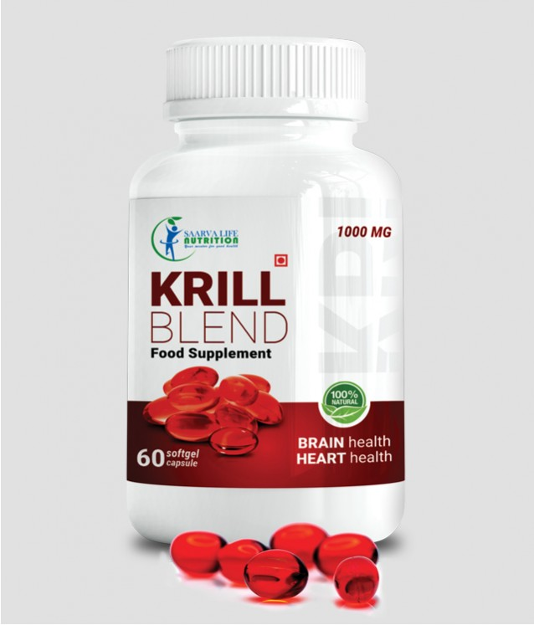
KRILL BLEND SOFT GEL
KRILL BLEND – Food for Brain & Heart
DESCRIPTION
Saarvasri Herbs Krill Blend Softgel is made from Krill oil which is a scientifically proven to be a super source of omega-3 fatty acids. It is made from krill, a type of small crustacean which is found in the oceans of Antarctica, Canada, and Japan. Two of the most important components in krill oil are omega-3 fatty acids and phospholipid-derived fatty acids (PLFA),
HEALTH BENEFITS
Promotes healthier cholesterol levels.
Reduces arthritis symptoms.
Relief from PMS symptoms and menstrual cramps.
Improves memory and concentration.
Helps to loose weight.
Detoxifies the body.
Promotes healthy heart, liver and eyesight.
Boosts immunity power.
Maintains cardio-vascular health.
Promotes healthy brain and nervous system.
Product Details
KEY INGREDIENTS
HOW TO USE
Product Name : Krill blend soft gel
Product type : Soft Gel
Pack Size : 60 Soft Gel
MRP : 1000/-
Krill Oil
1-2 Soft Gel two times daily or as directed by experts.

Slide 17
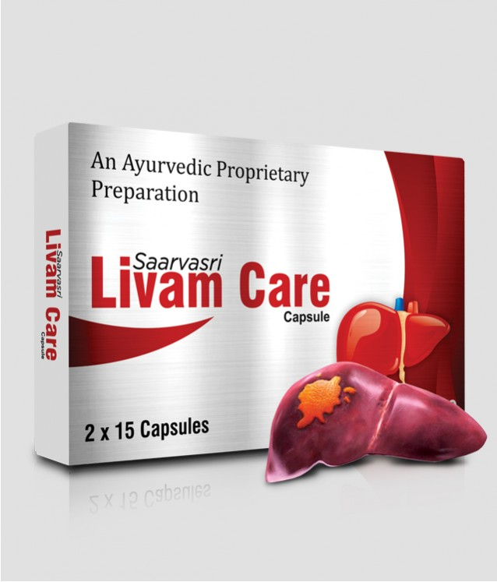
LIVAM CARE
SAARVASRI LIVAM CARE CAPSULE – Liver Care
DESCRIPTION
Livam Care Capsules contains different vital herbs in optimum concentration required to provide complete benefits to restore liver function parameters, which may help to check degeneration and promote regeneration of liver cells. Livam Care may have antiviral, antioxidant, anti-inflammatory and immune- modulator action.
HEALTH BENEFITS
Restores the functional efficacy of the liver by protecting the hepatic parenchyma.
Promotes hepatocellular regeneration.
Helpful in hepatitis.
Facilitates rapid elimination of toxins by proper metabolism
Ensures protection from alcohol induced hepatic damage.
Helps in preventing fatty infiltration of the liver.
If used before the onset of cirrhosis liver care arrests the progress of the disease and prevents further liver damage.
It can be used as daily health supplement by improving appetite, the digestion and assimilation process and promotes weight gain.
Product Details
KEY INGREDIENTS
HOW TO USE
Product Name : Livam Care
Product type : Capsule
Pack Size : 30 Cap
MRP : 350/-
Sarpankho, Bala Seeds, Ghritakumari, Bhringaraj, Kutki chhal, Gulvel, Vavding Fruit, Kariyatu, Daruharidra
1-2 capsules two times daily or as directed by experts.

Slide 18
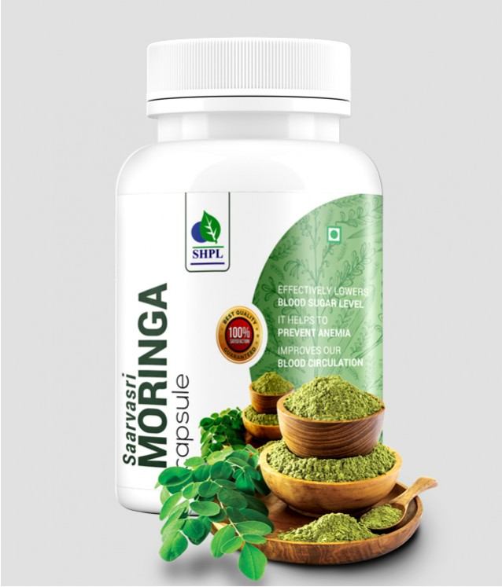
MORINGA
SAARVASRI MORINGA CAPSULE – For Daily Nutritional Needs
DESCRIPTION
Moringa Capsule is a proprietary blend of 92+ Nutrients, 21 Amino Acid (Protein), 49+Antioxidants, 11 Essential Vitamins, 85 Trace Minerals, 42 Anti Inflammatory, 4 Neutral Sources of Fibers, + Omega 3, 6 & 9 in one capsule essential for body health. It is one of the most powerful products for building a healthier lifestyle and it is charged with the strongest natural antioxidants available, enhanced with vitamins, Amino acids and trace minerals to boost the overall energy levels, substantially supplement daily nutritional needs and boost the body immune system.
HEALTH BENEFITS
Lowers blood sugar level.
Helps to prevent anemia.
Helps to protect liver
Cleanses the body internally.
helps to prevent cancer.
Relieves skin problems.
Improves our blood circulation.
Relieves any type of neural problems.
Effective for sexual problems.
Boosts immunity.
Product Details
KEY INGREDIENTS
HOW TO USE
Product Name : Moringa
Product type : Capsule
Pack Size : 90 Cap
MRP : 650/-
Moringa Oliefera Extract
1-2 capsules two times daily or as directed by experts.

Slide 19
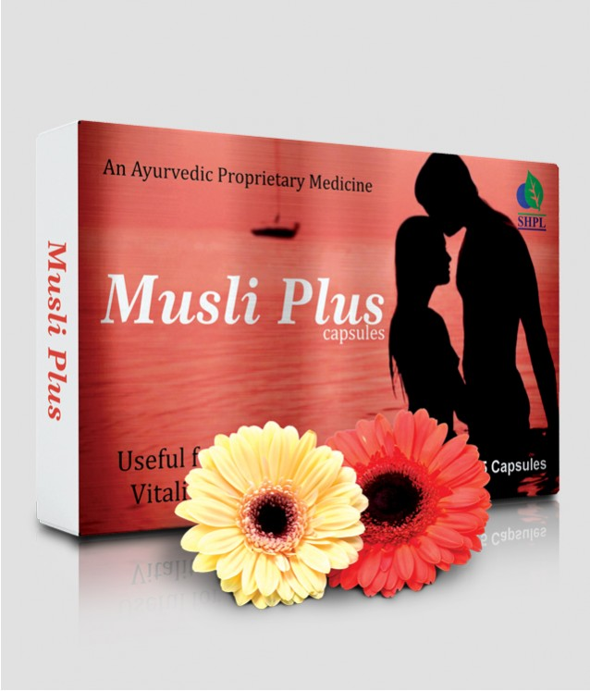
MUSLI PLUS
MUSLI PLUS CAPSULES – Increase Libido
DESCRIPTION
Saarvasri Herbs Musli Plus is a premium natural formulation for general sexual health enhancement. It is formulated and designed to enhance sexual performance without unwanted side effects of prescription drugs.
HEALTH BENEFITS
It instantly improves sexual energy, fights against sexual debility & sexual weakness.
It restores vitality and increases the stamina.
This product increases natural excitement, response to stimulation and give fantastic staying Energy and stamina for extended sexual performance.
It also significantly increases sex drive!
Product Details
KEY INGREDIENTS
HOW TO USE
Product Name : Musli Plus
Product type : Capsule
Pack Size : 30 Cap
MRP : 350/-
Safed Musli, Gokhru, Ashwagandha, Kaunch, Satavari, Mulethi, Javitri, Pippali, Akarkara, Salampanjha, Brahmi, Vidharikand, Dalchini, Jaiphal, Talamkhana, Makardhwaj, Shilajit, Vang Bhasma, Tamra Bhasma, Praval Bhasma, Kukkutandtwak Bhasma, Mukta Shukti Bhasma
1-2 capsules two times daily or as directed by experts.

Slide 20
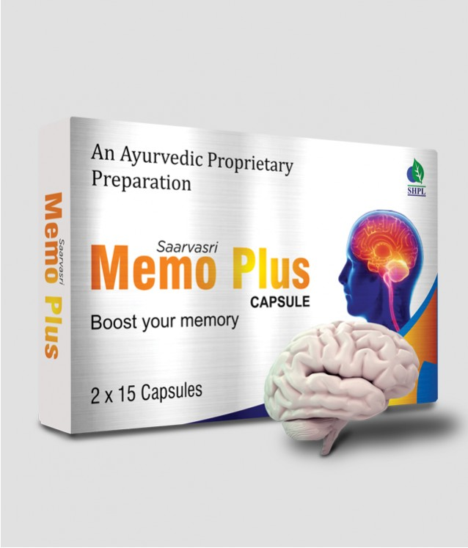
MEMO PLUS
SAARVASRI MEMO PLUS CAPSULE – Memory Booster
DESCRIPTION
Saarvasri Herbs Memo Plus Capsule can be used by people of any age groups. If you are searching for a best natural memory enhancing product, this is a perfect choice. Unique blend of natural ingredients in this product boost brain power naturally without inducing any adverse action on user. It is found to be as an excellent solution to boost the functioning of brain .
HEALTH BENEFITS
It helps you to use your brain to the maximum level.
The more you use it, the more you'll challenge your brain to grow new cells.
It helps memory to response quickly and it is used as a brain tonic to enhance memory development.
It is reported to have blood flow in cerebral and neuro protective effects.
It has got anti-oxidant activity as well as it gives support to healthy immune system.
It prevents cerebral oxidative damage through its anti-oxidant product.
Product Details
KEY INGREDIENTS
HOW TO USE
Product Name : Memo Plus
Product type : Capsule
Pack Size : 30 Cap
MRP : 350/-
Convulvulus Pluricaulis, Asparagus Racemosus, Bacopa Monnieri, Eclipta Alba, Withania Somnifera, Celastrus Panicultus, Cassia Fistula, Acorus Calamus, Nardotachys Jatamansi
1-2 capsules two times daily or as directed by experts.

Slide 21
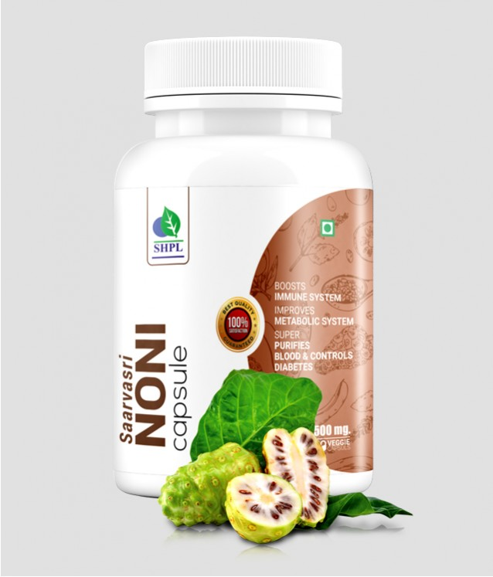
NONI
SAARVASRI NONI CAPSULE – Nutritional Immunizer
DESCRIPTION
Saarvasri Herbs Noni Capsule is made of Noni fruit containing a mixture of anthraquinones, xeronine, organic acids, vitamins, minerals, nutritional enzymes and polysaccharides. This has rich anti oxidant properties so this product protects from toxins & pollutants. This contains anti inflammatory, astringent properties for the patient of stomach problems. Analysis has shown that it is rich in elements basic to humans, like: dietary Fiber, Proteins, Carbohydrates, Iron, Vitamins (A, C, B1 and B2), Calcium, Sodium and Potassium along with many isolated nutrients.
HEALTH BENEFITS
Detoxifies our body and regulates Protein in the body.
It is an effective antioxidant,it has anti-inflammatory, anti microbial and anti carcinogenic properties.
Regulates proper cell functioning and rejuvenates the cells of the body and Boosts Immune system.
Improves metabolic system.
Reduces the risk of cancer.
Relieves pain as an analgesic.
Manages body weight.
Facilitates sound sleep.
Purifies blood and controls Diabetes.
Improves arthritis ,asthma as well as respiratory and digestive problems.
Improves circulatory system and Stabilizes Blood Pressure.
Maintains healthy skin, hair and scalp.
Product Details
KEY INGREDIENTS
HOW TO USE
Product Name : Noni
Product type : Capsule
Pack Size : 90 Tab
MRP : 650/-
Noni Extract
1-2 capsule two times daily or as directed by experts.

Slide 22
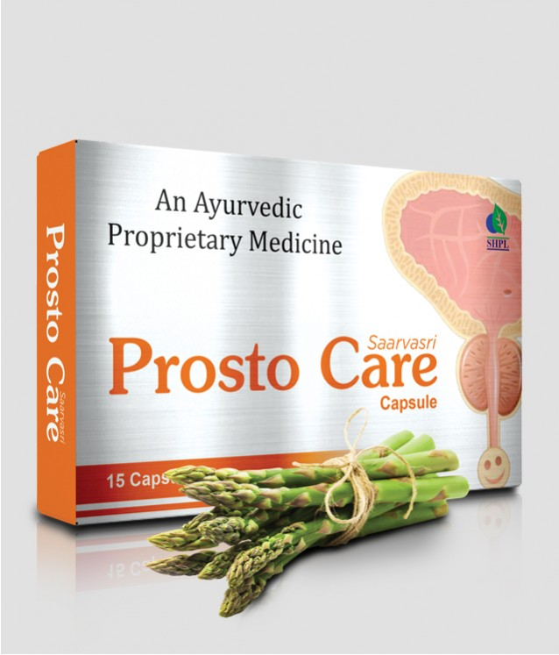
PROSTO CARE
SAARVASRI PROSTO CARE – Prostate Protector
DESCRIPTION
Saarvasri Herbs Prosto Care capsule is a perfect blend of many natural herbs to control any problem regarding our prostate and urination without any side effect. Prosto Care supports healthy prostate and normal male urogenital function. It improves urinary tract function and flow, reduces symptoms of enlarged prostate, supports healthy PSA levels and restores male energy.
HEALTH BENEFITS
Beneficial for Urinary tract function and flow.
Reduces symptoms of enlarge prostate.
Support Healthy PSA level.
Restores Male Energy.
Supports Healthy prostate and normal male urogential function.
Product Details
KEY INGREDIENTS
HOW TO USE
Product Name : Prosto Care
Product type : Capsule
Pack Size : 15 cap
MRP : 200/-
Varuna, Gokhru, Khus Khus, Gorakhmundi, Punarnava, Shatavari,Khadir, Salam Mishri, Lata Karanj, Shilajit, Kanchnar Guggul
1-2 capsule two times daily or as directed by experts.

Slide 23
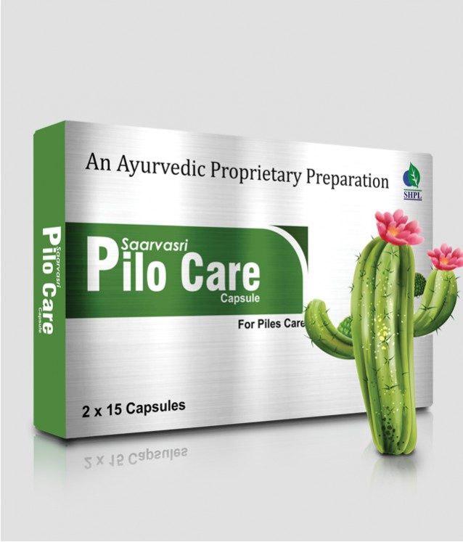
PILO CARE
SAARVASRI PILO CARE CAPSULE – Piles Care
DESCRIPTION
Piles is may be caused due to constipation, pregnancy, stomach problems etc. Saarvasri Herbs Pilo Care shrunken your piles and relieves discomfort. It soothes your itching and reduces inflammation. Give yourself freedom from the problem of piles by taking this piles care tablets infused with herbal ingredients. We use all natural and herbal ingredients for zero side effects
HEALTH BENEFITS
May be helpful in Chronic constipation, Hemorrhoids, fissure in ano, bleeding and non-bleeding piles, fistula, internal and external piles, painful defecation, rectal inflammation, peri-anal abscess, rectal prolapse.
Effective solution for the vein and capillary health of the anal passage.
These capsules provide soothing relief to the anal area and support the normal tone of the venous walls.
Helps in maintaining the regular routine circulation in the anal area while sitting and also supports the health of the surrounding tissue of the anal opening.
Specifically formulated for treatment of external hemorrhoids, internal hemorrhoid and prolapsed hemorrhoid.
It has anti-inflammatory properties, and is fast in penetrating body tissues.
Product Details
KEY INGREDIENTS
HOW TO USE
Product Name : Pilo Care
Product type : Capsule
Pack Size : 30 cap
MRP : 350/-
Commiphora Wighiti, Shilajit, Azadirachta Indica, Berberis Aristata, Emblica Officinalis, Terminalia Chebula, Terminalia Bellirica, Cassia Fistula, Bauhinia Variegata, Mesua Ferrea.
1-2 capsule two times daily or as directed by experts.

Slide 24
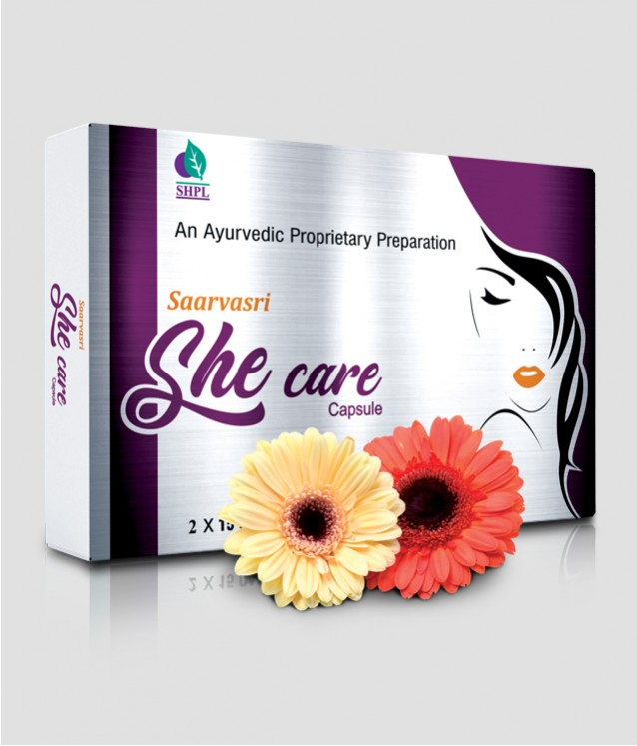
SHE CARE
SAARVASRI SHE CARE CAPASULE – Libido Enhancer for Women
DESCRIPTION
Female power and performance tends to fluctuate with time and age. It is a common fact because, with age, hormone levels and general desire in women isknown to reduce. But most products are focused on men. With Saarvasri Herbs She Care capsule, females now can find a complete solution for their satisfied happy life. It is made with 100% natural ingredients.
HEALTH BENEFITS
It helps to increase libido and sexual desire in women.
It boosts their stamina and performance.
It maintains daily energy level.
Protects reproductive organs.
Product Details
KEY INGREDIENTS
HOW TO USE
Product Name : She Care
Product type : Capsule
Pack Size : 30 cap
MRP : 350/-
Shatavari, Akarkara, Ashwagandha, Gokhuru, Arjuna, Shuddh Shilajit, Vaang Bhasma, Abhrak Bhasma, Swarna Bhasma, Rasasindur
1-2 capsule two times daily or as directed by experts.

Slide 25
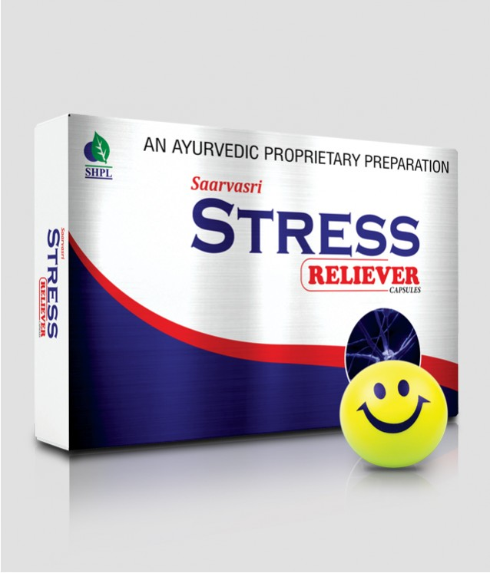
STRESS RELIEVER
SAARVASRI STRESS RELIEVER CAPSULE – Stress Reducer
DESCRIPTION
Saarvasri Herbs Stress Reliever Capsule has an anti-stress formula used to reduce stress or tension. Stress Reliever Capsules are purely herbal remedy made from natural and effective herbs. It is a natural way to keep a calm mind and enjoy all moments of life.
HEALTH BENEFITS
It calms the mind and helps to reduce tension or stress naturally and safely.
It also protects the heart and brain.
It provides anti-oxidants support and also boosts immunity.
It relieves nerve disorders.
It is very effective to control headache.
Product Details
KEY INGREDIENTS
HOW TO USE
Product Name : Stress Reliever
Product type : Capsule
Pack Size : 30 cap
MRP : 350/-
Shankhpuspi, Brahmi, Sarpagandha, Tagar, Triphala, Ashwagandha, Jatamansi
1-2 capsule two times daily or as directed by experts.

Slide 26
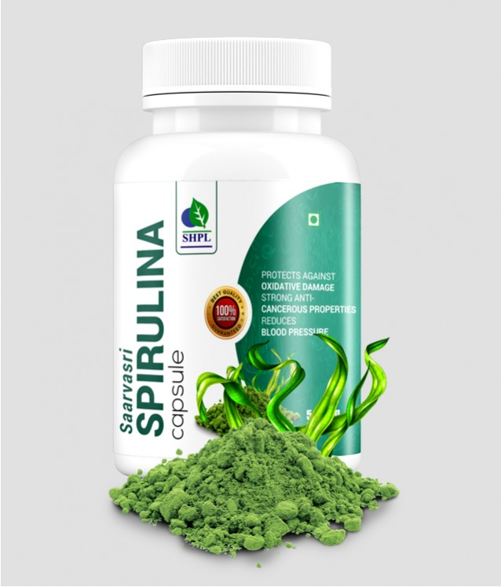
SPIRULINA
SAARVASRI SPIRULINA CAPSULE – Super Food
DESCRIPTION
Spirulina is a blue-green microalgae that has been consumed for centuries due to its high nutritional value and supposed health benefits. Saarvasri Herbs Spirulina Capsule has between 55 to 70% protein, 9 essential and 10 non-essential amino acids, as well as high levels of gamma-linolenic acid (GLA), beta-carotene, linoleic acid, arachidonic acid, vitamin B12, iron, calcium, phosphorus, chlorophyll, and phycocyanin, a strong anti-oxidant.
HEALTH BENEFITS
It can lower “Bad” LDL and Triglyceride Levels.
It has strong anti-cancerous properties.
It reduces Blood Pressure.
It is very helpful for Allergic patients.
It is very effective for Anemia.
It improves Muscle Strength and Endurance.
It controls blood sugar.
It helps to loose weight.
It prevents heart disease.
It boosts up metabolism.
It maintains our Neural and Mental health.
It prevents mal-nutrition.
It is very beneficial for our skin.
Product Details
KEY INGREDIENTS
HOW TO USE
Product Name : Spirulina
Product type : Capsule
Pack Size : 90 cap
MRP : 650/-
Spirulina Extract
1-2 capsule two times daily or as directed by experts.

Slide 27
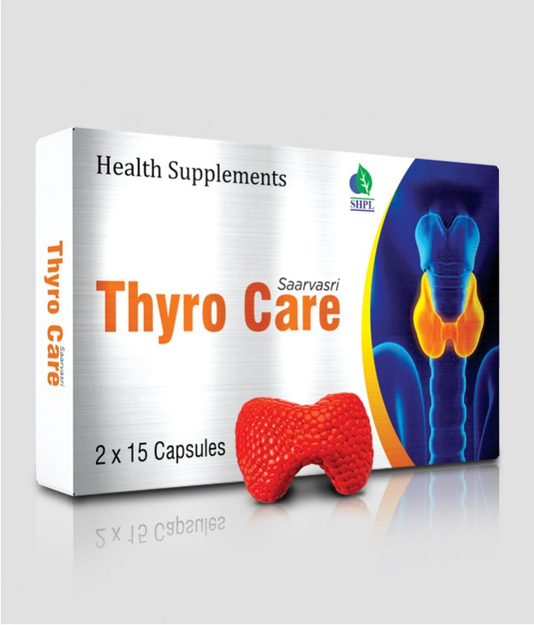
THYRO CARE
SAARVASRI THYRO CARE CAPSULE – Thyroid Care
DESCRIPTION
Saarvasri Herbs Thyro Care is an excellent combination of different herbs which can be extremely helpful not only in managing the symptoms of both hypothyroidism and hyperthyroidism, but they can also be an important part of restoring someone's health back to normal.
HEALTH BENEFITS
Acts as a thyroid stimulant.
Reduces the weight gained due to thyroid malfunction.
Regularizes the menstrual cycles and cleanses the genito-urinary system.
Diuretic and anti-inflammatory in action helps cure edema.
Restores the lost vitality and energy levels.
Enhances skin and hair tone.
Safe and effective- for long term usage.
Product Details
KEY INGREDIENTS
HOW TO USE
Product Name : Thyro Care
Product type : Capsule
Pack Size : 30 cap
MRP : 350/-
Licorice, Ashwagandha, Bacopa Monneri, Black Walnut, Flax Seed, Guggul,
1-2 capsule two times daily or as directed by experts.

Slide 28
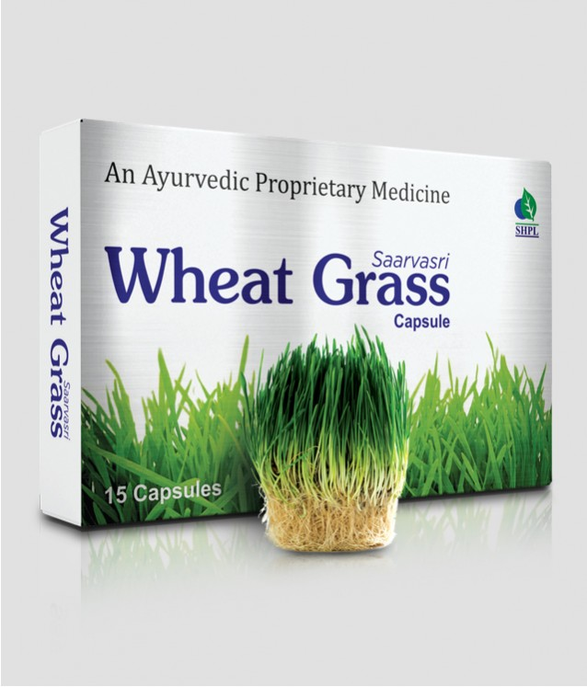
WHEAT GRASS
SAARVASRI WHEAT GRASS CAPSULE – High in Nutrients
DESCRIPTION
High in Nutrients and Antioxidants, Saarvasri Herbs Wheatgrass Capsules is an excellent source of many different vitamins and minerals. Wheatgrass is the fresh sprouted leaves of the wheat plant. Wheatgrass is a source of potassium, dietary fiber, vitamin A, vitamin C, vitamin E, vitamin K, thiamin, riboflavin, niacin, vitamin B6, iron, zinc, copper, manganese, and selenium. Wheatgrass is also a good source of essential Amino Acids.
HEALTH BENEFITS
Detoxifies body
Protects from cancer
Increases body metabolism
Helps to loose weight
Effective for skin & hair
Helpful in anemia
Increases platelet counts
Increases sperm count
Effective for digestive system
Protects our liver, heart and all the system of our body.
Effective for any kind of neural disorders.
Product Details
KEY INGREDIENTS
HOW TO USE
Product Name : Wheat Grass
Product type : Capsule
Pack Size : 30 Cap
MRP : 350/-
Wheat Grass Extract
1-2 capsule two times daily or as directed by experts.

Slide 29
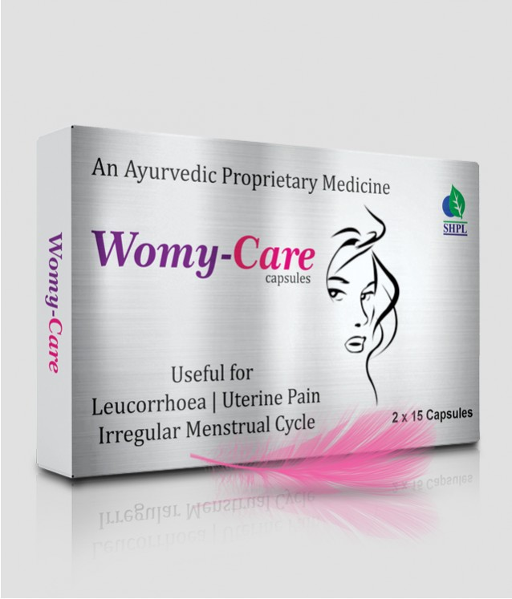
WOMY CARE
WOMY-CARE CAPSULES – Solution for Women
DESCRIPTION
Saarvasri Herbs Womy Care capsule is a complete solution for women for their many health problems. It is enriched with natural wonderful herbs. This product is very beneficial for menstrual problems in women along with that leucorrhea, cyst, energy loss etc.
HEALTH BENEFITS
Immunity booster.
Support Blood circulation.
Increases Hemoglobin.
Support tissue growth.
Helps in irregular menstruation, dysmenorrhea, abnormal menstruation.
Very beneficial in Leucorrhea.
Controls ovary cyst.
Helps in detoxification.
Relief for Gas Indigestion.
Reduce high blood pressure.
Improves liver function.
Helps to boost energy level.
Maintains healthy skin.
Product Details
KEY INGREDIENTS
HOW TO USE
Product Name : Womy Care
Product type : Capsule
Pack Size : 30 Cap
MRP : 350/-
Lodhra, Ashok, Manjistha, Shatavari, Ashwagandha, Nagkeshar, Draksha, Kutaj, Mochras, Saunth, Ghritakumari, Guduchi, Kakamchi, Vanshalochan, Chikni Supari, Ulat Kambal, Tankan Bhasma, Mandoor Bhasma
1-2 capsule two times daily or as directed by experts.

Slide 31
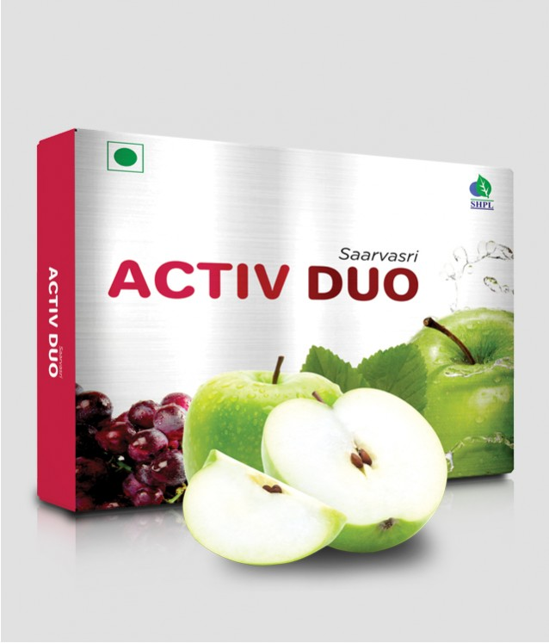
ACTIV DUO
SAARVASRI ACTIV DUO – Double Stem Cell Formula
DESCRIPTION
Saarvasri Activ Duo Tablet is made of using Double Stemcell Formula. It rejuvenates and activates body cells to raise energy and improve vitality. It is a safe, natural and convenient product for both women and men.
HEALTH BENEFITS
Helpful in Spinal cord injury
Controls Diabetes
Prevents Heart disease
Prevents Parkinson's and Alzheimer's disease
Helpful in Lung disorders
Prevents Cancer
Boosts Immune Power
Maintains daily energy level
Rejuvenates damaged cells and tissues
Product Details
KEY INGREDIENTS
HOW TO USE
Product Name : Activ Duo
Product type : Tablet
Pack Size : 15 Tab
MRP : Rs. 200/-
Vitis Vinifera Ext., Malus Domestica Ext., Plygonum Multiforum Ext., Argan Fruit Ext., Acai Berry Ext., Blue Berry Ext., Astragali Radix Ext., Angelica Sinensis Ext.
1-2 tablets two times daily or as directed by experts.

Slide 32
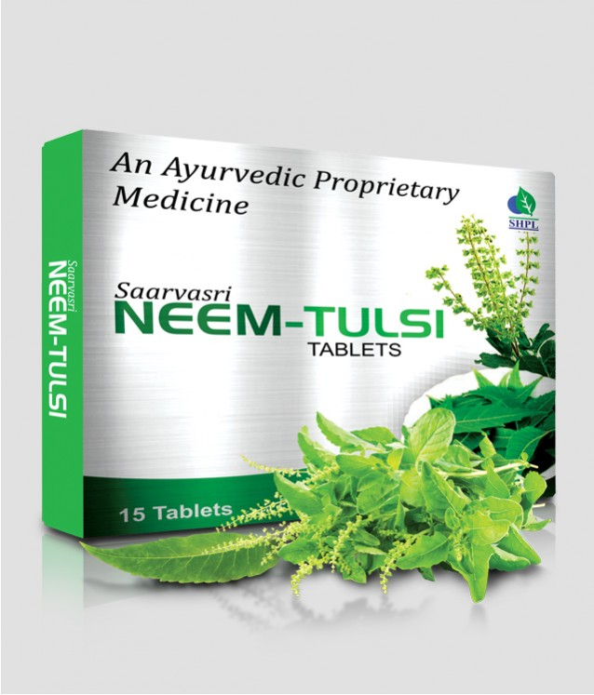
NEEM TULSI
SAARVASRI NEEM-TULSI TABLETS – Bacteria/Virus/Fungus Protector
DESCRIPTION
Saarvasri Herbs Neem-Tulsi Tablet is an anti-bacterial, Anti-viral and anti-fungal product to boost our immunity power. It is a perfect blend of nature’s two wonderful herbs Neem and Tulsi for protecting us from environmental hazards and toxicated pollutants to keep us healthy. By using this product we can lead a quality healthy life.
HEALTH BENEFITS
Helps to fight acne by inhibiting the bacteria that causes acne growth.
Supports restoration of functional pancreatic beta cells that secrete insulin in the body, and helps maintain healthy glucose levels.
Helps suppress cough and aids the mobilization of mucus. Assists in calming and dilating the lung's airways, thus relieving chest congestion.
It is very effective for any kind of skin infections and skin related disorders.
Very helpful for allergies.
It is an anti-bacterial, anti-viral and anti-fungal product to control disease.
It boosts our immunity power.
It is able to tackle stress, anxiety, and inflammation
Product Details
KEY INGREDIENTS
HOW TO USE
Product Name : Neem Tulsi
Product type : Tablet
Pack Size : 15 Tab
MRP : Rs. 200/-
Neem Extract, Tulsi Extract
1-2 tablets two times daily or as directed by experts.

Slide 33
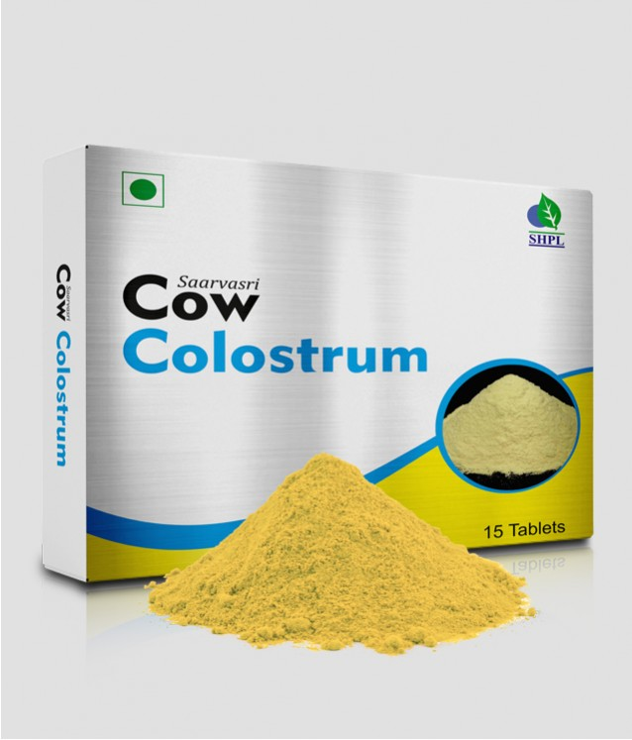
COW COLOSTRUM
SAARVASRI COW COLOSTRUM – Your Primary Protection
DESCRIPTION
Saarvasri Herbs Cow Colostrum is made of Colostrum which is a milky fluid that comes from the breasts of humans, cows, and other mammals the first few days after giving birth, before true milk appears. It contains proteins, carbohydrates, fats, vitamins, minerals, and proteins (antibodies) that fight disease-causing agents such as bacteria and viruses.
HEALTH BENEFITS
Helps protect the gastrointestinal tract from damage
Helps heal from chronic conditions, such as colitis
Helps improve physical performance
Helps build lean body mass
Protects from flu
Strengthens our immune system
Product Details
KEY INGREDIENTS
HOW TO USE
Product Name : Cow Colostrum
Product type : Tablet
Pack Size : 15 Tab
MRP : Rs. 200/-
Bovine Cholostrum
1-2 tablets two times daily or as directed by experts

Slide 34
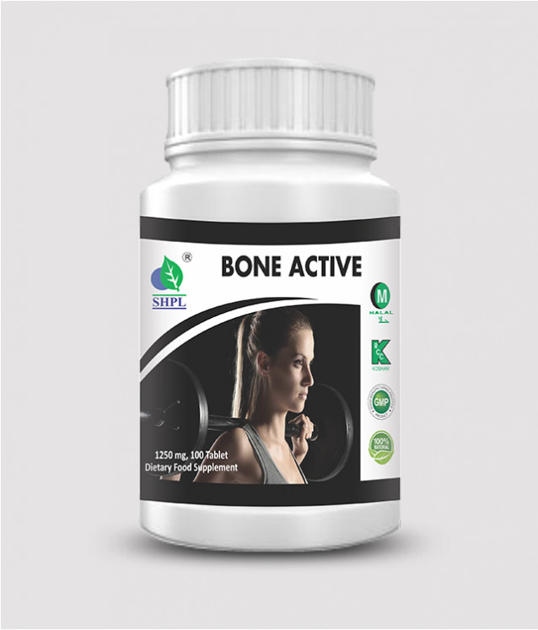
BONE ACTIVE
BONE ACTIVE – For Healthy Bones
DESCRIPTION
Saarvasri Herbs Bone Active Tablet is used to prevent or treat low blood calcium levels in people who do not get enough calcium from their diets. Vitamin D3 helps your body absorb calcium. Having the right amounts of vitamin D3, calcium is important for building and keeping strong bones.
HEALTH BENEFITS
Strengthens bones and prevents Osteoporosis.
Maintains bone and joint health.
Protects cardiac muscles.
Ensures healthy alkaline pH level.
Helps to maintain optimal body weight.
Product Description
KEY INGREDIENTS
HOW TO USE
Product Details
Product Name : Bone Active
Product type : Tablet
Pack Size : 100 Tab
MRP : Rs. 600/-
Vitamin D3, Calcium Carbonate
1-2 tablets two times daily or as directed by experts.

Slide 35
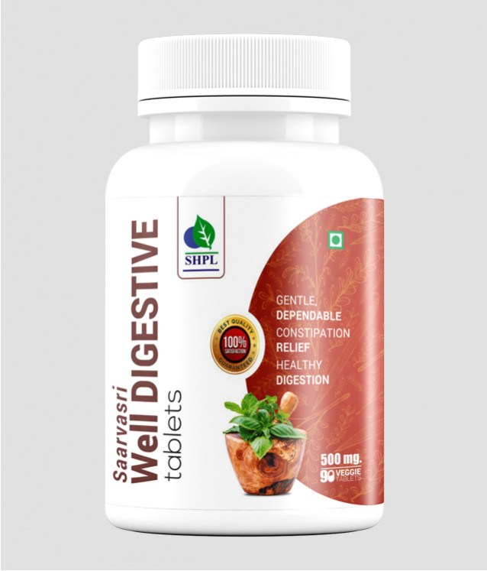
WELL DIGESTIVE
SAARVASRI WELL DIGESTIVE TABLETS – For Healthy Digestion
DESCRIPTION
Well digestive Tablet is strengthen the digestion and assimilation with a natural digestive stimulant. It splits the large, complex molecules mainly proteins, carbohydrates, and fats into smaller ones, allowing to be easily absorbed into the bloodstream and carried throughout the body. It speeds up the breakdown (hydrolysis) of food molecules into their ‘building block’ components.
HEALTH BENEFITS
Effective in Maintaining gas & Acidity
Effective and Perfect Cure to Constipation
Effective for Stomach Pain, Abdominal Pain & Burning Sensation
Naturally Neutralize Excess Acidity that can cause illness and Premature Aging
Fight against Low Energy, Chronic Fatigue, Slow Digestion
Increase metabolism in your body
Product Details
KEY INGREDIENTS
HOW TO USE
Product Name : Well Digestive
Product type : Tablet
Pack Size : 90 Tab
MRP : Rs. 650/-
Amlaki, Sonamukhi, Nasotar, Haritaki, Aragvadh, Ajma, Nvsadar, Kala Namak, Hing, Erand
1-2 tablets two times daily or as directed by experts

Slide 36
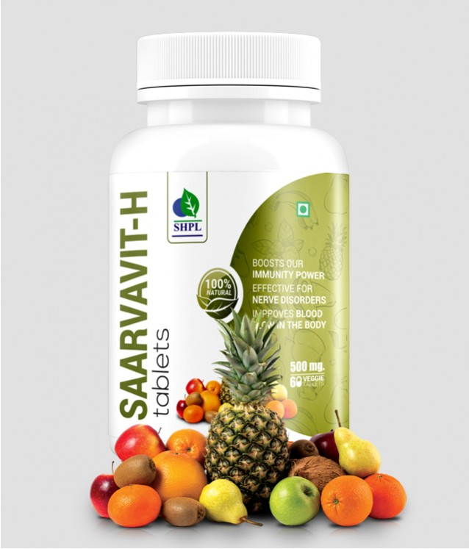
SAARVAVIT-H
SAARVAVIT-H TABLETS – Source Of Multi-vitamin
DESCRIPTION
Saarvasri Herbs Saarvavit-H Tablet is a multi vitamin and multi mineral product to provide sufficient vitamins and minerals to the body. It is enriched with many natural herbs to maintain our daily energy and vitality. It is a supportive product for our general health and can be used to everybody for a quality healthy life.
HEALTH BENEFITS
Supports healthy heart, liver, kidney & lungs function.
It is rich in super anti-oxidants to detoxify our body.
Maintains general health and energy.
Provides essential nutrients along with vitamins and minerals to the body.
Maintains healthy skin.
Beneficial for hair problems.
Effective for nerve disorders.
Improves blood flow in the body.
Supports eye health.
Boosts our immunity power.
Beneficial for cough, cold and flu.
Product Details
KEY INGREDIENTS
HOW TO USE
Product Name : Saarvavit-H
Product type : Tablet
Pack Size : 90 tab
MRP : Rs. 750/-
Wheat Grass, Grape Seed, Ashwagandha, Tulsi, Curcumin, Moringa, Neem
1-2 tablet two times daily or as directed by experts

Slide 37
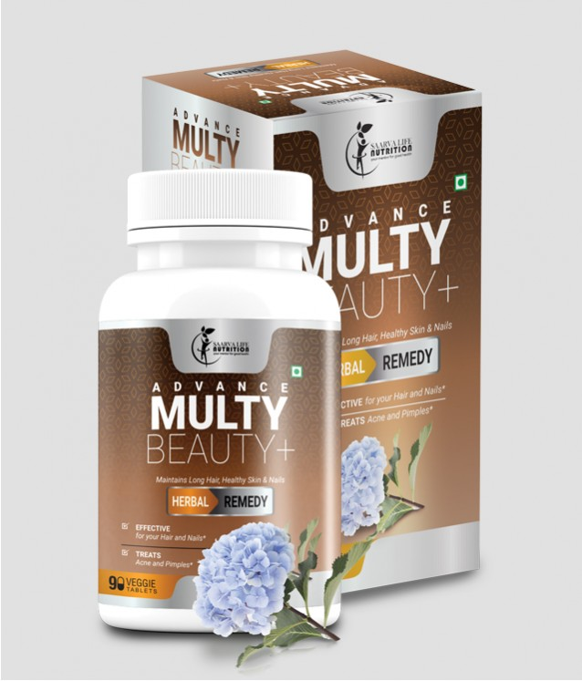
ADVANCE MULTI BEAUTY+
ADVANCE MULTY BEAUTY+ - Enhance Your Skin
DESCRIPTION
Advance Multi Beauty Plus Tablets are the complete solution for you ultimate beautification. we believe that, beautification is not to make fair your skin tone, but to clean you internally and only then the glow on your skin comes from inside your body. Saarvasri herbs Advance Multi Beauty Plus Tablets clean your internal body organs and flush out toxins from your body. It is specially designed for your healthy skin, hair and nails. The active natural ingredients within it makes you beautiful both internally and externally.
HEALTH BENEFITS
Effective for your Hair and Nails
Treats Acne and Pimples
Effective in Hair Fall Problem
Helps to rejuvenate Hair Follicles and thus activates hair growth
Protects your liver
Treat skin problems like Skin Allergy, Irritations, Rashes, Black Patches, Lines and Wrinkles
Product Details
KEY INGREDIENTS
HOW TO USE
Product Name : Advance Multi Beauty+
Product type : Tablet
Pack Size : 90 Tab
MRP : Rs. 1250/-
Curcuma Longa, Rosa Indica, Neem, Embellica Officinale, Aloevera, Tulsi, Santalum Album, Calamine, Glycerine
1-2 tablets two times daily or as directed by experts

Slide 38
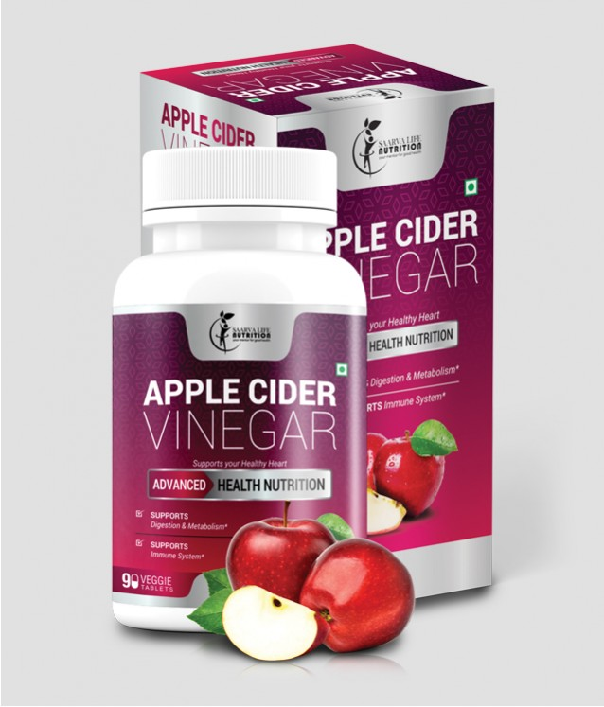
APPLE CIDER VINEGAR
APPLE CIDER VINEGAR – Advance Health Nutrition
DESCRIPTION
Apple Cider Vinegar has a long history as a home remedy, used to treat things like sore throat and varicose veins. The Ancient Greeks treated wounds with it. In recent years, people have explored apple cider vinegar as a way to loose weight, improve heart health and even treat dandruff. It has some powerful anti-oxidant properties called Polyphenols. They stop the cell damage. Cell damage can lead to other diseases like Cancer.
HEALTH BENEFITS
Effective for your Skin and Hair problems.
Can loose your weight naturally.
Reduces belly fat.
Can reduce cholesterol level and supports your heart health.
Normalize high blood pressure level.
Improves insulin sensitivity and thus lowers high blood sugar level.
Natural laxative and it can improve digestion.
Prevents and decreases the risk of getting Cancer
Protects you from external virus and bacteria.
Gives you the daily energy and stamina.
Product Details
KEY INGREDIENTS
HOW TO USE
Product Name : Apple Cider Vinegar
Product type : Tablet
Pack Size : 90 Tab
MRP : Rs. 1250/-
Apple Cider Vinegar Powder, Apple Peclin, Alfa Alfa, Ginger Root, Spirulina, Wheat Grass, Lecithin, Coconut Water Powder, Lactic Acid Bacilus, Cayenne.
1-2 tablets two times daily or as directed by experts

Slide 39
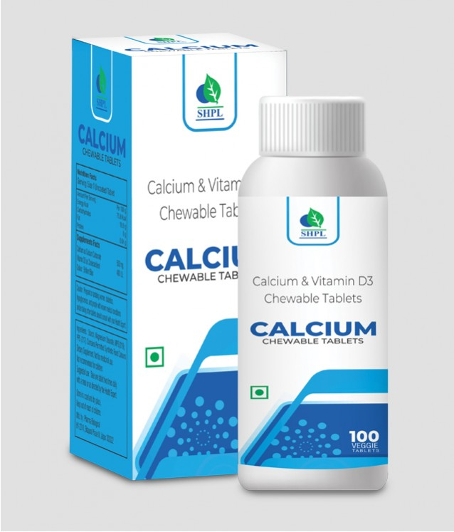
CALCIUM & VITAMIN D3
CALCIUM & VITAMIN D3 Chewable Tablets
DESCRIPTION
Lack of Calcium & Vitamin D3 in the body shows up through symptoms like feeling tired easily; constant pain in the legs, back & joints & muscle weakness. Adequate calcium intake is required to prevent calcium loss from bones. But your regular diet may not be enough to fulfill your daily calcium requirement. Prolonged Calcium deficiency may cause Osteoporosis leading to the weakening of bones later on. SHPL Calcium & Vitamin D3 tablets contain Calcium and Vitamin D3 which helps maintain bone strength and allows you to lead an active lifestyle.
HEALTH BENEFITS
Essential for critical metabolic functions.
Required for building and maintaining healthy bones and teeth.
Plays crucial role in nerve transmission, muscle function, cellular signaling and hormone secretion.
Important for maintaining the balance of breaking down and building up of bones.
Supports flexible movements and mobility of muscles and bones.
Maintains body pH level.
Product Details
KEY INGREDIENTS
HOW TO USE
Product Name : Calcium & Vitamin D3
Product type : Tablet
Pack Size : 100 Tab
MRP : Rs. 650/-
Calcium Carbonate, Cholocalciferol
1-2 tablets two times daily or as directed by experts

Slide 40
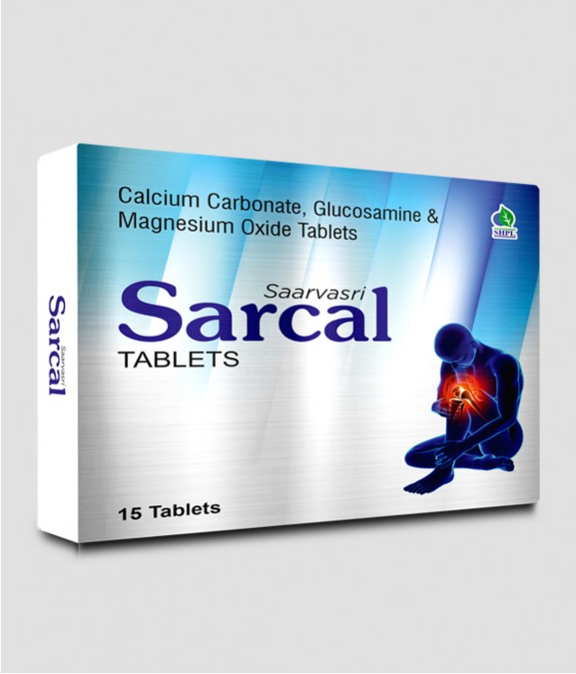
SARCAL
SAARVASRI SARCAL TABLETS – For Healthy Joints
DESCRIPTION
Saarvasri Sarcal Tablet is used to prevent or treat low blood calcium levels in people who do not get enough calcium from their diets. Calcium plays a very important role in the body. It is necessary for normal functioning of nerves, cells, muscle, and bone. If there is not enough calcium in the blood, then the body will take calcium from bones, thereby weakening bones. Glucosamine helps to maintain healthy joints and synovial fluid between bone joints.
HEALTH BENEFITS
It strengthens bones and prevents Osteoporosis
Maintains bone and joint health
Maintains healthy synovial fluid level between joints
Ensures healthy alkaline pH level
Helps to maintain optimal body weight
Product Details
KEY INGREDIENTS
HOW TO USE
Product Name : Sarcal
Product type : Tablet
Pack Size : 15 Tab
MRP : Rs. 200/-
Calcium Carbonate, Glucosamine, Magnesium Oxide
1-2 tablet two times daily or as directed by experts

Slide 41
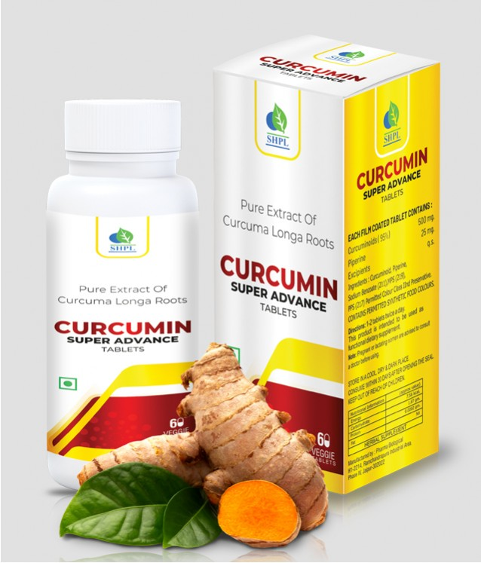
CURCUMIN SUPER ADVANCE TABLETS
CURCUMIN SUPER ADVANCE TABLETS – Power of Turmeric
DESCRIPTION
Saarvasri Herbs Curcumin Super Advance Tablet is a wonderful product made of 95% of curcumin. Curcumin is a yellow-orange dye obtained from tumeric, the powdered root of Curcuma Longa or Turmeric. Curcumin is a natural component of the rhizome of turmeric (Curcuma longa) and one of the most powerful chemopreventive and anticancer agents. Its biological effects range from antioxidant, anti-inflammatory to inhibition of angiogenesis and is also shown to possess specific antitumoral activity.
HEALTH BENEFITS
Helps your body fight foreign invaders and also has a role in repairing damage
Can neutralize free radicals
Boosts brain-derived neurotrophic factor
Can lower your risk of heart disease
Beneficial for cancer treatment
Useful in preventing and treating Alzheimer's disease
Incredible benefits against Depression
Help delay Aging and fight age-related chronic diseases
Product Details
KEY INGREDIENTS
HOW TO USE
Product Name : Curcumin Super Advance
Tablets
Product type : Tablet
Pack Size : 60 Tab
MRP : Rs. 2000/-
Curcumin Extract
1-2 tablets two times daily or as directed by experts

Slide 42
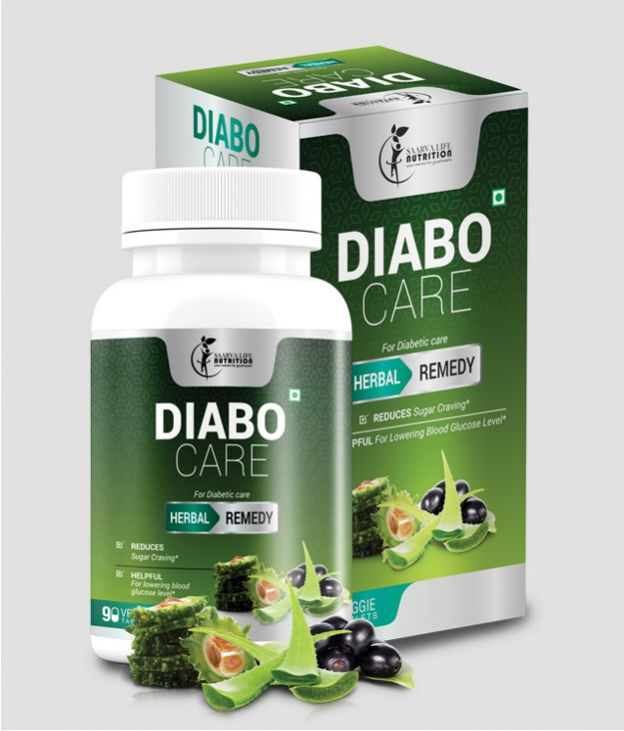
DIABO CARE
DIABO CARE – For Diabetic Patients
DESCRIPTION
Saarvasri Herbs introduces Diabo Care Tablets, a wonderful product for diabetic patients. Diabo Care Tablets is very helpful for lowering blood sugar level, increasing the secretion of Insulin and activating the beta cells.
HEALTH BENEFITS
Helpful for lowering blood glucose level
Detoxifies the Pancreas and activates the beta-cells
Increasing the secretion rate of Insulin
Karela provides polypeptide-p or p-insulin which helps to activate our body insulin
Reduces sugar craving
Reduces the symptoms of Diabetes like frequent thirst and urination
Maintains general body health
Reduces weakness
Block receptors at intestine to reduce Glucose Absorptions
Product Details
KEY INGREDIENTS
HOW TO USE
Product Name : Diabo Care
Product type : Tablet
Pack Size : 90 Tab
MRP : Rs. 1250/-
Neem, Karela, Jamun, Aloevera, Vijaysar, Gurmar, Chiraita, Methi, Triphala
1-2 tablets two times daily or as directed by experts

Slide 43
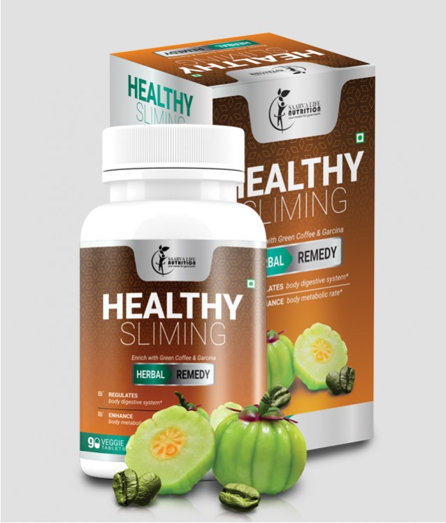
HEALTHY SLIMING
HEALTHY SLIMING – Loose Weight Naturally
DESCRIPTION
Saarvasri Herbs Healthy Slimming Tablet is completely herbs based product which can effectively & naturally remove fat especially from the belly, Ankles and Arms. Thus help you to get in good shape in merely few days of use and in a natural way. It has similar results on men & women. Specially this product is designed to enhance the body metabolic rate to optimum level so that body can break down the extra fats and reduces the further fat deposition in the body.
HEALTH BENEFITS
Enhance body metabolic rate
Regulates body digestive system
Helps in reducing the unnecessary fat deposition
Aids in Fat burning from Ankles, Arms and Belly
Help you to get in shape
Maintains the energy level throughout day
Naturally detoxifying the body
Product Details
KEY INGREDIENTS
HOW TO USE
Product Name : Healthy Sliming
Product type : Tablets
Pack Size : 90 Tab
MRP : Rs. 1250/-
Garcinia Combogia, Green Coffee Bean, Green Tea Leaf, Caffeine
1-2 tablets two times daily or as directed by experts

Slide 44
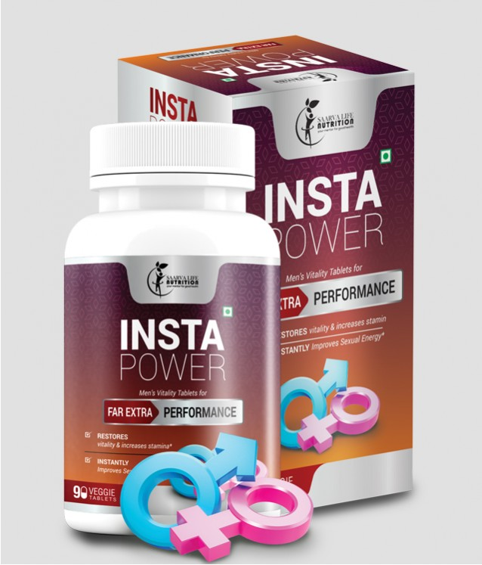
INSTA POWER
INSTA POWER – For Extra Performance
DESCRIPTION
Saarvasri Herbs Insta Power Tablet is a premium natural formulation for general sexual health enhancement for men. It is formulated and designed to enhance sexual performance without unwanted side effects of prescription drugs. Also it provides daily endurance, vitality and energy.
HEALTH BENEFITS
It instantly improves sexual energy, fights against sexual debility & sexual weakness.
It restores vitality and increases the stamina.
This product increases natural excitement, response to stimulation and give fantastic staying Energy and stamina for extended sexual performance.
It also significantly increases sex drive!
Product Details
KEY INGREDIENTS
HOW TO USE
Product Name : Insta Power
Product type : Tablets
Pack Size : 90 Tab
MRP : Rs. 1250/-
Ashwagandha, Safed Musli, Satawari, Kaunch Beej, Vidarikhand, Akarkara, Jaiphal, Salimpanja, Swarna Bhasma.
1-2 tablets two times daily or as directed by experts.

Slide 45
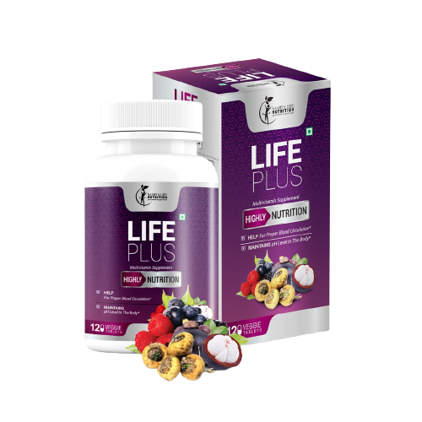
LIFE PLUS
LIFE PLUS – For Healthy Life
DESCRIPTION
Saarvasri Herbs Life Plus Tablets are made with 100% natural ingredients to boost your immunity power as well as to boost your daily energy level to live healthily. It has many health benefits. With other ingredients, this product is enriched with Mangosteen which is a miraculous fruit with lots of health benefits. In one sentence, Saarvasri Life Plus is your daily need.
HEALTH BENEFITS
Can neutralize the damaging effects of free radicals.
May reduce risk of inflammatory diseases, such as cancer, heart disease, and diabetes.
Boosts metabolism and burns excessive fats, thus it helps to lose over weight.
May help maintain healthy blood sugar levels.
Boosts Immunity Power naturally.
Maintains daily energy level.
Protection against ultraviolet-B (UVB) radiation in the skin.
Reduces heart disease
May reduce LDL (bad) cholesterol and triglycerides while increasing HDL (good) cholesterol.
Helps prevent mental decline, decrease brain inflammation, and improve symptoms of depression.
Helps to promote bowel regularity.
Effective to maintain healthy hair and skin.
Helpful to treat nerve problems, such as, Parkinson, Alzheimer.
Maintains healthy pH level in the body.
Help for proper blood circulation in the body.
Product Details
KEY INGREDIENTS
HOW TO USE
Product Name : Life Plus
Product type : Tablets
Pack Size : 120 Tab
MRP : Rs. 1,500/-
Mangosteen, Ashwagandha, Maca Root, Elderberry, Black Current, Ginseng, Sour Cherry, Ganoderma, Shigru, Curcumin, Alfa Alfa.
1-2 tablets two times daily or as directed by experts.

Slide 46
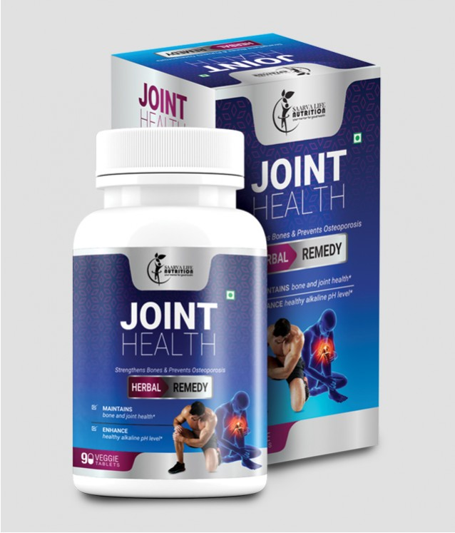
JOINT HEALTH – For Healthy Joints
JOINT HEALTH
DESCRIPTION
Saarvasri Joint Health Tablet is used to prevent or treat low blood calcium levels in people who do not get enough calcium from their diets. Calcium plays a very important role in the body. It is necessary for normal functioning of nerves, cells, muscle, and bone. If there is not enough calcium in the blood, then the body will take calcium from bones, thereby weakening bones. Glucosamine helps to maintain healthy joints and synovial fluid between bone joints.
HEALTH BENEFITS
Strengthens bones and prevents Osteoporosis
Maintains bone and joint health
Maintains healthy synovial fluid level between joints
Ensures healthy alkaline pH level
Helps to maintain optimal body weight
Product Details
KEY INGREDIENTS
HOW TO USE
Product Name : Joint Health
Product type : Tablets
Pack Size : 90 Tab
MRP : Rs. 1250/-
Calcium Carbonate, Glucosamine, Magnesium Oxide.
1-2 tablets two times daily or as directed by experts

Slide 47
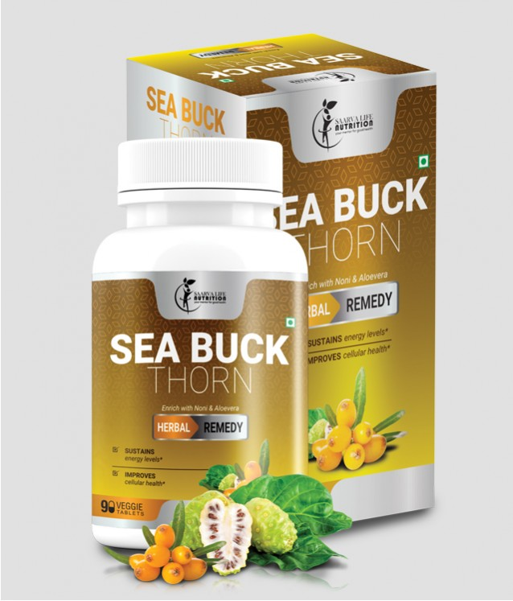
SEA BUCKTHORN
SEA BUCKTHORN – Miraculous Herbal Remedy
DESCRIPTION
Saarvasri Herbs Sea Buckthorn Tablet is made with mainly Sea Buckthorn which is a wonderful berry with 1300 years of traditional uses. With over 190 bioactive compounds, sea berry (sea buckthorn) is an unsurpassed source of Omega 3, 6, and 9. And it is the world's richest source of the elusive essential fatty acid, omega-7, a fatty acid vital to collagen production and healthy skin, hair and nails. It is enriched with Noni and Aloevera, which make this product more effective.
HEALTH BENEFITS
Sustains energy levels.
Improves cellular health.
Beneficial for Cardiovascular support.
Relieves pain & inflammation.
Supports Joint health.
Lowers bad cholesterol level.
Moisturizes dry and damaged skin.
Improves immune health.
Decreases wrinkles and fine lines.
Reduces the symptoms of eczema.
Product Details
KEY INGREDIENTS
HOW TO USE
Product Name : Sea Buckthorn
Product type : Tablets
Pack Size : 90 Tab
MRP : Rs. 1250/-
Sea Buckthorn, Noni, Aloevera.
1-2 tablets two times daily or as directed by experts.

Slide 48
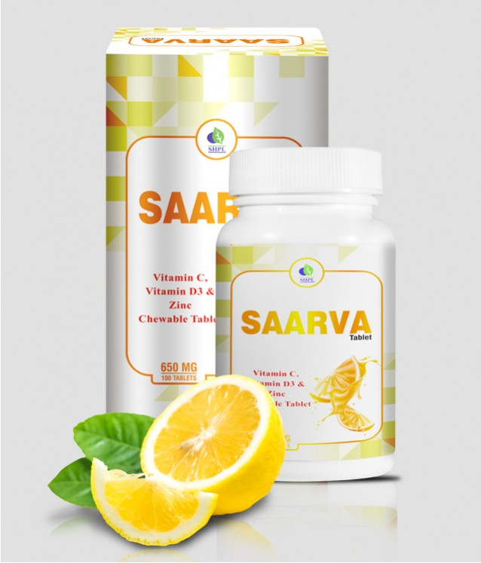
SAARVA TABLETS
SAARVA TABLET – Goodness of Vit C, Vit D3 & Zinc
DESCRIPTION
Vitamin C is a water-soluble vitamin known as L-Ascorbic Acid, essential nutrient for various metabolism in our body. Vitamin C plays an important role in many physiological processes, It is needed for the repair of tissues in all parts of the body, formation of protein used to make skin, tendons, ligaments, and blood vessels, repairing and maintaining cartilage, bones, and teeth and aid in the absorption of iron. One of the important properties of vitamin C is its antioxidant activity.
HEALTH BENEFITS
Helps Collagen Production.
Enhances the immune system.
It protects us from cough and cold.
Controls atherosclerosis.
Protects cardiovascular disease.
Regulates Hypertension.
Combats Cataracts.
Controls allergy by enhancing T-cell proliferation.
Maintains Healthy Gums.
Prevents scurvy.
Enhances Hair Growth and prevents split ends of hair.
Helps Prevent Cancer.
Combats Alzheimer’s and Parkinson’s disease.
Autoimmune Disorders.
Depression.
Prevent Breast Cancer.
Avoiding Polycystic Ovarian Syndrome (PCOS).
Prevents Rickets and Osteomalacia and Osteoporosis.
Helps Psychiatric and neurological diseases.
Helpful in schizophrenia.
Decreases risk of multiple sclerosis.
Benefit in thyroid dysfunction.
Reduces Severity of Asthma.
Negative Effect on Sarcoidosis.
Systemic Lupus Erythematosus.
Helps in protein synthesis.
Prevents Prostate Disorder.
Improves Cognitive Function.
Boosts Reproductive Health.
Increases Fertility.
Improves nyctalopia.
Helps to regulate the cell production and Cell Growth.
Product Details
KEY INGREDIENTS
HOW TO USE
Product Name : Saarva Tablets
Product type : Tablets
Pack Size : 90 Tab
MRP : Rs. 1250/-
Vitamin c, Vitamin D3 (cholecalciferol), zinc
1-2 tablets two times daily or as directed by experts

Slide 49
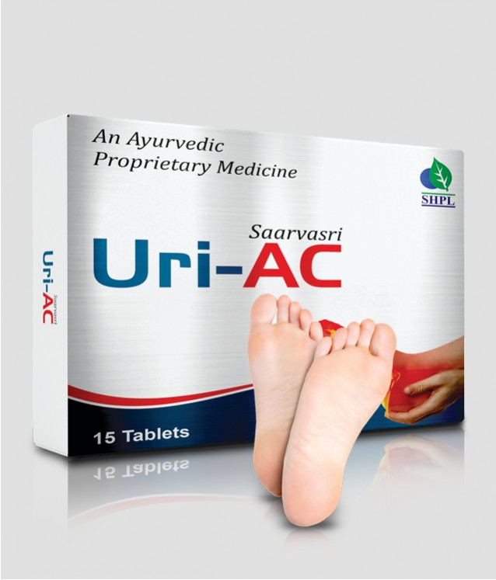
URI-AC
SAARVASRI URI-AC TABLETS – Relieves Uric Acid
DESCRIPTION
Saarvasri Herbs Uri-AC Capsules are known to control the Uric Acid formation in the body and prevent from increased uric acid level complications. It is a blend of many wonderful herbs to control excessive uric acid formation in the body.
HEALTH BENEFITS
Lessen uric acidity
Has an Anti-inflammatory
Increase cleansing of uric acid
Detoxify purines
Stimulate calcium carbonate and neutralizes the acids in the body
Stabilize uric acid levels
Prevent the formation of uric acid crystals
Help to keep the urine diluted
Prevent damage caused by free radicals
Product Details
KEY INGREDIENTS
HOW TO USE
Product Name : Uri-AC
Product type : Tablets
Pack Size : 15 Tab
MRP : Rs. 200/-
Tart Cherry, Bromelain from Pineapple, Curcuma Longa, Celery Seed.
1-2 tablet two times daily or as directed by experts

Slide 50
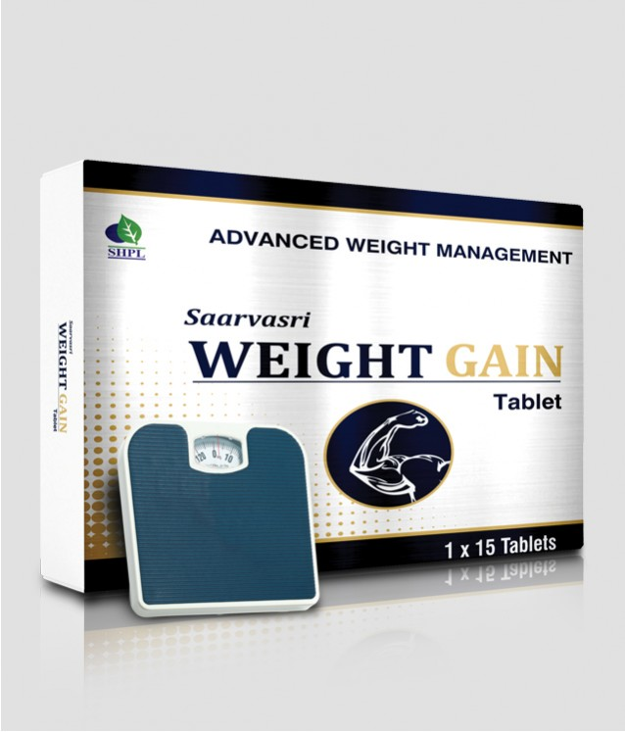
WEIGHT GAIN
SAARVASRI WEIGHT GAIN TABLETS – Get into Shape
DESCRIPTION
Saarvasri Herbs Weight Gain Tablets are made of some wonderful 100% natural herbs to gain your expected body weight naturally. It helps to increase your appetite level and metabolism. It is a complete solution to maintain the body weight naturally.
HEALTH BENEFITS
Helps to gain our body weight naturally.
Increases our healthy appetite level.
Increases our body metabolism.
Helps to control digestive problems.
Maintains healthy liver function.
Controls healthy pH balance in the body.
Product Details
KEY INGREDIENTS
HOW TO USE
Product Name : Weight Gain
Product type : Tablets
Pack Size : 15 Tab
MRP : Rs. 200/-
Amla, Ajwain, Kalmegh, Ashwagandha, Punarnava, Bhuiamla, Himsra, Spirulina, Taraxacum Alfalfa, Milk Thistle.
1-2 tablet two times daily or as directed by experts

Slide 51
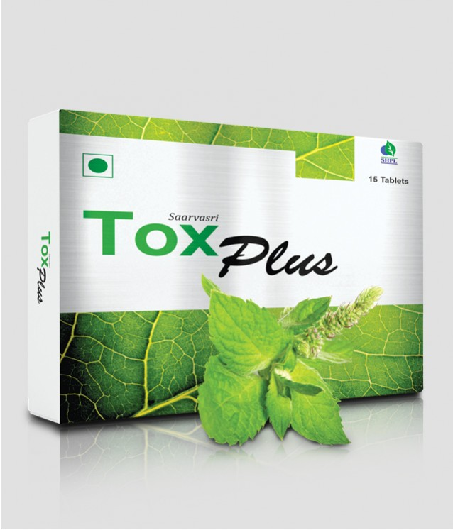
TOX PLUS
SAARVASRI TOX PLUS – Detox Yourself
DESCRIPTION
Saarvasri Herbs Tox Plus Tablet is the herbal formulation that may help to cleanse or detoxify the body by eliminating the free radicals. We all know that in today’s life we all consume lots of toxins through our foods and by our unhealthy lifestyle. Our lifestyle disorder is the main cause of all diseases. Because of this, so many toxins are deposited in our body. So it is important to clean or detoxify our body regularly. Tox Plus can make this detoxifying process more easier.
HEALTH BENEFITS
By detoxifying your body you help the vital organs cleanse themselves of the toxins
Enable the liver to function appropriately in excreting them.
Help in weight loss.
Improves digestion.
Improves liver function.
Reduces inflammation.
Improves skin.
Boosts energy
Product Details
KEY INGREDIENTS
HOW TO USE
Product Name : Tox Plus
Product type : Tablets
Pack Size : 15 tab
MRP : Rs. 200/-
Fenugreek Fibers, Neem Leaf, Picrorhiza Kurroa, Lactobacillus Sporogenes, Pepperment Oil
1-2 tablet two times daily or as directed by experts.

Slide 52
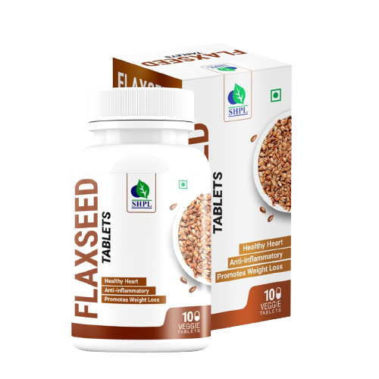
TOX PLUS
SAARVASRI FLAXSEED TABLETS
DESCRIPTION
Saarvasri Herbs introduces Flax Seed Tablets which are made from Flax Seeds, a rich source of healthy fat, antioxidants, and fiber. According to the United States Department of Agriculture (USDA), the seeds contain protein, lignans, and the essential fatty acid alpha-linolenic acid, also known as ALA or omega-3. Flaxseeds have been consumed for at least 6,000 years, making them one of the world’s first cultivated super food.
HEALTH BENEFITS
It lowers the bad cholesterol and protects the heart
Controls diabetes
Very helpful for arthritis and joint pain
It is very effective for improper digestion and constipation
Prevents cancer
Maintains skin and hair health
Helps to loose weight
Very effective for brain and neural health
Detoxifies our body
Reduces weakness and depression
Product Details
KEY INGREDIENTS
HOW TO USE
Product Name : Flaxseed
Product type : Tablets
Pack Size : 100 tab
MRP : Rs. 750/-
Flaxseed Extract
1-2 tablet two times daily or as directed by experts.

Slide 53
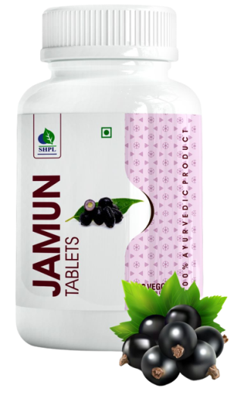

Slide 54
TRADITIONAL AYURVEDA - Single Herb Product
AMLA TABLET
ASHWAGANDHA TABLET
BRAHMI TABLET
Pack Size: 60 Tablets
MRP: Rs. 350/-
Pack Size: 60 Tablets
MRP: Rs. 350/-
Pack Size: 60 Tablets
MRP: Rs. 350/-
How to Use
Take 1 tablet twice daily, 30 mins before meal or as directed by experts
How to Use
Take 1 tablet twice daily, 15-30 mins after meal or as directed by experts
How to Use
Take 1 tablet twice daily, 30 mins before meal or as directed by experts
Boosts immunity
Reduces Hyperglycemia
Has lipid-lowering properties
Powerful anti-oxidant
Supports respiratory system
Strengthens the nervous system
Improves eyesight
Improves digestion and bowel movements
Boosts immunity
Reduces Hyperglycemia
Has lipid-lowering properties
Powerful anti-oxidant
Supports respiratory system
Strengthens the nervous system
Improves eyesight
Improves digestion and bowel movements
Helps relieve anxiety.
Enhance brain functions
Improves memory
Helps prevent Alzheimer’s Disease.
Helps manage depression.
Contains powerful antioxidants.
Anti-inflammatory properties.
Helps reduce ADHD symptoms.
Helps lower blood pressure levels

Slide 55
TRADITIONAL AYURVEDA - Single Herb Product
GILOY TABLET
GINSENG TABLET
JAMUN TABLET
Pack Size: 60 Tablets
MRP: Rs. 350/-
Pack Size: 60 Tablets
MRP: Rs. 350/-
Pack Size: 60 Tablets
MRP: Rs. 350/-
How to Use
Take 1 tablet twice daily, 15-30 mins after meal or as directed by experts
How to Use
Take 1 tablet twice daily, 30 mins before or as directed by experts
How to Use
Take 1 tablet twice daily, 15-30 mins after meal or as directed by experts
An excellent immune booster
Has a calming effect on the body
A powerful anti-oxidant
Helps lowering blood sugar and cholesterol.
Protects the liver, heart, nervous system
Helps relieve pain
Anti-pyretic (reduces fever)
Helps improve brain functions like memory, behavior and mood
Helps improve Erectile Dysfunction
Boosts immunity by improving immune markers
Prevents Cancer Reduces side effects of Chemotherapy
Natural Hypoglycaemic
Reduces triglycerides and LDL
Improves hemoglobin count.
Helps in obesity management and metabolic syndrome.
Helps maintain bone health, prevents diarrhea, and excessive urination.

Slide 56
TRADITIONAL AYURVEDA - Single Herb Product
KARELA TABLET
NEEM TABLET
PUNARNAVA TABLET
Pack Size: 60 Tablets
MRP: Rs. 350/-
Pack Size: 60 Tablets
MRP: Rs. 350/-
Pack Size: 60 Tablets
MRP: Rs. 350/-
How to Use
Take 1 tablet twice daily, 15-30 mins after meal or as directed by experts
How to Use
Take 1 tablet twice daily, 15-30 mins after meal or as directed by experts
How to Use
Take 1 tablet twice daily, 30 mins before meal or as directed by experts
Helps lower blood sugar levels
Helps to bring glucose into the cells
Improves sugar metabolism.
Anti-oxidant
Improves vision.
Promotes skin health.
Helps in metabolic syndrome.
Natural blood purifier
Effective in treating skin infections
Anti-inflammatory properties
Antioxidant, antimicrobial, antiparasitic, antidiabetic
Helps fight oxidative stress
Helps fight liver disease
Promotes healthy skin
Helps lower blood sugar levels
Prevents skin disease
Increases urine flow
Subsides the burning sensation during urination.
Revitalizes and detoxifies the liver.
Shodhan (purification) & Deepan (appetizer) properties.
Reduces excess urea and creatinine
Prevents obesity
Protects the heart and lungs.

Slide 57
TRADITIONAL AYURVEDA - Single Herb Product
SHALLAKI TABLET
SHATAVARI TABLET
SHILAJIT TABLET
Pack Size: 60 Tablets
MRP: Rs. 350/-
Pack Size: 60 Tablets
MRP: Rs. 350/-
Pack Size: 60 Tablets
MRP: Rs. 350/-
How to Use
Take 1 tablet twice daily, 15-30 mins after meal or as directed by experts
How to Use
Take 1 tablet twice daily, 15-30 mins after meal or as directed by experts
How to Use
Take 1 tablet twice daily (preferably with lukewarm milk) after meal or as directed by experts
Helps in managing Rheumatoid Arthritis and Osteoarthritis
Reduces the pain and inflammation in the joints.
Reduces the risk of heart disease.
May help inhibit cancer growth.
Effective in treating IBD- Crohn’s disease and Ulcerative Colitis.
Supports reproductive health (fertility) and improves hormonal balance and energy levels in women
Reduces menopausal symptoms
Improves sexual potency
Helps rejuvenate and nourishes both body and mind
Improves vitality.
It contains fulvic acid and more than 84 minerals
Improves body's immunity and memory.
An energy booster.
Helps sustain penile erection
Effective in treating male infertility by increasing total sperm count and motility.

Slide 58
TRADITIONAL AYURVEDA - Single Herb Product
TRIPHALA TABLET
TULSI TABLET
YASTIMADHU TABLET
Pack Size: 60 Tablets
MRP: Rs. 350/-
Pack Size: 60 Tablets
MRP: Rs. 350/-
Pack Size: 60 Tablets
MRP: Rs. 350/-
How to Use
Take 1 tablet twice daily, 30 mins before meal or as directed by experts
How to Use
Take 1 tablet twice daily, 30 mins before meal or as directed by experts
How to Use
Take 1 tablet twice daily, 30 mins before meal or as directed by experts
Supports digestive health
Prevents constipation
Controls uric acid
Regulates blood sugar levels
Helps in weight loss
Anti-inflammatory
Helps prevent cancer
Improves liver function
Protects the heart
Immune booster, anti-bacterial and anti-viral.
Helps eradicate cold, cough, sore throat, running nose.
Helps reduce acidity, constipation and stomach ache.
Reduces fever.
Benefits the respiratory system by clearing congestion.
Has anti-microbial and anti-viral properties.
Supports healthy respiratory system.
Helps treat heartburn, GERD, peptic ulcers and gastritis
Helps in dry and wet cough
Reduces inflammation in the bronchial tubes.

Slide 60
SEA BUCKTHORN
PREMIUM ALOEVERA WITH ASHWAGANDHA JUICE
DESCRIPTION
Aloe Vera contains many vitamins including A, C, E, folic acid, B1, B2, B3 (niacin), B6. Aloe Vera is also one of the few plants that contains vitamin B12. Minerals found in Aloevera include: calcium, magnesium, zinc, chromium, selenium, sodium, iron, potassium, copper, manganese. It is also rich in Ashwagandha, a miraculous plant found in nature.
HEALTH BENEFITS
Improves your digestive system and helps to prevent constipation
Heals wounds fast
Promotes healthy skin and hair
Enhances proper functioning in the body
Super anti-oxidant properties and detoxifies the body
Helpful for painful menstrual problems
Supports eye, bone and neural health
Beneficial for our neural health
Solve our sexual problems
Product Details
KEY INGREDIENTS
HOW TO USE
Product Name : Aloevera With Ashwagandha
Product type : Juice
Pack Size : 1 ltr
MRP : Rs. 600/-
Aloevera extract, Ashwagandha extract
Take 15 ml. twice daily mix with half glass of water or as directed by experts.

Slide 61
SEA BUCKTHORN
AMLA JUICE
DESCRIPTION
Amla or Indian Gooseberry is a small and highly nutritious fruit and has many health benefits. Amla is low in calories and fat but packed with nutrients. It contains Vitamin C, B5, B6, E; Minerals like Copper, Magnesium and Potassium; Fiber, Antioxidants, Phyto-nutrients like Flavonoids, Anthocyanins, Aromatic Acids, Organic Acids.
HEALTH BENEFITS
Very good for our skin and hair health
Delays ageing process
Maintains our heart health and reduces bad cholesterol level
Can improve our digestive system
Helps to reduce excessive body fat and loose weight
Detoxifies our inner body toxins
Can boost our immunity power
Has an effective anti-cancerous effect
Protects from flu, fever and cold
Maintains healthy joints
Product Details
KEY INGREDIENTS
HOW TO USE
Product Name : Amla Juice
Product type : Juice
Pack Size : 650 ml
MRP : Rs. 650/-
Amla Extract
Take 15 ml. twice daily mix with half glass of water or as directed by experts.

Slide 62
SEA BUCKTHORN
CHLOROPHYLL JUICE
DESCRIPTION
Chlorophyll plays an important role in making plants green and healthy. It also has vitamins, antioxidants, and therapeutic properties that may benefit your body. You can get chlorophyll from plants or supplements. Saarvasri Herbs Chlorophyll Juice Is an wonderful product for our optimal health.
HEALTH BENEFITS
Stimulating the immune system.
Eliminating fungus in the body.
Detoxifying your blood.
Cleaning your intestines.
Getting rid of bad odors.
Energizing the body.
Preventing cancer.
Maintaining pH level in the body.
Product Details
KEY INGREDIENTS
HOW TO USE
Product Name : Chlorophyll Juice
Product type : Juice
Pack Size : 650 ml
MRP : Rs. 750/-
Chlorophyllins derived from natural plant source
Take 15 ml. twice daily mix with half glass of water or as directed by experts.

Slide 63
SEA BUCKTHORN
DIABO CARE JUICE
DESCRIPTION
Saarvasri Herbs introduces Diabo Care Juice which is very helpful for lowering blood sugar level, increasing the secretion of Insulin and activating the beta cells. They are enriched with some wonderful natural herbs like Neem, Jamun, Karela, Methi, Vijaysar, Chirata, Triphala etc.
HEALTH BENEFITS
Helpful for lowering blood glucose level.
Detoxifies the Pancreas and activates the beta-cells.
Increasing the secretion rate of Insulin.
Karela provides polypeptide-p or p-insulin which helps to activate our body insulin.
Reduces sugar craving.
Reduces the symptoms of Diabetes like frequent thirst and urination.
Maintains general body health.
Reduces weakness.
Product Details
KEY INGREDIENTS
HOW TO USE
Product Name : Diabo Care Juice
Product type : Juice
Pack Size : 650 ml
MRP : Rs. 650/-
Neem, Karela, Jamun, Ghritakumari, Vijaysar, Gurmar, Chiraita, Methi, Triphala
Take 15 ml. twice daily mix with half glass of water or as directed by experts

Slide 64
SEA BUCKTHORN
GILOY JUICE
DESCRIPTION
Tinospora cordifolia commonly named as “Giloy” is known for its immense application in the treatment of various diseases in the traditional ayurvedic literature. In Sanskrit, Giloy is known as ‘Amrita'. Giloy Juice is packed with some wonderful nutrients and has some effective health benefits.
HEALTH BENEFITS
Boosts Immunity
Treats Chronic Fever
Improves Digestion
Treats Diabetes
Reduces Stress and Anxiety
Fights Respiratory Problems
Treats Arthritis
Reduces Asthmatic Symptoms
Improves Vision
Reduces Signs Of Aging
Product Details
KEY INGREDIENTS
HOW TO USE
Product Name : Giloy Juice
Product type : Juice
Pack Size : 650 ml
MRP : Rs. 650/-
Giloy Extract
Take 15 ml. twice daily mix with half glass of water or as directed by experts.

Slide 65
SEA BUCKTHORN
KARELA JAMUN JUICE
DESCRIPTION
Considering the nutritional components both in Karela and Jamun, they are widely used in Ayurveda. Karela (Bitter Gourd) is known for its many benefits such as achieving a glowing skin & is considered as plant insulin because of its ability to regulate blood sugar. Jamun (Indian Berry) on the other hand, has the ability to boost the healing process and it helps to control multiple diseases such as diabetes.
HEALTH BENEFITS
Helps in high blood sugar.
Stimulates liver to secrete digestive enzymes.
Works as an appetizer.
Helps remove intestinal tract worms.
Purifies blood and fights infections.
Very effective in skin diseases.
Helps to reduce acne and pimples on face.
Helps in oedema.
Boosts your immune system.
Helps in weight loss.
Product Details
KEY INGREDIENTS
HOW TO USE
Product Name : Karela Jamun Juice
Product type : Juice
Pack Size : 650 ml
MRP : Rs. 650/-
Karela Extract, Jamun Extract
Take 15 ml. twice daily mix with half glass of water or as directed by experts

Slide 66
SEA BUCKTHORN
NONI JUICE
DESCRIPTION
Noni fruit containing a mixture of anthraquinones, xeronine, organic acids, vitamins, minerals, nutritional enzymes and polysaccharides. This has rich anti oxidant properties so this product protects from toxins & pollutants. This contains anti inflammatory, astringent properties for the patient of stomach problems. Analysis has shown that it is rich in elements basic to humans, like: dietary Fiber, Proteins, Carbohydrates, Iron, Vitamins (A, C, B1 and B2), Calcium, Sodium and Potassium along with many isolated nutrients.
HEALTH BENEFITS
Detoxifies our body and regulates Protein in the body.
It is an effective antioxidant,it has anti-inflammatory, anti microbial and anti carcinogenic properties.
Regulates proper cell functioning and rejuvenates the cells of the body and Boosts Immune system.
Improves metabolic system.
Reduces the risk of cancer.
Relieves pain as an analgesic.
Manages body weight.
Facilitates sound sleep.
Purifies blood and controls Diabetes.
Improves arthritis ,asthma as well as respiratory and digestive problems.
Improves circulatory system and Stabilizes Blood Pressure.
Maintains healthy skin, hair and scalp.
Product Details
KEY INGREDIENTS
HOW TO USE
Product Name : Noni Juice
Product type : Juice
Pack Size : 650 ml
MRP : Rs. 650/-
Noni Extract
Take 15 ml. twice daily mix with half glass of water or as directed by experts

Slide 67
SEA BUCKTHORN
SUPER KIDS ENERGY DRINK
DESCRIPTION
Saarvasri Herbs Super Kids Energy Drink is a health drink for children to protect themselves from mal-nutrition and act on them like a growth promoter. So many natural nutritional herbs make it so effective that it can give a child his/her optimal health.
HEALTH BENEFITS
Boosts Immunity power.
Promotes normal growth.
Improves body cells and tissues.
Promotes healthy liver and digestive system.
Promotes healthy skin and hair.
Maintains energy and vitality.
Protects from cough, cold and flu.
Promotes healthy bones.
Product Details
KEY INGREDIENTS
HOW TO USE
Product Name : Super Kids Energy Drink
Product type : Juice
Pack Size : 500 ml
MRP : Rs. 500/-
Kesar, Elaichi, Ark Kewra, Ark Gulab, Giloy, Punarnava, Aloe Vera, Sarkara, Tulsi, Silver Leaves, Ashwagandha, Nagarmotha.
Mix 20 ml in 200 ml of water/milk and take after breakfast or as per Expert’s advice.

Slide 68
SEA BUCKTHORN
SAARVA SLIM CARE JUICE
DESCRIPTION
The active ingredient in Saarva slim & care (juice) Hydroxycitric acid (HCA), blocks an enzyme called citrate lyase, which your body uses to make fat. It also raises levels of the brain chemical serotonin, which may make you feel less hungry.
HEALTH BENEFITS
Lower high levels of fat in your blood.
Reducing the accumulation of belly fat in people who are overweight.
Potential to help with weight loss.
Boost fat metabolism,
Lower cholesterol and triglyceride levels,
Improve obesity-related hormone levels.
Decrease fat absorbed from the diet.
Saarva slim & care (juice) acts as a fuel to make the liver produce glucose which keeps the brain sugar levels high and forces it to release fat burning hormones.
Honey is also known to have the power of suppressing the appetite.
Product Details
KEY INGREDIENTS
HOW TO USE
Product Name : Saarva Slim Care Juice
Product type : Juice
Pack Size : 650 ml
MRP : Rs. 750/-
Garcinia Combogia, Green Coffee, Honey
Take 15 ml. twice daily mix with half glass of water or as directed by experts

Slide 69
SEA BUCKTHORN
HEALTH AMRIT JUICE
DESCRIPTION
HEALTH AMRIT is a health solution made from a specially selected assortment of herbs. 18 omnipotent herbs in it provides sustainable & continued energy those are improve digestibility, boost the immune system, tune-up muscle, nerve health and etc.
HEALTH BENEFITS
Effective in the enhancement of immune system
Protects cardiovascular disease
Enhancing visual performance.
Works against nephrosis of the kidney.
Protects against mental decline.
Have cancer-fighting properties.
Boosts absorption of nutrients.
Has hepato-protective actions.
Improves the function of brain.
Inflammatory bowel disease.
Sexual performance and fertility.
Improve Memory
Relieves menopausal symptoms
Product Details
KEY INGREDIENTS
HOW TO USE
Product Name : Health Amrit Juice
Product type : Juice
Pack Size : 500 ml
MRP : Rs. 500/-
Saak, Kali Mirch, Shilajit, Kalonji, Noni, Adrak, Kokum, Ghritkumari, Amla, Anar, Draksha, Chai Patra, Tulsi, Ashwagandha, Tarbuz, Palak, Gajar.
Take 15 ml. twice daily mix with half glass of water or as directed by experts

Slide 70
SEA BUCKTHORN
TRIPHALA JUICE
DESCRIPTION
Triphala has been used in traditional Ayurvedic medicine since ancient times more than 1000 years, as a multi-purpose treatment. Triphala is one of the most popular and widely used Ayurvedic formulations, contains fruits of three Amalaki, Vibhitaka, and Haritaki. Saarbasri herbs Triphala juice a combination of synergistic polyherbal medicinal herbs which provides extra therapeutic effectiveness and provides more powerful treatment than any one component taken alone. Triphala is a constituent of about 1500 Ayurveda formulations and the drug of choice for several ailments.
HEALTH BENEFITS
Immunity Booster
An efficient digestive
Blood Pressure Regulator
Managing Arthritis and Gout
Aid for Diabetes
Antioxidant Agent
Upkeep of Oral Health
A Stimulant for Hair
Skin Protectant
Stress and Anxiety
Product Details
KEY INGREDIENTS
HOW TO USE
Product Name : Triphala Juice
Product type : Juice
Pack Size : 650 ml
MRP : Rs. 650/-
Amla (Gooseberry), Bahera ( Terminala Bellirica ),Harad (Terminalia Chebula)
Take 15 ml. twice daily mix with half glass of water or as directed by experts

Slide 71
SEA BUCKTHORN
WHEAT GRASS JUICE
DESCRIPTION
High in Nutrients and Antioxidants, Saarvasri Herbs Wheat Grass Juice is an excellent source of many different vitamins and minerals. Wheatgrass is the fresh sprouted leaves of the wheat plant. Wheatgrass is a source of potassium, dietary fiber, vitamin A, vitamin C, vitamin E, vitamin K, thiamin, riboflavin, niacin, vitamin B6, iron, zinc, copper, manganese, and selenium. Wheatgrass is also a good source of essential Amino Acids.
HEALTH BENEFITS
Aids in weight loss
Helps with digestion
Improves cognitive function
May increase platelet count
Prevents anemia
Helps in cancer treatment
Immunity booster
May Reduce Cholesterol
May Aid in Blood Sugar Regulation
May Alleviate Inflammation
Shown to have the ability to fight tumors
Product Details
KEY INGREDIENTS
HOW TO USE
Product Name : wheat Grass Juice
Product type : Juice
Pack Size : 650 ml
MRP : Rs. 650/-
Wheat Grass, Amla, Giloy
Take 15 ml. twice daily mix with half glass of water or as directed by experts

Slide 72
SEA BUCKTHORN
SAARVA BOOST JUICE
DESCRIPTION
From prehistoric times, sexuality has been considered as a cornerstone for quality life, and man has always been on a quest for a remedy that can enhance sexual functions. Sexual function is a product of mind and body. There’s no amount of sex that’s considered “normal”. Everyone has different Sex. Sex depends on how strong your sex drive (your desire to have sex) is. Every People have different sex drive. Sex drive can be change based on things like stress, medications you take, sexual attraction, sexual behaviors, unhealthy relationship, other physical, emotional, day to day lifestyle, suffering diseases, etc. Saarvasri Herbs Pvt. Ltd. Introduced SAARVA BOOST for experiencing satisfaction towards sexual activity.
HEALTH BENEFITS
Early or premature ejaculation
Inability to achieve orgasm
Inadequate vaginal lubrication before and during intercourse
Dyspareunia (Pain during sexual intercourse)
Loss of Libido
Erectile Dysfunction
Increases sperm count
Improves sperm quality
Enhancing the contractile tone of penis
increase the blood flow to the genitals
Product Details
KEY INGREDIENTS
HOW TO USE
Product Name : Saarva Boost
Product type : Juice
Pack Size : 1 ltr
MRP : Rs. 1500/-
Sudh Shilajeet, Ginseng, Kesar, Ashwagandha, Safed Musli, Gokhru, Satavari, Kounch Beej, Jaiphal, Ginger, Akarkara, Lawang, Dal Chini , Gond Pater, Triphala, Aloeavera Ras
Take 15 ml. twice daily mix with half glass of water or as directed by experts.

Slide 73
SEA BUCKTHORN
FLAX OMEGA JUICE
DESCRIPTION
Saarvasri Herbs Pvt. Ltd, introduce a unique product “Flax Omega Juice” are the golden yellow to reddish brown seeds of flax. Flaxseed has been eaten as a food or used as a medicine since 5000 BC. It contents omega 3, Omega 6, Omega 9 along with phytoestrogens, p- coumaric acid, fiber, protein 6g, vitamin B1 (thiamine ), manganese, potassium, selenium, molybdenum, vitamin b6, iron, potassium, copper, zinc, omega-3, ferulic acid, phytosterols.
HEALTH BENEFITS
Antibacterial activity
Safe and effective anxiolytic
Keeps cholesterol down
Helps to maintain a healthy weight
Stabilizes blood sugar levels
Normalizes bowel movements
Increased Vitamin and mineral absorption
Helps to reduce the risk of kidney stones
Reduces risk of diverticulitis
Irritable bowel syndrome (IBS)
Improved muscular health
Stronger immune system
Improved nervous system
Product Details
KEY INGREDIENTS
HOW TO USE
Product Name : Flax Omega
Product type : Juice
Pack Size : 850 ml
MRP : Rs. 750/-
Flax Seed Extract
Take 15 ml. twice daily mix with half glass of water or as directed by experts

Slide 74
SEA BUCKTHORN
STONE CLEAR JUICE
DESCRIPTION
Saarvasri Herbs Stone Clear is a natural formula to breakdown and clear renal stones. It is rich in many natural herbs that made this product so effective. Stone Clear has been launched for kidney health. This is known to possess multiple benefits such as managing Uro-genital diseases such as Kidney stone, bladder infection and other Urinary Tract infections. Stone Clear is also a diuretic that flushes out small stones from the kidneys.
HEALTH BENEFITS
It is beneficial for renal calculi.
It is very effective for urinary tract infection.
Effective for renal colic urethritis, cystitis, recurrent calculi.
It breaks down renal stones and flushes out gravel.
Prevents Burning Micturation.
Product Details
KEY INGREDIENTS
HOW TO USE
Product Name : Stone Clear
Product type : Syrup
Pack Size : 200 ml
MRP : 200/-
Gokshru Beej, Palash Pushpa, Lajaloo Mool, Suddh Shilajit, Swait Parpati, Moolishar, Sheetal Chini Root, Sandhav Namak, Sajjkhar, Punarnava Root, Panchtrin Mool, Ikshu Mool, Makoi Panchang, Kakri Beej, Daru Haridra, Pashan Bhed Fruit.
Take 10 ml-15 ml. twice daily or as directed by experts.

Slide 75
SEA BUCKTHORN
16 BERRIES JUICE
DESCRIPTION
Saarvasri Herbs 16 Berries juice contains all the vitamins, minerals and other phytonutrients present in whole berries. It serves as a source of anthocyanins -- red and purple antioxidants that protect you from the genetic mutations linked to gastrointestinal cancer development. While different types of berry juice offer slightly different nutritional profiles, they share several nutritional similarities all contribute to your good health.
HEALTH BENEFITS
Very High in Antioxidants
Protect Against Heart Disease and Diabetes
Boost Weight Loss
Promote Digestion
Help Fight Cancer Cells
Boost the Immune System
Increase Energy Levels
Promote Sound Sleep
Have Anti-Aging Properties
Control Pigmentation
Control Acne
Hydrate Your Skin
Strengthen Hair
Product Description
KEY INGREDIENTS
HOW TO USE
Product Name : 16 Berries
Product type : Juice
Pack Size : 850 ml
MRP : Rs. 1000/-
Acai Berry, Blue Berry, Rasp Berry, Cran Berry, Black Berry, Goose Berry, Bil Berry, Goji Berry, Elder Berry, Straw Berry, Mul Berry, Dew Berry, Bay Berry, Crow Berry, Bear Berry, Sea Buckthorn.
Take 15 ml. twice daily mix with half glass of water or as directed by experts.

Slide 76
SEA BUCKTHORN
SEA BUCKTHORN PREMIUM JUICE
DESCRIPTION
Saarvasri Herbs Sea Buckthorn Juice is made with mainly Sea Buckthorn which is a wonderful berry with 1300 years of traditional uses. With over 190 bioactive compounds, sea berry (sea buckthorn) is an unsurpassed source of Omega 3, 6, and 9. And it is the world's richest source of the elusive essential fatty acid, omega-7, a fatty acid vital to collagen production and healthy skin, hair and nails.
HEALTH BENEFITS
Sustains energy levels
Improves cellular health
Beneficial for Cardiovascular support
Relieves pain & inflammation
Supports Joint health
Lowers bad cholesterol level
Moisturizes dry and damaged skin
Improves immune health
Decreases wrinkles and fine lines
Reduces the symptoms of eczema
Product Details
KEY INGREDIENTS
HOW TO USE
Product Name : Sea Buckthorn
Product type : Juice
Pack Size : 850 ml
MRP : Rs. 1000/-
Sea Buckthorn Extract
Take 15 ml. twice daily mix with half glass of water or as directed by experts

Slide 77
SEA BUCKTHORN
ACTIVATED BLACK ALOEVERA
DESCRIPTION
Saarvasri Herbs Activated Black Aloevera Juice is a wonderful product. It is activated with the gum of Aloevera itself. Aloe Vera contains many vitamins including A, C, E, folic acid, B1, B2, B3 (niacin), B6. Aloe Vera is also one of the few plants that contains vitamin B12. Minerals found in Aloevera include: calcium, magnesium, zinc, chromium, selenium, sodium, iron, potassium, copper, manganese. It is also rich in Blue Berries which are healthy, stress-free food. You get fiber, vitamin C, vitamin K, manganese and potassium.
HEALTH BENEFITS
Improves digestive system
Helps to prevent constipation
Heals wounds fast
Promotes healthy skin and hair
Enhances proper functioning in the body
Super anti-oxidant properties and detoxifies the body
Very helpful for painful menstrual problems
Supports eye, bone and neural health
Beneficial for neural health
Can solve sexual problems
Product Details
KEY INGREDIENTS
HOW TO USE
Product Name : Activated Black Aloevera
Product type : Juice
Pack Size : 1 ltr
MRP : Rs. 1500/-
Aloe Barbadensis, Blue Berries
Take 15 ml. twice daily mix with half glass of water or as directed by experts.

Slide 78
SEA BUCKTHORN
RED ALOEVERA JUICE
DESCRIPTION
Red Aloevera is an wonderful gift by nature to us. It is 22 times more powerful and effective than common Aloevera. It contains essential Amino acids, Vitamins, Minerals and strong Anti-oxidants like Anthraquinone.
HEALTH BENEFITS
Helps in digestion and constipation
Helps to flush out toxins from the body
Alkalizes the body by neutralizing the acids
Helps to maintain cardiovascular health
Helps to boost up our body immune system
Effective for skin problems
Reduces any kind of Inflammations
Helps to loose weight
Protects our heart, liver and kidney function
Maintains our energy level
Product Details
KEY INGREDIENTS
HOW TO USE
Product Name : Red Aloevera
Product type : Juice
Pack Size : 1 ltr
MRP : Rs. 750/-
Red Aloevera Pulp, Honey, Ashwagandha.
Take 15 ml. twice daily mix with half glass of water or as directed by experts

Slide 79
SEA BUCKTHORN
S-PULSE ADVANCE
DESCRIPTION
Invigorating nutritional supplements, in the eve of today’s health scenario Saarvasri Herbs has fulfilled the demand across the country for restorative heath supplement to protect healthcare aspect. S-Pulse encourages alternative remedy to health and wellness in future days. S-Pulse closely evaluated on the evidence of nutrition based with special emphasis of on building immunity, strengthening, and repairing our body. S-Pulse is an omnipotent, synergistic combination of nutritional supplement, meets all criteria of a dietary supplement towards ailments.
HEALTH BENEFITS
Protect Cells
Scavenges for Free Radicals
Strengthen cell membrane
Build proteins.
Restores Antioxidant numbers
Strengthen Immune System
Enhances Cellular Communication
Strengthens Nervous System
Reduces the risk of cancer
Relieves Inflammation
Fights with Bacteria and Viruses
Provides essential oils
Combats with the effects of Diabetes
Strengthens Vision
Takes care of the Prostrate
Strengthens the Heart
Fights with cellular mutation
Helps in Digestion
Product Details
KEY INGREDIENTS
HOW TO USE
Product Name : S-PULSE
Product type : Juice
Pack Size : 1 ltr
MRP : Rs. 2500/-
Acai Berry, Banana, Green Apple, Pineapple, Dragon Fruit, Grape Seed, Pomegranate, Blueberry, Blackberry, Strawberry, Cranberry, Cherry, Sea Buckthorn, Mulberry, Orange, Pear, Ginseng, Cinnamon, Clove, Beet Root
Take 15 ml. twice daily mix with half glass of water or as directed by experts

Slide 80
SEA BUCKTHORN
SEA BUCKTHORN WITH CURCUMIN JUICE
DESCRIPTION
Saarvasri Herbs Sea Buckthorn with Curcumin Juice is an another panacea product of SHPL. With over 190 bioactive compounds, sea berry (sea buckthorn) is an unsurpassed source of Omega 3, 6, and 9. And it is the world’s richest source of the exclusive essential fatty acid, omega-7. Curcumin is a natural component of the rhizome of turmeric (Curcuma longa) and one of the most powerful chemo-preventive and anticancer agents.
HEALTH BENEFITS
Sustains energy levels
Improves cellular health
Beneficial for Cardiovascular support
Relieves pain & inflammation
Supports Joint health
Lowers bad cholesterol level
Moisturizes dry and damaged skin
Improves immune health
Decreases wrinkles and fine lines
Reduces the symptoms of eczema
Product Details
KEY INGREDIENTS
HOW TO USE
Product Name : Sea Buckthorn with Curcumin
Product type : Juice
Pack Size : 1 ltr
MRP : Rs. 2500/-
Sea Buckthorn Dry Extract, Curcumin
Take 15 ml. twice daily mix with half glass of water or as directed by experts.

Slide 82
ANTI DIABETIC TEA – For Diabetes Control
JOINT HEALTH
DESCRIPTION
Diabetes is a group of conditions characterized by chronically high blood sugar levels resulting from either the inadequate secretion of the blood-sugar-regulating hormone insulin, reduced sensitivity to insulin, or both. Saarvasri Anti Diabetic Tea is a wonderful health drink to reduce high blood sugar level. With the help of nature’s omnipotent natural ingredients, this herbal tea can be a good anti diabetic effect on a diabetic patient.
HEALTH BENEFITS
Helpful for lowering blood glucose level
Detoxifies the Pancreas and activates the beta-cells
Increasing the secretion rate of Insulin
Karela provides polypeptide-p or p-insulin which helps to activate our body insulin
Reduces sugar craving
Reduces the symptoms of Diabetes like frequent thirst and urination
Maintains general body health
Reduces weakness
Product Details
KEY INGREDIENTS
HOW TO USE
Product Name : Anti Diabetic Tea
Product type : Tea
Pack Size : 250 gm
MRP : Rs. 600/-
Syzygium Cumini, Gymnema Sylvestre, Withania Coagulance, Terminalia Bellirica, Emblica Officinalis, Tribulus Terrestris, Momordica Oiffusa, Boerhaavia Diffusa, Berberidaceae.
Take 1 cup of Anti Diabetic Tea and drink twice a day

Slide 83
SLIM TEA – For Obesity Control
JOINT HEALTH
DESCRIPTION
Saarvasri Slim Tea is a holistic product with numerous health benefits. There is a host of other health benefits associated with the consumption of Slim Tea. The presence of antioxidants in Slim Tea help speed up your metabolism, which means you will be able to shed those extra kilos faster. It also gives a boost to your energy levels that help you keep exercising for longer.
HEALTH BENEFITS
It aids weight loss
Helps in accelerating the metabolic rate
Burning of fat in the body
Cuts down on the calorie consumption
Lowers the fat deposits in the human body
Protects our cells and molecules from damage
Removes the threat of excess triglyceride production in the body
Product Details
KEY INGREDIENTS
HOW TO USE
Product Name : Slim Tea
Product type : Tea
Pack Size : 250 gm
MRP : Rs. 600/-
Haritaki, Bahera, Amla, Kali Mirch, Mulethi, Elaichi, Gokhru, Lambi Kali Mirch, Punarnava, Ashoka, Green Tea.
Take 1 cup of Slim Tea and drink twice a day.

Slide 84
GREEN TEA TABLETS – Antioxidant For You
JOINT HEALTH
DESCRIPTION
People have hailed the health benefits of green tea for centuries. Studies suggest that consuming green tea may positively affect skin health, help with weight loss, and reduce the risk of cardiovascular disease. Green tea is made from unoxidized leaves and is one of the least processed types of tea. For this reason, it contains the most antioxidants and beneficial polyphenols. Saarvasri Green Tea is a wonderful product that is in tablet form, easy to use, has more health benefits.
HEALTH BENEFITS
Improves brain function.
May boost metabolic rate
Increase fat burning
Lower risk of various types of cancer
Inhibit the growth of bacteria in the mouth
Reducing the risk of bad breath
Lowers blood sugar levels
Lowers LDL (bad) cholesterol
Lowers risk of cardiovascular disease
Helps to loose obesity
Product Details
KEY INGREDIENTS
HOW TO USE
Product Name : GreenTea
Product type : Tablet
Pack Size : 60 Tab
MRP : Rs. 600/-
Camelia Sinensis, Grapes, Cinnamon Ext., Tulsi Ext., Lemon Ext., Ginger Ext., Kali Mirch., Black Salt.
Take 1 cup of lukewarm water, mix 1 Green Tea tablet into it and drink twice a day

Slide 85
LEMON TEA TABLETS – Refresh Yourself
JOINT HEALTH
DESCRIPTION
Lemon tea is a simple, refreshing and tasty drink that you can easily make at home. Saarvasri Lemon Tea is a wonderful product that is in tablet form, easy to use, has more health benefits. Lemon tea is a low-sugar, low-calorie way to add a range of vitamins and minerals to your diet. Grating lemon zest into your tea also adds the peel's limonene. This antioxidant, found in fruit peels, may lower your risk of cancer, diabetes, osteoarthritis, and other chronic diseases.
HEALTH BENEFITS
Delays premature skin aging
Increases collagen content
Reduces wrinkle & pimple
Provides antibacterial activity against some bacteria
Offers better anticancer activity
Helps lower high blood sugar
Good effect on blood pressure
Helps in preventing cardiovascular disease
Helps cleanse the digestive tract, aid in digestion
Helps to loose weight
May be helpful for reducing cough
Improving the quality of your sleep
Product Details
KEY INGREDIENTS
HOW TO USE
Product Name : LemonTea
Product type : Tablet
Pack Size : 60 Tab
MRP : Rs. 600/-
Moringa, Lemon Ext., Ginger Ext., Kali Mirch, Cinnamon Ext
Take 1 cup of lukewarm water, mix 1 Lemon Tea tablet into it and drink twice a day

Slide 87
SEA BUCKTHORN
SAARVA WELL DIGEST SYRUP
DESCRIPTION
Well digest is strengthen the digestion and assimilation with a natural digestive stimulant. Well digest splitting the large, complex molecules mainly proteins, carbohydrates, and fats into smaller ones, allowing to be easily absorbed into the bloodstream and carried throughout the body. Well digest speed up the breakdown (hydrolysis) of food molecules into their ‘building block’ components.
HEALTH BENEFITS
Strengthens the digestion and assimilation process of the body
Speeds up the breakdown (hydrolysis) of food molecules into their ‘building block’ components
Helps reduce symptoms of: Bloating, Flatulence, Abdominal pain or discomfort, Irritable bowel symptoms, Constipation, Gut microbiota dysbiosis, Undigested food in the stools, Steatorrhea, Food allergies and intolerances.
Product Details
KEY INGREDIENTS
HOW TO USE
Product Name : Well Digest Juice
Product type : Juice
Pack Size : 650 ml
MRP : Rs. 650/-
Ajwain, Dalchini, Kali Mirch, Dhania, Jaiphal, Peepal, Laung, Adarak, Nausadar, Nimbu, Sendha Namak, Sanchar Namak, Jeera, Pudina, Saunf, Amaltas Phali, Amla, Makoy, Nagarmotha, Hing.
Take 10 ml-15 ml. twice daily or as directed by experts

Slide 88
SEA BUCKTHORN
SAARVASRI HONEY RAS COUGH SYRUP
DESCRIPTION
Saarvasri Herbs Honey Ras is blended with all natural ingredients which are internationally proven to be helpful in different conditions such as Cold, cough, respiratory infections, flu & sore throat etc. It is a good anti allergic, expectorant and relieves congestion.
HEALTH BENEFITS
For immediate relief in cough, common cold rhinitis & bronchitis
It is an expectorant anti-allergic, anti-biotic, anti-septic agent
Helps in mucolysis & expelling out of cough
Helps to increase the volume of cough to be expelled out
Product Details
KEY INGREDIENTS
HOW TO USE
Product Name : Honey Ras
Product type : Syrup
Pack Size : 100 ml / 200 ml
MRP : Rs. 110/- / Rs. 165/-
Sea Buckthorn Dry Extract, Curcumin
Take 10 ml-15 ml. twice daily or as directed by experts

Slide 89
SEA BUCKTHORN
SAARVAZYME
DESCRIPTION
Saarvasri Herbs Saarvazyme is a very good digestive syrup with the help of Pineapple to relieve any kind of digestive problems . It contains digestive enzymes, which are natural substances needed by the body to help break down and digest food. It is used when the pancreas cannot make or does not release enough digestive enzymes into the gut to digest the food.
HEALTH BENEFITS
Constipation
General digestive problems
Loss of appetite
Indigestion
Flatulence
Dyspepsia
Product Details
KEY INGREDIENTS
HOW TO USE
Product Name : Saarvazyme
Product type : Syrup
Pack Size : 200 ml
MRP : Rs. 165/-
Capsicum Annum, Pineapple, Jawasa, Dhaniya, Tejbal, Sunthi, Anar, Tinpatia, Hingu, Black Pepper, Jeera, Nagarmotha, Papaya.
Take 10 ml-15 ml. twice daily or as directed by experts

Slide 90
SEA BUCKTHORN
SAARVASRI TULSI COUGH SYRUP
DESCRIPTION
Saarvasri Tulsi Cough Syrup is a combination supplement used in the treatment of dry & wet cough. It narrows the small blood vessels and provides relief from congestion or stuffiness in the nose. It also relieves allergy symptoms like watery eyes, sneezing, runny nose, and throat irritation. It is a best solution for cough.
HEALTH BENEFITS
Relief from cough and cold.
Soothes sore throat.
Reduces dry cough.
Helps wet cough expectoration.
Relieves chest congestion.
With Triple action formula that thins, loosens and expels sputum
Product Details
KEY INGREDIENTS
HOW TO USE
Product Name : Tulsi Cough Syrup
Product type : Syrup
Pack Size : 200 ml
MRP : Rs. 165/-
Tulsi, Vasaka, Kantakari, Mulethi, Baheda, Kulanjan, Kakdasigh, Vekand, Dalchini, Pippali, Sunthi, Kali Mirch, Sonth, Bach, Kur, Golmarich, Nasodar.
Take 10 ml-15 ml. twice daily or as directed by experts

Slide 91
SEA BUCKTHORN
SAARVASRI HEMOFIT SYRUP
DESCRIPTION
Hemofit syrup tends to stimulate blood cell formation, increasing the hemoglobin in the blood to prevent Anemia. Hemoglobin is an iron-containing protein in your red blood cells that carries oxygen to your body's organs and tissues and transports carbon dioxide from your organs and tissues back to your lungs. Anemia is a decrease in the total amount of red blood cells (RBCs) or hemoglobin in the blood or a lowered ability of the blood to carry oxygen.
HEALTH BENEFITS
Helps to formation of blood cells in the process of hematopoiesis.
Improves to carry adequate oxygen to your body's tissues to overcome hypoxia.
Take care Irregular heartbeats.
Rectification of Shortness of breath.
Controls Pain in your bones, chest, belly, and joints.
Unintended movement in the lower leg (restless legs syndrome).
Product Details
KEY INGREDIENTS
HOW TO USE
Product Name : Hemofit
Product type : Syrup
Pack Size : 200 ml
MRP : Rs. 200/-
Basana, Jeera, Saunf, Soya, Ashwagandha, Khubkalan, Anantmool, Manjishtha, Elaichi, Brahmi, Datstraw, Navasar, Satava Nimbo, Lohasav, Limewater.
Take 10 ml-15 ml. twice daily or as directed by experts.

Slide 92
SEA BUCKTHORN
SAARVASRI SRIBION SYRUP
DESCRIPTION
Anemia is a common problem especially among females that often becomes the cause of weakness and exhaustion in them. Saarvasri Herbs Sribion Syrup is an amazing product for Iron Deficiency & Anemia which is a combination of naturally processed iron and essential herbs like Papaya Leaf etc. that are helpful in treating iron deficiency and Anemia as recommended by Ayurveda.
HEALTH BENEFITS
To boost platelet & Hemoglobin count in Anemia
Supportive in the treatment of Chemotherapy
To regulate Liver functioning & immunomodulation
Supportive in the treatment of Flu & Liver
Product Details
KEY INGREDIENTS
HOW TO USE
Product Name : Sribion
Product type : Syrup
Pack Size : 200 ml
MRP : Rs. 200/-
Papaya Leaf Extract, Giloy, Ashwagandha
Take 10 ml-15 ml. twice daily or as directed by experts

Slide 93
SEA BUCKTHORN
SAARVASRI SAARVAVITA SYRUP
DESCRIPTION
Saarvasri Saarvavita Syrup is an wonderful product, made with nature’s amazing herbs. It is an Anti-oxidant, Multivitamin and Multimineral product that gives you multiple health benefits.
HEALTH BENEFITS
An anti-oxidant, multi-vitamin, Multi-mineral syrup that helps restore energy levels.
Helps promote general health and well-being.
Provides sustainable & continued energy.
Provides essential vitamin & minerals
Product Details
KEY INGREDIENTS
HOW TO USE
Product Name : Saarvavita
Product type : Syrup
Pack Size : 200 ml
MRP : Rs. 200/-
Ascorbic acid, L-Lysine, Vitamin A, E, B1, B2, B6, B12, Copper, Manganese, Selenium, Iodine, Zinc.
Take 10 ml-15 ml. twice daily or as directed by experts

Slide 94
SEA BUCKTHORN
WOMY CARE-F SYRUP
DESCRIPTION
Saarvashri Herbs Womy Care-F Syrup is multifactorial product for woman health which is very much effective in many ailments. Womy Care Syrup is enriched with seventeen (17) wonderful natural ingredients which normalizes the hormonal balance, takes care menstrual problems along with Leucorrhea, polycystic ovary syndrome (pcos), uterine health, and sexual vigour. Saarvashri Herbs Womy Care syrup is powerful uterine tonic.
HEALTH BENEFITS
Helpful in Leucorrhea
Normalizes Hormonal balance
Takes care of menstrual problems along with Leucorrhea, PCOS, uterine health, and sexual vigour.
Effective against irregular menstrual cycles.
Helps in easy flow during the menstrual cycle.
Relieves pain in endometriosis.
Reduces reproductive problems like cysts and fibroids.
A powerful uterine tonic and reduces cramps.
Product Details
KEY INGREDIENTS
HOW TO USE
Product Name : Womy Care-F
Product type : Syrup
Pack Size : 200 ml
MRP : Rs. 200/-
Ashoka, Lodhra, Dhatki Pushpa, Amla, Vidheetaki, Hareetaki, Sunthi, Amrasthi, Mustaka, Chandan Rakta, Safed Jeera, Daruharidra, Vasaka, Pippali, Neelkumari, Manjistha, Shahad.
Take 10 ml-15 ml. twice daily or as directed by experts

Slide 95
SEA BUCKTHORN
WOMEN SHAKTI SYRUP
DESCRIPTION
Saarvasri Herbs Women Shakti Syrup works as Female tonic that supports the needs of women for restoring normal hormonal function as well as providing relief from various gynecological related issues. Further, as these are purely herbal formulation, the syrup also fulfill the demands of purification of blood as well as in overcoming –General weakness Fatigue Backache.
HEALTH BENEFITS
Immunity booster.
Support Blood circulation.
Increases Hemoglobin.
Support tissue growth.
Helps in irregular menstruation, dysmenorrhea, abnormal menstruation.
Very beneficial in Leucorrhea.
Controls ovary cyst.
Reduces Cholesterol level.
Helps in detoxification.
Relief for Gas Indigestion.
Reduce high blood pressure.
Cleanses the kidney, blood, liver.
Improves liver function.
Helps to boost energy level.
Relieves pain and stiffness of arthritis.
Maintains healthy skin.
Product Details
KEY INGREDIENTS
HOW TO USE
Product Name : Women Shakti
Product type : Syrup
Pack Size : 650 ml
MRP : Rs. 750/-
Ashok, Amla, Sonth, Lodhra, Giloy, Gokhur, Kachnar, Chikni Supari, Ajwain, Shatavari, Ashwagandha, Triphala, Arjun, Vidarikamnd, Mustaka
Take 10 ml-15 ml. twice daily or as directed by experts

Slide 96
SEA BUCKTHORN
SHALLAKI SYRUP
DESCRIPTION
Shallaki resin extract (Boswellia serrata), contains active levels of Boswellic acids that has anti-inflammatory & analgesic properties. It has been used in Ayurveda for thousands of years for joint support & management of pain in Arthritic conditions. Saarvasri Herbs Shallaki Juice is made out of best quality and authentic Shallaki resin or Salai Guggulu.
HEALTH BENEFITS
Prevents swelling at joints
Prevents breakdown of cartilage
Effective remedy against osteoarthritis
Helpful in rheumatoid arthritis
Provides healthy blood flow to the joints
Reduces pain and inflammation
Product Details
KEY INGREDIENTS
HOW TO USE
Product Name : Shallaki
Product type : Syrup
Pack Size : 650 ml
MRP : Rs. 750/-
Shallaki, Singhara, Chob Chini, Ama Haldi, Ashwagandha, Suranjjan, Shilajit, Malkangni.
Take 10 ml-15 ml. twice daily or as directed by experts

Slide 98
EAR CARE DROPS
JOINT HEALTH
DESCRIPTION
Ear infection is an extremely painful infection for us and can cause a lot of discomfort. Ear infection may be fungal or bacterial in nature and can be effectively managed by the use of Saarvasri Herbs Ear Care Drops. The strong antimicrobial properties of the ear drops can bring immediate relief against the symptoms of ear infections - itching and irritation in ears.
HEALTH BENEFITS
Relieve pain & congestion
Relieves swelling caused by middle ear inflammation (acute otitis media)
Helps to remove earwax
Product Details
KEY INGREDIENTS
HOW TO USE
Product Name : Ear Care
Product type : Liquid
Pack Size : 10 ml
MRP : Rs. 75/-
Gulab, Amla, Harar, Bahera, Neem, Haldi, Punarnava, Tulsi, Madhu, Karpur, Glycerine.
Take 1 drop into each ear twice daily

Slide 99
EYE CARE DROPS
JOINT HEALTH
DESCRIPTION
Saarvasri Herbs Eye Care Drops is to recover various conditions of the eye. It contains no medication and are meant to lubricate the eyes or to rinse out toxins.
HEALTH BENEFITS
It helps to replace your eye’s natural moisture when your eyes aren’t making enough on their own.
It relieves dryness and irritation, promoting comfort.
In an injured eye, artificial tears also promote surface healing, increase comfort by reducing the feeling of a surface scratch and flush out any residual contaminating or injurious particles.
It prevents further damage by keeping the eye lubricated.
Product Details
KEY INGREDIENTS
HOW TO USE
Product Name : Eye Care
Product type : Liquid
Pack Size : 10 ml
MRP : Rs. 75/-
Rasona Bulb, Arka Leaf, Dhatur Leaf, Nimba Leaf, Gomutra, Karpur, Musterd Oil
Take 1 drop into each ear twice daily

Slide 100
ACIDITY CARE DROPS
JOINT HEALTH
DESCRIPTION
Saarvasri Herbs Acidity Care Drops is made of internationally recognized herbs that help naturally neutralize excess acid that can cause illness and premature aging. These herbs are known to provide long lasting effects on heartburn, excess acid formation and indigestion.
HEALTH BENEFITS
Effective in maintaining acidity
Effective and perfect cure to constipation
Effective for stomach pain, abdominal pain & burning sensation
Naturally neutralize excess acidity that can cause illness and premature aging
Fight against low energy, chronic fatigue, slow digestion
Product Details
KEY INGREDIENTS
HOW TO USE
Product Name : Acidity Care
Product type : Liquid
Pack Size : 30 ml
MRP : Rs. 500/-
Elachi, Saunf, Jeera, Eucalyptus, Ajowain, Pudina, Lavang, Karpur
Take 10 drops with half cup of water twice daily or as directed by Expert

Slide 101
ANTI ADDICTION DROP
JOINT HEALTH
DESCRIPTION
Saarvasri Herbs Anti-Addiction Drop is a Halal and Kosher certified has been produced under International GMP regulations. It is a combination of unique blend of ancient herbs which are internationally known to quit smoking or intaking alcohol or drugs and then helps in balancing the emotional, mental and psychological responses of human being and also gradually eliminating the crave for these addictions.
HEALTH BENEFITS
It helps to eliminate the reactions of intaking various types of harmful addictives.
It helps to balance emotional, mental and psychological responces.
It nourishes our body cells.
It decreases the cravings of addictions.
Product Details
KEY INGREDIENTS
HOW TO USE
Product Name : Anti Addiction
Product type : Liquid
Pack Size : 30 ml
MRP : Rs. 500/-
Kanteli, Kudzu, Yasthimadhu, Polygala Tenvifolia, Rhizoma Corydalis
Take 10 drops with half cup of lukewarm water/ milk/ dal/ any kind of juice etc. twice daily or as directed by Expert.

Slide 102
ACTIVE MORINGO DROP
JOINT HEALTH
DESCRIPTION
Active Moringa Drop is a proprietary blend of 92+ Nutrients, 21 Amino Acid (Protein), 49+Antioxidants, 11 Essential Vitamins, 85 Trace Minerals, 42 Anti Inflammatory, 4 Neutral Sources of Fibers, + Omega 3, 6 & 9 in one drop essential for body health. It is one of the most powerful products for building a healthier lifestyle and it is charged with the strongest natural antioxidants available, enhanced with vitamins, Amino acids and trace minerals to boost the overall energy levels, substantially supplement daily nutritional needs and boost the body immune system.
HEALTH BENEFITS
It is very helpful in Spinal cord injury.
It controls Diabetes.
It prevents Heart disease.
It treats Parkinson's and Alzheimer's disease.
It is very helpful in Lung disorders.
It prevents cancer.
It boosts our immune power.
It maintains our daily energy level.
It rejuvenates damaged cells and tissues.
Product Details
KEY INGREDIENTS
HOW TO USE
Product Name : Active Moringo
Product type : Liquid
Pack Size : 30 ml
MRP : Rs. 500/-
Moringa Oleifera
Take 10 drops with half cup of water twice daily or as directed by Expert.
Take 10 drops with half cup of water twice daily or as directed by Expert

Slide 103
ASTHMA CARE DROP
JOINT HEALTH
DESCRIPTION
Saarvasri Herbs Asthma Care is a 100% natural product. Asthma Care has different herbs & other natural ingredients that may give relief to reactions of asthma, wheezing, bronchitis, shortness of breath, coughing & tightness in chest.
HEALTH BENEFITS
Prevents asthma attacks.
Maintains normal lung function.
Strengthens the immune system.
Relaxes the muscles of the breathing passages.
Helps to decrease the frequency of asthma attacks.
Reduces symptoms like wheezing, shortness of breath, chest tightness etc.
Product Details
KEY INGREDIENTS
HOW TO USE
Product Name : Asthma Care
Product type : Drop
Pack Size : 30 ml
MRP : Rs. 500/-
Take 10 drops with half cup of water twice daily or as directed by Expert.
Take 10 drops with half cup of water twice daily or as directed by Expert

Slide 104
CMD PLUS
JOINT HEALTH
DESCRIPTION
It is 100% natural with no other ingredients added. It contains a full spectrum of all the minerals in a balance natural to the body. It is highly concentrated being 78 times more concentrated than sea water and contains over 84 ionically charged trace minerals. CMD is the perfect solution for replenishing your body with the nutrients you need to maintain optimum health.
HEALTH BENEFITS
CMD activates system of the body.
Helps in getting rid of damaged skin or skin that is in bad health.
Its very effective in allergy.
Keeps heart healthy and healthy skin.
Its very effective in diabetic condition.
Helps in hypertension, osteoporosis and stroke.
Product Details
KEY INGREDIENTS
HOW TO USE
Product Name : CMD Plus
Product type : Liquid
Pack Size : 50 ml
MRP : Rs. 600/-
Magnesium, Chloride, Sodium, Sulfate, Lithium, Boron
Take 10 drops with half cup of water twice daily or as directed by Expert
Take 10 drops with half cup of water twice daily or as directed by Expert

Slide 105
NINE POWER
JOINT HEALTH
DESCRIPTION
Saarvasri Herbs Nine Power Drop is a premium natural formulation for general sexual health enhancement. It improves the blood circulation of the body. It is formulated and designed to enhance sexual performance without unwanted side effects of prescription drugs.
HEALTH BENEFITS
It instantly improves sexual energy, fights against sexual debility & sexual weakness.
It improves blood circulation and helps in paralysis.
It restores vitality and increases the stamina.
This product increases natural excitement, response to stimulation and give fantastic staying Energy and stamina for extended sexual performance.
It also significantly increases sex drive!
Product Description
KEY INGREDIENTS
HOW TO USE
Product Name : Nine Power
Product type : Liquid
Pack Size : 30 ml
MRP : Rs. 1000/-
Ashwagandha, Safed Musli, Satavari, Kaunch Beej, Vidarikanda, Akarkara, Jaiphal, Noni, Salimpanja, Swarn Bhasma
Take 10 drops with half cup of water twice daily or as directed by Expert.
Take 10 drops with half cup of water twice daily or as directed by Expert

Slide 106
PILES CARE DROP
JOINT HEALTH
DESCRIPTION
Piles is may be caused due to constipation, pregnancy, stomach problems etc. Saarvasri Herbs Piles Care Drop shrunken your piles and relieves discomfort. It soothes your itching and reduces inflammation. Give yourself freedom from the problem of piles by taking this piles care tablets infused with herbal ingredients. We use all natural and herbal ingredients for zero side effects.
HEALTH BENEFITS
helpful in Chronic constipation, Hemorrhoids, fissure in ano, bleeding and non bleeding piles, fistula, internal and external piles, painful defecation, rectal inflammation, peri-anal abscess, rectal prolapse.
Saarvasri Herbs Piles Care is an effective solution for the vein and capillary health of the anal passage.
These capsules provide soothing relief to the anal area and support the normal tone of the venous walls.
It helps in maintaining the regular routine circulation in the anal area while sitting and also supports the health of the surrounding tissue of the anal opening.
It is specifically formulated for treatment of external hemorrhoids, internal hemorrhoid and prolapsed hemorrhoid.
Has anti-inflammatory properties, and is fast in penetrating body tissues.
Product Details
KEY INGREDIENTS
HOW TO USE
Product Name : Piles Care
Product type : Liquid
Pack Size : 30 ml
MRP : Rs. 500/-
Moringa, Ashwagandha, Nux Vomica, Cassia Fistula, Piper Nifurm, Kang Seeds, Pumba Leaf
Take 10 drops with half cup of water twice daily or as directed by Expert.
Take 10 drops with half cup of water twice daily or as directed by Expert

Slide 107
PANCH TULSI DROPS
JOINT HEALTH
DESCRIPTION
It is well known in the epics that Tulsi is known for its medicinal values. Tulsi is worshipped in Hindu religion/ rituals. It is a religious practice to water mother Tulsi. Apart from rituals and religion, Tulsi itself holds the position to be the Worlds best medicinal plant which has properties like anti – oxidant, anti – aging, anti – viral, anti – bacterial, anti – flu, etc .
HEALTH BENEFITS
Gives Immune Support, Helps Wound Healing
Antimicrobial Protection For Your Body
Eases Respiratory Illness
Helps The Body Combat Physical and Mental Stress
Good For Digestive Health
Keeps away the deadly fevers away like dengue, malaria, swine flu, etc.
It helps in getting from the problem of sore throat, running nose, cold, etc.
Effective in cough, cold, acidity, constipation, stomach ache and abdominal pain.
Product Details
KEY INGREDIENTS
HOW TO USE
Product Name : Panch Tulsi
Product type : Liquid
Pack Size : 30 ml
MRP : Rs. 210/-
Ram Tulsi, Shwet Tulsi, Krishna Tulsi, Van Tulsi, Arjak Tulsi
Take 3-4 drops with half cup of water twice daily or as directed by Expert
Take 10 drops with half cup of water twice daily or as directed by Expert

Slide 108
TULSI CURCUMIN DROPS
JOINT HEALTH
DESCRIPTION
Saarvasri Herbs Tulsi Curcumin Drop is an anti-bacterial, Anti-viral and anti-fungal product to boost our immunity power. It is a perfect blend of nature’s two wonderful herbs Curcumin and Tulsi for protecting us from environmental hazards and toxinated pollutants to keep us healthy. By using this product we can lead a quality healthy life.
HEALTH BENEFITS
Helps to fight acne by inhibiting the bacteria that causes acne growth.
Supports restoration of functional pancreatic beta cells that secrete insulin in the body, and helps maintain healthy glucose levels.
Helps suppress cough and aids the mobilization of mucus. Assists in calming and dilating the lung's airways, thus relieving chest congestion.
It is very effective for any kind of skin infections and skin related disorders.
Very helpful for allergies.
It is an anti-bacterial, anti-viral and anti-fungal product to control disease.
It boosts our immunity power.
It is able to tackle stress, anxiety, and inflammation
Product Details
KEY INGREDIENTS
HOW TO USE
Product Name : Tulsi Curcumin
Product type : Liquid
Pack Size : 30 ml
MRP : Rs. 350/-
Ram Tulsi, Shwet Tulsi, Krishna Tulsi, Van Tulsi, Arjak Tulsi, Curcumin
Take 3-4 drops with half cup of water twice daily or as directed by Expert.
Take 10 drops with half cup of water twice daily or as directed by Expert

Slide 109
VITAMIN D3 DROPS
JOINT HEALTH
DESCRIPTION
Saarvasri Vitamin D3 Drop is an wonderful product, rich in Vitamin D3, also known as cholecalciferol. It is extracted from seaweed, one of the nature’s source of vitamn D3. You may experience a wide spectrum of its health benefits by using this.
HEALTH BENEFITS
Boost the Production of Vitamin D
Enhance Immune System Function
Lower Cholesterol Levels
Helps Prevent Prostate Cancer and Breast Cancer
Boost Strength of Bone
Fight against Free Radicals
Detoxifies Your Body
Product Details
KEY INGREDIENTS
HOW TO USE
Product Name : Vitamin D3
Product type : Liquid
Pack Size : 50 ml
MRP : Rs. 600/-
Seaweed Extract
Take 10 drops with half cup of water twice daily or as directed by Expert

Slide 110
SPRAY ME DETOX
JOINT HEALTH
DESCRIPTION
Saarvasri Herbs Spray Me Detox is a wonderful product that can easily gives you relief from your pain and inflammations. It is a 100% herbal product with no side effect. It instantly neutralize your toxins and promotes your health.
HEALTH BENEFITS
Facilitates safe and effective detoxification.
Relief of aches, pains, spasms.
Elevates mood and relieves stress.
Helps maintain proper muscle function.
Supports a healthy immune system, prevents from various infection causing microbes.
It helps to prevent Tooth ache, headache, back pain, joint pain, piles, and skin problems also BP and sugar level.
Lessen the pain while periods or menstruation.
Help reduce toxic from food and increase the natural taste
Reduce the amount of oil to be used if sprayed on oil packets.
Product Description
KEY INGREDIENTS
HOW TO USE
Product Name : Spray Me Detox
Product type : Liquid
Pack Size : 60 ml
MRP : Rs. 500/-
Carbonate, Potassium, Chloride, Sodium, Nitrate, Magnesium.
Spray it on the pain prone area 4-5 times at an angle of 90 degree

Slide 111
PREMIUM FENNEL SEEDS DROP
JOINT HEALTH
DESCRIPTION
Fennel seeds offer a wide array of health benefits and may provide antioxidant, anti-inflammatory, and antibacterial effects. Fennel seeds are low in calories but provide many important nutrients. It is a good source of vitamin C. It also contains other minerals vital to bone health, including potassium, magnesium, and calcium. It contains more than 87 volatile bio-active compounds, including the polyphenol antioxidants rosmarinic acid, chlorogenic acid, quercetin, and apigenin.
HEALTH BENEFITS
Combats bad breath
Improves digestive health
Helps to regulate blood pressure
Reduces Gas
Reduces asthma and other respiratory ailments
Promotes lactation
Improves skin appearance
Purifies blood
Helps to improve eyesight
Keeps cancer at bay
Promotes weight loss
Product Description
KEY INGREDIENTS
HOW TO USE
Product Name : Fennel Seeds
Product type : Liquid
Pack Size : 30 ml
MRP : Rs. 300/-
Fennel Seeds Extract.
Take 3-4 drops with half cup of water twice daily or as directed by Expert.

Slide 112
NONI ENZYME
JOINT HEALTH
DESCRIPTION
Saarvasri Noni Enzyme is made of pure Noni Extract. The extract is in a highly concentrated form so that a very small quantity will be sufficient at a time. Noni Enzyme can penetrate the body cells rapidly, help in absorption of nutrients by the cells. It promotes micro-circulation and corrects the metabolism processes in the body, besides strengthening the self-defense ability of the cells.
HEALTH BENEFITS
Aids In Cancer Prevention.
Fights Inflammation.
Promotes Heart Health.
Aids Weight Loss.
Improves Brain Health.
Improves Skin Health.
Improves Digestive Health.
Improves Vision.
Strengthens Hair.
Supports in Cellular Repairing.
Helps Prevent Parasitic Disease.
Can Relieve Age-Related Spinal Damage.
Reduces Muscle Spasms.
Helps Relieve Fatigue.
Improves Liver Health.
Boosts Immunity.
Product Details
KEY INGREDIENTS
HOW TO USE
Product Name : Noni Enzyme
Product type : Liquid
Pack Size : 15 ml
MRP : Rs. 500/-
Pure Noni Extract.
Take 3-4 drops with half cup of water twice daily or as directed by Expert.

Slide 113
SAARVA PURE
JOINT HEALTH
DESCRIPTION
Saarva Pure transforms your normal drinking water to alkaline water. Normal drinking water generally has a neutral pH of 7. Alkaline water typically has a pH of 8 or 9. However, pH alone isn’t enough to impart substantial alkalinity to water. Alkaline water also contains alkaline minerals and negative oxidation reduction potential (ORP). ORP is the ability of water to act as a pro- or antioxidant. The more negative the ORP value, the more anti-oxidizing it is.
HEALTH BENEFITS
It can neutralize acids in the body.
It maintains pH level in the body.
It boosts your immune power.
It supplies minerals like magnesium and calcium that can help to maintain healthy bones.
Product Details
KEY INGREDIENTS
HOW TO USE
Product Name : Saarva Pure
Product type : Liquid
Pack Size : 100 ml
MRP : Rs. 500/-
Apamarga Kshara, Yava Kshara, Swarjika Kshara
Mix 1-2 drops in a glass of your normal drinking water.

Slide 114
JOINT HEALTH

Slide 115
PAIN GO OIL
JOINT HEALTH
DESCRIPTION
Pain Go Oil provides fast relief from Joint Pain and stiffness due to its quick-absorb technology. It is an Advanced formula, which is documented to relieve pain of neck, back, joints, muscles and stiffness. It has been specifically formulated with ‘Essential Oils’, since, in comparison to ‘Fixed Oils’ these penetrate much faster and deeper to reach ‘hypodermis’, the inner layer of skin. Thus it is absorbed much faster providing almost instant relief.
HEALTH BENEFITS
Provides quick relief from painful inflammatory conditions
No side effects on skin
Very helpful in Rheumatoid Arthritis, Gouty Arthritis, Arthralgia, Sciatica
Quick relief in cases of sprain, strains & sports injuries
Product Details
KEY INGREDIENTS
HOW TO USE
Product Name : Pain Go Oil
Product type : Oil
Pack Size : 150 ml
MRP : Rs. 350/-
Mahanarayan Tail, Nirggundi Oil, Karpoor, Pudina Tail, Saarsav Tail, Nilgiri Oil, Winter Green Oil, Shallaki, Devdar.
Take 4-5 drops and massage gently on the affected area

Slide 116
SAARVASRI PAIN BALM
JOINT HEALTH
DESCRIPTION
Pain Balm provides fast relief from Headache, Joint Pain and stiffness due to its quick-absorb technology. It is an Advanced formula, which is documented to relieve pain of Head, neck, back, joints, muscles and stiffness. It has been specifically formulated with ‘Essential Oils’, since, in comparison to ‘Fixed Oils’ these penetrate much faster and deeper to reach ‘hypodermis’, the inner layer of skin. Thus it is absorbed much faster providing almost instant relief.
HEALTH BENEFITS
Provides quick relief from painful inflammatory conditions.
No side effects on skin.
Very helpful in Headache, neck and back pain.
Quick relief in cases of sprain, strains & sports injuries.
Product Details
KEY INGREDIENTS
HOW TO USE
Product Name : Pain Balm
Product type : Balm
Pack Size : 20 gm
MRP : Rs. 85/-
Pipermint Phool, Camphor, Eucalyptus Oil, Terpentine Oil, Winter Green Oil.
Take small amount of Pain Balm and massage gently on the affected area.

Slide 117
SAARVASRI MUSCLE & JOINT GEL
JOINT HEALTH
DESCRIPTION
This formulation is used to treat minor aches and pains of the muscles/joints (such as arthritis, backache, sprains). Menthol is known as a counterirritant. It works by causing the skin to feel cool and then warm. These feelings on the skin distract you from feeling the aches/pains deeper in your muscles and joints.
HEALTH BENEFITS
When you suffer from achy joints, arthritis, or muscle pain, every motion or step you give you a jolt of pain or annoying discomfort. All you want is relief, and you want it in a hurry. That's why Muscle & Joint gel may be the answer you're looking for.
Product Details
KEY INGREDIENTS
HOW TO USE
Product Name : Muscle & Joint Gel
Product type : Ointment
Pack Size : 30 gm
MRP : Rs. 99/-
Gandhpura tel, Phudina ke phool(menthol), Nilgiri tel, Devdaru tel, Kattrina tel.
Apply sufficient quantitity gently on the effected area 2-3 times a day, orr as directed by the physician

Slide 118
SAARVASRI FOOT CRACK CREAM
JOINT HEALTH
DESCRIPTION
Saarvasri Herbs Foot Crack Cream its an extraordinary mix of natural ingredients that revives your crackd feet and helps lock moisture into the skin and forms a protective barrier over it to not let the moisture evaporate.
HEALTH BENEFITS
provides deep hydration to dry heels.
Remove bacterial infections.
Repair crackd skin surface & making it soft and smooth
Product Details
KEY INGREDIENTS
HOW TO USE
Product Name : Foot Crack Cream
Product type : Ointment
Pack Size : 30 gm
MRP : Rs. 150/-
Honey, Turmeric, Fenugreek, Ginger, Sal Tree, Alovera
Wash feet with lukewarm water and pet dry.apply required amount of Saarvasri foot crack cream over the area twice daily

Slide 119
HAPPY ENJOY OIL
JOINT HEALTH
DESCRIPTION
Saarvasri Herbs Happy Enjoy Oil for men is used by men to improve and stimulate libido and increase vigor. It contains various herbs and plant extracts that are proven for their reputed warming and aphrodisiac effect and are used since ages to alleviate or reduce particular symptoms of impotence and disharmony. It is the most efficient stimulator for sex in men. Mainly the level of satisfaction is guaranteed by the amount and quality of sex.
HEALTH BENEFITS
It increases libido in men.
It helps to recover the sexual power and stamina.
It is very helpful in erectional disorder and short timing.
It improves the quality of sex.
Product Details
KEY INGREDIENTS
HOW TO USE
Product Name : Happy Enjoy Oil
Product type : Oil
Pack Size : 30 ml
MRP : Rs. 350/-
Kesar, Malkangni Oil. Akarkara, Harital, Dalchini, Jaiphal, Nagkesar, Clove Oil, Olive Oil, Til Oil
Take 4-5 drops and massage gently on your penis daily.
Take 10 drops with half cup of water twice daily or as directed by Expert

Slide 120
HAPPY FEELING OIL
JOINT HEALTH
DESCRIPTION
Saarvasri Herbs Happy Feeling Oil contains many natural herbs. Happy Feeling Oil indicates in Sagging vagina due to aging, pregnancy and other factors. Happy Feeling Oil is a special product made to maintain and restore youth in women. It helps to restore firmness of female breasts and vagina if applied regularly. Most of its contents are astringent and offer firmness to the muscles and skin.
HEALTH BENEFITS
Restores female beauty and youth.
Firms the female vagina.
Tightens and tones the body.
Prevents vaginal dryness.
Product Details
KEY INGREDIENTS
HOW TO USE
Product Name : Happy Feeling Oil
Product type : Oil
Pack Size : 30 ml
MRP : Rs. 350/-
Aloevera, Indian Gooseberry, Harital, Dalchini, Jaiphal, Nagkesar, Clove Oil, Olive Oil, Til Oil
Take 4-5 drops and massage gently on your vagina daily.
Take 10 drops with half cup of water twice daily or as directed by Expert

Slide 122
APPLE STEM
JOINT HEALTH
DESCRIPTION
Saarvasri Herbs Apple Stem is a perfect blend of stem cell formula, made from green apple, grape and acai berry. We all know that stem cell is called the father of the cells. This technology is been taken from plants to make us healthy and protected. This panacea product can regenerate our body cells and repairs cellular damage.
HEALTH BENEFITS
Helps in increasing energy.
Improves appearance of skin.
Strengthens finger nails.
Helps in making hair thick.
It is the best anti – aging system.
Helpful for elite athletes
Helps in rebuilding and rejuvenating the body.
Supports youthful and healthy aging.
Supports a general sense of well being.
Maintains telomere length and boosts energy.
Promotes a positive mind and mood.
Repairs and rejuvenates cells.
Delays aging process.
Enhances health and vitality.
Maintains acid – base balance within body.
Boosts immune system.
Product Details
KEY INGREDIENTS
HOW TO USE
Product Name : Apple Stem
Product type : Powder
Pack Size : 60 gm
MRP : Rs. 1500/-
Green Apple, Grapes, Argan Fruit, Acai Berry, Blue Berry
Take 1 sachet daily with 1 glass of water

Slide 123
NONI KETONES
JOINT HEALTH
DESCRIPTION
Noni Ketones is another wonderful and panacea product by Saarvasri Herbs. It is made of ketones from Noni fruit which helps the body to regain the energy and transforms the body into a complete energy house. Another ingredient of the product is Raspberry which helps to slow down the aging process.
HEALTH BENEFITS
Detoxifies our body and regulates Protein in the body.
Gives you instant energy and power.
It is an effective antioxidant
It has anti-inflammatory, anti microbial and anti carcinogenic properties.
Regulates proper cell functioning and rejuvenates the cells of the body
Boosts Immune system.
Improves metabolic system.
Relieves pain as an analgesic.
Reduces the risk of cancer.
Manages body weight.
Facilitates sound sleep.
Purifies blood and controls Diabetes.
Improves arthritis, asthma as well as respiratory and digestive problems.
Improves circulatory system and Stabilizes Blood Pressure.
Maintains healthy skin, hair and scalp.
Product Details
KEY INGREDIENTS
HOW TO USE
Product Name : Noni Ketones
Product type : Powder
Pack Size : 75 gm
MRP : Rs. 1500/-
Noni, Seabuckthorn
Take 1 sachet daily with 1 glass of water

Slide 124
NONI STEM
JOINT HEALTH
DESCRIPTION
We all know that stem cell is called the father of the cells. This technology is been taken from plants to make us healthy and protected. Saarvasri Herbs Noni Stem is made of following the same process. This panacea product can regenerate our body cells and repairs cellular damage.
HEALTH BENEFITS
It helps in increasing energy.
It improves appearance of skin.
It strengthens finger nails.
Helps in making hair thick.
It is the best anti – aging system.
Works wonder for those people who wants to enjoy optimal health, performance and fitness.
Helpful for elite athletes or simply those who wish to maintain excellent health.
Helps in rebuilding and rejuvenating the body.
Supports youthful and healthy aging.
Supports a general sense of well being.
Maintains telomere length and boosts energy.
Promotes a positive mind and mood.
Repairs and rejuvenates cells.
Delays aging process.
Enhances health and vitality.
Maintains acid – base balance within body.
Boosts immune system.
Product Details
KEY INGREDIENTS
HOW TO USE
Product Name : Noni Stem
Product type : Powder
Pack Size : 75 gm
MRP : Rs. 1500/-
Noni Fruit, Elder berry, Cran Berry, Mangosteen
Take 1 sachet daily with 1 glass of water

Slide 125
HAPPY MORNING
JOINT HEALTH
DESCRIPTION
Constipation, the most common gastrointestinal complaint in these days. Not to worry at all. Saarvasri Herbs Happy Morning can be a gift to those people who almost suffers with a chronic disease related to stomach.
HEALTH BENEFITS
Bloating
Acidity
Constipation
Gas
Indigestion
Flushes out
Irregular bowel movements
Relieves other stomach issues
Product Details
KEY INGREDIENTS
HOW TO USE
Product Name : Happy Morning
Product type : Powder
Pack Size : 100 gm
MRP : Rs. 165/-
Cassid Angustifolia (Senna), Phyllanthus Emblica (Amla), Terminalia Chebula (Haritaki), Zingiber Officinale (Adrak), Foeniculum Vulgare (Saunf), Operculina Tupenhum (Sarala), Black Salt (Sanchal).
Take 1 spoon of Happy Morning with 1 glass of lukewarm water after dinner

Slide 126
ADVANCE MASS GAINER
JOINT HEALTH
DESCRIPTION
Saarvasri Herbs Advanced Mass Gainer is a high-calorie mass gaining supplement to boost weight and strength gain needs of athletes. Saarvasri Herbs Advanced Mass Gainer is the new standard for Mass Gainers in the supplement industry. The proteins of this product come from 7 different protein sources leading to a timely protein release in 7 phases maintaining constant anabolism and reducing muscle breakdown. It serves a complete meal in itself delivering all the essential nutrients with multiple enzymes and key muscle building ingredients.
HEALTH BENEFITS
Builds up muscles of the body.
Maintains energy and power.
It is a complete nutritional food without any side effect for gym goers.
Product Details
KEY INGREDIENTS
HOW TO USE
Product Name : Advance Mass Gainer
Product type : Powder
Pack Size : 500 gm
MRP : Rs. 2400/-
Whey Protein Concentrate, Soya Protein Isolate, Coca Powder, Maltodextrin
Mix 4 scoops with 300-400 cold water or milk. Drink 3 times a day for better result.

Slide 127
WHEY PROTEIN CONCENTRATE
JOINT HEALTH
DESCRIPTION
Saarvasri Herbs Whey Protein Concentrate is packed with all nine essential amino acids, that could provide benefits, especially to people who work out. Particularly valued for it's ability to be broken down and absorbed quickly, whey can help give your body the boost it needs before or after workouts.
HEALTH BENEFITS
This helps speed up the rate of muscle recovery, post exercise and delays the onset of fatigue.
Both these factors allow the gym enthusiast to work out for a longer duration.
Essential amino acids in a serving of Whey Gold Protein Powder support lean muscle gain and enable you to maximize your muscle building efforts.
Product Details
KEY INGREDIENTS
HOW TO USE
Product Name : Whey Protein Concentrate
Product type : Powder
Pack Size : 500 gm
MRP : Rs. 2400/-
Whey Protein Concentrate
Take 1-2 scoops of Whey Protein Concentrate Powder with 1 glass of lukewarm milk or water.

Slide 128
SAARVA FIT
JOINT HEALTH
DESCRIPTION
Saarvasri Herbs Saarva-fit Shake is a perfect solution for managing excessive body weight. It works as a meal replacement to reduce your calorie intake and helps you manage weight. It improves your digestion and reduces the accumulation of fats in the body.
HEALTH BENEFITS
Saarvasri Herbs Saarva-fit Shake is a perfect solution for managing excessive body weight.
It works as a meal replacement to reduce your calorie intake and helps you manage weight.
It improves your digestion and reduces the accumulation of fats in the body.
Product Details
KEY INGREDIENTS
HOW TO USE
Product Name : Saarva Fit
Product type : Powder
Pack Size : 500 gm
MRP : Rs. 1250/-
Soy Protein Isolate, Fructose, Soy Iecithin, Soybean Oil, Com Bran, Oat Fiber, Strawberry, Guar Gum
Take 2-3 scoops of Saarva-fit shake with 1 glass off lukewarm toned milk or water daily one time by replacing your meal that time.

Slide 129
SAARVAFRESH ENERGY DRINK MIX
JOINT HEALTH
DESCRIPTION
Saarvafresh Energy Drink Mix contains zero sugar and high quality nutrients which is an wonderful product for providing your mental and physical stimulation. It is a refreshing and rejuvenating drink which is full of antioxidants. It helps you to vitalize your body and mind as well as to keep your energy level at peak all day long.
HEALTH BENEFITS
Provides the body with energy.
Reduces fatigue and rejuvenates the mind.
Improves metabolism.
Flushes out toxins from the body.
Gives refreshing feeling all day.
Zero sugar formulation.
Product Details
KEY INGREDIENTS
HOW TO USE
Product Name : Saarvafresh
Product type : Powder
Pack Size : 500 gm
MRP : Rs. 650/-
Orange Pekoe Extract, Green Tea Extract, NAD Natural Caffine Extract
Take 1 gram of Saarvafresh with 160 ml of hot or cold water in morning for a refreshing drink.

Slide 130
GLUCOSE-C
JOINT HEALTH
DESCRIPTION
Glucose-C is an instant energy drink. A beverage particularly consumed during the summer as a source of instant energy that is said to prevail throughout the day. Glucose-C provides all the necessary nutrients and minerals that are required by the body during the days of extreme exhaustion and fatigue.
HEALTH BENEFITS
Excellent energy drink enriched with calcium and Vitamin C.
Enriched with the goodness of glucose.
Provides body with instant energy.
Available in lemon and orange flavors.
Product Details
KEY INGREDIENTS
HOW TO USE
Product Name : Glucose-C
Product type : Powder
Pack Size : 500 gm
MRP : Rs. 250/-
Glucose Powder, Lemon & Orange Flavour
Take 1 spoon of Glucose-C with 1 glass of water or as required.

Slide 131
KIDS CARE PROTEIN POWDER
JOINT HEALTH
DESCRIPTION
Protein helps in the growth of children, so it is a necessary cog in their diet. Saarvasri Herbs Kids Care Protein Powder is the ‘complete’ one, as it has all the essential amino acids which play a huge role in the development of the child’s body.
HEALTH BENEFITS
It helps children to grow faster in a natural process.
It boosts their body power and immune system.
It is very helpful to the children who suffers from malnutrition.
Product Details
KEY INGREDIENTS
HOW TO USE
Product Name : Kids Care
Product type : Powder
Pack Size : 200gm/400gm
MRP : Rs.550/- / Rs.1000/-
Whey Protein Concentrate, Skimmed Milk Powder, Minerals, Vitamins
Mix 10 gm of Kids Care Protein Powder with any kind of juice/soup/water

Slide 132
WOMEN CARE PROTEIN POWDER
JOINT HEALTH
DESCRIPTION
Saarvasri Herbs Women Care Protein Powder Co is made from high quality natural herbs. Great tasting and super creamy, it mixes easily and is a good source of clean protein. And it’s perfect for all women.
HEALTH BENEFITS
Getting enough can boost your metabolism
Reduce your appetite
Help you lose body fat without losing muscle
It can be very helpful to the women who suffers from malnutrition.
Product Details
KEY INGREDIENTS
HOW TO USE
Product Name : Women Care
Product type : Powder
Pack Size : 200gm/400gm
MRP : Rs.550/- / Rs.1000/-
Whey Protein, Soy Protein
Take 1-2 scoops of Women Care Protein Powder with 1 glass of lukewarm milk or water.

Slide 133
PLANT PROTEIN POWDER
JOINT HEALTH
DESCRIPTION
Plant protein, also known as vegan protein, is a great source of essential amino acids, fiber, vitamins, and minerals. They are also low in calories and fat. Plant protein is rich in micronutrient profiles such as magnesium, zinc, and potassium that you get from plants. The addition of protein enzymes in combination with probiotics helps increase protein absorption by 2X.
HEALTH BENEFITS
Muscle growth
Boosts metabolism
Helps in weight loss
Easy to digest
Improves immunity
Lactose-free
4g natural BCAA
Sugar free
Product Details
KEY INGREDIENTS
HOW TO USE
Product Name : Whey Gold
Product type : Powder
Pack Size : 200gm/400gm
MRP : Rs.800/- / Rs.1500/-
Pea Protein Isolate, Brown Rice Protein Isolate, Chia Seed Protein, Spirulina Powder, Moringa Powder, Chlorella Powder, Bilberry Extract, Cherry Extract, Gojiberry Extract, Cranberry Extract, Grape Seed Extract, Mangosteen, Green-tea Extract, Protease, Papain And Bromelain.
Take 1-2 scoops of Plant Protein Powder with 1 glass of lukewarm milk or water.

Slide 134
WHEY PROTEIN POWDER
JOINT HEALTH
DESCRIPTION
Saarvasri Herbs Whey Protein Powder is powered by the purity of whey protein isolate, the purest protein and has set a higher benchmark of purity for other proteins. It is the most premium protein, especially for those fitness enthusiasts who would settle for nothing, but the best protein for themselves. A 30g serving size of whey gold contains 25g of whey protein isolate.
HEALTH BENEFITS
This helps speed up the rate of muscle recovery, post exercise and delays the onset of fatigue.
Both these factors allow the gym enthusiast to work out for a longer duration.
Essential amino acids in a serving of Whey Gold Protein Powder support lean muscle gain
Enable you to maximize your muscle building efforts.
Product Details
KEY INGREDIENTS
HOW TO USE
Product Name : Whey Gold
Product type : Powder
Pack Size : 200gm/400gm
MRP : Rs.550/- / Rs.1000/-
Whey Protein Concentrate, Soy Protein
Take 1-2 scoops of Whey Protein Powder with 1 glass of lukewarm milk or water.

Slide 135
SEA BUCKTHORN
FOOT PATCH
DESCRIPTION
Detox Foot Patches are a product that will draw out impurities and toxins through the soles of the feet. Detox Foot Patch removes harmful substances from the body, including: toxins, metabolic waste, heavy metals, chemicals. The body already has ways of getting rid of these harmful substances. For instance, the kidneys and liver eliminate waste and toxins from the body, and sweat glands also clear these substances when the body sweats. It helps the body clear out toxins and waste more effectively.
HEALTH BENEFITS
Effective in cleansing and detoxifying from the inside out
Stimulate reflex points in feet
Promote a beneficial equilibrium in the corresponding area of the body like weight loss, colon cleansing and relieving the stress
Dispel toxins and maintains beauty, relax muscles, reduce aches, pains, headaches & tiredness.
Product Details
HOW TO USE
Product Name : Foot Patch
Product type : Pad
Pack Size : 5 Pair
MRP : Rs. 600/-
Apply the SHPL Foot Patch on the soles of the feet just before sleeping. Dispose of the tainted patch the next morning. Use a fresh pad the next night and repeat it daily. For new user, use every day for two weeks, then 1-2 days in a week subsequently.

