Slide 1


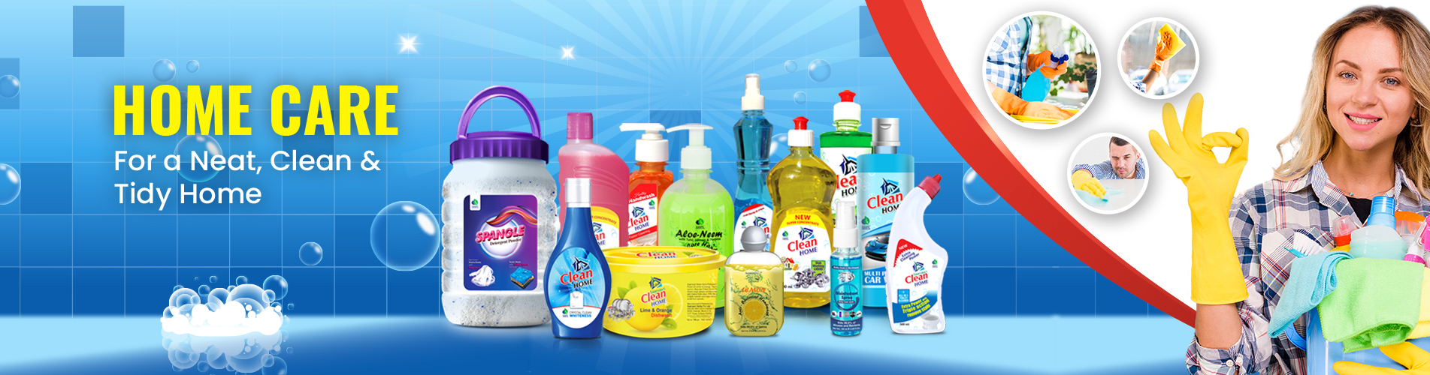

Slide 2
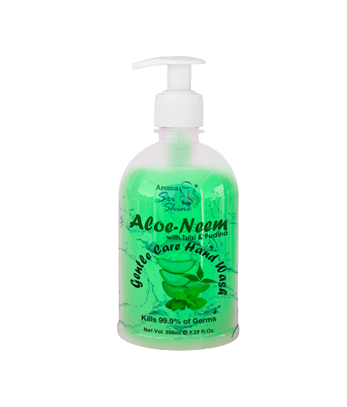
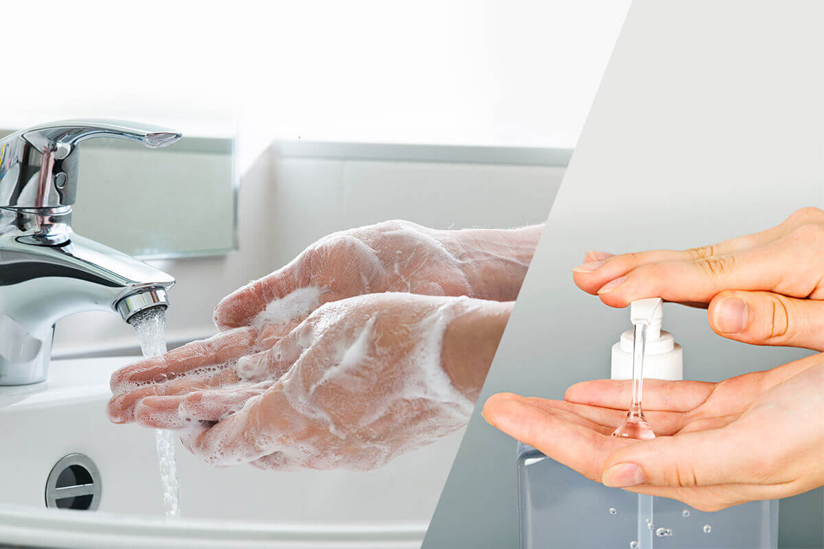
Aloe-Neem
Gentle Care Hand Wash
DESCRIPTION
Protect your hands with the goodness of natural ingredients that has a mild action on the skin and tough on germs. With the best of nature like 100% pure Neem Oil and Aloe Vera, it cares for your hands and purifies the skin. Give you and your family gentle and caring protection and stay protected from germs with this natural hand wash.
BENEFITS
Removes 99.9% of germs
Specially formulated with pure neem oil
Washes away the impurities on the skin
Protects the skin with gentle care
HOW TO USE
Pour a few drops of the liquid hand wash. Add water and rub the hands together until it forms lather. Rinse well with tap water and dry with a clean cloth.
Product Type: Liquid
Pack Size: 500 ml
MRP: Rs. 250/-

Slide 3
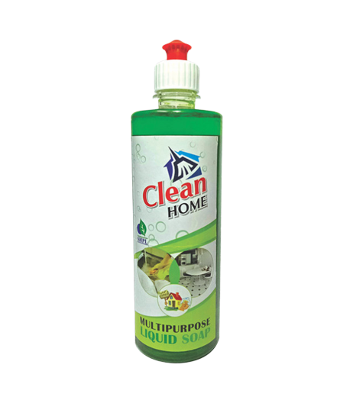

MULTIPURPOSE
LIQUID SOAP
DESCRIPTION
Saarvasri Herbs Multipurpose Liquid Soap has double power. It cleanses the toughest grease, oil and burnt stains. It removes the residual food odours. As a result you have sparkling dishes that are completely clean. It also clean lavatory, bathroom and glaze tiles.
BENEFITS
Floor Cleaner
Toilet Cleaner
Tiles Cleaner
Utensil Cleaner
Glass cleaner
HOW TO USE
Mix a few drops of Multipurpose Liquid Soap with water as per your requirement and apply.
Product Type: Liquid
Pack Size: 500 ml
MRP: Rs. 129/-

Slide 4
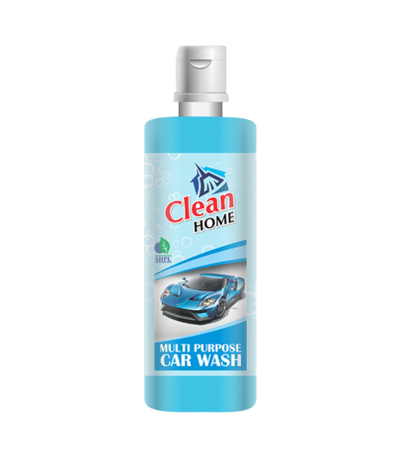
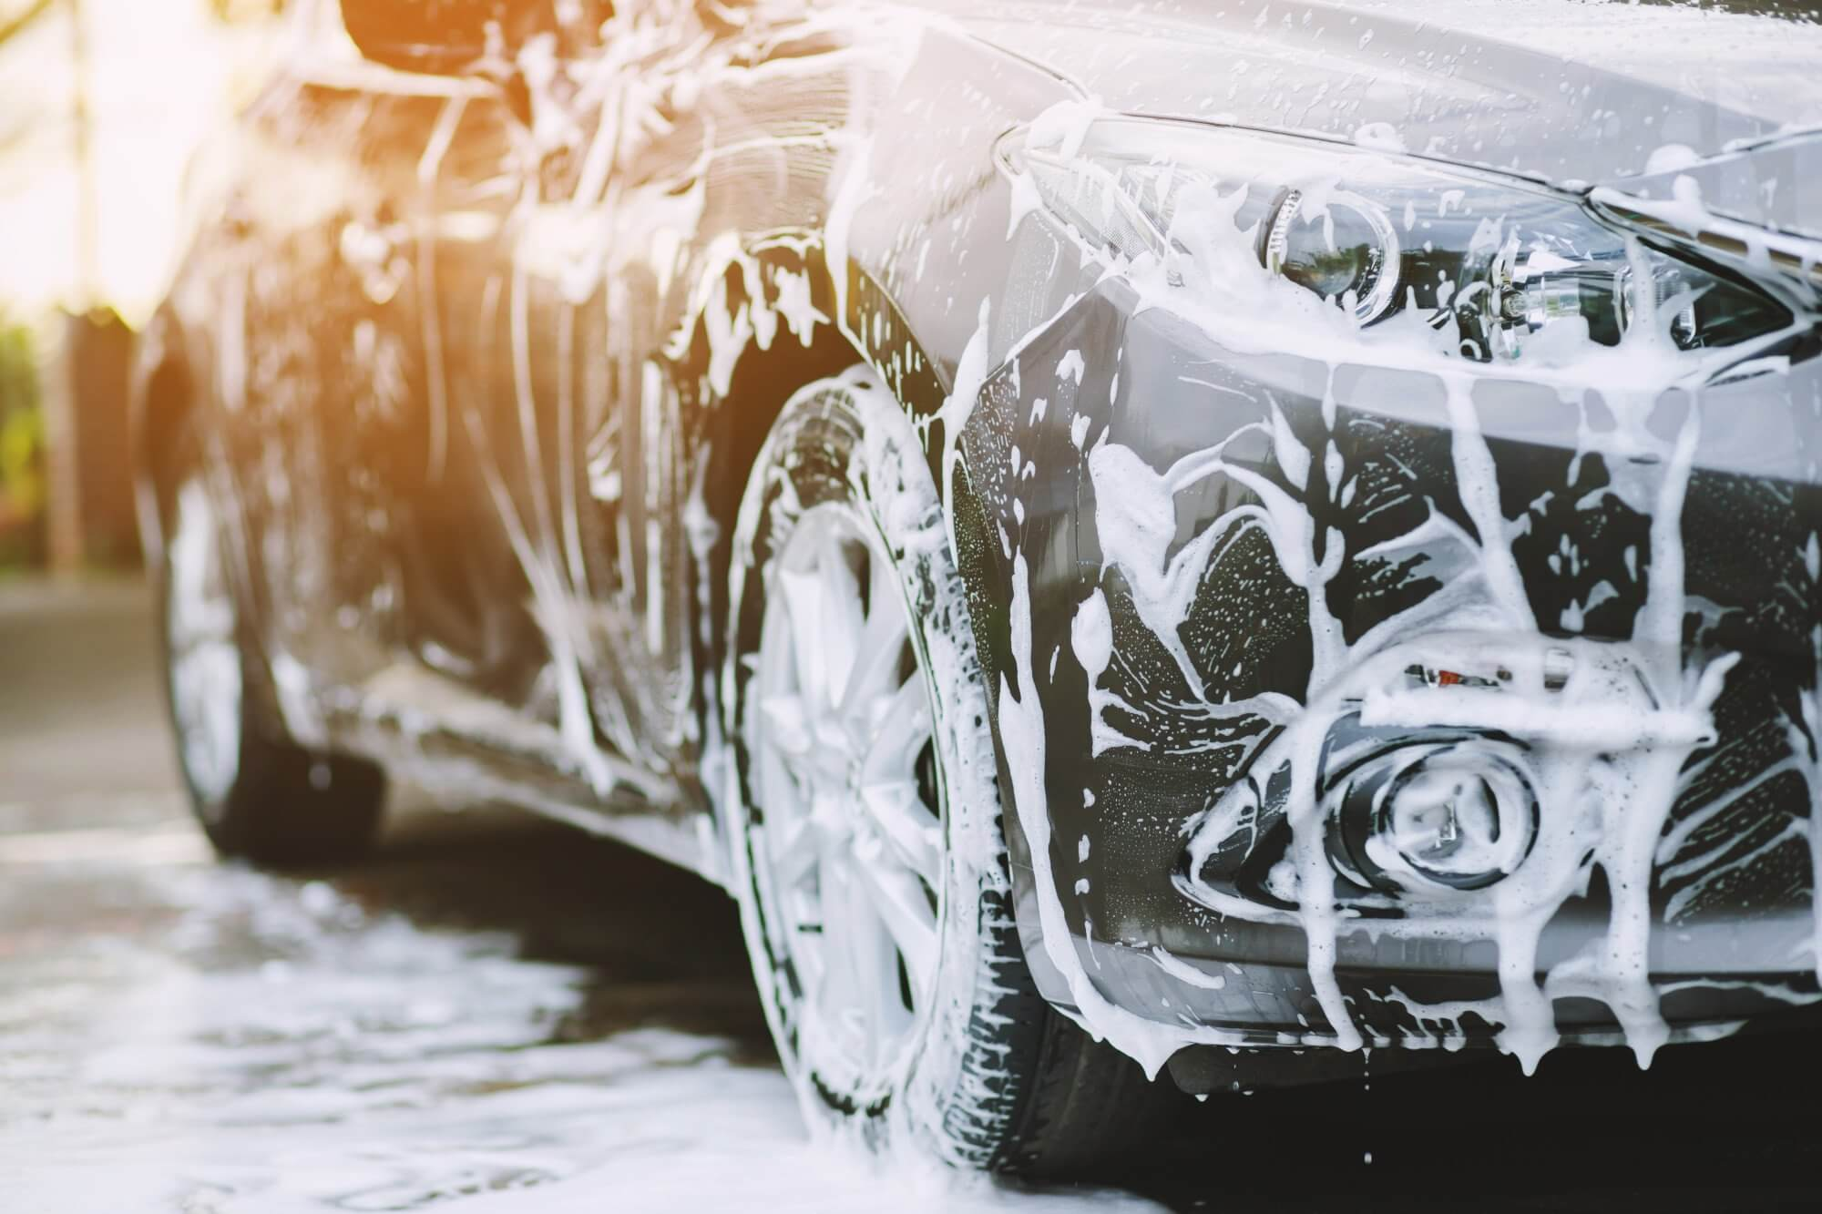
CAR WASH
MULTIPURPOSE
DESCRIPTION
High quality Saarvasri Herbs Car Wash removes dirt quickly and thoroughly. It has a soft feel to the water which can give the best results when washing cars with extra foam based formulas. The Super Silk formula is enriched with a gloss enhancer and wax to provide a Super Silk finish to all painted and glass surfaces.
BENEFIT
It helps remove road dirt, traffic debris and other pollutants efficiently
HOW TO USE
Mix a few drops of Car Wash with water as per your requirement and apply.
Product Type: Liquid
Pack Size: 500 ml
MRP: Rs. 175/-

Slide 5
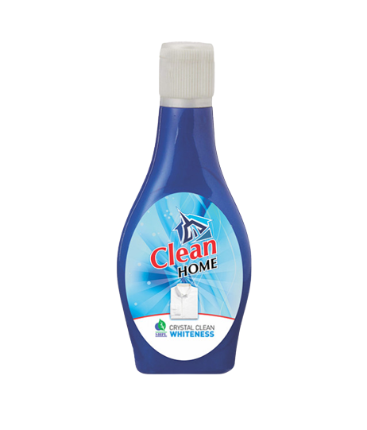
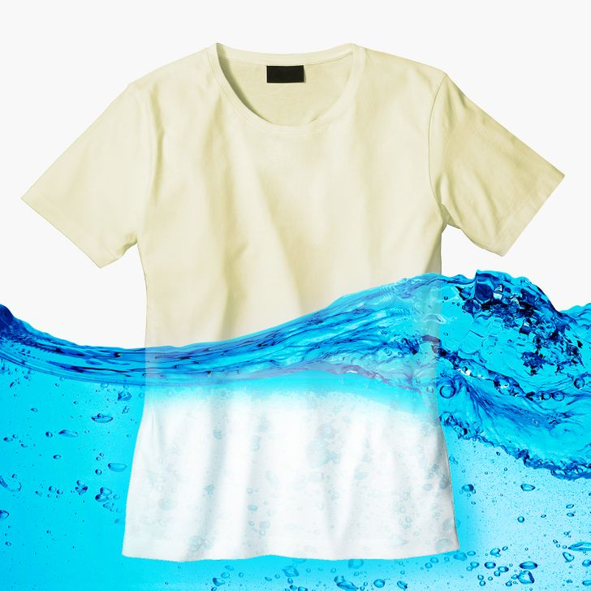
WHITENESS
CRYSTAL CLEAN
DESCRIPTION
Sarvasree Herbs Crystal Clean Whiteness brightens fibers and gives your clothes the whiteness they deserve. It contains ultra-bright molecules, which help it dissolve faster, penetrate deeper and leave your clothes sparkling white.
BENEFITS
The blue tint on white fabrics absorbs the yellow part of the spectrum, thereby making the yellowish tint invisible.
HOW TO USE
Mix 4 drops of Crystal Clean Whiteness with a bucket of water and use on your washed clothes.
Product Type: Liquid
Pack Size: 200 ml
MRP: Rs. 65/-

Slide 6
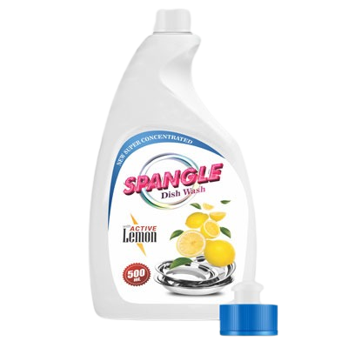
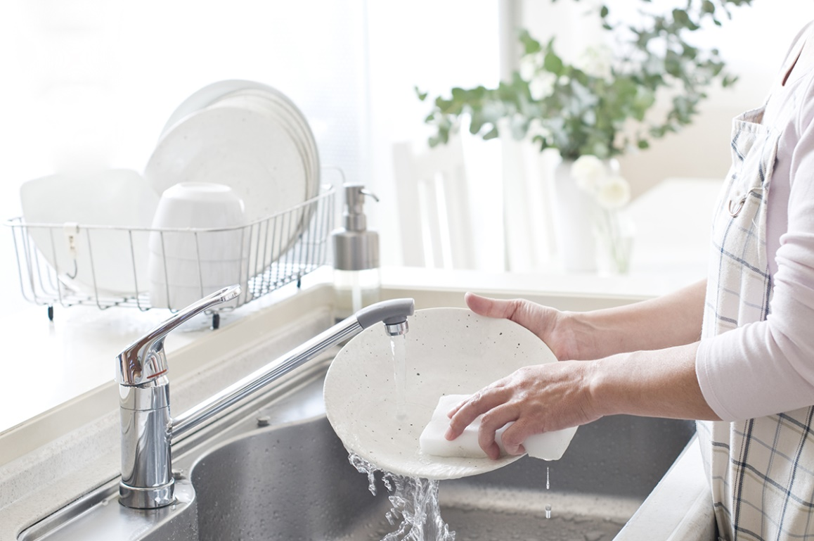
SPANGLE
DISH WASH
DESCRIPTION
Spangle Liquid Dish Wash is generally mild, it is frequently a better choice as a household cleaner than other harsh chemicals. That is why it can be a great alternative to other harsh cleaners and can be used for washing your dishes.
BENEFITS
Apply some dishwashing liquid directly to a wet sponge. It cleans the toughest grease and burnt stains and removes residual food odors.
HOW TO USE
Mix the dish wash with water as per your requirement and apply it to the areas you need.
Product Type: Liquid
Pack Size: 500 ml
MRP: Rs. 119/-

Slide 7
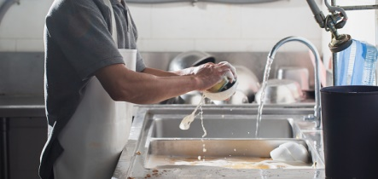
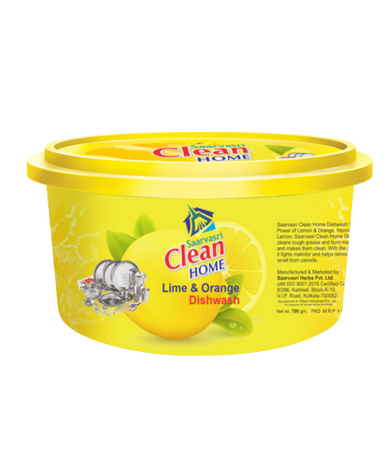
SPANGLE
DISH WASH TUB
DESCRIPTION & BENEFIT
Lime & Orange Dish Wash Tub contains the power of lemon to clean grease and burn marks from dishes and help remove odors from dishes.
HOW TO USE
Use a scrubber to get shiny and stain-free dishes. Use regularly.
Product Type: Liquid
Pack Size: 700 ml
MRP: Rs. 70/-

Slide 8
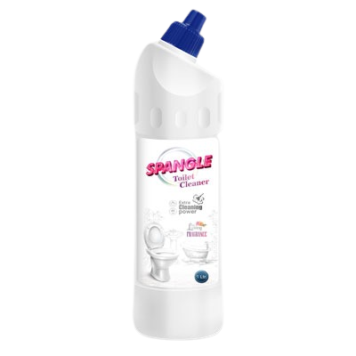
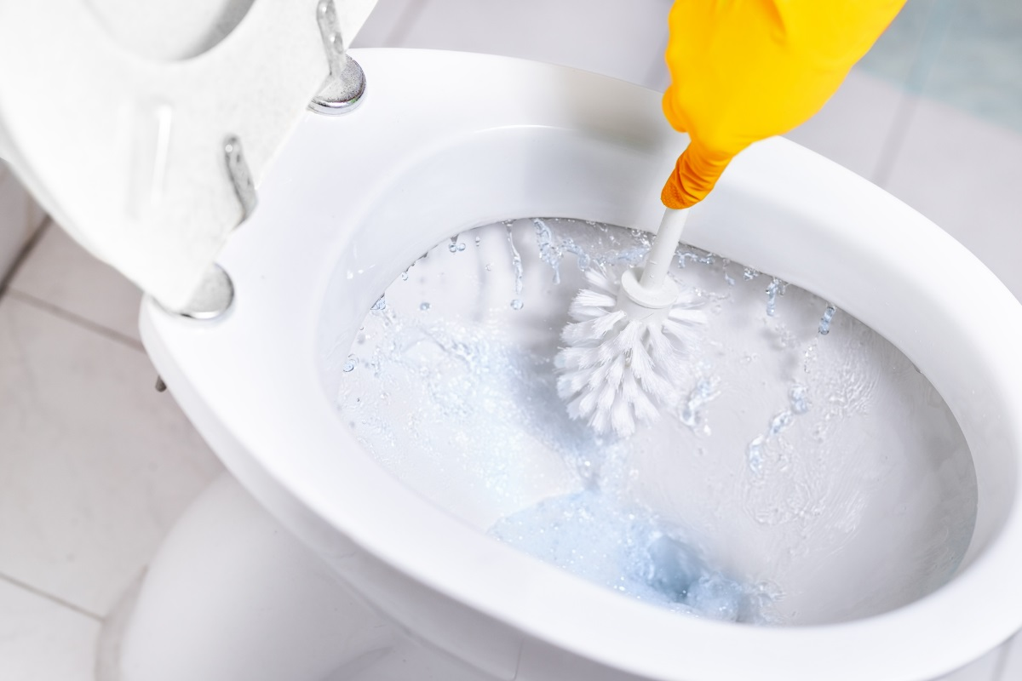
SPANGLE
TOILET CLEANER
DESCRIPTION & BENEFIT
Toilet cleaner is a powerful formula for removing stains from toilets and washrooms. Toilet cleaner is very effective against scaling and heavy stains. Toilet cleaners can be safely used on urinals, commodes, bathtubs, sinks and basins.
HOW TO USE
Squeeze it around the commode and leave it on for 10 to 15 minutes for glowing results. Scrub and flush the inside of the commode with the brush.
Product Type: Liquid
Pack Size: 500 ml
MRP: Rs. 119/-

Slide 9
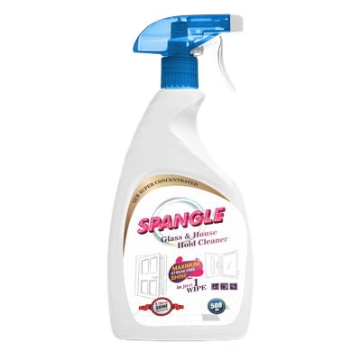
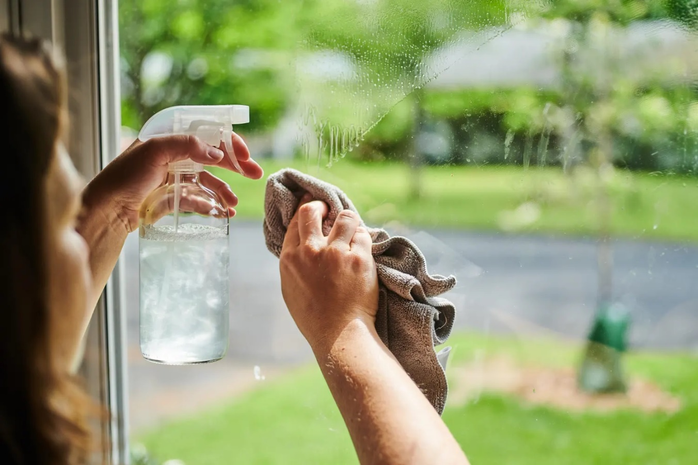
SPANGLE
GLASS & HOUSE HOLD CLEANER
DESCRIPTION & BENEFIT
Glass cleaner easily cleans dust, smoke and grease on all types of glass surfaces.
HOW TO USE
Mix the Glass Cleaner with water as per your requirement and apply it on the required area.
Product Type: Liquid
Pack Size: 500 ml
MRP: Rs. 119/-

Slide 10
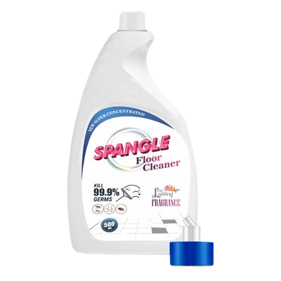
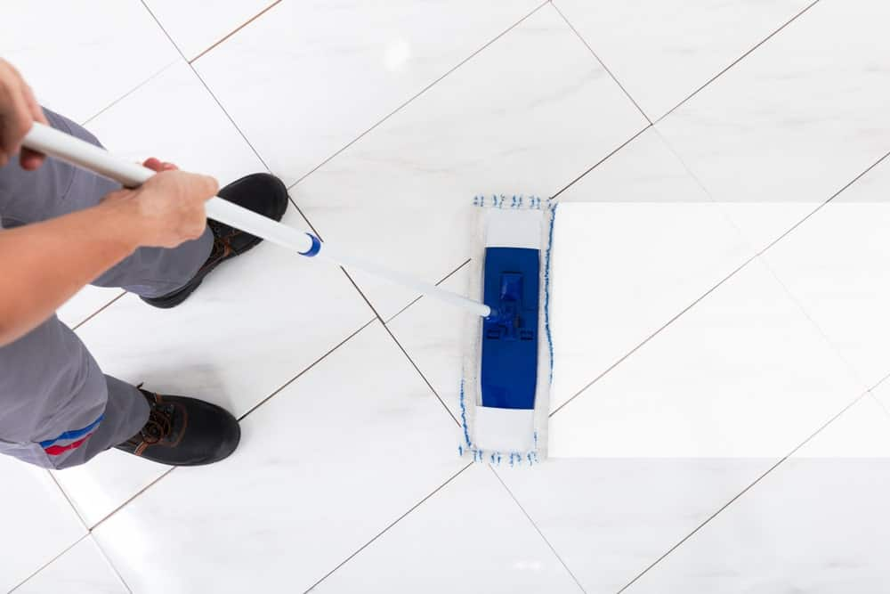
SPANGLE
FLOOR CLEANER
DESCRIPTION & BENEFIT
Floor Cleaner is a general purpose concentrated cleaner cum sanitizer. Ideal for quick cleaning on any hard surface such as floors. Daily mopping is crucial for keeping surface dirt away; deep cleaning will help to preserve floors from damaging dirt and water.
HOW TO USE
Mix the floor cleaner with water as per your requirement and apply it on the required area.
Product Type: Liquid
Pack Size: 500 ml
MRP: Rs. 119/-

Slide 11
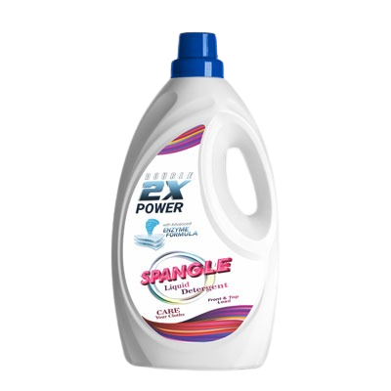
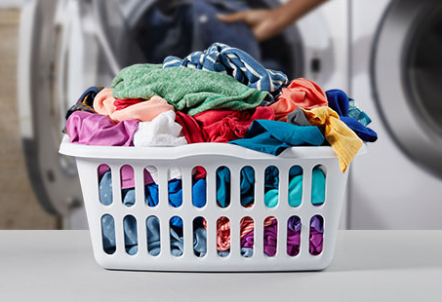
SPANGLE
LIQUID DETERGENT
DESCRIPTION & BENEFIT
Liquid Detergent has numerous benefits as well. Liquid Detergent has the key advantage of already being a liquid, which means that it dissolves immediately into the machine as the water starts to fill. Liquid Detergent is ideal for fully-automatic washing machines, and works well on coloured loads because it is gentler. The liquid detergent formula works to remove tough stains in 1 wash inside the machine, particularly grease stains.
HOW TO USE
Mix the Liquid Detergent with water as per your requirement and wash your clothes.
Product Type: Liquid
Pack Size: 1 ltr
MRP: Rs. 250/-

Slide 12
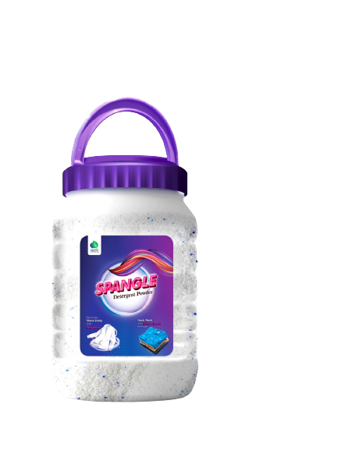

SPANGLE
DETERGENT POWDER
DESCRIPTION & BENEFIT
It possesses good cleansing power in both cold and warm water. It is readily soluble to give a good lather which does not quickly wear down. It does not contain substances that can harm fabrics or the user's hand.
HOW TO USE
Mix the Detergent Powder with water as per your requirement and wash your clothes.
Product Type: Liquid
Pack Size: 2 kg
MRP: Rs. 300/-

Slide 13
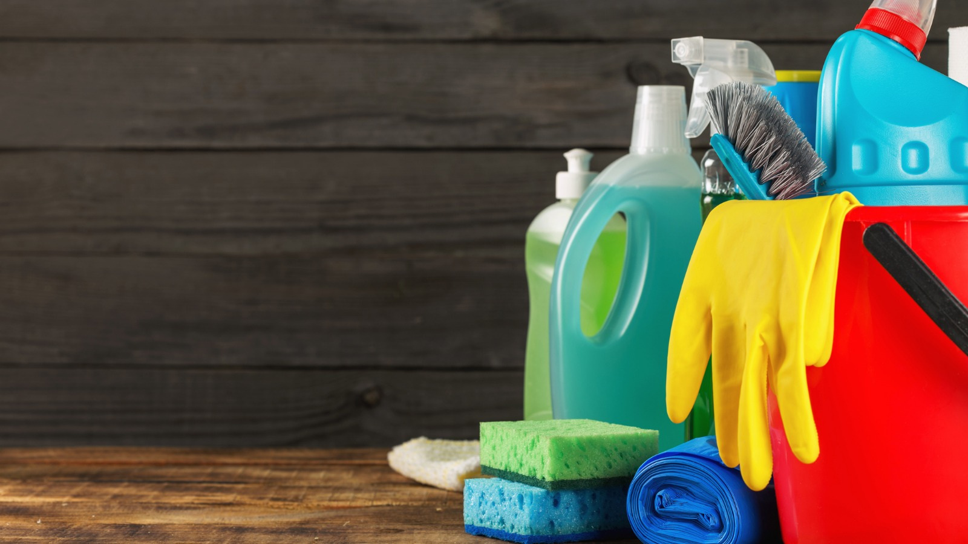
Thank You

