Slide 2
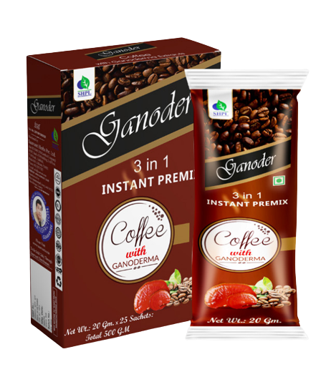
Ganoder
Coffee with Ganoderma
DESCRIPTION
Ganoder 3 in 1 instant premix coffee is a powdered drink mix that typically contains instant coffee and the powdered extract of Ganoderma lucidum, a medicinal mushroom also known as "reishi" or "Lingzhi." Other ingredients, such as sugar, non-dairy creamer, and herbs, are also included in this pack of SHPL Ganoder Coffee.
INGREDIENTS
Ganoderma lucidum & cofee
BENEFITS
Boost immunity
Fight fatigue
Improve memory
Increase energy stamina
Lower cholesterol
Reduce inflammation
Relieve stress
Reverse the aging process
Stimulate circulation
Source of antioxidants
HOW TO USE
Pour contents of sachet into a cup add hot water(not boiling) and stir well, enjoy Ganoder 3 in 1 coffee
Product Type: Powder
Pack Size: 500 gm
MRP: Rs. 2500/-

Slide 3
ZAITOON OIL
Extra Virgin Olive Oil
BENEFITS
Large amount of antioxidants
Rich in healthy monounsaturated fats
Anti-inflammatory properties
Help reduce the risk of strokes
Protection against heart disease
Improve bone health
Assists in weight loss
Protection against specific cancers
Antibacterial properties
Reduced risk of alzheimer’s
Reduced risk of arthritis
Supports A healthy gut microbiome
HOW TO USE
In salads as dressings
Light sautéing
You can drink a tablespoon of extra virgin olive oil as soon as you wake up on an empty stomach
You can leave olive oil on your face overnight
Product Type: Oil
Pack Size: 500ml
MRP: Rs.1100/-

Slide 4
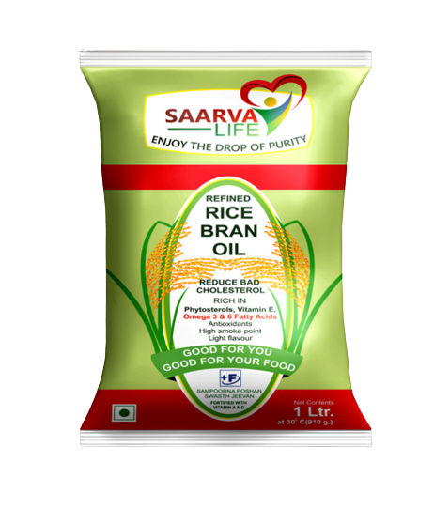
RICE BRAN OIL
Enjoy the drop of Purity
DESCRIPTION
SHPL Rice bran oil is made from bran which makes it rich in Vitamin E that is essentially an antioxidant. Rice bran oil has an almost balanced fatty acid composition. Rice bran oil is rich in monounsaturated and polyunsaturated fats and free of trans-fats. Rice bran helps to lower cholesterol because it contains the right amount of oryzanol (1500 mg) which is an antioxidant. It will reduce your bad cholesterols, its rich in phytosterols, omega 3 & 6 fatty acids.
INGREDIENTS
Rice Bran
BENEFITS
Maintain blood sugar levels
Lowers Cholesterol
Contains Good Fats
Heart Friendly
Prevent gas/acidity
Supports digestion
Aids Weight Loss
Good for the Skin
Anti-Inflammatory Properties
HOW TO USE
Use SHPL Rice bran oil as your regular cooking oil.
Product Type: Cooking Oil
Pack Size: 1 Ltr. | 2 Ltr.
MRP: Rs. 250/- | Rs. 500/-

Slide 5
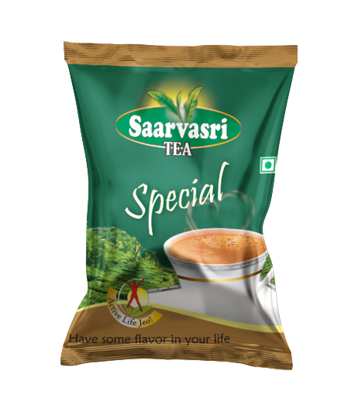
SAARVASRI TEA
Special
DESCRIPTION
Saarvasri Special Tea is a blended CTC tea with the best quality leaves; Processed in high quality technology. Each cup of this tea is made with the best selected tea leaves; Which ensures the strength, rich color and fresh taste of your tea.
HOW TO USE
Use Saarvasri Tea as your regular tea.
Product Type : CTC Tea
Pack Size : 50 gm | 250 gm
MRP : Rs. 25/- | Rs. 135/-

Slide 6
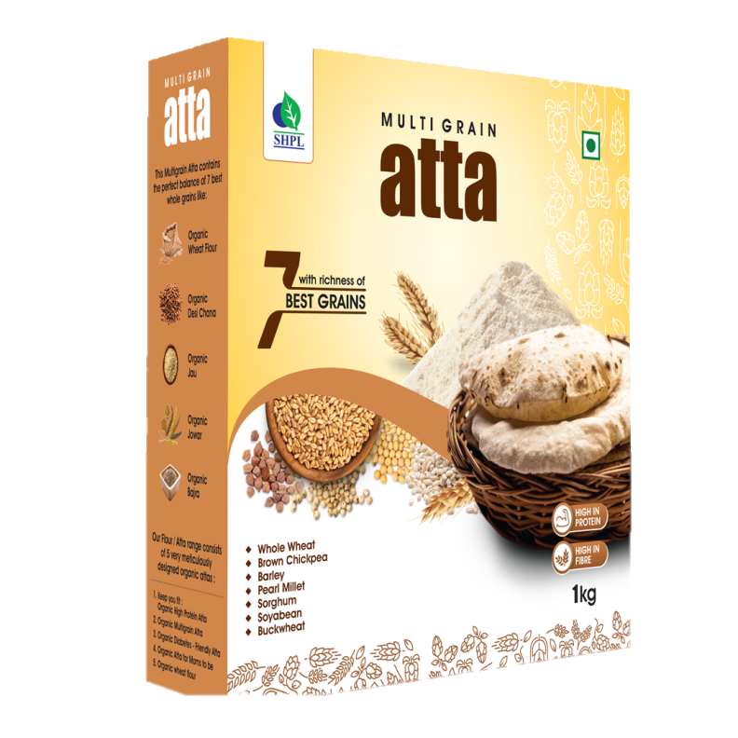
BENEFITS
Fibre-rich and wholegrain foods
Multigrain flour contains a lower glycemic index
Contains whole wheat, brown chickpea, barley, pearl millet, sorghum, soyabean & buckwheat
Contains insoluble dietary fibres and prebiotics that improve gut health
Can reduce risk of colon cancer
Promote the feeling of fullness
Helps in weight loss and weight management
High fibre content also improves digestion
Recommended for diabetics, expectant mothers, growing children, cardiac patients, weight-watchers and the aged
Product Type: Powder
Pack Size: 1kg
MRP: Rs.175/-

Slide 7
Saarvasri
BENEFITS
Contains many important bioactive plant compounds and antioxidants, such as flavonoids and phenolic acids
Actives immune response to infection
Have strong bactericidal properties
May increase levels of adiponectin, a hormone that reduces inflammation and improves blood sugar regulation
May help lower blood pressure, improve blood fat levels, regulate your heartbeat, and prevent the death of healthy cells
Contains propolis, that may improve cholesterol and triglyceride levels
Has been used to heal wounds and burns
Can act as a natural and safe cough suppressant
Product Type: Semi-Liquid
Pack Size: 500gm
MRP: Rs.300/-

Slide 8
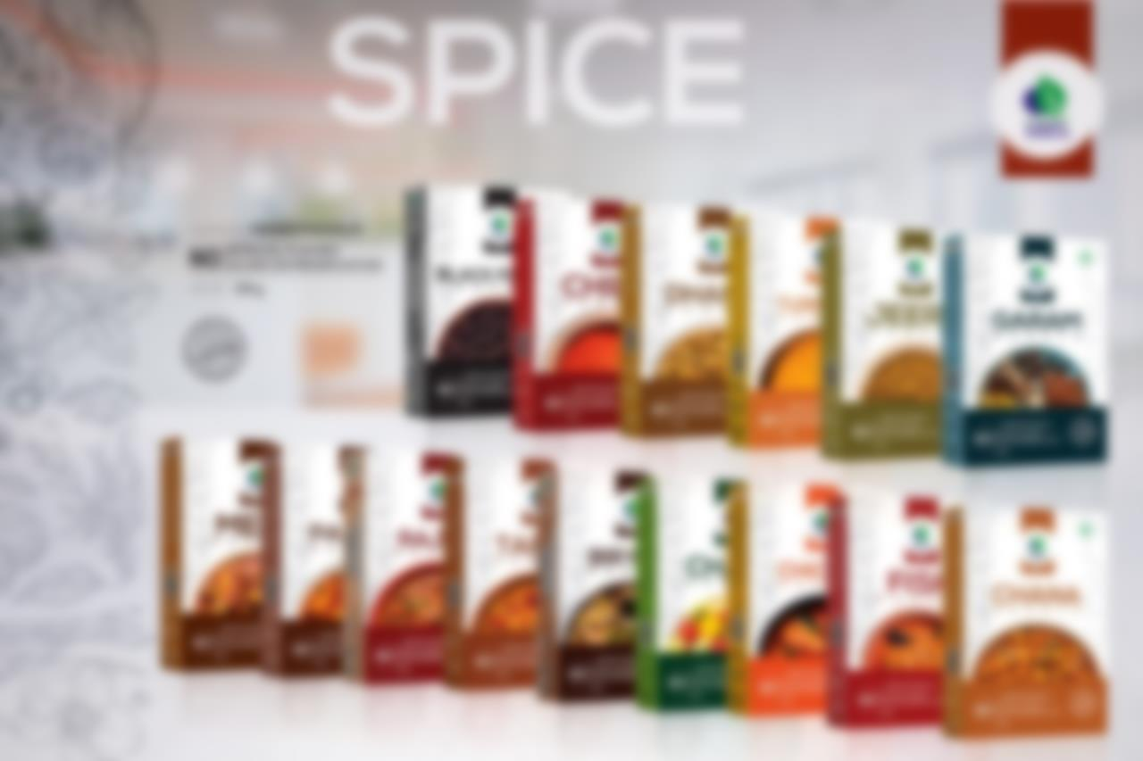
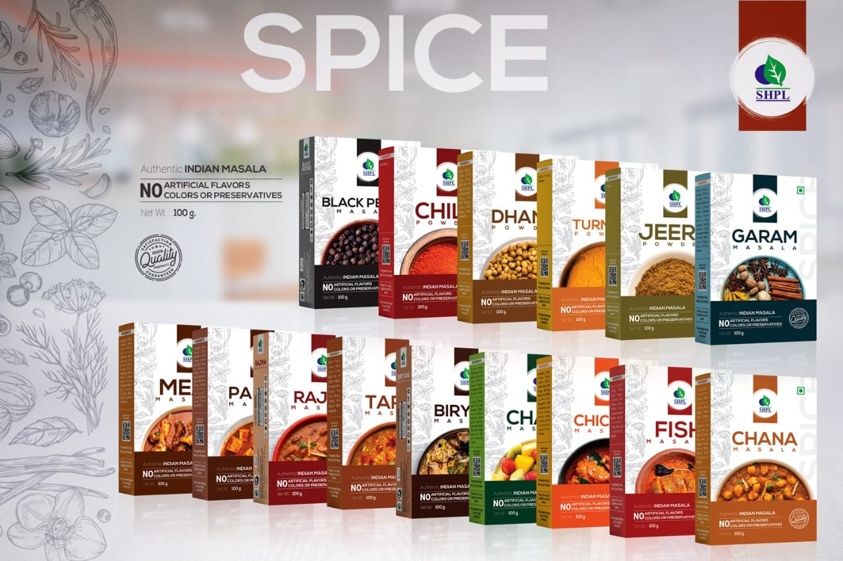

Slide 9
Product Type: Powder
Pack Size: 100 gm
MRP: Rs. 40/-

Slide 10
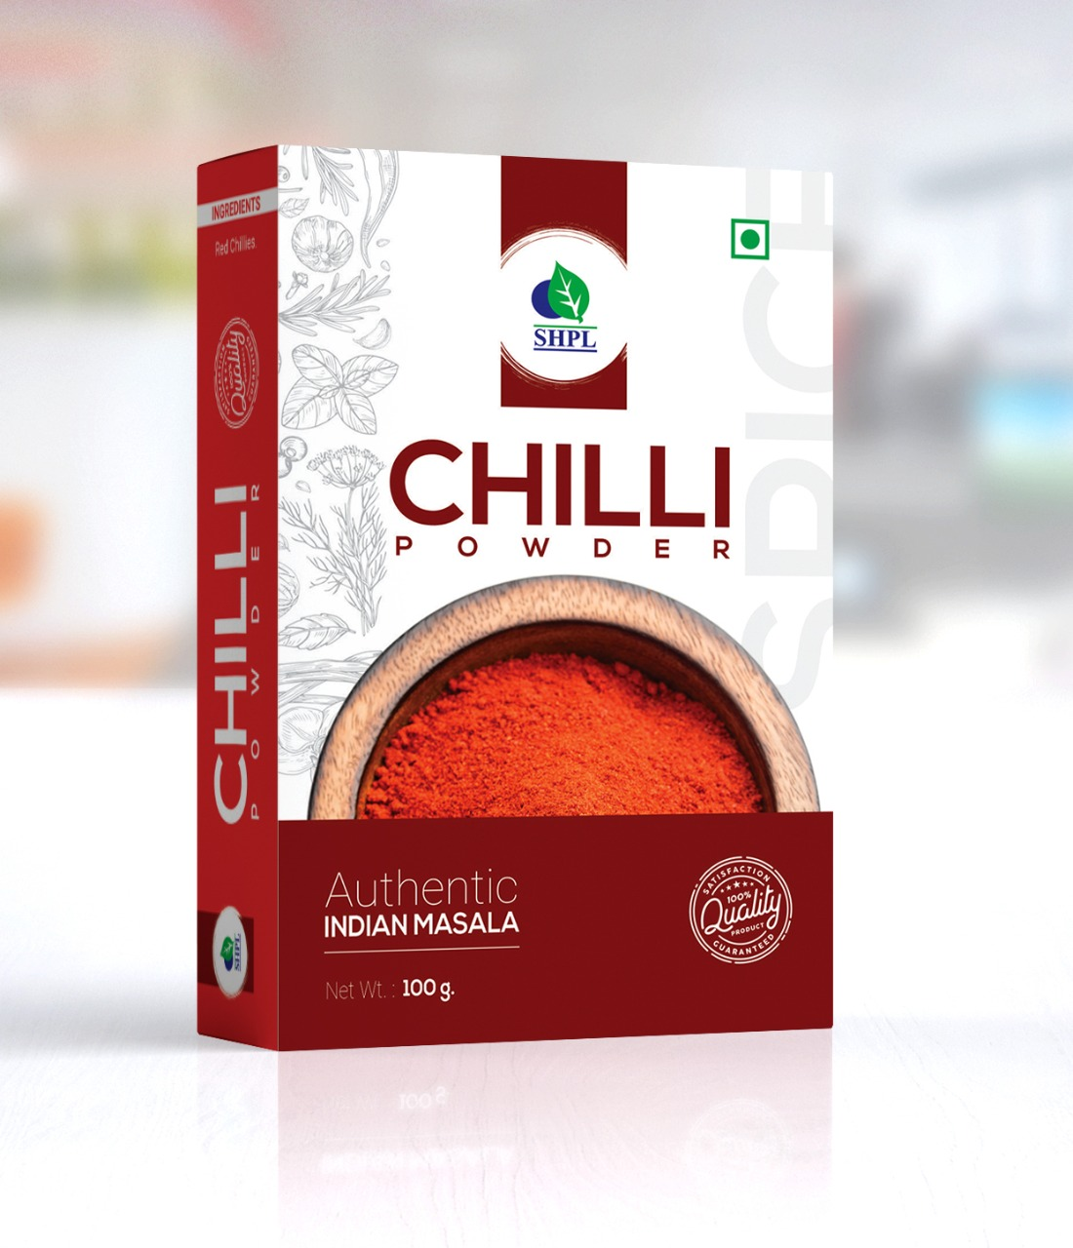
Product Type: Powder
Pack Size: 100 gm
MRP: Rs. 60/-

Slide 11
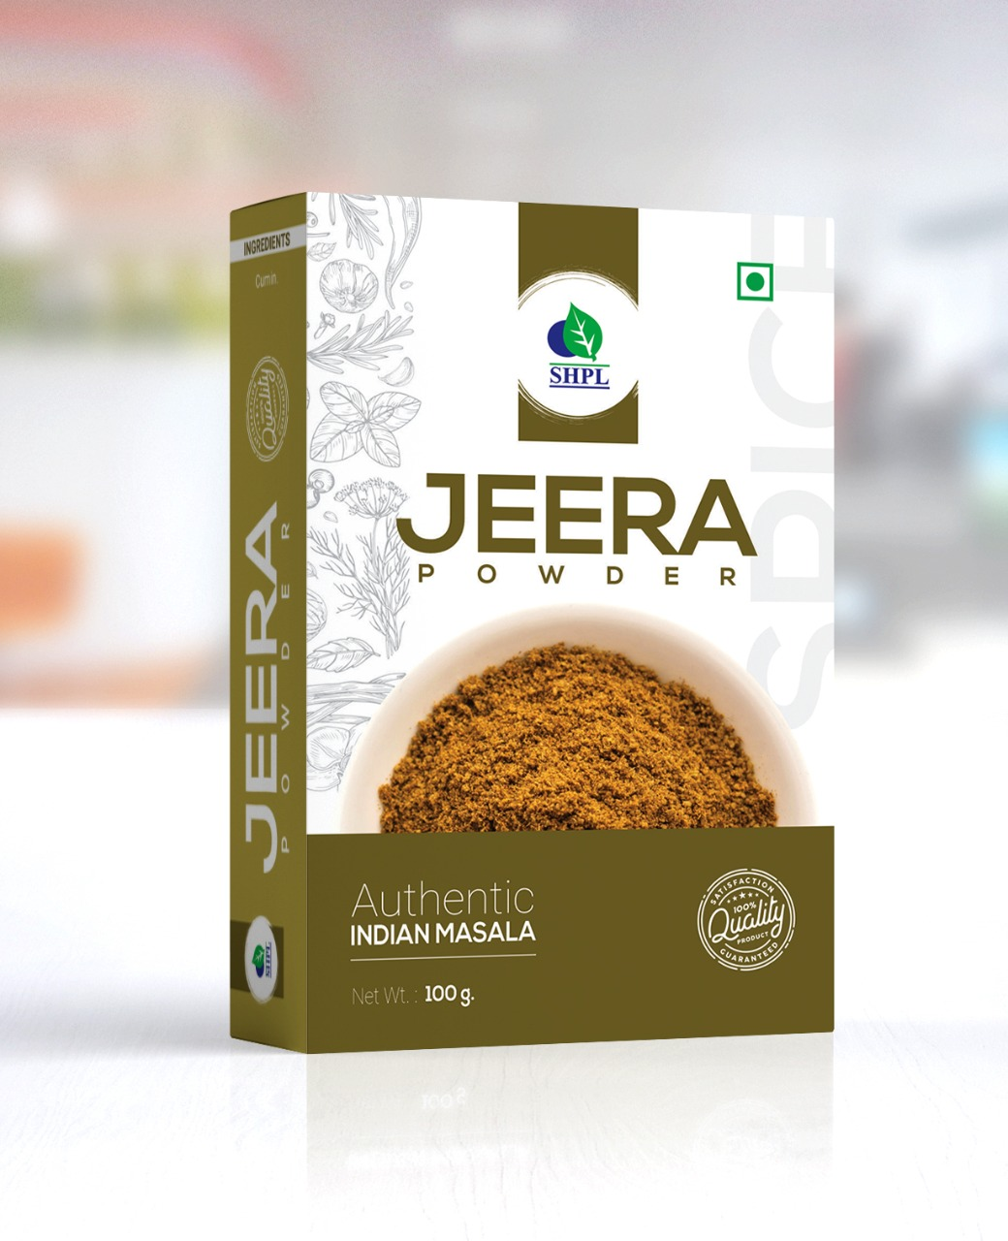
Product Type: Powder
Pack Size: 100 gm
MRP: Rs. 65/-

Slide 12
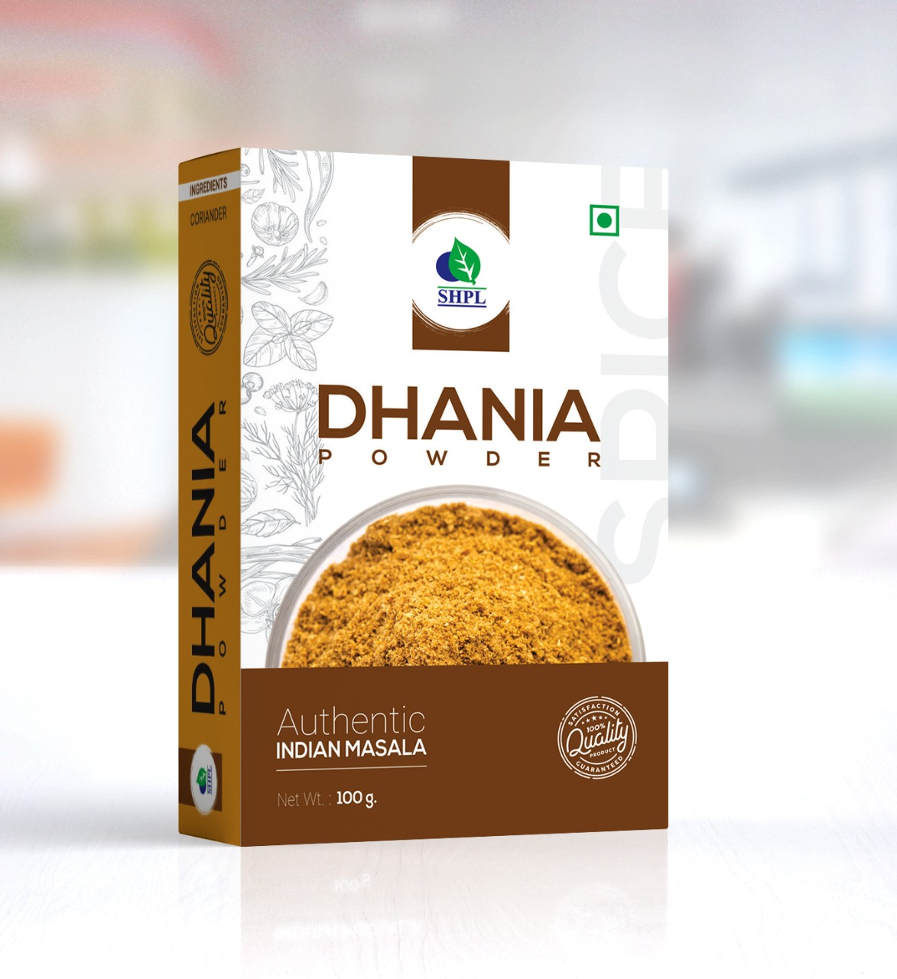
Product Type: Powder
Pack Size: 100 gm
MRP: Rs. 50/-

Slide 13
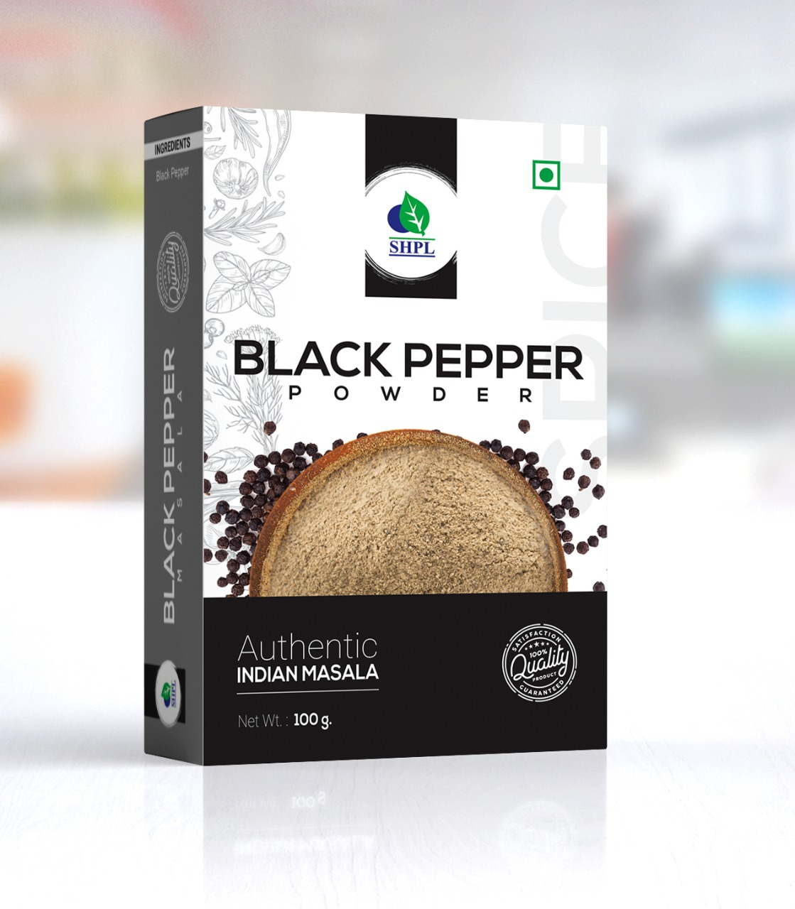
Product Type: Powder
Pack Size: 100 gm
MRP: Rs. 150/-

Slide 14
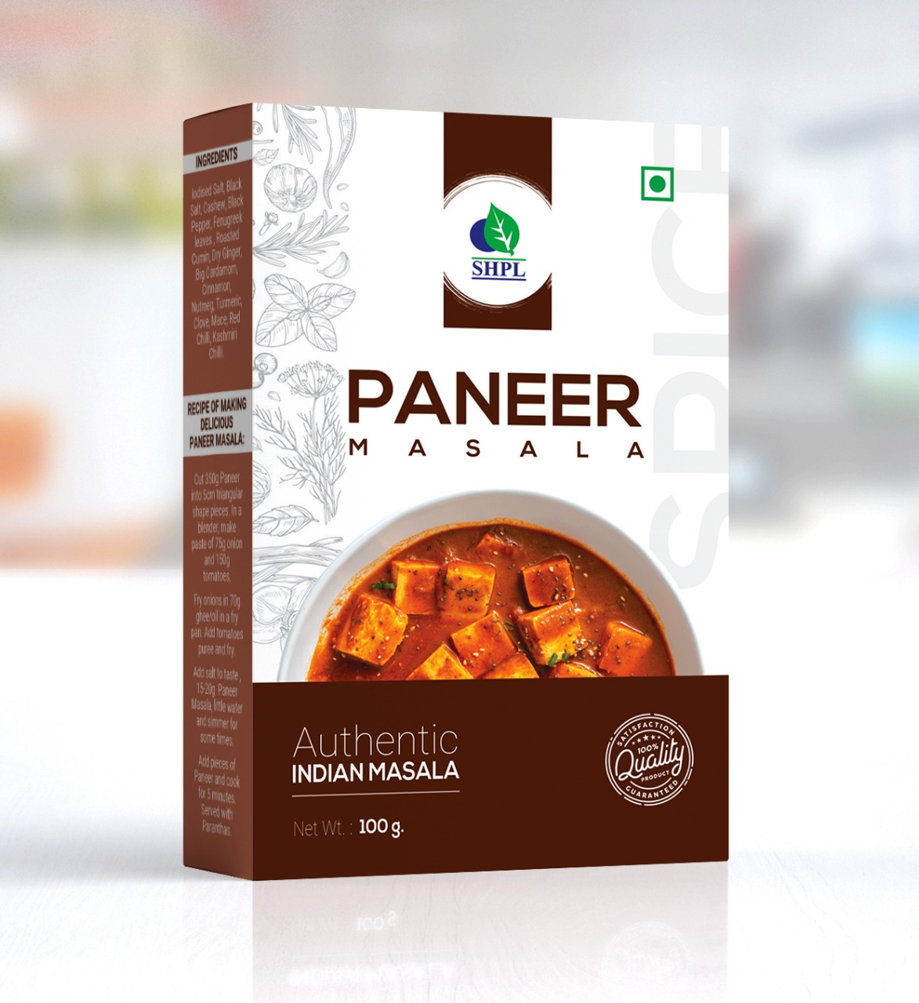
Product Type: Powder
Pack Size: 100 gm
MRP: Rs. 90/-

Slide 15
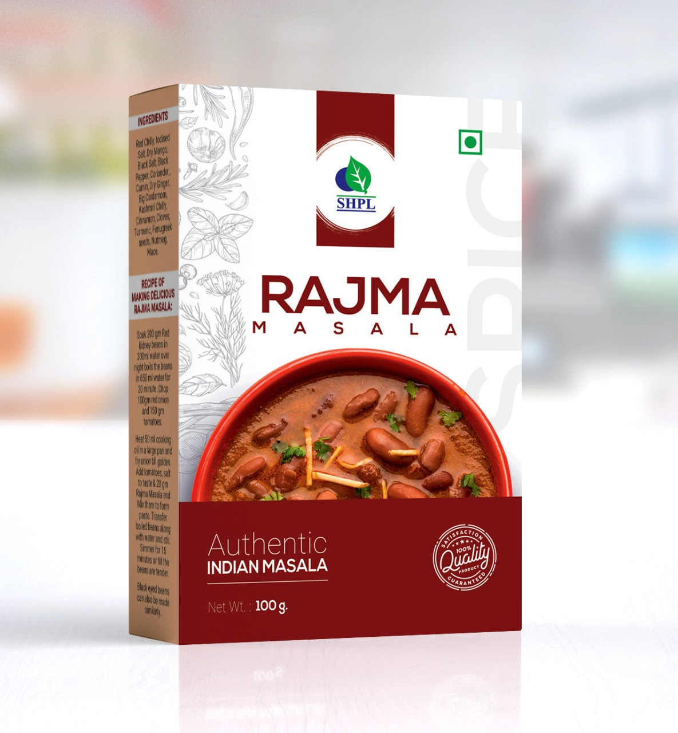
Product Type: Powder
Pack Size: 100 gm
MRP: Rs. 75/-

Slide 16
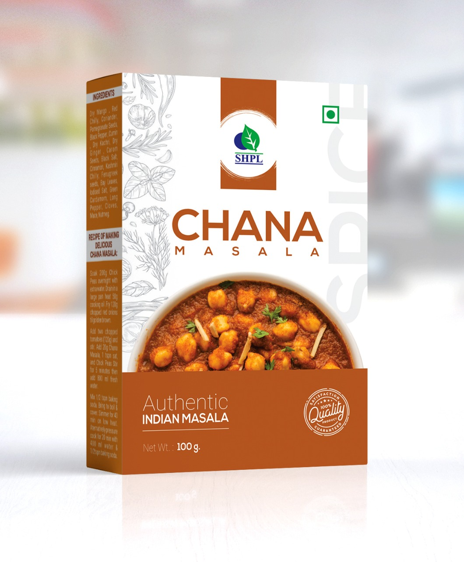
Product Type: Powder
Pack Size: 100 gm
MRP: Rs. 85/-

Slide 17
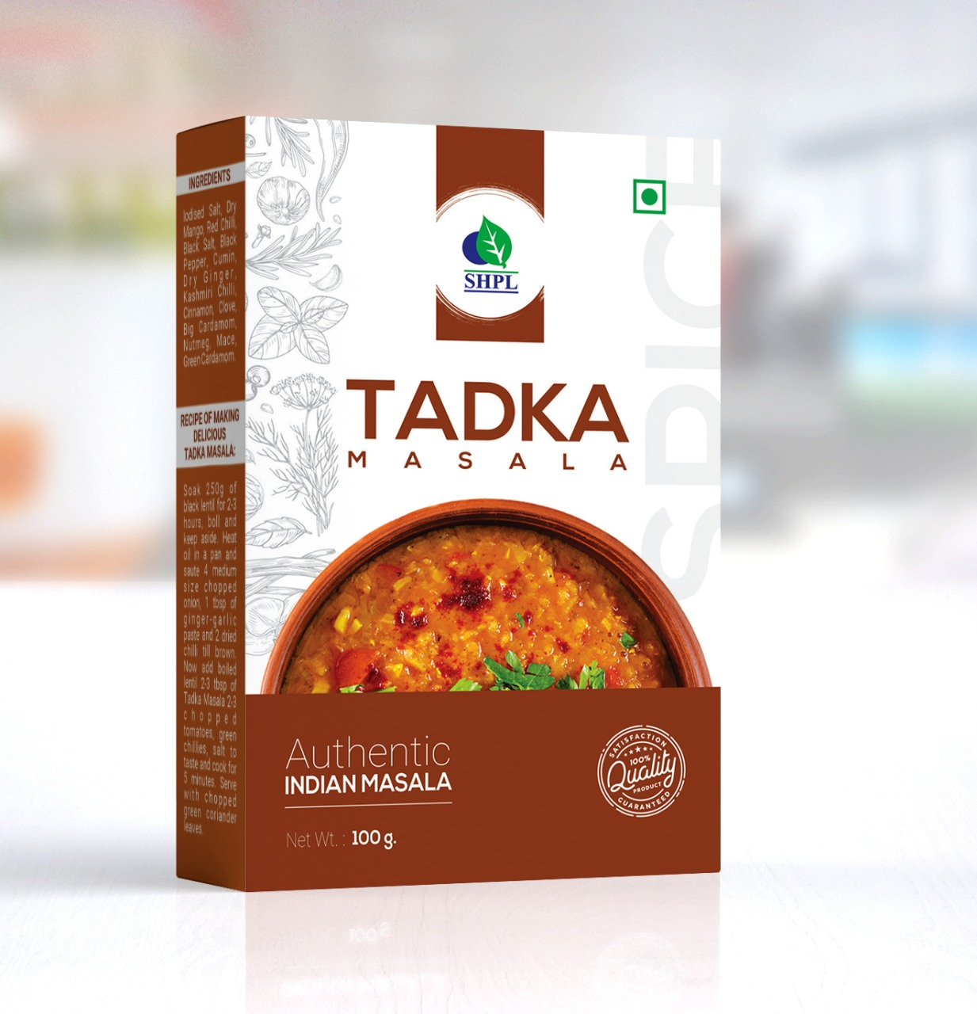
Product Type: Powder
Pack Size: 100 gm
MRP: Rs. 75/-

Slide 18
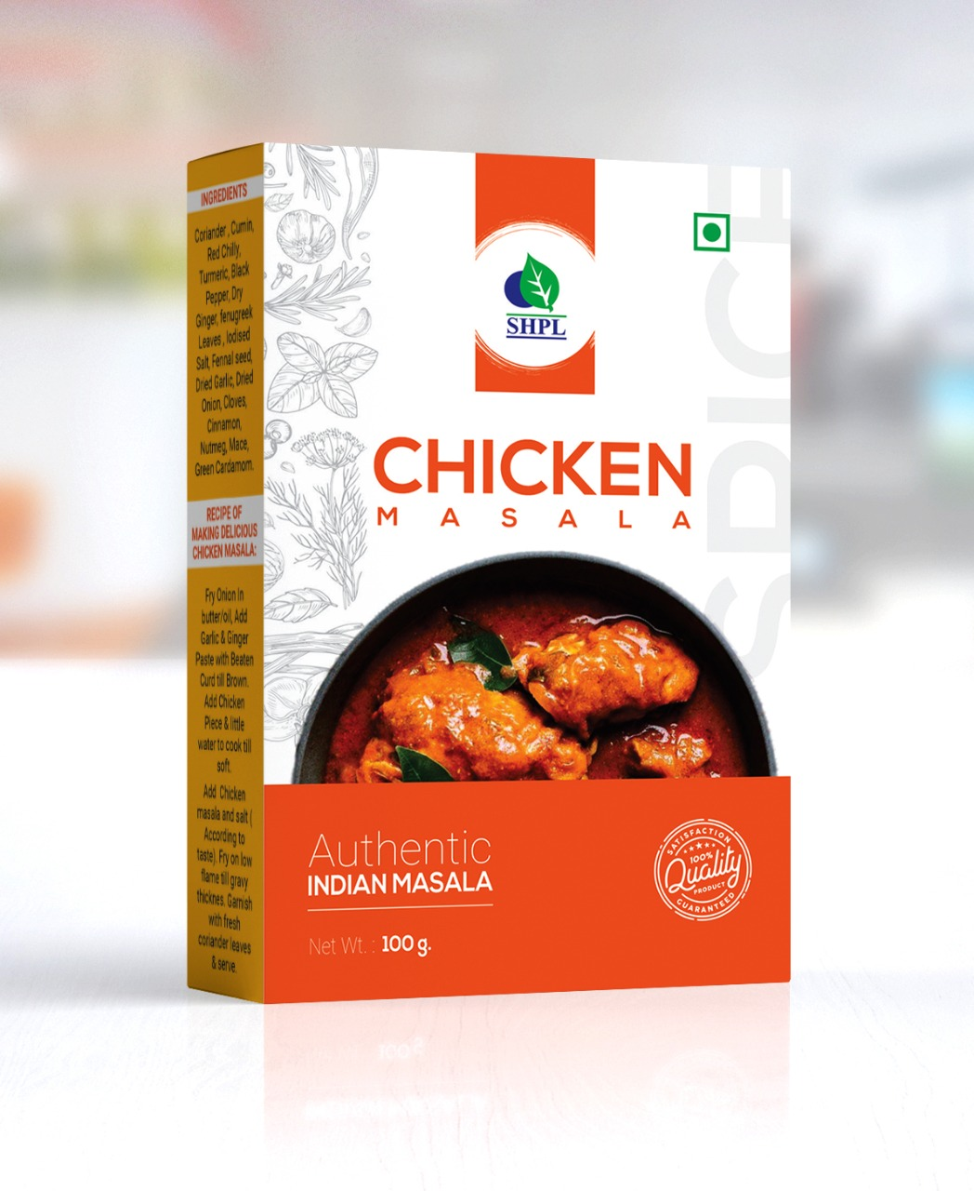
Product Type: Powder
Pack Size: 100 gm
MRP: Rs. 85/-

Slide 19
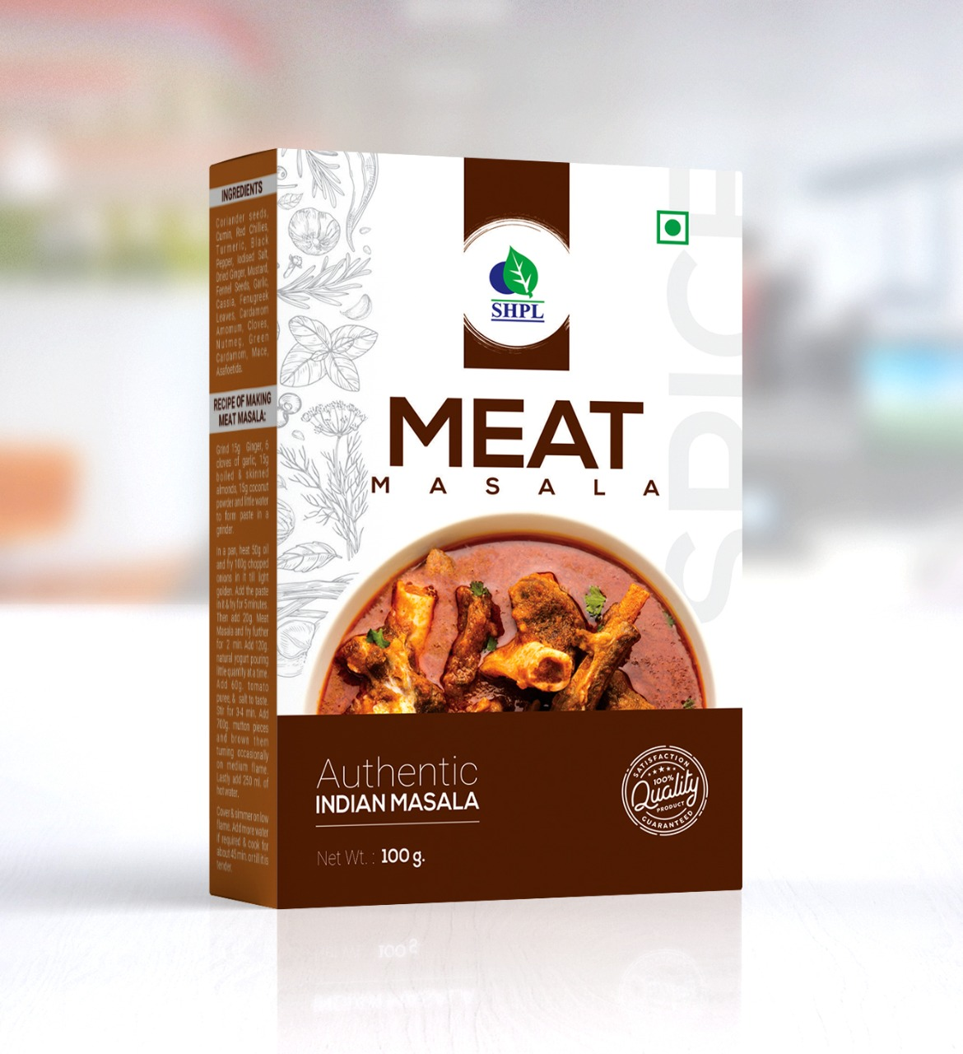
Product Type: Powder
Pack Size: 100 gm
MRP: Rs. 85/-

Slide 20
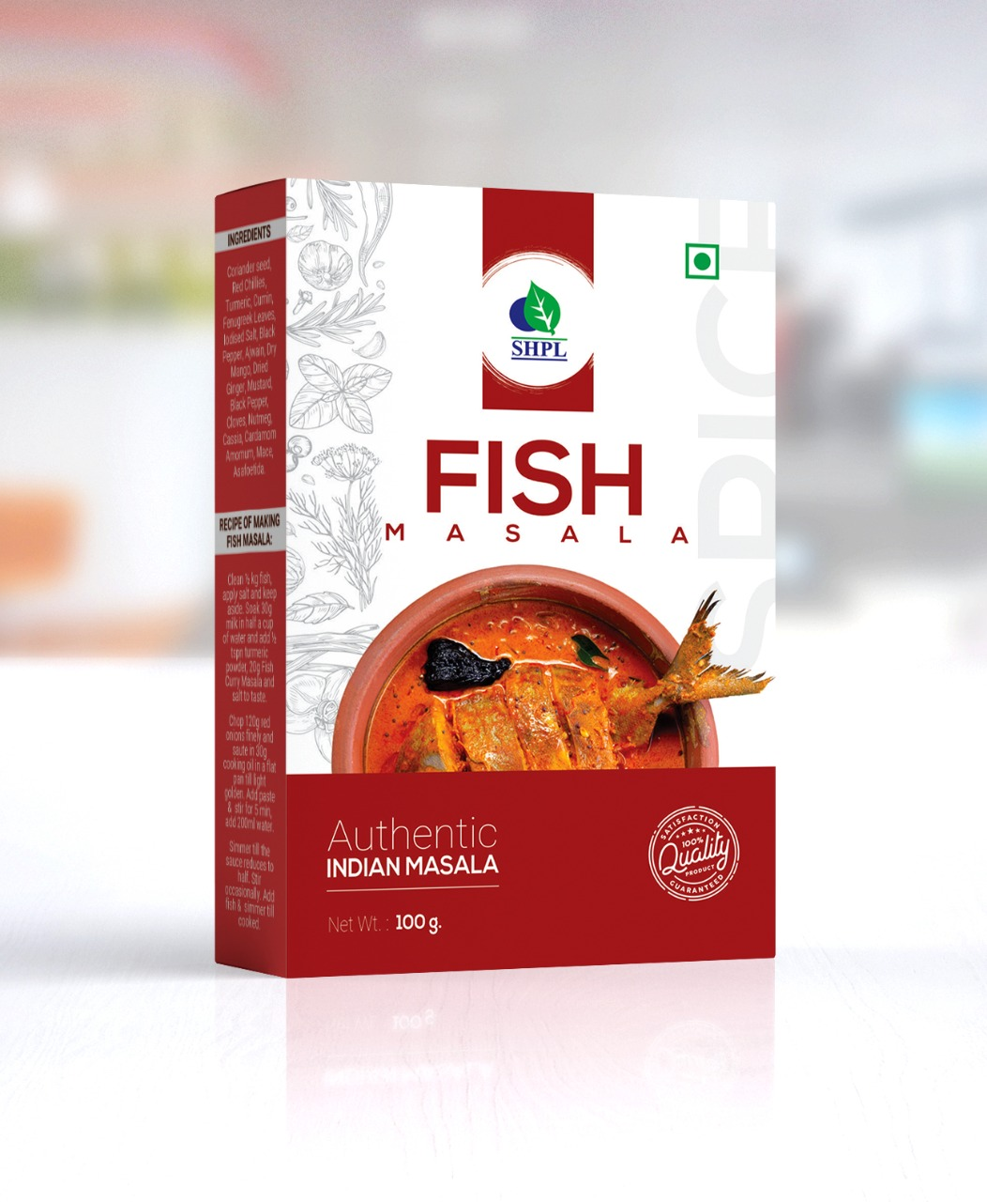
Product Type: Powder
Pack Size: 100 gm
MRP: Rs. 85/-

Slide 21
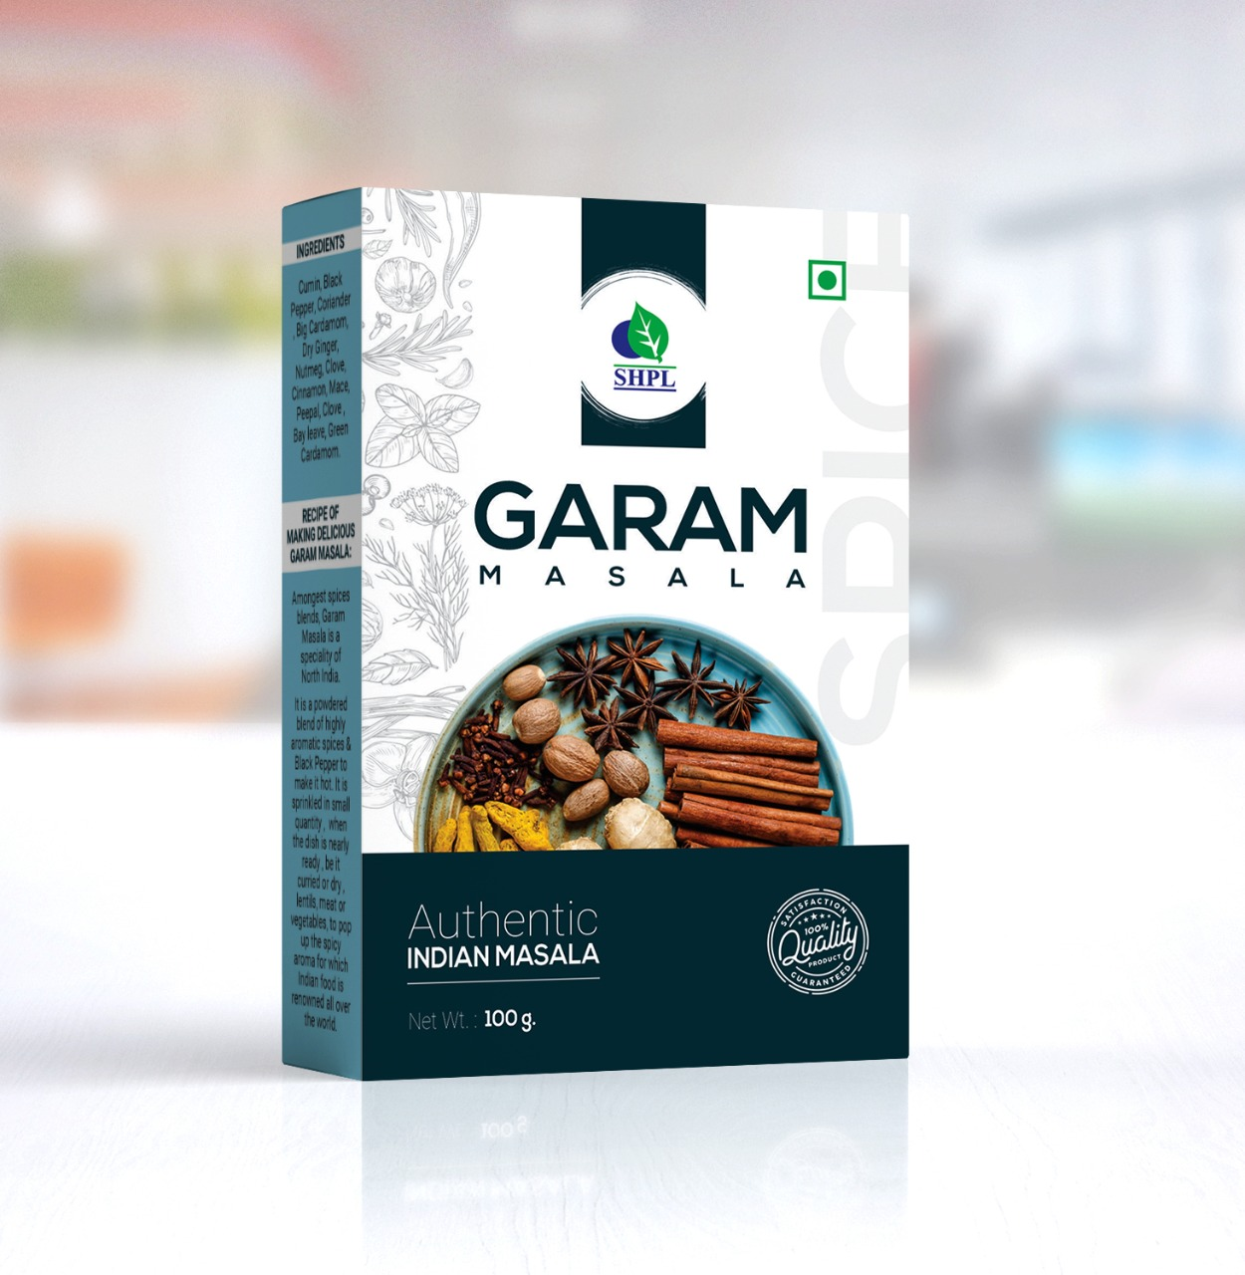
Product Type: Powder
Pack Size: 100 gm
MRP: Rs. 95/-

Slide 22
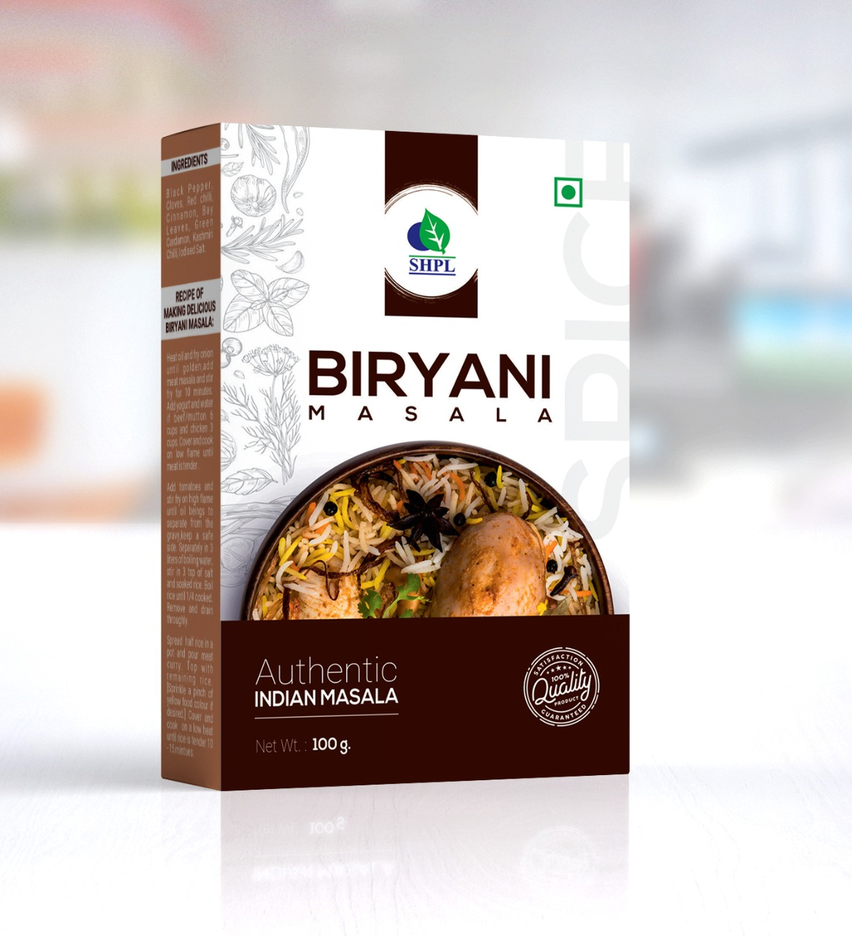
Product Type: Powder
Pack Size: 100 gm
MRP: Rs. 150/-

Slide 23
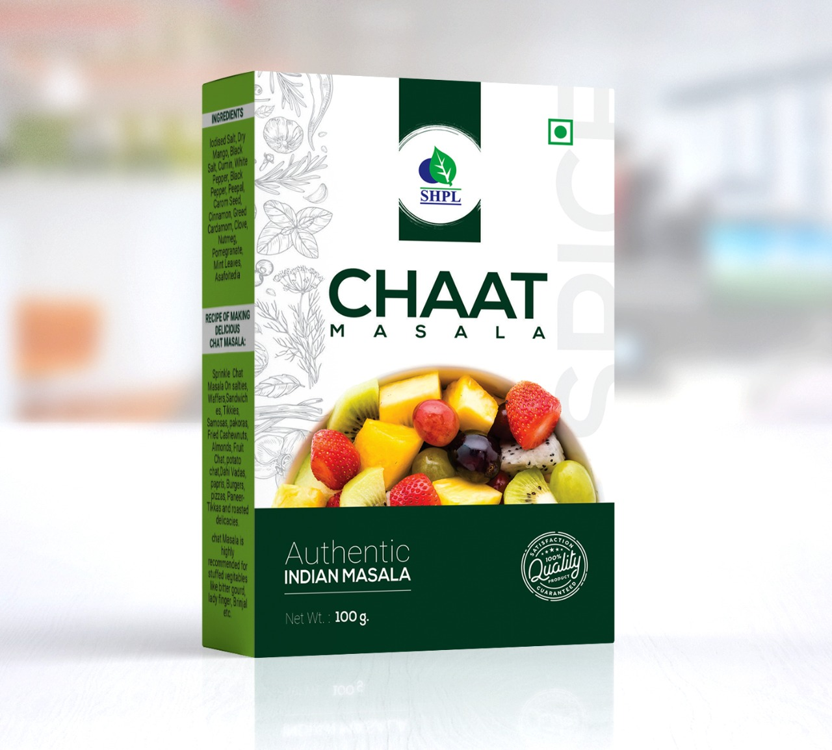
Product Type: Powder
Pack Size: 100 gm
MRP: Rs. 75/-

Slide 24
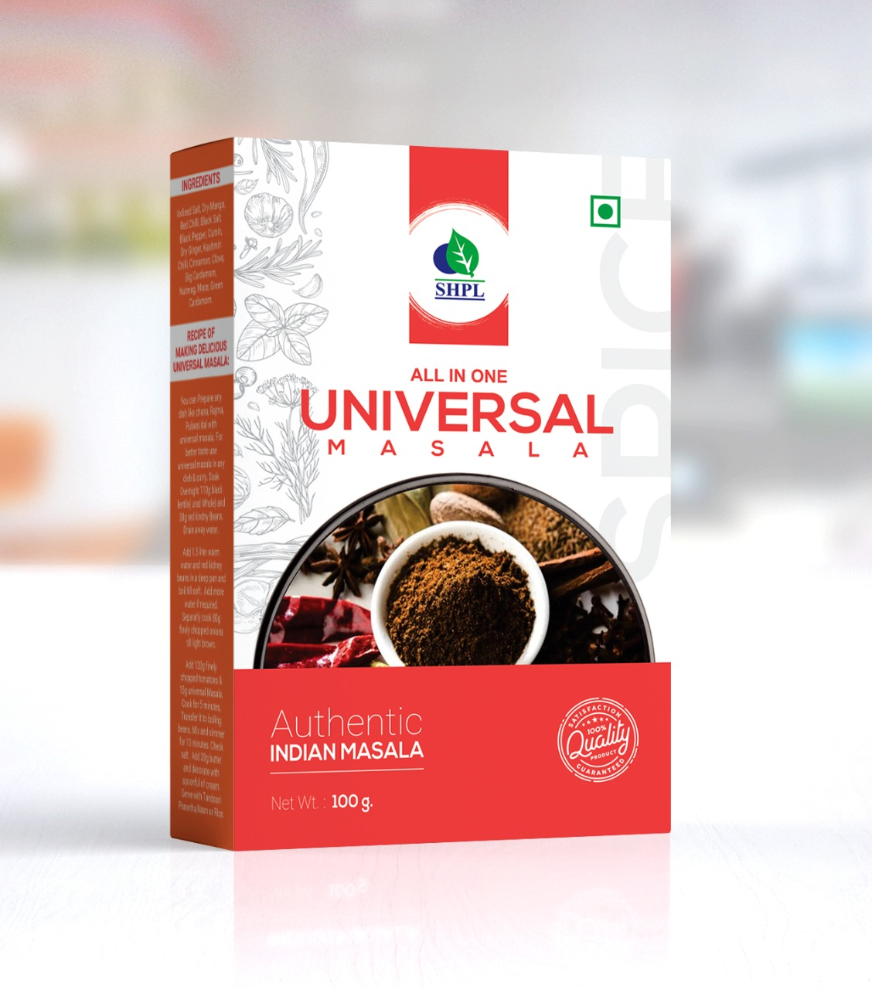
Product Type: Powder
Pack Size: 100 gm
MRP: Rs. 75/-

