Slide 3
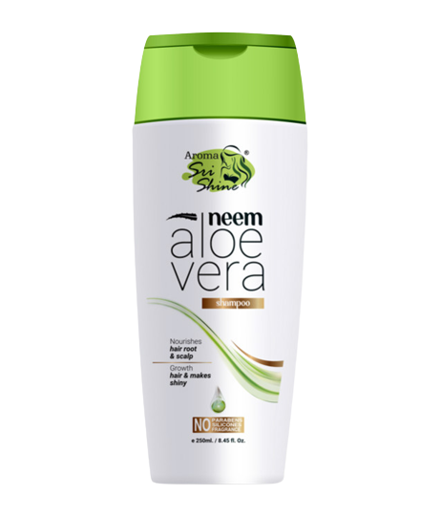
NEEM ALOEVERA
SHAMPOO
DESCRIPTION
The aloevera and neem condition the hair, strengthen the roots and make the hair silky. It also helps the hair grow faster. Aloe & Neem Keep Dandruff Away. It helps your hair to be smooth,shiny and less frizzy.
KEY INGREDIENTS
Neem & Aloevera extract
BENEFITS
Nourishes hair root and scalp
Improves blood circulation to hair follicles & stimulates growth of hair
Makes hair shiny
Makes hair healthier, stronger and longer
Controls hair falling, scaling and itching
Controls dandruff
HOW TO APPLY
Use as your regular bathing shampoo
Product Type: Shampoo
Pack Size: 250 ml
MRP: Rs. 350/-

Slide 4
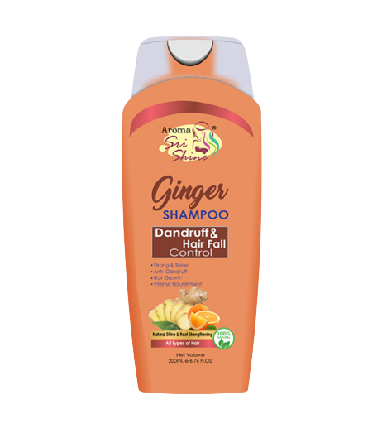
GINGER SHAMPOO
Dandruff & Hair Fall Control
DESCRIPTION
Ginger Anti-Dandruff & Anti hairfall Shampoo gently loosens flakes and helps soothe dry, itchy scalps. If you live in fear of flakes, this is the best shampoo for dry scalps. It helps take care of the snowstorm shoulders that can drive a dandruff sufferer to distraction, and smells pleasantly – well, gingery.
KEY INGREDIENTS
Ginger Extract
BENEFITS
Promotes natural hair growth
control hair fall
fights against dandruff
prevents split ends
HOW TO APPLY
Use as your regular bathing shampoo
Product Type: Shampoo
Pack Size: 200 ml
MRP: Rs. 300/-

Slide 5
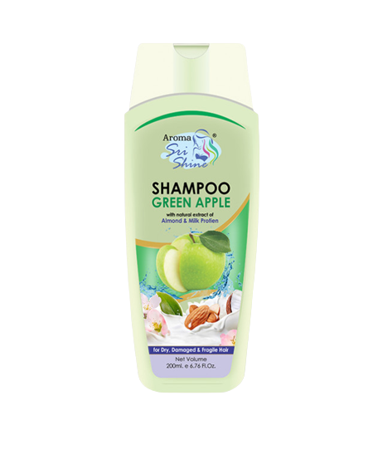
GREEN APPLE
SHAMPOO
DESCRIPTION
Sri Shine Green Apple Shampoo created with the leaves ans skin of green apple works wonders to fix dandruff. Packed with a tempting array of vitamin, minerals & green apple juice which are potential natural remedy for strengthening your hair.
KEY INGREDIENTS
Green Apple Extract, Milk Protein Extract & Almond Oil
BENEFITS
Promotes hair growth
Gives you long, strong & lush hair
Controls hair fall
Controls dandruff
HOW TO APPLY
Use as your regular bathing shampoo
Product Type: Shampoo
Pack Size: 200 ml
MRP: Rs. 300/-

Slide 6
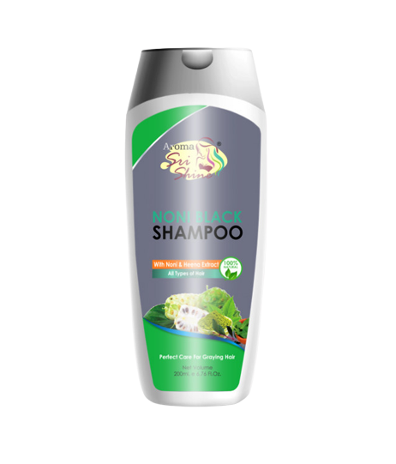
NONI BLACK
SHAMPOO
DESCRIPTION
Noni Black Shampoo blackens premature grey hair slowly and it protects hair too besides blackening hair. It also has anti-dandruff and nourishing properties which can supply essential nutrients to hair roots and effectively prevent hair lose. It won‘t damage hair and scalp as it contains no harmful chemicals. This ayurvedic shampoo promotes some anti-oxidant action and is anti-bacterial, promote blood circulation to the hair follicles.
KEY INGREDIENTS
Noni & Heena extract
BENEFITS
Controls premature greying
Removes dandruff and makes the hair look healthy and manageable
Removes split ends
Helps the hair growth cycle
HOW TO APPLY
Use as your regular bathing shampoo
Product Type: Shampoo
Pack Size: 200 ml
MRP: Rs. 300/-

Slide 7
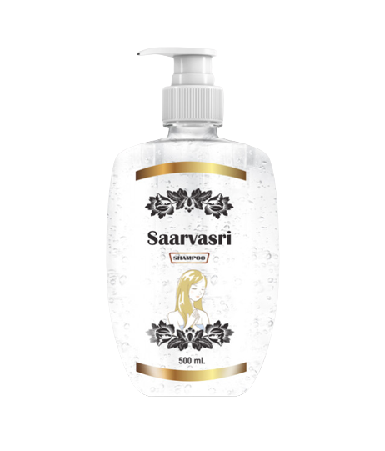
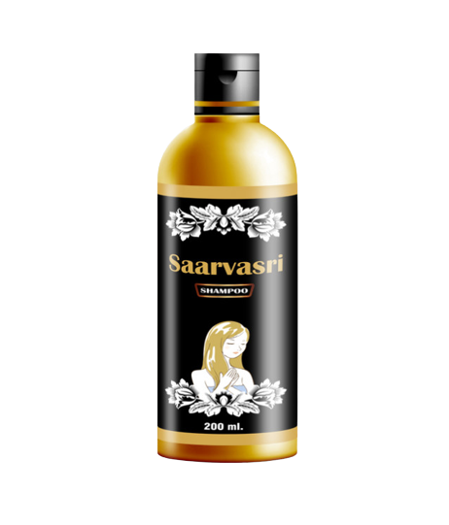
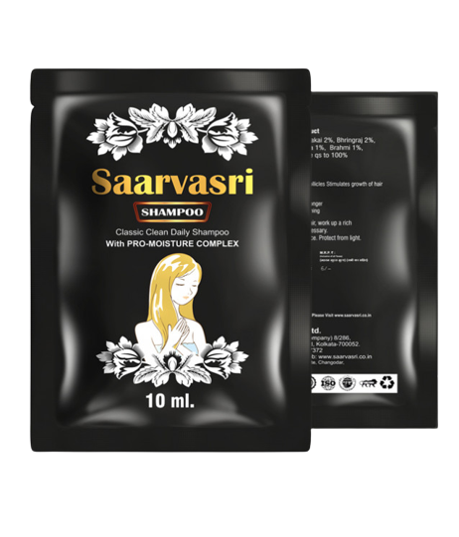
SAARVASRI
SHAMPOO
DESCRIPTION
Saarvasri Shampoo is formulated with lots of natural ingredients which specially used for damaged hair and hair fall problem. It's premium quality's ingredients and anti oxidant property nourishes scalp and hair, unclogs follicle, remove impurities & Make hair stronger root to tips.
KEY INGREDIENTS
Activated Charcoal & Aloevera Extract
BENEFITS
Prevent excessive hair fall
Promote healthy hair
Maintain the moisture balance of hair
Protect from damage and dryness
Helps to preserve natural oil into scalp
Its conditioning effect making hair soft, smooth, manageable
HOW TO APPLY
Use as your regular bathing shampoo
Product Type: Shampoo
Pack Size & MRP: 500 ml - Rs. 500/-
200 ml – Rs. 250/-
10 ml – Rs. 6/-

Slide 8
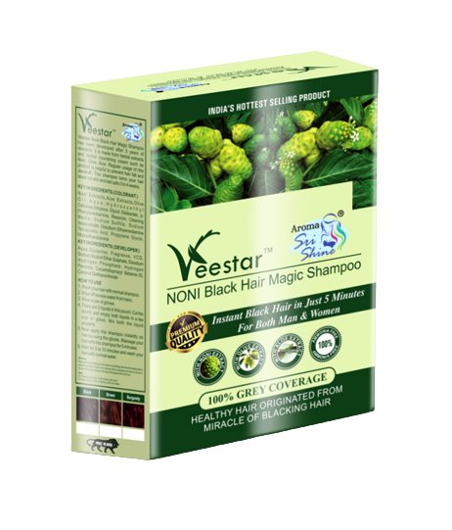
NONI BLACK
HAIR MAGIC SHAMPOO
DESCRIPTION
Noni Black Hair Magic Shampoo is a natural dye product formulated with various herbal essences for hair nutrition. Besides blackening hair, it also has anti-dandruff and nourishing properties which can supply essential nutrients to hair roots and effectively prevent hair loss.
KEY INGREDIENTS
Noni Juice, Aloevera Extract, Olive Oil.
BENEFITS
Get natural black hair instantly
Easy to use
No Ammonia
Controls hair fall
No more stain, won't stick to your skin
No need for anyone help. You can apply by yourself
HOW TO APPLY
1. Apply on dry and clean hair
2. Wear gloves then cut and open the sachet
3. Pour entire hair dye liquids into a non metallic bowl then mix it well.
4. Apply the mixture on hair and leave it for 15 to 20 Minutes.
5. Wash hair with Water.
Product Type: Shampoo
MRP: Rs. 100/-

Slide 9
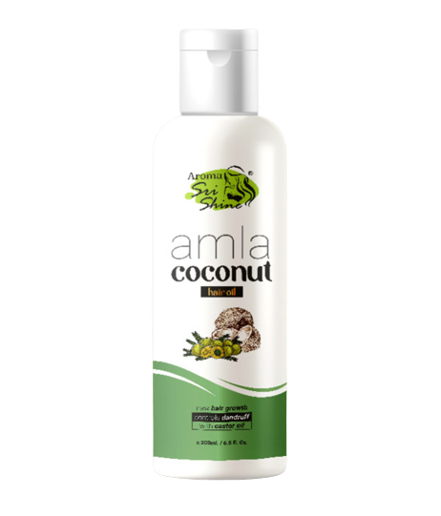
Amla Coconut
HAIR OIL
DESCRIPTION
Amla and coconut oil is rich in vitamin C that can enhance hair growth and volume. Coconut oil penetrates deep into the scalp, moisturises dry hair and add shine & lusture to them. Rich in vitamin E, omega 6 & 9, fatty acids and castor oil is excellent to prevent hair loss and split ends.
KEY INGREDIENTS
Amla Oil, Coconut Oil, Castor Oil
BENEFITS
Helps in new hair growth
Repairs dull hair
Controls dandruff
Stops hair fall
HOW TO APPLY
Gently massage on scalp and hair leave it for at least 2-3 hours and wash it with shampoo for better result keep it over night and wash it with shampoo on next day. Use 2-3 days in a week.
Product Type: Oil Product Size: 200 ml MRP: Rs. 300/-

Slide 10
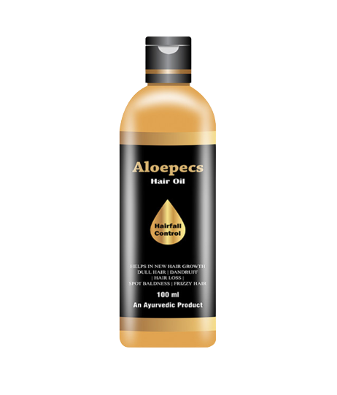
Aloepecs
HAIR OIL
DESCRIPTION
Alopecs hair oil designed to stimulate hair growth and restore vitality of hair. This multifunctional and intensive formula helps to treat Alopecia , strengthen your hair, reduce hairfall, and promote overall hair & scalp health, boost blood circulation. It's natural extract encourages hair growth and revitalize the hair follicles.
KEY INGREDIENTS
Black Till oil, Bhringraj, coconut oil, Neem, Anantamul, Amla, Bahera, Bramhmi, Karan, Malkangi, Mehendi, Sankhpushpi
BENEFITS
It helps in getting rid of sign baldness.
Adds nutrients and vitamins to the hair follicle
Stimulates of the circulation of blood to the scalp
prevent scalp psoriasis, relieves dry and itchy scalp problems.
Tighten hair root, retain hair's natural texture.
HOW TO APPLY
Gently massage on clean scalp . Leave on for at least 2 hours, for better result keep it overnight next day using Saarvasri Shampoo wash your hair properly.
Product Type: Oil Product Size: 100 ml MRP: Rs. 350/-

Slide 11
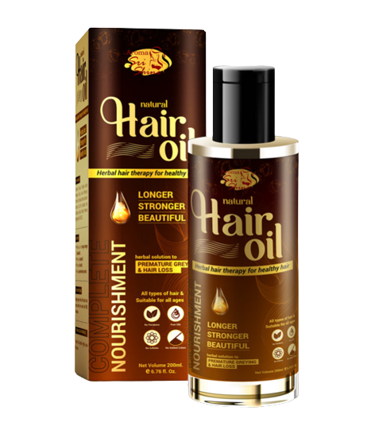
Natural
HAIR OIL
DESCRIPTION
Saarvasri Natural Hair Oil is a herbal hair therapy for healthy hair. It contains many natural herbs which are very rare and helps to keep your hair smooth, nourished, silky, shining and makes your hair more strong. It deeply penetrates in your hair follicles which will increase your hair's life span.
KEY INGREDIENTS
Sankhpushpi, Triphala, Kevda Manjeet, Giloy, Amla, Bhringraj, Brahmi, Balchad Kapoor, Dalchini, Tezpatta, Soya Chandan, Gulab, Mulaithi And Til Oil
BENEFITS
Makes your hair longer, stronger & beautiful
Removes dandruff
Prevents hair fall
Gives nourishment to your hair
HOW TO APPLY
Apply gently with soft hand in your hair roots to the end, keep for 2-3 hours at least, then wash it with shampoo. for better result you can keep it for over night and wash your hair with shampoo on next morning repeat this process for 2-3 days in week
Product Type: Oil Product Size: 200 ml MRP: Rs. 350/-

Slide 12
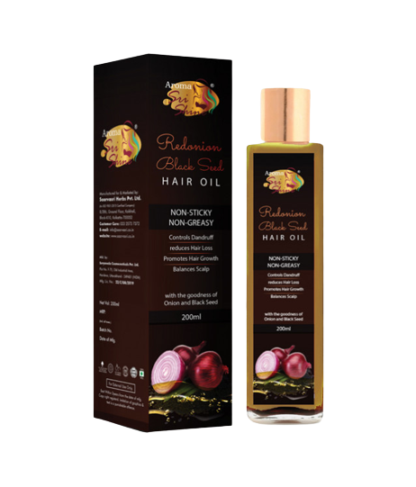
Red Onion
BLACK SEED HAIR OIL
DESCRIPTION
The luxurious non greasy and non sticky hair oil, which provides intense nourishment to the scalp, stimulates hair growth, strengthen hair roots and reduces hair loss. It also helps to eliminate dandruff and hair roots healthy for better hair growth.
KEY INGREDIENTS
Red Onion Oil, Black Seed, Sesame Oil, Olive Oil, Bhringraj Oil, Sweet Alomd Oil, Aloevera Oil Extract, Amla Oil, Brahmi Oil
BENEFITS
Controls dandruff
Reduces hair loss
Promotes hair growth
Balances pH of scalp
Stops split ends
Increase hair volume & length
HOW TO APPLY
Apply this hair oil all over the scalp, massage the scalp gently with fingers in a circular motion, so that the oil gets absorbed into the scalp gradually, leave for an hour or more then wash your hair with shampoo
Product Type: Oil Product Size: 200 ml MRP: Rs. 650/-

Slide 13
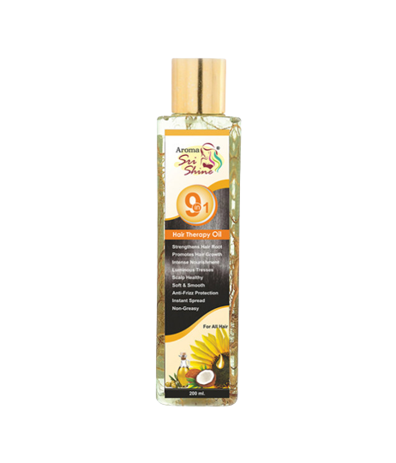
9 in 1
HAIR THERAPY OIL
DESCRIPTION
This oil is highly effective and excellent remedy for falling hair, premature graying, sleeplessness & head ache. It helps in nourishing hair follicles & boosting hair growth.
KEY INGREDIENTS
Amla Extract, Almond Oil, Methi Extract, Brahmi Extract, Olive Oil, Arnika Extract, Sunflower Oil, Bhringraj Extract, Vetiver Roots
BENEFITS
Strengthens hair roots
Promotes hair growth
Intense nourishment
Healthy scalp
Soft and smooth
Anti-frizz protection
Instant spread
Non greasy
HOW TO APPLY
Apply this hair oil all over the scalp, massage the scalp gently with fingers in a circular motion, so that the oil gets absorbed into the scalp gradually, leave for an hour or more then wash your hair with shampoo
Product Type: Oil Product Size: 200 ml MRP: Rs. 500/-

Slide 14
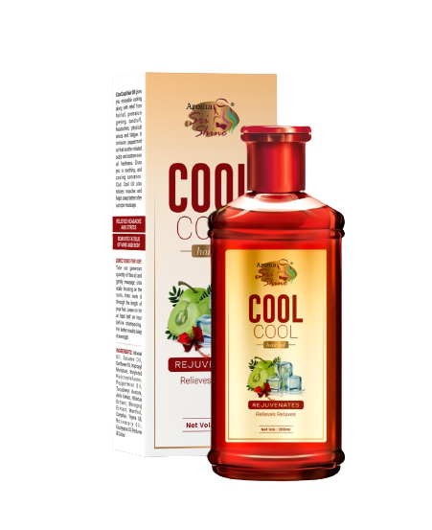
COOL COOL
HAIR OIL
DESCRIPTION
SHPL Hair Treatment is a procedure that helps make hair strong, bouncy and shiny, while simultaneously dealing with damaged hair, hair breakouts, & split ends. Coconut have several benefits for your hair. Using it as a hair mask and leave-in treatment may help moisturize and seal hair. Jojoba is rich in vitamins and minerals that nourish hair. So it is the ultimate solution for your hair problems.
KEY INGREDIENTS
Coconut Oil, Extracts, Jojoba Oil & Silk Protein
BENEFITS
Deep conditions your hair
Make your hair bouncy
Brings the natural shine & lusture of your hair
Repair damaged hair
Prevents split ends.
Gives you soft, smooth, & healthy hai
HOW TO APPLY
After washing your hair with any shampoo from Saarvasri. On wet hair put the coconut treatment cream on your hair length and massage with your finger tips to the end of your hair and keep it for 5-10 minutes and then rinse it off with water. Don’t apply the product on your scalp. If you do so it will make your hair root lose and it will increase your hair fall.
Product Type: Oil Product Size: 200 ml MRP: Rs. 350/-

Slide 15
HAIR GEL
Extra Hold
DESCRIPTION
Sri Shine Extra Hold Hair Gel is 100% natural and contains no harsh surfactants, artificial coloring, or fragrances. It is one of the few hair gels on the market. Our mild Hair Gel is also infused with Aloe Vera and milk protein to provide a full range of moisturizing and pH-balancing benefits.
KEY INGREDIENTS
Extract of aloevera & milk protein
BENEFITS
Strong hold for 15 hours
Boosts hair growth
All-natural styling
Prevents hair fall
Protects hair from getting damaged
Gives soft, smooth and bouncy hair
HOW TO APPLY
Apply sri shine extra hold hair gel on to wet or dry hair and create your own style using comb or fingers. Safe and east to rinse off. No harmful effects on hair
Product Type: Gel Product Size: 50 ml MRP: Rs. 75/-

Slide 16
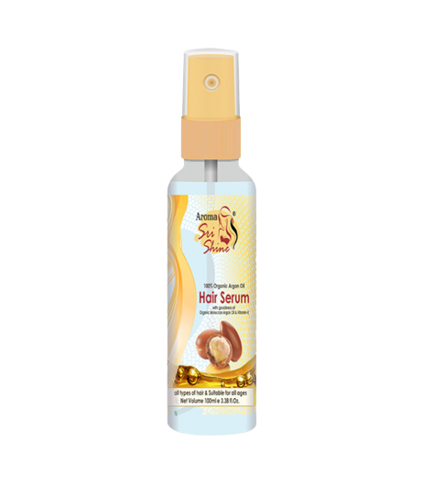
HAIR SERUM
DESCRIPTION
Sri shine argan oil Hair Serum makes hair more manageable and adds a healthy, attractive shine to any hair style. Argan oil is proven to make hair softer, silkier & shinier. It is ideal hair serum, and it can even help to treat split ends and tame frizzy hair.
KEY INGREDIENTS
LLP Oil, Almond Oil, Vitamin E, Argan Oil
BENEFITS
Makes your hair shiny
Removes split ends
Prevents frizzy hair
Makes your hair soft and attractive
HOW TO APPLY
Take a few amount of serum on hand & apply evenly through hairs and style as desire
Product Type: Liquid Product Size: 100 ml MRP: Rs. 850/-

Slide 17
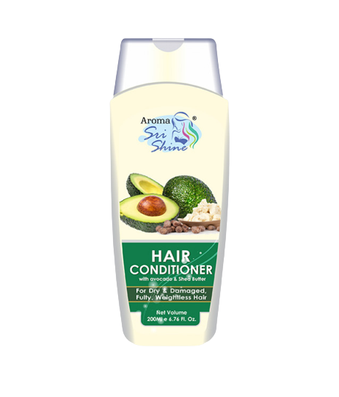
HAIR CONDITIONER
DESCRIPTION
Saarvasri Hair Conditioner is specially designed for dry, damaged, fragile and lifeless looking hair. Rich in natural moisturizers, nourishes and repairs the cuticle & hair cortex, adds moisture to the hair, increases the hair strength and shine creating lustrous and healthy looking hair.
KEY INGREDIENTS
Coconut Oil, Avacado Oil, Shea Butter
BENEFITS
Deeply penetrates and repairs the cuticle & hair cortex
adds moisture to the hair
gives the proper nourishment of the hair
prevents dry & damaged hairs
HOW TO APPLY
After rinse off the shampoo apply this condition to your hair (lengths) keep it for few minutes and wash it with normal water
Product Type: Conditioner Product Size: 200 ml MRP: Rs. 300/-

Slide 18
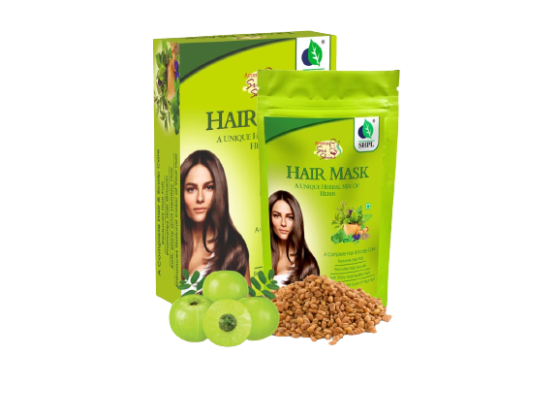
HAIR MASK
DESCRIPTION
Sometimes your hair just needs a little something extra. Damage from the elements, from styling, from using hair straightening irons, from waiting too long in between trims, these things all add up. A hair mask is a deep conditioning treatment that helps to heal damaged hair. They contain rich ingredients such as natural oils and lipids, in heavier concentrations than normal conditioners.
KEY INGREDIENTS
Amla, Shikakai, Aritha, Methi, Neem, Brahmi, Bhringraj, Triphala, Nagarmoth, Haldi, Jatamansi, Sugandhi, Tulsi, Bhimseni kapur, Ratanjot
BENEFITS
Shinier, softer hair.
Added moisture.
Reduced hair breakage and damage.
Less frizz.
A healthier scalp.
Stronger hair.
Less environmental and product damage.
HOW TO APPLY
Ensure that your hair is clean & dry
Apply your mask to hair in sections.
Start from the roots and work your way down.
Leave it in for up to 30-40 minutes so it actually works.
Rinse the mask with normal water and use Saarvasri Shampoo to complete the process.
Product Type: Paste Product Size: 100 gm MRP: Rs. 350/-

Slide 19
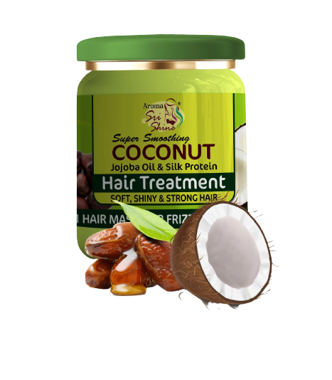
HAIR TREATMENT
HAIR MASK
DESCRIPTION
SHPL Hair Treatment is a procedure that helps make hair strong, bouncy and shiny, while simultaneously dealing with damaged hair, hair breakouts, & split ends. Coconut have several benefits for your hair. Using it as a hair mask and leave-in treatment may help moisturize and seal hair. Jojoba is rich in vitamins and minerals that nourish hair. So it is the ultimate solution for your hair problems.
KEY INGREDIENTS
Coconut Oil, Extracts, Jojoba Oil & Silk Protein
BENEFITS
Deep conditions your hair
Make your hair bouncy
Brings the natural shine & lusture of your hair
Repair damaged hair
Prevents split ends.
Gives you soft, smooth, & healthy hai
HOW TO APPLY
After washing your hair with any shampoo from Saarvasri. On wet hair put the coconut treatment cream on your hair length and massage with your finger tips to the end of your hair and keep it for 5-10 minutes and then rinse it off with water. Don’t apply the product on your scalp. If you do so it will make your hair root lose and it will increase your hair fall.
Product Type: Paste Product Size: 500 ml MRP: Rs. 800/-

Slide 21
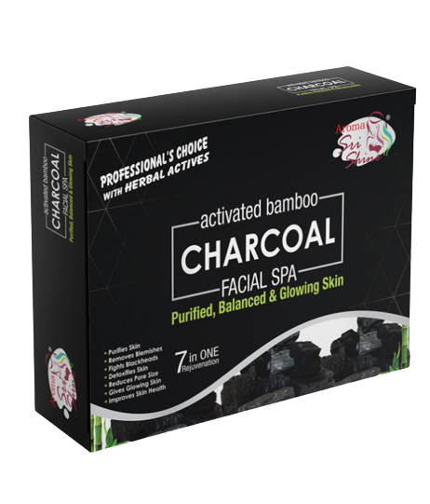
CHARCOAL
FACIAL KIT
DESCRIPTION
Charcoal is one of the most important elements that deep cleans, detoxifies and rejuvenates the skin! With main actives like Activated Charcoal, Aloevera Extract, fruit extract, tea tree oil, black grapes, vitamin E. SHPL Activated Bamboo Charcoal Facial Kit provides purified, balanced and glowing skin through 7-in-1 Rejuvenation. It Purifies the Skin, Removes Blemishes, Fights Blackheads, Detoxifies Skin, Reduces Pore Size, Gives Glowing Skin and Improves Skin Health.
BENEFITS
Purifies Skin | Removes Blemishes | Fights Blackheads | Detoxifies Skin | Reduces Pore Size | Gives Glowing Skin | Improves Skin Health.
HOW TO APPLY
STEP-1
ACTIVATED BAMBOO CHARCOAL CREAM CLEANSER
take an appropriate amount of cleanser and apply evenly on clean, wet face, than gently massage in circular and outward strokes for 5 minutes and rinse with water or wipe off using moist cotton.
STEP-2
ACTIVATED BAMBOO CHARCOAL FACIAL SCRUB
take an appropriate amount of this scrub and apply evenly on clean, wet face. Then gently scrub with feather like circular and outward strokes for 5 minutes and rinse off with water.
STEP-3
ACTIVATED BAMBOO CHARCOAL FACIAL GEL
Apply to a wet face using a gentle massaging motion, avoiding the eyes areas, rinse thoroughly with water.
HOW TO APPLY
STEP-4
ACTIVATED BAMBOO CHARCOAL MASSAGE CREAM
Take an appropriate amount of this gel and apply on face and neck gently massage till the gel is absorbed in the skin.
STEP-5
ACTIVATED BAMBOO CHARCOAL FACE MASK
protect the hairline with folded tissues. Apply this pack in a thin layer over the face and neck area with fingertips avoid the eye areas and leave it till it dries off for 10-15 minutes. Remove the mask with a wet wipe and rinse it off.
STEP- 6
DEEP DETOX FACE SERUM
To complete your facial take a small amount of serum and apply it all over your face. Leave on face and no need to rinse it off
MRP: Rs. 1500/-

Slide 22
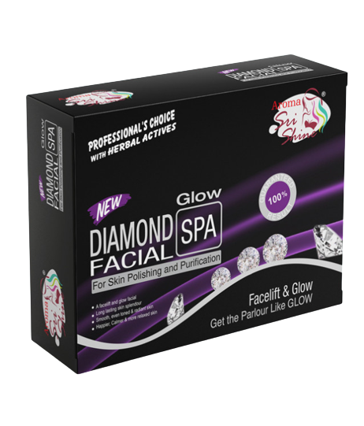
DIAMOND
FACIAL KIT
DESCRIPTION
Diamond Glow facial kit boosts and re balances anti oxidant defenses of skin cell and protects them against free radicals. It provides action to re-harmonize cellular movement which improves skin elasticity. It is an advanced in home spa treatment that helps to relax and soothe, tired and over worked skin, it enables pores to hydrate, detoxify and purify, which leads to reduction in pore size & appearance. Also it replenished collagen and elastin production with advanced formulations for smoother skin & instant glow.
BENEFITS
Exfoliates Skin | Prevents Aging-Related Issues | Detoxifies Skin | Makes Skin Tight | Improves Absorption | Keeps Face Hydrated | Gives Smooth & Even-toned Skin
HOW TO APPLY
STEP-1
Diamond Glow Cream Cleanser
take an appropriate amount of cleanser and apply evenly on clean, wet face, than gently massage in circular and outward strokes for 5 minutes and rinse with water or wipe off using moist cotton.
STEP-2
Diamond Glow Facial Scrub
take an appropriate amount of this scrub and apply evenly on clean, wet face. Then gently scrub with feather like circular and outward strokes for 5 minutes and rinse off with water.
STEP-3
Diamond Glow Massage Cream
Apply to a wet face using a gentle massaging motion, avoiding the eyes areas, rinse thoroughly with water.
HOW TO APPLY
STEP-4
Diamond Glow Facial Gel
Take an appropriate amount of this gel and apply on face and neck gently massage till the gel is absorbed in the skin.
STEP-5
Diamond Glow Face Mask
protect the hairline with folded tissues. Apply this pack in a thin layer over the face and neck area with fingertips avoid the eye areas and leave it till it dries off for 10-15 minutes. Remove the mask with a wet wipe and rinse it off.
STEP- 6
Diamond Glow Serum
To complete your facial take a small amount of serum and apply it all over your face. Leave on face and no need to rinse it off
MRP: Rs. 1500/-

Slide 23
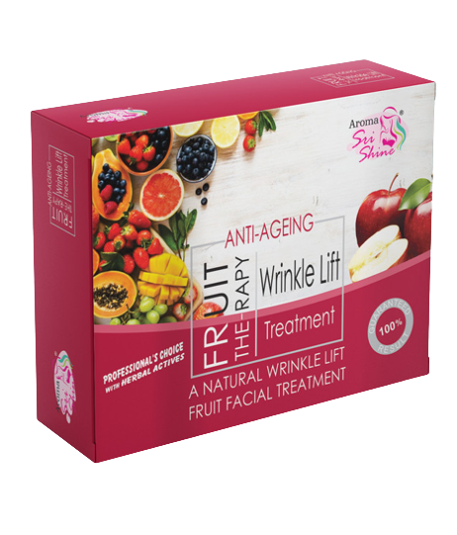
FRUIT
FACIAL KIT
DESCRIPTION
Fruits revive the skin hence the elements in a fruit facial kit will help to rejuvenate and brighten the skin. For the skin that is dull and dry, fruit facial is good to get done since fruits will get rid of the dryness and dullness. They also make the skin complexion fairer. SHPL Fruit Therapy Facial Kit comprising of vitamin-rich fruit extracts is specially designed to revitalize and nourish the skin, imparting a healthy, youthful radiance
BENEFITS
Deep Cleansing Of The Skin | Lessens Pigmentation | Detoxifies Skin | Reducing Dark Spots | Keeps Face Hydrated | Gives Smooth & Even-toned Skin
HOW TO APPLY
STEP-1
FRUIT THERAPY CREAM CLEANSER
take an appropriate amount of cleanser and apply evenly on clean, wet face, than gently massage in circular and outward strokes for 5 minutes and rinse with water or wipe off using moist cotton.
STEP-2
FRUIT THERAPY FACIAL SCRUB
take an appropriate amount of this scrub and apply evenly on clean, wet face. Then gently scrub with feather like circular and outward strokes for 5 minutes and rinse off with water.
STEP-3
FRUIT THERAPY FACIAL GEL
Apply to a wet face using a gentle massaging motion, avoiding the eyes areas, rinse throughly with water.
HOW TO APPLY
STEP-4
FRUIT THERAPY MASSAGE CREAM
Take an appropriate amount of this gel and apply on face and neck gently massage till the gel is absorbed in the skin.
STEP-5
FRUIT THERAPY FACE MASK
protect the hairline with folded tissues. Apply this pack in a thin layer over the face and neck area with fingertips avoid the eye areas and leave it till it dries off for 10-15 minutes. Remove the mask with a wet wipe and rinse it off.
STEP- 6
FRUIT THERAPY FACE SERUM
To complete your facial take a small amount of serum and apply it all over your face. Leave on face and no need to rinse it off
MRP: Rs. 1500/-

Slide 24
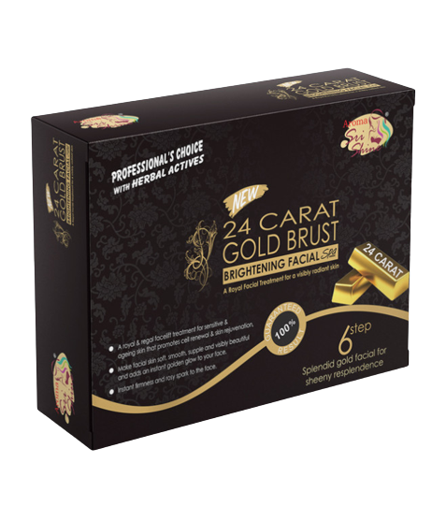
24 CARAT GOLD BURST
FACIAL KIT
DESCRIPTION
SHPL Gold Burst Facial Kit has harnessed the best benefits of the metal to curate this luxurious facial that improves skins hydration and metabolism, prevents premature aging, removes pigmentation, age spots, lines and wrinkles, boosts collagen regeneration, and strengthens elastin fibers to reveal radiant, luminous, youthful complexion. Its give you a royal facial treatment for a visibly radiant skin.
BENEFIT
Reduction of wrinkles and fine lines | More youthful looking skin | Improves your blood circulation | Helps with oily and dry skin | Brightens up your face and helps with dullness | It is antibacterial so it helps with acne and pimples | Combats damage from the sun
HOW TO APPLY
STEP-1
GOLD BURST GEL CLEANSER
take an appropriate amount of cleanser and apply evenly on clean, wet face, than gently massage in circular and outward strokes for 5 minutes and rinse with water or wipe off using moist cotton.
STEP-2
GOLD BURST FACIAL SCRUB
take an appropriate amount of this scrub and apply evenly on clean, wet face. Then gently scrub with feather like circular and outward strokes for 5 minutes and rinse off with water.
STEP-3
GOLD BURST FACIAL GEL
Apply to a wet face using a gentle massaging motion, avoiding the eyes areas, rinse thoroughly with water.
HOW TO APPLY
STEP-4
GOLD BURST MASSAGE CREAM
Take an appropriate amount of this gel and apply on face and neck gently massage till the gel is absorbed in the skin.
STEP-5
GOLD BURST FACE MASK
protect the hairline with folded tissues. Apply this pack in a thin layer over the face and neck area with fingertips avoid the eye areas and leave it till it dries off for 10-15 minutes. Remove the mask with a wet wipe and rinse it off.
STEP- 6
POST FACIAL FACE SERUM
To complete your facial take a small amount of serum and apply it all over your face. Leave on face and no need to rinse it off
MRP: Rs. 1500/-

Slide 25
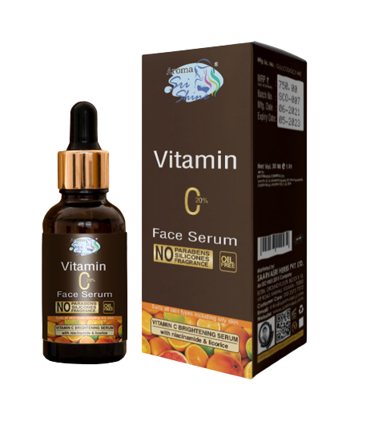
VITAMIN C
FACE SERUM
DESCRIPTION
Vitamin C Face Serum helps reduce your wrinkles because they contain essential ingredients like antioxidants and pass through the skin quickly, preventing water loss while keeping skin plump. Antioxidants also boost collagen production and strengthen skin elasticity – another anti-aging perk. This magical oil can be your skin's saviour for bedtime night routines, giving you flawless and glowing skin in the morning.
KEY INGREDIENTS
Sandalwood, Vetiver, Lotus Oil, Tea Tree Oil & Vitamin C
BENEFITS
Brightens dull skin
Repairs pigmentation
Minimizes fine lines and signs of aging
Relieves dark circles
moisturize your skin
gives a natural glow to your skin
prevents dry skin
makes your skin younger looking
HOW TO APPLY
Before going to bed wash your face with any of Saarvasri natural face wash & apply 3-4 drops of SHPL Vitamin C Face Serum in your face, massage softly and let the serum get absorbed to your skin.
Product Type: Serum
Pack Size: 30 ml
MRP: Rs. 750/-

Slide 26
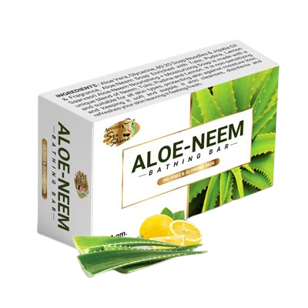
ALOE-NEEM
BATHING BAR
DESCRIPTION
Aloe-Neem Bathing Bar has a rich concentration of natural herbs such as Aloe Vera, Neem, lemon, pudina, & tulsi extracts. The Aloe Vera has antifungal, antibacterial and anti-inflammatory properties that help in keeping the skin free of infection and microbial attacks. Neem helps in combating skin diseases.
KEY INGREDIENTS
Aloevera, Neem, Tulsi, Pudina, Lemon
BENEFITS
Smooth and moisturized skin
Anti inflammatory
Anti oxidant
Gives your fresh and glowing skin
HOW TO APPLY
Apply as your regular soap.
Product Type: Bathing Bar
Pack Size: 100 gm
MRP: Rs. 55/-

Slide 27
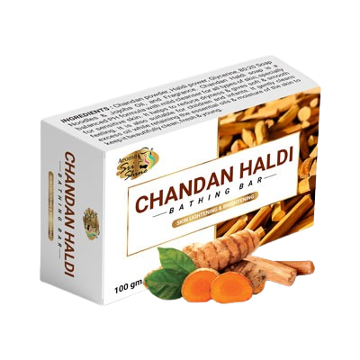
CHANDAN HALDI
BATHING BAR
DESCRIPTION
Chandan Haldi Bathing Bar cleanses, tones and nourishes your skin with it's pure ayurvedic ingredients known to heal skin problems and give a clear, flawless skin naturally. Specially formulated preparation with Chandan, Haldi, Glycerin and Jojoba feels the skin so radient and soft. Those Ingredients are very well known wonder herbs with lot of medicinal value to improve skin.
KEY INGREDIENTS
Chandan Powder, Haldi Powder, Jojoba Oil
BENEFITS
Maintain moisture balance throughout the day.
Detoxifies and remove dirt from the skin.
With regular use its protects from common skin problems like spots, rashes, pigmentation etc.
Keeps skin naturally soft, supple and gently perfumed.
HOW TO APPLY
Apply as your regular soap.
Product Type: Bathing Bar
Pack Size: 100 gm
MRP: Rs. 55/-

Slide 28
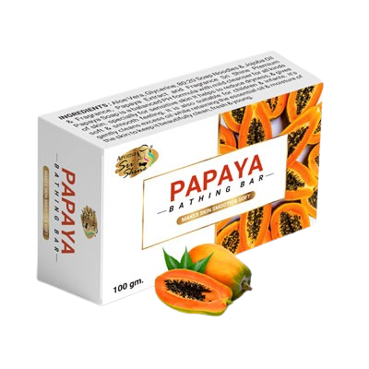
PAPAYA
BATHING BAR
DESCRIPTION
SHPL Papaya Bathing Bar comes with 78%TFM and it contains fresh papaya fruit extract and other beneficial herbal ingredients like Jojoba, Aloevera. This extract and papain fruit enzymes helps to rejuvenate skin by sloughing of dead skin cells. Its an excellent antioxidant properties play a role to slow down skin's aging process and improve skin's elasticity.
KEY INGREDIENTS
Papaya, Aloevera, Jojoba Oil
BENEFITS
Moisturizes skin keeping it soft and smooth.
Cleanse, purify and detoxifies skin.
Reduces dark spots, blemishes, patches
leaves the skin brighter and glowing.
HOW TO APPLY
Apply as your regular soap.
Product Type: Bathing Bar
Pack Size: 100 gm
MRP: Rs. 55/-

Slide 29
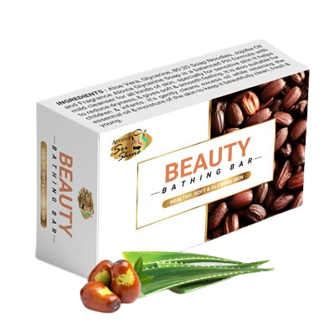
BEAUTY
BATHING BAR
DESCRIPTION
Beauty Bathing Bar contains Natural Moisturizing Factors which helps prevent wrinkles and delays the aging process. The combined formulation of ingredients provide skin repairing nurturing factors making skin look younger and feel better. Intense moisturizing soap ingredients provide natural moisturizing factors and phenomenal natural skin care.
KEY INGREDIENTS
Aloevera, Jojoba Oil & Glycerine
BENEFITS
penetrate the top layer of skin
Contain natural sun protection qualities for your skin
Stimulate collagen production
Increase the amount of collagen
Rejuvenate, hydrate & restore the skins elasticity
fight free radicals
HOW TO APPLY
Apply as your regular soap.
Product Type: Bathing Bar
Pack Size: 100 gm
MRP: Rs. 55/-

Slide 30
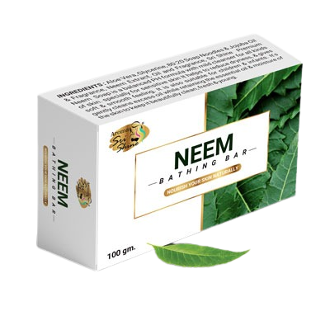
NEEM
BATHING BAR
DESCRIPTION
Saarvasri handmade Neem Bathing Bar has a proprietary formula of key plant extracts to protect, refresh and revive and has powerful anti bacterial effects. Gentle on skin, it leaves the body clean, refreshes without disturbing the natural balances. It also helps to counteract the effects of pollution and chlorinated water. Regular use makes the body free from skin problem like Ringworm, Scabies and Dermatitis.
KEY INGREDIENTS
Neem Extract
BENEFITS
It has Anti-bacterial & Anti-fungal properties in it
Prevent skin infection
Gives rid from allergy & redness
Prevents sensitive skin.
HOW TO APPLY
Apply as your regular soap.
Product Type: Bathing Bar
Pack Size: 100 gm
MRP: Rs. 55/-

Slide 31
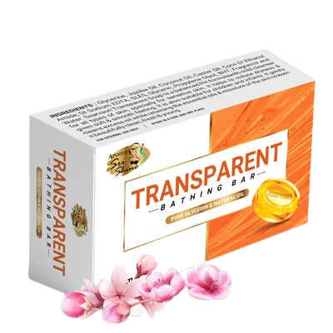
TRANSPARENT
BATHING BAR
DESCRIPTION
Transparent Bathing Bar is enriched with the goodness of Glycerin, Jojoba, Coconut, and Caster oil which moisturizes your skin and prevent over drying. This mild soap's ingredients doesn't irritate your skin but can helps to lock skin's moisture which are often stripped during the bathing process, whether from hot water or harsh product.
KEY INGREDIENTS
Glycerin, Jojoba oil, Coconut oil, Caster oil
BENEFITS
Maintain skin's PH levels.
Making skin soft and supple.
Controls skin's own moisture and elasticity.
prevent roughness and skin's rashes
HOW TO APPLY
Apply as your regular soap.
Product Type: Bathing Bar
Pack Size: 100 gm
MRP: Rs. 100/-

Slide 32
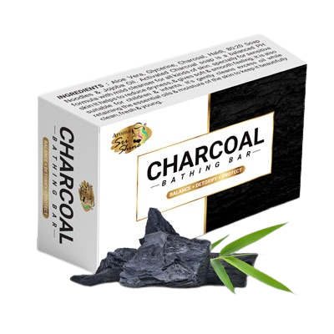
CHARCOAL
BATHING BAR
DESCRIPTION
Charcoal Bathing Bar is enriched with natural extracts which keeps your skin oil free and absorbs deep into pores to drown out dirt. It’s pH balanced formula helps to eliminate rashes, dead cells, excess oil while retaining the essential oils and moisture to keep fresh clean and odour free skin.
KEY INGREDIENTS
Activated Charcoal, Aloevera, Jojoba Oil
BENEFITS
SHPL Charcoal soap composed with 76% TFM. Higher TFM is sign of purity.
Being an excellent exfoliant with the ability to remove dead skin cells along with the extraction of dirt also treats psoriasis and eczema.
Remove spot and excess oil production.
HOW TO APPLY
Apply as your regular soap.
Product Type: Bathing Bar
Pack Size: 100 gm
MRP: Rs. 100/-

Slide 33
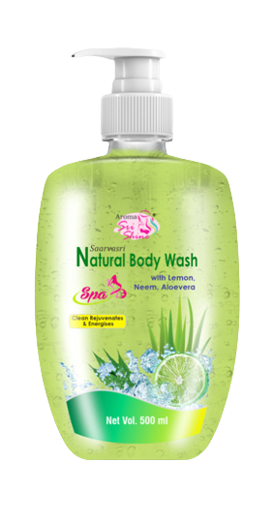
NATURAL BODY WASH
With Lemon, Neem & Aloevera
DESCRIPTION
SHPL Natural Body Wash is a refreshing cleanser body wash, formulated with Alovera, Neem & Lemon oil to give you protection against acne and irritation causing Pollutants & dirt in each use. It removes excess oils from the skin and balances PH levels of skin & improve skin texture.
KEY INGREDIENTS
Aloevera, Neem, Lemon, natural Grass extract, & jojoba oil
BENEFITS
protection against acne and irritation causing
removes excess oils from the skin
balances PH levels of skin & improve skin texture
removes all Microbes and pollutants
delicate fragrance and ingredients makes your showering delight
prevents black heads, acne and soothes irritations
HOW TO APPLY
Pour some body wash onto a sponge or washcloth. Lather & gently scrub yourself all over. Rinse it all off with water.
Product Type: Body Wash
Pack Size: 500 ml
MRP: Rs. 500/-

Slide 34
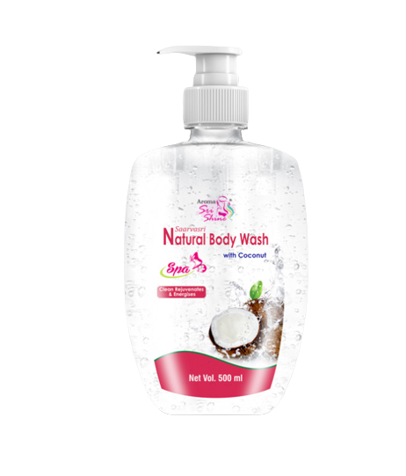
NATURAL BODY WASH
With Coconut
DESCRIPTION
Intensely hydrating coconut body wash formulated with Jojoba Oil, Organic Coconut Oil and lemon extract. Replenishes and soothes dull, stressed skin, while treating you to a delicious Coconut scent. It makes a wonderful lather and smells heavenly, and that smell lasts all day.
KEY INGREDIENTS
Coconut oil, natural extract of lemon Grass, jojoba oil
BENEFITS
Prevent premature ageing
Smooth skin
Retain moisture
Heal wounds
Protect against cracking
Help skin growth
Repairs skin cells
Removes tan
HOW TO APPLY
Pour some body wash onto a sponge or washcloth. Lather & gently scrub yourself all over. Rinse it all off with water.
Product Type: Body Wash
Pack Size: 500 ml
MRP: Rs. 500/-

Slide 35
NEEM
FACE WASH
DESCRIPTION
The soap-free herbal formulation deep cleanses the skin removing all impurities. The purifying Neem Face Wash enriched with lemon & turmeric goes deep into your pores and removes the excess sebum secretion and impurities leaving your skin feeling healthy and glowing. It also Helps Control Acne and Pimples.
KEY INGREDIENTS
Neem extract, lemon extract & turmeric extract.
BENEFITS
Controls acne & pimples
Can help in brighten & lighten your skin
Reduce redness
Helps in sensitive skin
Controls excess sebum production
HOW TO APPLY
Take out a small quantity of facewash from tube on wet palms. Rub palms against each other to work up the lather and gently massage on face for 1-2 minutes. Rinse with water and pat dry.
Product Type: Face Wash Pack Size: 100 ml MRP: Rs. 230/-

Slide 36
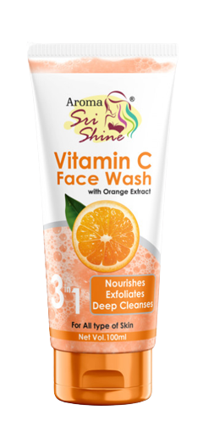
Vitamin C
Face Wash
DESCRIPTION
Vitamin C Face Wash with the goodness of Vitamin C has brightening properties to give your skin a natural glow. It also helps in skin repair by boosting collagen production and blood circulation, leaving the skin radiant and healthy. Perfect for daily use, retains moisture,prevents dry skin and fights free radical damage.
KEY INGREDIENTS
orange extract
BENEFITS
Smooths skin & fights signs of ageing
Brightens skin & Even skin tone
Reduces appearance of dark spots
Prevents dry skin & Strengthens your skin
Improves texture.
Removes impurities.
HOW TO APPLY
Take out a small quantity of facewash from tube on wet palms. Rub palms against each other to work up the lather and gently massage on face for 1-2 minutes. Rinse with water and pat dry.
Product Type: Face Wash Pack Size: 100 ml MRP: Rs. 250/-

Slide 37
ALOE & NEEM
Face Wash
DESCRIPTION
A natural active based foaming facewash that lifts away impurities without drying out the skin. Moisturizing aloevera hydrates skin while detoxifying. Neem deeply cleanses dirt, grime, toxins, pollutants and pimple causing bacteria. This super mild soap free pH balanced formula removes oil imbalances of your skin and prevents frequent skin breakouts.
KEY INGREDIENTS
Neem Extract, Aloevera Extract, Lemon Extract, Pudina Extract, Tulsi Extract
BENEFITS
Moisturising
Hydrates
Detoxifies
Deep cleansing
pH balanced
Anti-acne
HOW TO APPLY
Take out a small quantity of facewash from tube on wet palms. Rub palms against each other to work up the lather and gently massage on face for 1-2 minutes. Rinse with water and pat dry.
Product Type: Face Wash Pack Size: 100 ml MRP: Rs. 150/-

Slide 38
24 Carat
GOLD FACE WASH
DESCRIPTION
24 carot gold facewash is a rich, creamy, SLES free, crystal formula gently cleanses & revitalizes the skin whilst the blend of nourishing of protect it from dryness. Refine your face with this invigorating face wash bestows luxurious glow & shine to the skin, making your face look beautiful radiantly blushing.
KEY INGREDIENTS
Turmeric Extract, Aloevera Extract, Gold Dust
BENEFITS
Instant glow & Shine
Even toned
Radiantly blushing
HOW TO APPLY
Take out a small quantity of facewash from tube on wet palms. Rub palms against each other to work up the lather and gently massage on face for 1-2 minutes. Rinse with water and pat dry.
Product Type: Face Wash Pack Size: 100 ml MRP: Rs. 300/-

Slide 39
PAPAYA
FACE WASH
DESCRIPTION
This face wash is produced scientifically by combining the properties of papaya , which is an excellent source of Vitamin A and Papain, and other valuable extract that is honey. which prevents wrinkles, fine lines and age pigmentation. Vitamin A acts as an anti-oxidant, while the papain breaks down inactive proteins and removes dead skin cells. This two extracts coupled with treated granules aid in removing dead skin cells, deep cleansing the skin and help mitigating blemishes and pigmentation, which makes skin look visibly even toned, young and fairer.
KEY INGREDIENTS
Extract Of Papaya & Honey
BENEFITS
Removes blemishes
Prevents wrinkles & fine lines
Makes skin even toned
Keeps your skin fresh and young
HOW TO APPLY
Take out a small quantity of facewash from tube on wet palms. Rub palms against each other to work up the lather and gently massage on face for 1-2 minutes. Rinse with water and pat dry.
Product Type: Face Wash Pack Size: 100 ml MRP: Rs. 250/-

Slide 40
CHARCOAL
FACE WASH
DESCRIPTION
Activated charcoal is amazingly adsorbent, known to effectively cleans the skin, unclog pores, remove deeper impurities and dead skin cells, resulting in smooth, supple skin. Since it contains a large surface area due to its unique physical structure, dirt, toxins, heavy metals, chemicals and other poisons are attracted to the charcoal molecules and washed away. The beauty of activated charcoal is that it removes these impurities without adsorbing vitamins and nutrients, leaving your skin radiantly healthy.
KEY INGREDIENTS
Activated Charcoal, Green Tea Extract & Aloevera Extract
BENEFITS
Removes blackheads
Removes excess oil
Removes tan
Spot reduction
Anti pigmentation
Long protection
Removes dirt from the pores
HOW TO APPLY
Take out a small quantity of facewash from tube on wet palms. Rub palms against each other to work up the lather and gently massage on face for 1-2 minutes. Rinse with water and pat dry.
Product Type: Face Wash Pack Size: 100 ml MRP: Rs. 300/-

Slide 41
ALOEVERA & NEEM
DEEP CLEANSING MILK
DESCRIPTION
Sri Shine Aloevera & Neem Deep Cleansing Milk cleanses your skin from deep within. This light formulation helps in removing dirt, pollutants and other impurities trapped in the skin pores. Aloevera helps in repairing skin damage. It removes dead cells leaving your skin smooth and supple gifting you a youthful fresh glow.
KEY INGREDIENTS
Aloevera Extract, Tea Tree Oil, & Extract Of Neem
BENEFITS
Deep cleanses from pores
Keep your skin refresh
Repair your skin texture
Keeps your skin naturally soft
HOW TO APPLY
Apply this cleanser on the face and neck with your finger tips and massage in circular motion for few minutes. Wipe off with cotton or tissue. use daily for a clean, smooth, hydrated and vibrant appearance.
Product Type: Cleanser Pack Size: 200 ml MRP: Rs. 250/-

Slide 42
PREMIUM ROSE
SOLUTION
DESCRIPTION
Sri Shine Premium Rose Solution helps in maintaining the skin pH balance, and also controls excess oil. Rose water has anti inflammatory properties that can help reduce the redness of irritated skin, get rid of acne, dermatitis and eczema.
KEY INGREDIENTS
Rose water
BENEFITS
Skin's ph balance
Oil control
Reduce skin irritation
Helps in spot lightning
HOW TO APPLY
Wash your face with fresh water and pat dry after that apply few sprays of this toner, leave it on your face no need to rinse off. Use 2-3 times for better result.
Product Type: Toner Pack Size: 100 ml MRP: Rs. 210/-

Slide 43
PREMIUM ORANGE
SOLUTION
DESCRIPTION
Sri Shine Premium Orange Solution is a crazy good skin tonic. Orange solution is soothing and toning. It is a natural tonic and fortifier for dry, sensitive & mature skin. It keeps skin fresh , well hydrated and lively throughout the day. It is a great toner for dry skin.
KEY INGREDIENTS
Orange water
BENEFITS
Prevents dry skin
Keeps skin fresh
Maintain pH balance
Even toned
HOW TO APPLY
Wash your face with fresh water and pat dry after that apply few sprays of this toner, leave it on your face no need to rinse off. Use 2-3 times for better result.
Product Type: Toner Pack Size: 100 ml MRP: Rs. 210/-

Slide 44
PREMIUM NEEM
SOLUTION
DESCRIPTION
Sri Shine Premium Neem Solution as a skin toner regularly wil help in clearing acne, scars, pigmentation and blackheads. It is a natural tonic and fortifier for oily, sensetive & matured skin and krrps your skin fresh, well hydrated and lively throughout the day.
KEY INGREDIENTS
Neem Water & Aloevera
BENEFITS
Controls acne
Gives you clear skin
Maintain pH balance
Keeps your skin hydrated
Controls excess oil
HOW TO APPLY
Wash your face with fresh water and pat dry after that apply few sprays of this toner, leave it on your face no need to rinse off. Use 2-3 times for better result.
Product Type: Toner Pack Size: 100 ml MRP: Rs. 210/-

Slide 45
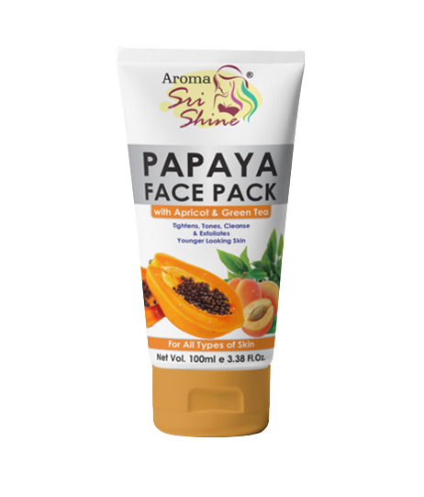
PAPAYA
FACE PACK
DESCRIPTION
Papaya facepack contains a blend of natural ingredients like apricot, papaya and green tea. Papaya contains high amounts of vitamin A and vitamin C remove dullness and dryness. Green tea contains anti-aging and antioxidant benifits that can help delay sings. Apricot treats itching due to sunburn, eczema and scabies. This also helps to clear acne and exfoliates the skin.
KEY INGREDIENTS
Kaolin, Bentonite, Extract of papaya, Extract of apricot, Extract of green tea.
BENEFITS
Tightens skin pores
Deep cleanses
Tones
Exfoliates
Remove blemishes
Gives you a younger looking skin
HOW TO APPLY
Apply thick layer of sri shine Papaya Face Pack on your face & neck and converet to a smooth layer. Allow it to dry or wait for 10-15 minutes then rinse off with fresh water.
Product Type: Face Pack Pack Size: 100 ml MRP: Rs. 300/-

Slide 46
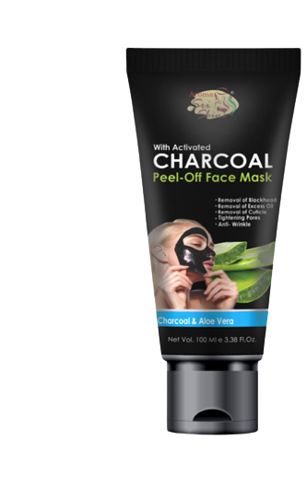
CHARCOAL
FACE MASK
DESCRIPTION
Activated charcoal draws grime, bacteria, oil and other impurities from the skin, which makes it an amazing ingredient to treat all your skin woes. It's even better when you use an activated charcoal peel off mask as it exfoliates your skin and sloughs away dead skin cells.
KEY INGREDIENTS
Activated charcoal, Aloevera extract.
BENEFITS
Helps remove impurities
Excellent exfoliator
Removes blackheads
Detoxifies skin
Deep cleanse your skin
Brightens the appearance of your skin
HOW TO APPLY
Cleanse your face before you use the mask
Spread the charcoal mask on your face. Avoid spreading the mask near your eyes and lips. Wait for 10 to 15 minutes. Peel off the charcoal mask, Start at the bottom of the mask and slowly peel upwards towards the top of your face Wash and moisturize after you use the mask.
Product Type: Face Mask Pack Size: 100 ml MRP: Rs. 350/-

Slide 47
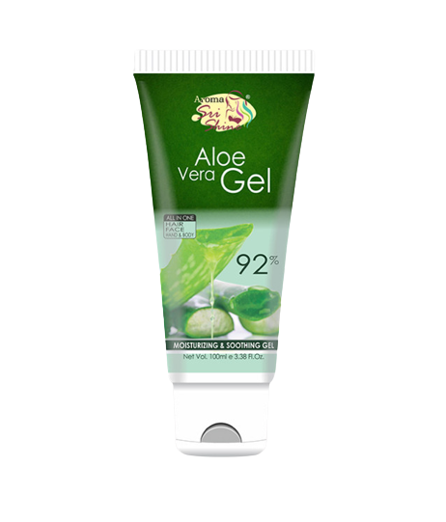
Aloevera
Gel
DESCRIPTION
Sri shine Aloe Vera Gel is perhaps one of the most widely used herbal remedies for topical skin conditions. Aloevera gel is an antibacterial, antioxidant, anti-inflammatory. Its helps with signs of ageing, removes dark circles and puffiness.
KEY INGREDIENTS
Aloevera Extract
BENEFITS
Controls excess oil
Controls inflammation
Keeps skin fresh
Remove dark circle and puffiness
HOW TO APPLY
Apply aloevera gel on your face and massage in upward circular motion. To get better result use at night.
Product Type: Gel
Pack Size: 100 ml
MRP: Rs. 270/-

Slide 48
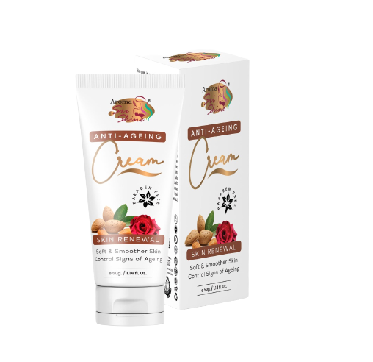
Anti-Ageing
Cream
DESCRIPTION
Anti-Ageing Cream helps delay the onset of sagging skin and significantly firms up the skin to unveil your natural, healthier & radiant skin. Reduces appearance of wrinkles and age spots, naturally. Helps prevent premature signs of aging. Rehydrates the skin, lifts sag and diminishes fine lines.
KEY INGREDIENTS
Almonds and Rose extracts
BENEFITS
Boosts collagen
Hydrates skin
Fights signs of ageing
Improves skin tone
HOW TO APPLY
Before going to bed wash your face with any shpl facewash that you are using and apply the anti ageing cream all over your face massage throughly and keep it over night.
Product Type: Cream
Pack Size: 50 gm
MRP: Rs. 350/-

Slide 49
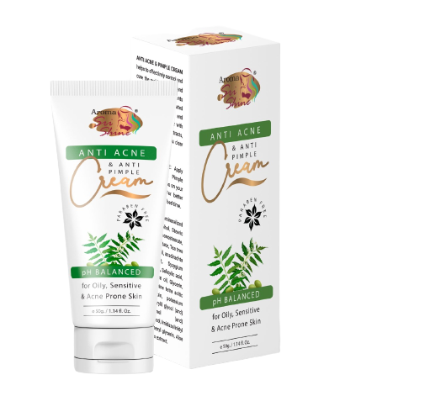
Anti Acne & Anti Pimple
Cream
DESCRIPTION
Anti Acne & Anti Pimple cream helps to effectively control and cure the problem of acne and pimples and also prevents their reoccurrence. Formulated with neem, long pepper and red sandalwood together with many precious herbal extracts, this cream will give you clear skin.
KEY INGREDIENTS
Tea Tree Oil, Rosemarry Oil, Neem Extract, Aloevera Extract, Long Pepper, Red Sandalwood
BENEFITS
Cure acne & pimples problem
Also prevents their reoccurrence
Gives you clear skin
HOW TO APPLY
Apply this product on your acne & pimples with the help of fingertips. for better result use daily at bed time.
Product Type: Cream
Pack Size: 50 gm
MRP: Rs. 300/-

Slide 50
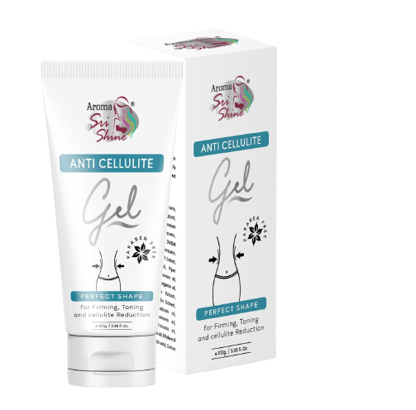
Anti Cellulite
Gel
DESCRIPTION
This gel is an advance product that works on shinking the adipose tissue of fat and cellulite. It also include vitamins that reduce wrinkles in different areas of your body & makes your skin more elastic.
KEY INGREDIENTS
Aloevera Extract, Aromaticum Oil, Piper Nigrum Oil, Citrus Limonum Oil, Cypress Oil, Saraca Indica Bark Extract, Emblica Officinalis Extract, Terminalia Chebula Oil, Citrus Bergamia Oil, Juniperus Communis Oil.
BENEFITS
Shrink the adipose tissue of fat & cellulite
Reduce wrinkles from different parts of your body
Makes your skin most elastic
HOW TO APPLY
This gel should be massaged on thighs, hips, bottoms and belly with circular movements atleast twice a day.
Product Type: Gel
Pack Size: 100 gm
MRP: Rs. 500/-

Slide 51
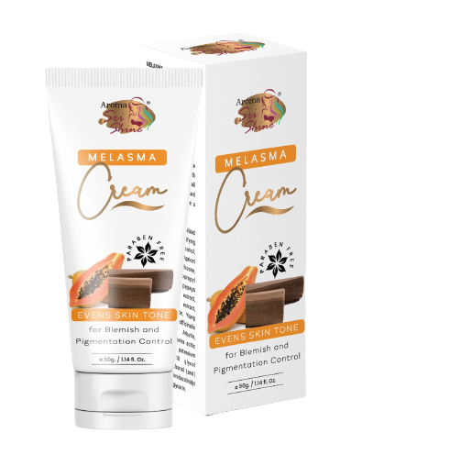
Melasma
Cream
DESCRIPTION
Melasma cream is skin brightning and smoothning, reduce fine lines & frackles, improves skin complexion, reduce hyper pigmentation, reduce acne scars, reduce sunburn, even skin tone and nourishment
KEY INGREDIENTS
Apricot Oil, Almond Oil, Papaya Extract, Sandalwood Extract, Aloevera Extract, Ylang Oil, Lavender Oil.
BENEFITS
Pigmentation control
improves skin complexion
reduce fine lines
removes blemishes
even toned skin
HOW TO APPLY
Clean the face with face wash and apply this cream all over the face and leave it for over night (use this product as night cream).
Product Type: Cream
Pack Size: 50 gm
MRP: Rs. 350/-

Slide 52
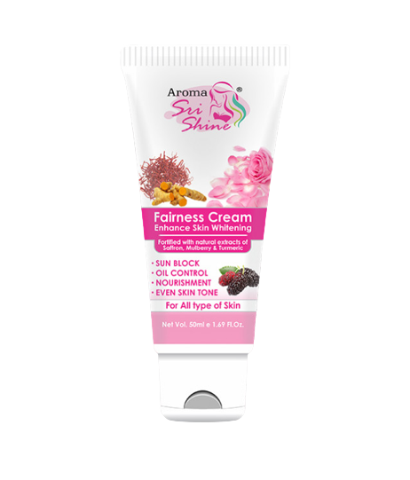
Fairness
Cream
DESCRIPTION
Saarvasri Herbs Fairness Cream is an innovative multi action formula with combination of natural skin brightening ingredients, which lightens overall skin tone reduces the appearance of dark spots, provides lasting fairness along with nourishment.
KEY INGREDIENTS
Saffron, Mulberry, Turmeric
BENEFITS
Help make skin radiant fairer and smoother.
Refines skin and even out dull uneven tone.
Protect for the skin against harmful uv rays.
Control excess oil production.
HOW TO APPLY
After cleansing your face apply i Saarvasri fairness cream to the face and neck daily
Product Type: Cream
Pack Size: 50 gm
MRP: Rs. 250/-

Slide 53
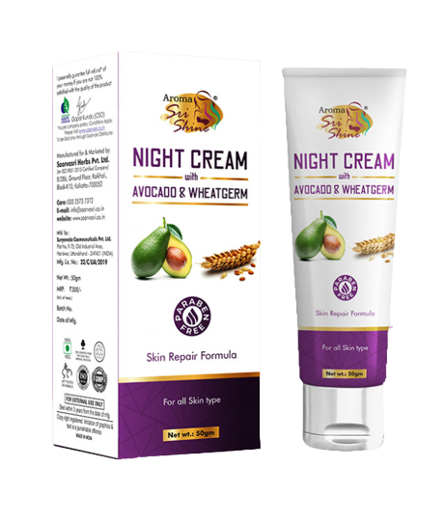
Night
Cream
DESCRIPTION
Saarvasri Night cream was often a product that was heavy on moisturizing ingredients like various oils. These were meant to treat the skin at night.It is a known fact that one of the best times to give your skin some care and love is at night. This is also because that is the only time when your skin gets maximum rest and time to rejuvenate. It is a luxurious nutrient rich cream that helps renew the skin while you sleep.
KEY INGREDIENTS
Avacado Oil, Wheatgerm Oil, Olea Europeaen Oil
BENEFITS
Night cream supplies moisture to the dry parts of your face. Therefore, your face is kept hydrated.
It soothes your face.
It also ensures that your skin has an even complexion along with having a finer skin texture.
this night cream boosts collagen in your skin.
The cream also helps in better blood circulation.
The wrinkles and other lines on your face get reduced.
One major role that a night cream plays is that it prevents your skin from sagging.
It makes your skin soft and supple.
Your aging skin may not look old anymore.
It helps your skin to restore its elasticity.
Helps in renewal of the cells and nourishes your skin.
HOW TO APPLY
Before going to bed wash your face with any of the saarvasri natural face wash, after thats take appropriate amount of night cream & simply massage your night cream into your skin in an upward and outwards motion.
Product Type: Cream
Pack Size: 50 gm
MRP: Rs. 350/-

Slide 54
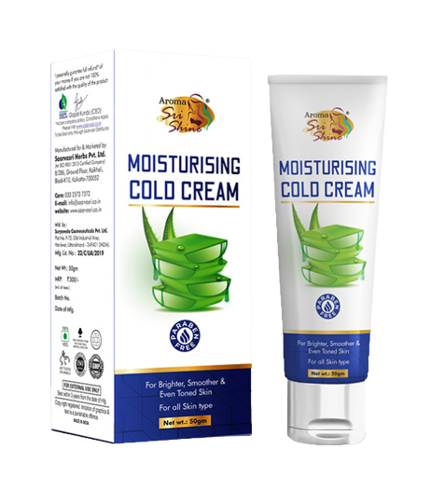
Aloevera
MOISTURISING CREAM
DESCRIPTION
Saarvasri herbs Alovera Moisturising Cream is a lightweight nourishing cream blended with pure ingredients.It absorbs into the skin to replenish lost moisture, keeps skin very soft and gives healthy supple glow.
KEY INGREDIENTS
Almond Oil, Liquorice, Alovera, Rose.
BENEFITS
Leaves skin feeling hydrated and smoother.
Helps retain skin's natural moisture.
Treat sunburn.
Maintain skin elasticity.
HOW TO APPLY
Scoop a small amount of Alovera Moisturising Cream, apply all over your face and massage smoothly until it fully absorbs.
Product Type: Cream
Pack Size: 50 gm
MRP: Rs. 250/-

Slide 55
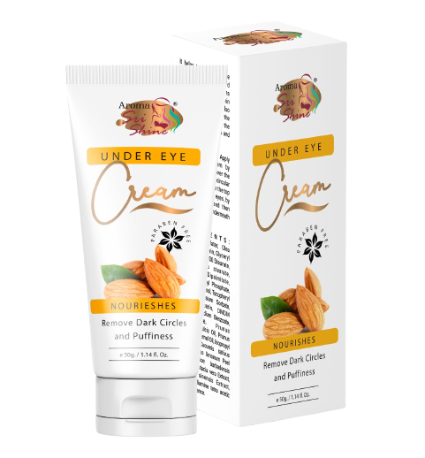
Under Eye
Cream
DESCRIPTION
Under eye cream is a very effective and result oriented formulation for dark circles and puffiness around eyes. Carefully choosen ingridients minimize wrinkles & fine lines. It improves micro circulation around the eyes to reduce congestion. This nature based cream reduces melanin formation and lightens the skin around eyes to make it more radiant.
KEY INGREDIENTS
Almond Oil, Vitamin C, Vitamin E, Cucumber Extract, Olive Extract, Licorice Extract & Geranium Oil
BENEFITS
Removes under eye dark circles
Removes puffiness around eyes
Minimize wrinkles & fine lines surrounding eye areas
HOW TO APPLY
To be applied arround eye areas at bed time
Product Type: Cream
Pack Size: 50 gm
MRP: Rs. 350/-

Slide 56
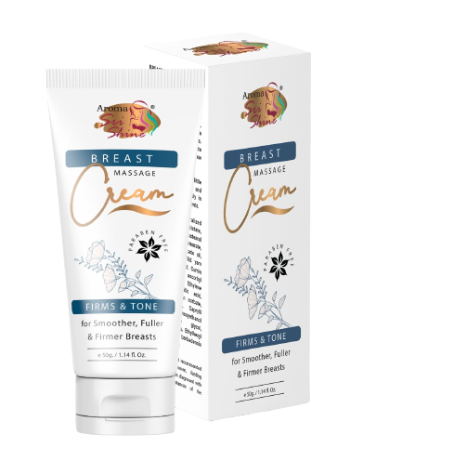
Breast Massage
Cream
DESCRIPTION
Herbal Breast Massage cream has all natural ingredients that nourishes and feeds the cells below the breasts, and helps in enhancing, tightness, plumpness, fullness, and a more young looks.
KEY INGREDIENTS
Wheat Germ Oil, Avocado Oil, Fenugreek Extract, Wild Yam Extract, Fennel Extract, Cumin Extract, Aloevera Extract
BENEFITS
Tightens
Enhancing
Plumpness
Perfect shape
Younger looks
HOW TO APPLY
Pour a little cream on the hand and massage the breast softly in upward and circulate movements(clockwise & anti-clockwise). use 2-3 times a day for better result
Product Type: Cream
Pack Size: 50 gm
MRP: Rs. 350/-

Slide 57
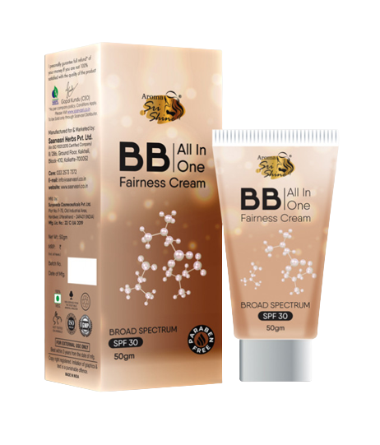
BB All in One
Fairness Cream
DESCRIPTION
BB Cream is a fairness cream with broad spectrum SPF 30, this colour changing cream also protects your skin from harmful rays. A skin brightening cream that also conceals your blemishes and evens your skin tone leaves your face feeling non-oily, fresh and bright throughout the day
KEY INGREDIENTS
Jojoba Oil, Aloevera Extract
BENEFITS
Even toned skin
Primer
Base foundation
Concealer
SPF 30
HOW TO APPLY
A little bit of BB cream on your hand is all you need.
Gently blend- spread evenly and blend it gently with your finger tips all over your face
Take over- leave it undisturbed on your skin and embrace the glow.
Product Type: Cream
Pack Size: 50 gm
MRP: Rs. 350/-

Slide 58
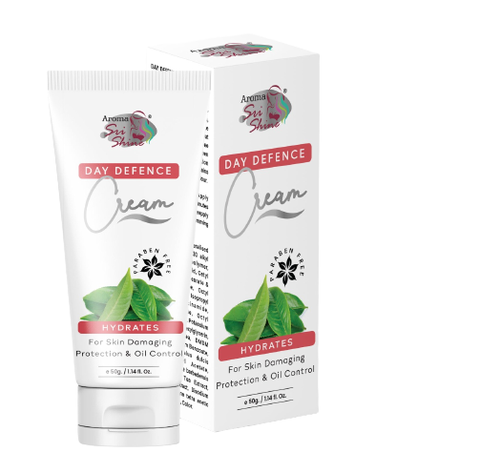
Day Defence
Fairness Cream
DESCRIPTION
Day Defense cream SPF 20 shields skin from damaging UV rays & controls oil protection with this invisible sunscreen. Micro sponge technology absorbs oil, maintain an all- day matte finish & prevents shine without any powdery residue. Oil free formula contains soothing green to help calm inflammation caused by breakouts. Contains no artificial fragrance or cool.
KEY INGREDIENTS
Green Tea Extract, Seaweed & Aloevera Extract
BENEFITS
Suns protection
Oil free throughout the day
Protects your from skin burning
Gives your skin a matte look
HOW TO APPLY
Apply liberally to skin 15 to 30 minutes prior to sun exposure. Reapply after excess sweating, swimming or washing
Product Type: Cream
Pack Size: 50 gm
MRP: Rs. 350/-

Slide 59
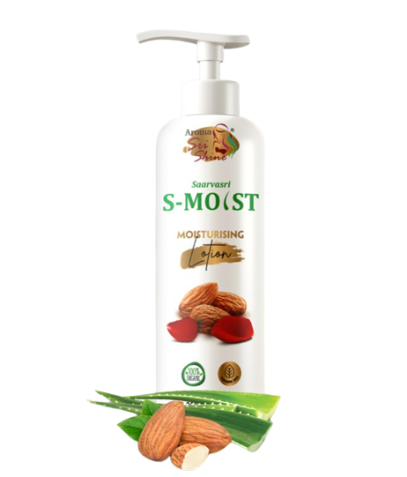
S-Moist
Moisturising Lotion
DESCRIPTION
An ayurvedic solution Saarvasri S-Moist Moisturizing Lotion makes the skin feel soft, supple and young as it made from pure natural ingredients. This lotion is highly effective and result oriented without harming the skin , it detoxifies the skin by removing the contaminants pass through air pollution, oxidation and other impurities.
KEY INGREDIENTS
Almond oil, Liquorice, Aloevera, Rose
BENEFITS
Re-hydrate dried skin.
Replenish extra dry or rough spots on the skin.
Smooth calluses.
Feel and smell good.
Help yourself relax.
HOW TO APPLY
Place a quarter-size amount of your go-to body lotion into the palm of your hand. Rub the lotion between your palms for a few seconds to warm it up. Use both the hands to massage the lotion on skin in a gentle circular motion.
Product Type: Lotion
Pack Size: 200ml
MRP: Rs. 350/-

Slide 60
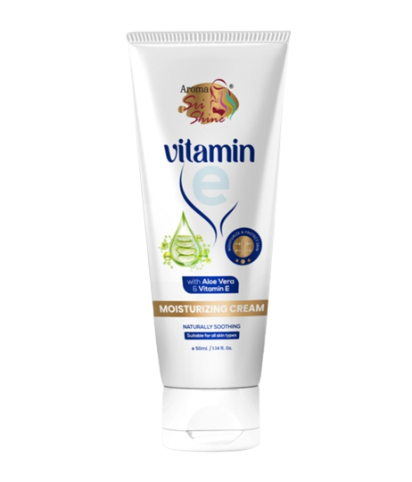
Vitamin E
Moisturising Cream
DESCRIPTION
Vitamin E face cream does just that, helping to protect the skin. But more than that. It helps to restore vital hydration. To quench thirsty skin. Little wonder, then, that our little pot of heaven has stood the test of time for generations. SHPL Vitamin E Moisture Cream helps restore moisture to your complexion, and locks in that much-needed to your skin.
HOW TO APPLY
Add a dollop to your hand, Use your hands to massage the cream into your face in small circular motions.
Product Type: Cream | Pack Size: 50gm | MRP: Rs. 250/-

Slide 61
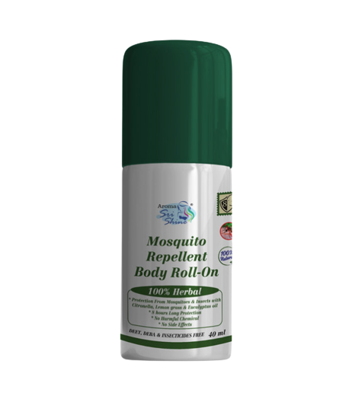
MOSQUITO REPELLANT
BODY ROLL ON
DESCRIPTION
SHPL Mosquito replent body roll-on formulated with natural ingredients and is designed to provide 8 hours of protection from mosquito bites. The roll-on does not stain clothes and can be applied to strollers, prams, school bags, and cots. The Eucalyptus Oil present in the roll-on keeps mosquitoes at bay. The fragrance of lemongrass irritates bugs and keeps you safe from the bug bites. Citronella oil has great mosquito-repelling properties that help you to stay safe from dengue mosquitoes, Aedes.
KEY INGREDIENTS
Eucalyptus oil, lemongrass extract, & citronella oil
BENEFITS
No toxic chemicals
Natural ingredients
Deet-free
Travel-friendly
No stains on clothes
Provides 8 hours of protection.
Protects against mosquito bites of dengue, malaria, and chikungunya
HOW TO APPLY
You just need to apply 4 coin-sized dots on your clothes.You can also apply it around the bed, prams and strollers. (Apllying directly to your skin will not give any bad effects).
Product Type: Roll-On
Pack Size: 40ml
MRP: Rs. 150/-

Slide 62
SAARVASRI TALCO POWDER
DESCRIPTION
Sprinkle saarvasri cool cool talco powder provide quick and long lasting relief from prickly heat. It prevents skin problem like heat rash, burning sensation & other mninor skin infection. It is excellent in absorbing sweat & prevent body odour to keep long lasting freshness around the day.
KEY INGREDIENTS
Magnesium carbonate, menthol, lavender oil
BENEFITS
Quick relief from heat
prevents heat rashes
controls bad body odour
excelent in absorbing sweat
HOW TO APPLY
Sprinkle saarvasri cool cool talco powder after every bath on all over body.
Product Type: Powder
Pack Size: 150gm
MRP: Rs. 150/-

Slide 63
SAARVASRI OLIVE BODY OIL
DESCRIPTION
Olive oil is truly natural, contains more natural vegetable squalene than any other plant source (squalene is naturally produced by our bodies and is very soothing & moisturizing even for sensitive skin conditions. If you're prone to dry skin anywhere on your body, definitely try this product.
KEY INGREDIENTS
Olive oil, neem oil, sandalwood oil, arjuta, manjistha & daruharida
BENEFITS
It nourishes & protects the skin
keeps skin soft, smooth & glowing
protects against rashes, discoloration and dryness
tones muscles to prevent premature ageing.
HOW TO APPLY
Apply daily all over the body before or after bath.
Product Type: Roll-On
Pack Size: 200ml
MRP: Rs. 300/-

Slide 64
STRAWBERRY
LIP BALM
DESCRIPTION
sri shine strawberry lip balm is excellent natural exfoliators for our lips. They are very effective when used on thein, delicate skin on our lips.
KEY INGREDIENTS
Strawberry extract, shea butter and vitamin-E.
BENEFITS
UV protection
removes tan
helps to get back the natural lip colour
moisturized your lips
HOW TO APPLY
Apply lip balm whenever lips are dry & cracking or when you go out to protect them from UV light and weather.
Product Type: Balm
Pack Size: 5gm
MRP: Rs. 155/-

Slide 65
Bentonite
Clay Powder
DESCRIPTION
This is a very popular clay for skin benefits—you probably have spotted this in many of your acne-addressing products. Because of its super absorbing capabilities, this is a great clay for oily skin since it can suck up all that excess sebum easily. Not only that, but it has electric properties that when mixed with water makes the molecules charged and attracts toxins out of your face and to the clay kind of like a magnet. This also goes for any skin ailments involving bacteria and fungus and impurities. Since bentonite clay swells when mixed with water, making it a highly porous substance, it can absorb more than its initial mass, including any swelling from excess sodium in your face. With its tightening, acne-clearing, and impurity-absorbing abilities, you can probably tell why bentonite is a go-to for any skin concerns.
HOW TO APPLY
Wash your face with warm water. Make the mask. Put about a tablespoon or two of clay in a bowl. Apply the mask. Apply the paste with your fingertips, covering all of the skin except the skin around your eyes. Let sit. Allow the paste to dry. Rinse off with water.
Product Type: Powder Pack Size: 50gm MRP: Rs. 200/-

Slide 66
Fuller's Earth
Clay Powder
DESCRIPTION
This is another powerful absorber of oil and impurities—so much so that fuller’s earth clay is also used in cat litter and automotive products to absorb oil spills on pavement. So you can tell… this means business. You can use it to spot-dry-clean fabrics too, in case you get any oily salad dressing on your silk blouse. There are SO many uses. For your face, however, this is a great oil-absorber on top of working well for addressing hyperpigmention, as it has mild bleaching properties. When combined with some rose water and used as a mask, it helps boost circulation. This is recommended for people with oily skin since it can be quite drying—but it wouldn’t hurt for normal skin if used no more than once a week.
HOW TO APPLY
Wash your face with warm water. Make the mask. Put about a tablespoon or two of clay in a bowl. Apply the mask. Apply the paste with your fingertips, covering all of the skin except the skin around your eyes. Let sit. Allow the paste to dry. Rinse off with water.
Product Type: Powder Pack Size: 50gm MRP: Rs. 200/-

Slide 67
French Green
Clay Powder
DESCRIPTION
Found in France (duh), French green clay is your go-to for exfoliation and pore-tightening on top of oil-absorption. It can be called Illite Clay or Sea Clay, the green color comes from the amount of decomposed plant material and iron oxide and is a determining factor in the quality of the clay—it should never be gray or white, it should be very green. It’s so absorbent that not only does it drink up oils, it also pulls blood towards the surface of your skin, giving you a bit of a tingling sensation as it boosts circulation.
HOW TO APPLY
Wash your face with warm water. Make the mask. Put about a tablespoon or two of clay in a bowl. Apply the mask. Apply the paste with your fingertips, covering all of the skin except the skin around your eyes. Let sit. Allow the paste to dry. Rinse off with water.
Product Type: Powder Pack Size: 50gm MRP: Rs. 200/-

Slide 68
Rose Kaolin
Clay Powder
DESCRIPTION
Rose clay has been all the buzz lately as a natural cleanser and overall amazing natural ingredient.Rose clay is a mild kaolin clay, often referred to as pink clay, and is a gentle, natural clay that contains kaolinite. Rose clay is fabulous for most skin types; including sensitive skin, which simply means it's a naturally occurring clay that has kaolinite as its main component.Rose clay is also abundant in minerals like Silica. Rose clay masks help to replenish and restore skin with moisture, exfoliate the complexion with its slightly grainy texture, and draw out impurities.
HOW TO APPLY
Wash your face with warm water. Make the mask. Put about a tablespoon or two of clay in a bowl. Apply the mask. Apply the paste with your fingertips, covering all of the skin except the skin around your eyes. Let sit. Allow the paste to dry. Rinse off with water.
Product Type: Powder Pack Size: 50gm MRP: Rs. 200/-

Slide 69
Rhassoul Red
Clay Powder
DESCRIPTION
Unique in that rhassoul clay is great for both skin and hair, this ancient clay is mined from Morocco and is crazy-rich in minerals. It’s very negatively charged and most toxins in your skin are positively charged, so this clay is the perfect magnet for sopping up all those impurities—sebum plugs, blackheads, and oil around hair follicles. It doesn’t, however, leave you dry because of its elasticity and texture-improving effects. It’s gentle enough for daily use in small doses like in soap, makes a heavy-duty exfoliator when mixed with crushed oats or almonds, and is even great for absorbing excess build-up on hair, restoring volume, and shine.
HOW TO APPLY
Wash your face with warm water. Make the mask. Put about a tablespoon or two of clay in a bowl. Apply the mask. Apply the paste with your fingertips, covering all of the skin except the skin around your eyes. Let sit. Allow the paste to dry. Rinse off with water.
Product Type: Powder Pack Size: 50gm MRP: Rs. 200/-

Slide 70
FRUIT SCRUB
DESCRIPTION
Sri Shine Fruit Scrub with walnut is a powerful, yet gentle exfoliating scrub that removes the dry & dead skin cells. Peach helps to remove dark circle and blemishes. Its macro nutrients also helps in removing wrinkles. It tightens the skin's pores and does wonders for a tired skin.
KEY INGREDIENTS
Walnut shell scrub grains, Extract of apricot, Extract of peach fruit, Fruit extract
BENEFITS
Removes black & white heads
Exfoliates
Deep clean from the pores
Tightens skin texture
Make skin smoother and softer
Gives you a vibrant skin
HOW TO APPLY
Wash face with fresh water & pat dry. Apply the Fruit Scrub on to the face & neck . Gently massage the scrub on face for few minutes & then rinse off.
Product Type: Scrubber Gel
Pack Size: 100ml
MRP: Rs. 300/-

Slide 71
PAPAYA
SPF 30
DESCRIPTION
Sri Shine Papaya SPF 30 sunscreen cream is an ideal natural preparation for summers, its natural formula gives UV A and UV B protection. It is an oil free , fast absorbing, multi care cream providing ultimate protection to the skin. Fortified with protective, healing & nourishing natural extracts of papaya, liquorice & green tea, this suns screen block & neutralizes the effect of harmful UV A & UV B rays and provides 25 times more natural protection to skin from redness, sun burn & pre mature skin ageing leading to a lighter, brighter, even toned and younger looking skin.
KEY INGREDIENTS
Papaya Extract, Licorice Extract, Green Tea Extract
BENEFITS
UV A & UV B protection
Fast absorbing
25 times more natural protection
Protect skin from redness
Protects from sun burn
Keeps your skin oil free
HOW TO APPLY
Apply Sri Shine Papaya Sunscreen Cream liberally on face, neck, & arms 15 minutes before going out in sun. Reapply this cream every 2-3 hours in case of very long exposure to sun.
Product Type: Cream Pack Size: 60ml MRP: Rs. 250/-

Slide 72
ALOEVERA SUNSCREEN
SPF 50
BENEFITS
Protects the skin against pollution-induced skin damage.
Provides enhanced broad spectrum protection against both ultraviolet A (UVA) and ultraviolet B (UVB) rays.
Helps in reducing the appearance of fine lines and wrinkles.
It is also rich in antioxidants.
KEY INGREDIENTS
Aloevera Extract
HOW TO APPLY
Apply Aloevera Sunscreen Gel liberally on face, neck, & arms 15 minutes before going out in sun. Reapply this cream every 2-3 hours in case of very long exposure to sun.
Product Type: Gel Pack Size: 50ml MRP: Rs. 399/-

Slide 73
BENEFITS
Aroma Sri Shine ANTI-ACNE Foaming Wash developed after extensive research, is a combination of Neem, Aloe Vera & Turmeric. gently removes dirt, excess oil and dead skin cellsto reveal a clean, bright and fresh face. The nor Irritating formula maintains a healthy moisture balance, never stripping the skin, while eliminating shiny, oily areas. Replenishing Rose water and Turmeric produce a healthy skin barrier so your face feels comfortable without any tightness or dryness
Product Type: Foaming Wash
Pack Size: 150ml
MRP: Rs. 500/-

Slide 75
TRUE ME
POCKET PERFUME
DESCRIPTION
True Me Body Spray is a very light mixture of scent, alcohol, and water. The primary purpose of body spray is for light spritzing on a warm day. The misty drops and wide area coverage makes it perfect for you to use targeting certain areas that sweat easily, such as the neck, under arms etc.
KEY INGREDIENTS
thyl alcohol, purified water, fragrance, propylene glycol
BENEFITS
Body Spray helps hydrate your skin and their light aroma will leave you smelling great and feeling fresh for the day ahead. As they last for a long time though, you will need to re-spray your body mist throughout the day if you plan to use it as part of fragrance layering.
HOW TO APPLY
Hold the deodorant 10-15 cm away
spray directly on underarms and over body, avoiding broken/irritated skin.
allow product to dry completely
Product Type: Liquid
Pack Size: 20ml
MRP: Rs. 100/-

Slide 76
INVISIBLE DEODORANT ROLL ON
DESCRIPTION
Invisible Deodorant Roll On is designed to help prevent body odor—and keep you smelling like a field of lilacs. While it won’t stop you from sweating, deodorant can eliminate the naturally occurring bacteria on your skin and help get rid of unpleasant body odors. It delivers exceptional overall protection because it goes on wet and then dries on your skin. Applying liquid deodorant allows it to cover a larger surface area and easily contour to the unique shape of your armpit.
HOW TO APPLY
To apply roll-on deodorant correctly, first, take a shower or wash your underarms with a cleansing cloth.
Apply roll-on deodorant using three or four back-and-forth motions.
Let your underarms dry completely before you get dressed or do any activity that may cause you to sweat.
Product Type: Roll On | Pack Size: 50ml | MRP: Rs. 350/-

Slide 78
SAARVASRI
TOOTHPASTE
DESCRIPTION
Saarvasri toothpaste is made from natural ingredients and some are certified as organic. Now a day many consumers have started using natural toothpaste in order to avoid synthetic and artificial flavours which are commonly found in natural toothpaste. It don’t contain any artificial flavours or chemicals. It is good choice for people who allergic to mint or to sodium lauryl sulphate, a foaming agent that is included in most commercial toothpaste brands.
KEY INGREDIENTS
Salt, Dalchini, Elaichi
BENEFITS
Protect the teeth and gums from infections
Reduce pain & stop the bleeding
Prevent cavities in the tooth
Help get rid of bad breath
Controls gingivitis
HOW TO APPLY
Use as your regular toothpaste
Product Type: Toothpaste| Pack Size: 100 gm | MRP: Rs. 110/-

Slide 79
NEEM TULSI
TOOTHPASTE
DESCRIPTION
It helps provides complete dental hygiene with potent antibacterial, antioxidant and anti-inflammatory properties which helps prevent plaque and tartar formation. With detoxifying action, it curbs teeth stains, combats cavities and counteracts bad breath.
KEY INGREDIENTS
Neem, Tulsi & Pudina
BENEFITS
Fights against dental problems
Stops bad breath and tooth decay
Prevent cavities in the tooth
Help get rid of bad breath
Protects gums from germs
Prevents pyorrhea
HOW TO APPLY
Use as your regular toothpaste
Product Type: Toothpaste | Pack Size: 100 gm | MRP: Rs. 59/-

Slide 80
CHARCOAL
TOOTHPASTE
DESCRIPTION
Saarvasri Charcoal Toothpaste has whitening formula and teeth whitening gel, along with a high-quality oral health solution with active charcoal in it. If you have been battling yellowed teeth, bad breath & other common oral ailments, this is Dental Expert's activate charcoal toothpaste is your ideal solution.
KEY INGREDIENTS
Activated Charcoal
BENEFITS
Help remove surface stains on the teeth
Stops bad breath and tooth decay
Keeps teeth bright white
Help get rid of bad breath
Protects gums from germs
HOW TO APPLY
Use as your regular toothpaste
Product Type: Toothpaste | Pack Size: 100 gm | MRP: Rs. 119/-

Slide 81
GANO
TOOTHPASTE
DESCRIPTION
This herbal toothpaste is specially made with high quality Ganoderma Lucidum extract in order to effectively maintain oral hygiene. It is the natural way to treat teeth and does not contain saccharin, fine sand and other dyes. It provides effective oral hygiene with great freshness.
KEY INGREDIENTS
Ganoderma Lucidium
BENEFITS
Stops bad breath and tooth decay
Heals mouth ulcers, bites or sting
Help remove surface stains on the teeth
Help get rid of bad breath
Helps in maintaining stronger gums
Protects gums from germs
HOW TO APPLY
Use as your regular toothpaste
Product Type: Toothpaste | Pack Size: 100 gm | MRP: Rs. 150/-

Slide 82
MOUTH PROTECT
SPRAY
DESCRIPTION
Saarvasri Mouth Protect Spray helps to clear the respiratory tracts and protects the lungs and throat against infections and viruses. It works as the best medicine for cough for adults and children. It is a natural safeguard for the oral and respiratory health.
KEY INGREDIENTS
Camphor, Honey, Pudina, Thymol, Tulsi Extract, Mulethi, Kali Mirch, Pippali, Sunthi, Turmeric, Amla, Clove, Vasa, Limbu
BENEFITS
Increase immunity
Protects respiratory system
Relief from cough, sore throat, bronchitis
Protects your teeth
Protects from bacteria
Maintains oral hygeine
HOW TO APPLY
Use as your regular toothpaste
Product Type: Liquid | Pack Size: 50ml | MRP: Rs. 350/-

Slide 83
SAARVASRI
TOOTHBRUSH
DESCRIPTION
SHPL toothbrush is an oral hygiene instrument used to clean the teeth, gums, and tongue. It consists of a head of tightly clustered bristles, atop of which toothpaste can be applied, mounted on a handle which facilitates the cleaning of hard-to-reach areas of the mouth.
BENEFITS
Breaks up plaque and rotates to clear it away.
Removes more plaque along gum line.
Deep cleaning
whitening your teeth
gives relief from sensitivity
tongue cleaning.
Product Type: Brush | Pack Size: 1pc | MRP: Rs. 60/-

Slide 85
VAGINAL WASH
DESCRIPTION
This gently vaginal wash has been specially formulated to cleanse intimate part whilst helping maintain a healthy PH balance. The low ph of the intimate area helps to protect against irritation. Its pleasant fregrance and soothing extracts, of herbal providing long lasting freshness throughout the day
KEY INGREDIENTS
Tea tree oil, matricaria flower extract, lactic acid, aloevera extract
BENEFITS
Maintain pH balance
protect against irritation
maintain your hygiene
providing long lasting freshness throughout the day
HOW TO APPLY
Apply it to the external part of intimate area and wash it off with water
Product Type: Balm
Pack Size: 100ml
MRP: Rs. 300/-

Slide 86
CREAM HAIR REMOVER
DESCRIPTION
Achieve superior, long-lasting smoothness with SHPL Cream Hair Remover. It works close to the root of your hair, giving you silky and smooth skin in just 5-6 minutes. You can use the hair removal cream over stubborn hair on all over your legs, arms, underarms, bikini as well as body hair where razors cannot reach.
KEY INGREDIENTS
Cetanol & green tea
BENEFITS
Pain Free
No Harsh Smell
Slower the span of ingrowing hair
No stuble or Razor burn
HOW TO APPLY
Apply sufficient quantity of sri shine cream Hair Remover on legs, arms & underarms, bikini line with the help of spatula. let it soak for 5-6 minutes. wipe out with coin tissue or clean cloth.
Product Type: Cream
Pack Size: 50gm
MRP: Rs. 250/-

Slide 87
Aloevera
Shaving Cream
DESCRIPTION
This Shaving Cream generates a creamy lather that helps to protect the skin from irritation, by improving razor glide. Enriched with the revitalizing properties herbal extracts, this shaving cream gently soothes and moisturizes the skin for a close and comfortable shaving experience.
KEY INGREDIENTS
Aloevera Extract, Neem Extract, Tulsi Extract, Haldi Extract, Menthol.
HOW TO APPLY
Add a small almond size drop of Shaving Cream on to the shaving brush, or into your lathering bowl and then either lather directly onto your face to be shaved or whip up a lather in your lathering bowl with shaving brush, and then shave as normal.
Product Type: Cream Pack Size: 100gm MRP: Rs. 300/-

Slide 88
After Shave
Balm
DESCRIPTION
Saarvasri After Shave Balm has been formulated to provide an extra hydrating and moisturizing impact on your skin to help counteract the dryness caused by shaving. It prevents redness, razor burn and irritation and helps to deliver smoother, softer and healthier skin.
KEY INGREDIENTS
Apricot Oil, Coconut Oil, Jojoba Oil, Peppermint Oil, Olive Oil, Avocado Oil, Aloevera Extract, Lime Extract, Menthol.
HOW TO APPLY
Gently massage the After Shave Balm into the shaven area, using upward, circular motion to help the product absorb quickly.
Product Type: Cream Pack Size: 50gm MRP: Rs. 250/-

Slide 89
Stay Long
Sanitary Napkin
DESCRIPTION
STAY-LONG Anion Far-IR Revolutionary Sanitary Pads are the latest in women personal hygiene products. That generates negative ions,. helps prevent infection , odour and creates general health and well-being. Stay-Long Anion pads -- are also the first breathable pad with a unique Anion strip & made of 100% cotton that reduces irritation, infection and odour. This pad also helps You to balance PH level, kill bacteria and viruses and improve blood circulation.
Layer1- Silky smooth surface for quick absorbing.
Layer2- Extra protection on both sides.
Layer3- Far-Infrared and Anion generating insert.
Layer4 and 6- Dust-free paper.
Layer5- Active water absorbent materials, 5 times more absorbent than conventional ones.
Layer7- Dry and ventilated base materials.
Layer8- Food grade plastic cover at the back
Product Type: Pads Pack Size: 8pcs MRP: Rs. 200/-

