Slide 1
WELCOME TO INDIA’S
FASTEST-GROWING
DIRECT SELLING COMPANY
JOIN THE CONSUMER NETWORK OF SAARVASRI HERBS PVT LTD.

Slide 2
SAARVASRI STORY
PHASE 1
Incorporated in September 2013 with a Humble Beginning
Operated from its Headquarter in Kolkata, West Bengal
Engaged in Contract Manufacturing of Wellness Products
Marketed through Traditional Sales Network in East India
Quality Products, Affordable Prices with Amazing Results
Extremely High Demand for SHPL Products Across India
PHASE 2
Entered into the Direct Selling Business on 20 May 2018
Fastest Growing Consumer Network Present in all States
7+ Lakhs Independent Business Owners (IBOs) & Growing
Over 300 World-class Products in 10 Product Categories
Legitimate and Ethical Business: Member of FIDSI, Delhi
Shifted its Registered Office to New Delhi in March 2022
Stepped into the 5th Year of Glorious Presence and Growth

Slide 3
SAARVASRI VISION
To offer a wide range of
World-Class Products & Services
To Our Esteemed Customers
At An Affordable Price
and offer a
Legitimate Entrepreneurship Opportunity to
Awaken The Giant Within Them
and Support them
Explore Life To The Fullest

Slide 4
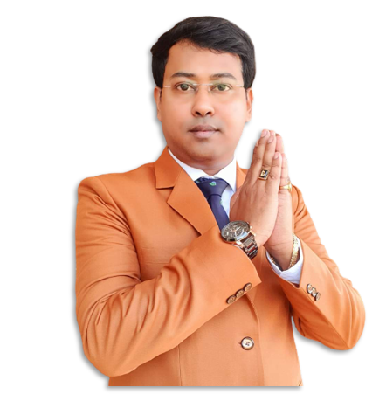
SAARVASRI MISSION
To be one amongst the
Top 5 Direct Selling Companies
of India by
FY 2025-26
Most Respected Leading Direct Selling Company
Professional, Clean and Transparent Management
Finest Quality Products with Affordable Pricing
Legitimate Business that follows TCP(DS) Rules 2021
SHPL Education: Finest Training and Support System

Slide 5
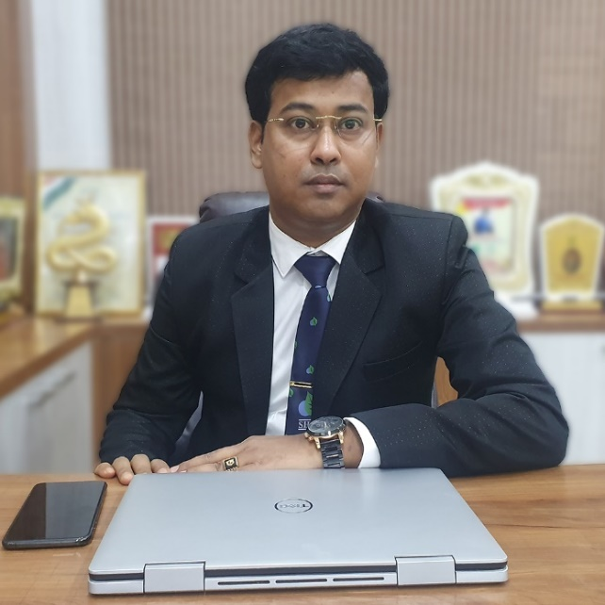
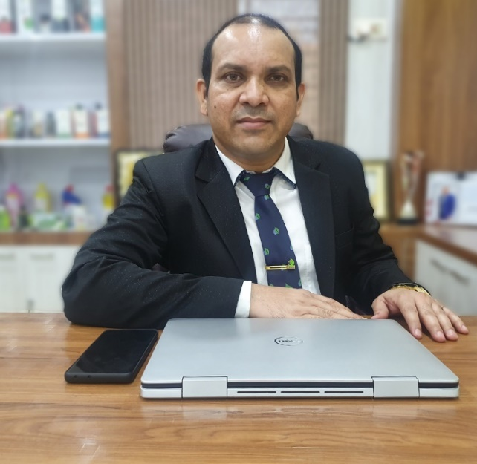
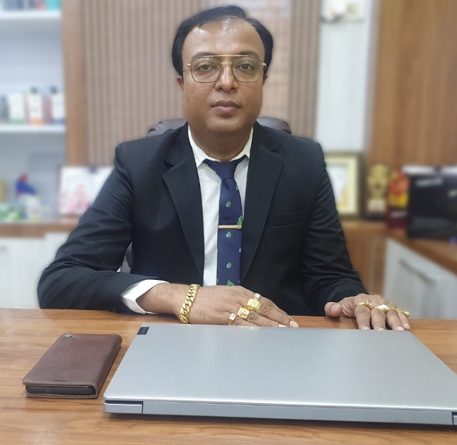
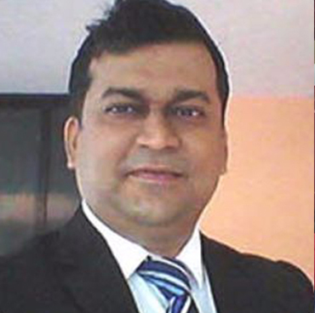
SAARVASRI MANAGEMENT
GOPAL KUNDU
Chairman & Managing Director (CMD)
SUBASH SAHU
Chief Financial Officer (CFO)
PRASANATA KUNDU
Chief Operating Officer (COO)
STAN SERRAO
Business Coach
PROFESSIONAL
ADVISORS
DEDICATED
YOUNG TEAM
IN-HOUSE
WEB & IT
MULTILINGUIL
TRAINERS
EFFICIENT
SERVICES

Slide 6
SAARVASRI COMPLIANCE
THE CONSUMER PROTECTION (DIRECT SELLING) RULES 2021

Slide 8
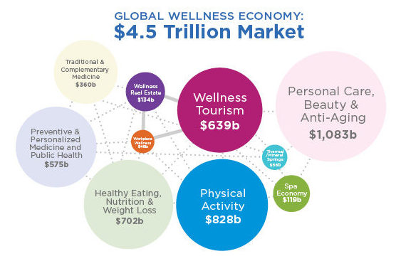
TRILLION DOLLAR WELLNESS INDUSTRY
EVER-GREEN INDUSTRY
Recession Proof Industry with Demand
Fastest Growing Industry World-Wide
4 Times Bigger than the Pharma Industry
Numerous Unresolved Medical Diagnosis
Obesity and Multiple Chronic Diseases
Malnutrition > Anaemia > Poor Lifestyle
Back to Nature from Modern Lifestyle
Natural > Organic > Alternative Therapy
Traditional & Ancient Healing System
Ayurveda Medicine > Nutraceuticals
Beauty Care > Personal Care Products
Wellness Food > Recipes > Beverages

Slide 9
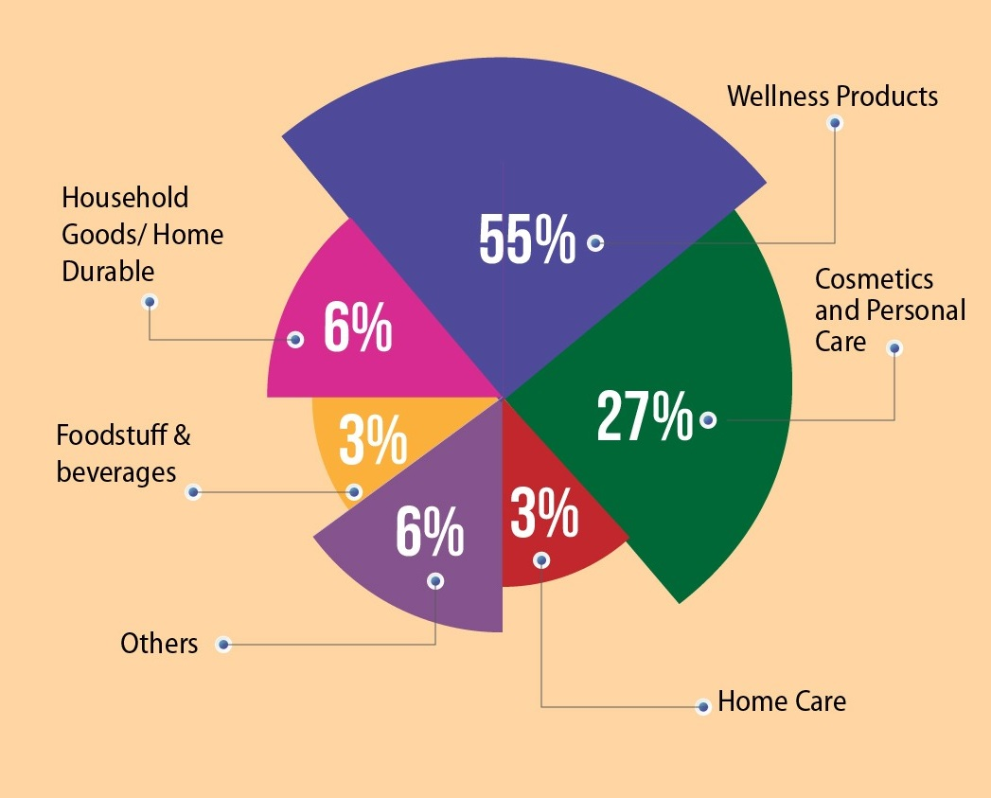
NOW REGULATED DIRECT SELLING INDUSTRY
MAINSTREAM INDUSTRY
Direct Selling is the Sale of a Consumer Product or Service, Person-to-Person, Away From A Fixed Retail Location, Marketed through Independent Sales Representatives who are also referred to as Consultants, Distributors, Associates and many such titles.
130 Years Old Business Model Globally
Actively Promoted in India since 1995
8th Wonder: Socio-Economic Transformation
Misused > Misrepresented > Manipulated
The Direct Selling Guidelines 2016
The Consumer Protection (DS) Rules 2021

Slide 10
SAARVASRI OFFICE NETWORK
DWARKA, NEW DELHI
KOLKATA, WEST BENGAL
MUMBAI, MAHARASHTRA
BENGALURU, KARNTAKA
Plot No A, 236, Pocket A2, Pocket 2, Sector 17 Dwarka, Dwarka
110078, New Delhi
8/286, Ground Floor, Kaikhali
VIP Road, Block – K-10
Kolkata 700052, West Bengal
608, Corporate Annex, Behind Udyog Bhavan, Sonawala Cross Road, Goregaon East, Mumbai 400063, Maharashtra, India
CS Tower, 46/47, Thimmaiah Road, 1st Stage, 5th Phase, WOC Road, Shivanagar, Rajajinagar, Bengaluru 560010, Karnataka
07AATCS7335Q1ZA
19AATCS7335Q1Z5
27AATCS7335Q1Z8
29AATCS7335Q1Z4
MOHALI, PUNJAB
GUWAHATI, ASSAM
AGARTALA, TRIPURA
IMPHAL, MANIPUR
SCO 81, Compass Point Building, Gillco Valley, Mundi Kharar, Mohali, 140301, Punjab,
Laxmi Bhawan (East), House No 23, P.B. Road, Rehabari, Guwahati 781008, Assam
G.B Road, Melarmath
Agartala 799001, Tripura
Singjamei Sougrakpam Leikai, Near Little House Pre-School, Imphal West 795001, Manipur
03AATCS7335Q1ZI
18AATCS7335Q1Z7
16AATCS7335Q1ZB
14AATCS7335Q1ZF
ROURKELA, ODISHA
SURAT, GUJARAT
MADURAI, TAMIL NADU
ERNAKULAM, KERALA
R.N Sahoo Complex, 2nd Floor, Udit Nagar Main Road
In Front Of Goffur Colony
Rourkela 769012, Odisha
Shop No. 3039, The Palladium Mall, Pune-Simada Road, Yogichowk, Varachha, Surat, 395010, Gujarat
Jaiwin Foods & Herbals, No. 20, Ellisnagar, 70 Feet Road, Madurai 625016, Tamil Nadu
Shalom Building, 17/391b, Kacheripady Jn, Cheranellore, Ernakulam 682034 , Kerala
21AATCS7335Q2ZJ
19AATCS7335Q1Z5
33AATCS7335Q1ZF
29AATCS7335Q1Z4

Slide 19
Welcome to the Business World of Saarvasri
Healthy Living By Nature

Slide 20
PURCHASE WITH BV
THREE R’s OF DIRECT SELLING
RECRUITING
(JOINING)
The Law of Leverage
Direct Selling is 1% of 100 People
Helps Build a Large Sales Network
Fresh Recruits Bring New Energy
RETAILING
(RE-PURCHASE)
Foundation of a Direct Selling Co.
Access to Finest Quality Products
Enhances Belief in the Products
Helps Convert Retail Customers
RETAINING
(TRAINING & EDUCATION)
The Law of Average (80:20 Rule)
Strong Training & Support System
Genuine Dream & Passion for Life
Personal and Professional Skills

Slide 21
HOW TO ASSOCIATE?
HOW TO ASSOCIATE WITH SHPL?
STEP 1: REGISTER ONLINE FOR FREE
Register Online as a Preferred Customer (PC)
Registration is Absolutely FREE
Simply Provide Basic Personal Details and Delivery Address (Mandatory)
No KYC Compliance Needed
Get SHPL User ID and Password to access IBO Back Office
STEP 2: BUY SHPL PRODUCTS AS A CUSTOMER
Buy SHPL Products at MRP to Avail an Exciting Buy 1 – Get 1 FREE Offer
Buy SHPL Products from Your Nearest SHPL Gallery or Place Order Online
Buy ANY SHPL Products across ANY Categories Including Home Care & Kitchen Care
Payment Options: Gallery, E-Wallet, Online Payment Gateway & Company Bank Account
Home Delivery of Products within 4 – 7 working days; Free Delivery above Rs.2500/-
STEP 3: APPLY TO BE AN IBO TO BECOME AN ENTREPRENEUR
Self- Use Finest Quality SHPL Products and get Satisfied of its Quality & Benefits
Optionally and Voluntarily Choose to Refer SHPL Products after Having Used Them
Apply Online to be a SHPL ‘Independent Business Owner (IBO)’ in the IBO Back Office
Update KYC Online and Become KYC Compliant; Get Trained to Succeed with SHPL Education

Slide 22
1. BUY 1 GET 1 FREE OFFER
PURCHASE FINEST SHPL PRODUCTS
EVERY SINGLE MONTH
FOR SELF-USE AND SET AN EXAMPLE
When you buy products at MRP, you get 1 Product FREE giving you an Extra-ordinary Discounted Price of 50%
When you have Hundreds and Thousands of People in your Network Buying SHPL Products ever single month, you accumulate Impressive BV (Business Volume) Giving you Leverage Income

Slide 23
CONSISTENCY OFFER
OFFER VALID FOR 3, 6 AND 12 ROLLING MONTHS
3-MONTH CHALLENGE
6-MONTH CHALLENGE
12-MONTH CHALLENGE
Purchase 1000 Self BV worth of SHPL Products before 15th of each month in a single invoice for 3 consecutive months
Purchase 1000 Self BV worth of SHPL Products before 15th of each month in a single invoice for 6 consecutive months
Purchase 1000 Self BV worth of SHPL Products before 15th of each month in a single invoice for 12 consecutive months
GET FREE SHPL PRODUCTS WORTH
MRP. 1500/-
ABSOLUTELY FREE
GET FREE SHPL PRODUCTS WORTH
MRP. 5000/-
ABSOLUTELY FREE
GET FREE SHPL PRODUCTS WORTH
MRP. 15000/-
ABSOLUTELY FREE
# Only purchase Invoices with Personal BV (beyond Personal BV required to maintain the Rank) is considered. # Invoices must be dated before 15th of every month # For New IBOs, the Re-purchase can be up to 31st of the Month of Activation # Re-Purchase Invoices with a max of 2 Kitchen Care / Home Care Products are considered # Invoices with Business Tools will not be considered. # Invoices comprising of any other Promotional Offers including any kind of Combo Packs bill will not be considered. # Free products will be issued at the discretion of the Company Management # Repetition of same product as free Products may not be allowed # Kitchen Care / Home Care products & Business Tools will not be allowed as Free Product # No BP, BV or FP will be awarded against Free Products # Regular Mandatory Self Purchase requirement of ‘Leadership Bonus’ will not be considered for this offer # Only Highest Achievement will be Awarded.

Slide 24
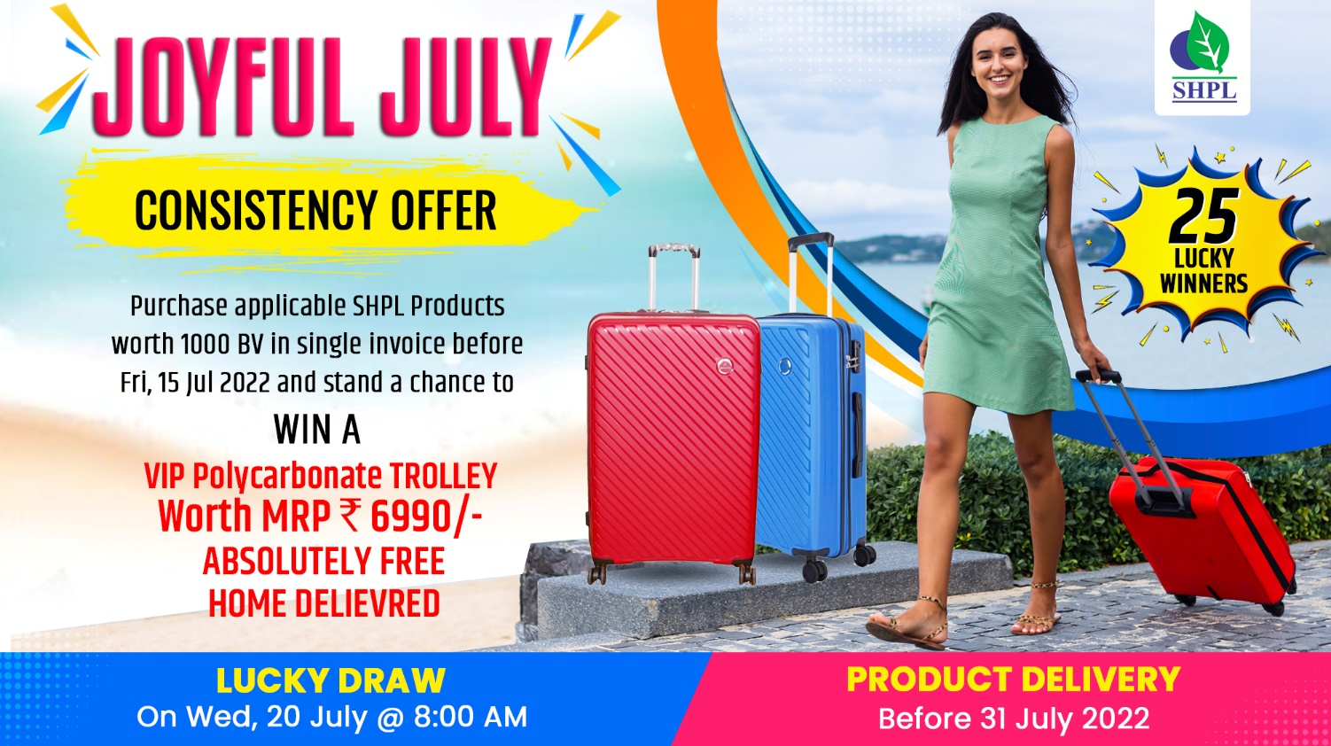

Slide 25
2. SELF-PURCHASE BONUS (SRB)
Self 2000 BV*
U
Left
Right
A
5000 BV
B
3000 BV + 2000 BV = 5000 BV
Your Self BV is Automatically Counted In Your Lesser (Weaker) Team To Help You Earn
Team Matching Bonus (TMB)

Slide 26
3. TEAM MATCHING BONUS (TMB): 10%
Get 10% Team Matching Bonus on BV
Capping per Pay Cycle: Rs.1,25,000/-
Unmatched BV will be carried Forward
U
A Team
B Team
A
A Team
50,000 BV
B
B Team
40,000 BV
Closing on the 7th, 14th, 21st & Last day of the Month
Payout: 12th, 19th, 26th, 5th of Every Month
Pay out less than Rs.300/- will be fully transferred to E-Wallet

Slide 27
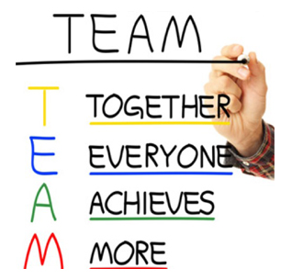
4. TEAM BUILDING BONUS (TBB): 10%
U
10%
10%
10%
10%
10%
A
B
C
D
E
25,000
50,000
1,00,000
2,50,000
5,00,000
EARN 10%
OF TEAM MATCHING BONUS (TMB)
OF ALL YOUR DIRECT REFERRALS

Slide 28
5. TEAM CONSULTANCY BONUS (TCB): 10%
10% of Company’s Total BV Turnover will be allocated for TCB
25,000 Fresh BV Matching Pair = 1 TCB Unit
Maximum 100 Units per Month
FOB TCB UNIT VALUE CALCULATION
Total Company BV Per Month X 10%
1 TCB Unit Value =
___________________________________________________
Total TCB Units of 25,000 BV Matching Pair
25,00,000 Group BV Matching / 25,000 BV Matching Pair = 100 TCB Units
100 TCB Units x Rs. 1250 TCB Value = Rs. 1,25,000/- TC Bonus

Slide 29
ACHIEVE PRESTIGIOUS SHPL RANKS
13. SHPL BRAND AMBASSADOR – 5 CR
12. ROYAL PRESIDENTIAL CLUB DIRECTOR - 2.5 CR
11. PRESIDENTIAL CLUB DIRECTOR – 1CR MBV
10. DOUBLE UNIVERSAL CROWN AMBASSADOR – 50L MBV
9. UNIVERSAL CROWN AMBASSADOR – 25L MBV
8. TRIPLE CROWN AMBASSADOR – 10,00, 000 MATCHING BV
7. DOUBLE CROWN AMBASSADOR – 5,00,000 MATCHING BV
6. CROWN AMBASSADOR – 2,50,000 MATCHING BV
5. EXECUTIVE CROWN DIAMOND – 1,50,000 MATCHING BV
4. CROWN DIAMOND – 75,000 MATCHING BV
3. ROYAL DIAMOND - – 50,000 MATCHING BV
2. EXECUTIVE DIAMOND – 30,000 MATCHING BV
1. DIAMOND – 15,000 MATCHING BV

Slide 30
6. LEADEERSHIP BONUS (LSB): 30%
30% of the Monthly Total Company BV will be allocated to distribute Leadership Bonus (LSB)
Leadership Bonus (LSB) is Distributed from Qualifying Diamond up to Qualifying Crown Ambassadors
RANK
SELF
BV
TEAM BV MATCHING
SAARVASRI
DIAMOND
5%
EXECUTIVE
DIAMOND
5%
ROYAL
DIAMOND
8%
CROWN
DIAMOND
11%
EXE. CROWN
DIAMOND
14%
CROWN AMBASSADOR
17%
TMB (15%)
Team Mentoring Bonus
300
15,000
5%
2%
2%
2%
2%
2%
BDB (3%)
Business Development
500
30,000
-
3%
3%
3%
3%
3%
CEC (3%)
Child Education Bonus
600
50,000
-
-
3%
3%
3%
3%
FTB (3%)
Family Travel Bonus
700
75,000
-
-
-
3%
3%
3%
LCB (3%)
Luxury Car Bonus
800
1,50,000
-
-
-
-
3%
3%
DHB (3%)
Dream House Bonus
1000
2,50,000
-
-
-
-
-
3%

Slide 31
7. ROYALTY CLUB BONUS (RCB): 3%
U
9 Points
3% of Company’s Total BV Turnover Per Month will be allocated for RCB, to be paid Monthly
Eligibility: Must be an Active Crown Ambassador
Criteria: 1 RCB Point from Every Qualified Crown Ambassador within 3 Levels Compressed
A 4 Point B
1 Point C
1 Point
D
1 Point
E
1 Point
FOB UNIT VALUE CALCULATION
A1
1 Point
A2
1 Point
A3
1 Point
1 RCB Unit Value =
Total Company BP Per Month X 3%
____________________________________________________
Total RCB Units Per Month
ROYAL REWARD FOR ROYAL ACHIEVERS

Slide 32
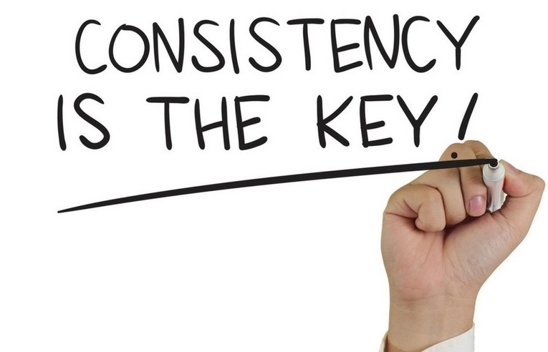
8. SUPER PERFORMANCE BONUS (SPB): 2%
2% of Company’s Total BV Per Month will be allocated for SPB, to be paid Monthly
Eligibility: 25,00,000 Fresh BV will be considered as 1 SPB & Personal FBV of 1750
SPB UNIT VALUE CALCULATION
Total Company BV Per Month X 2%
1 SPB Unit Value =
____________________________________________________
Total SPB Units Per Month

Slide 33
DOUBLE CROWN AMBASSADOR
YOU
1250 PBV
LEFT
RIGHT
5,00,000 GBV
5,00,000 GBV
YOUR REWARD
4N/5D
INTERNATIONAL TOUR OF THAILAND
Fresh BV Per Month
Reward is One-Time

Slide 34
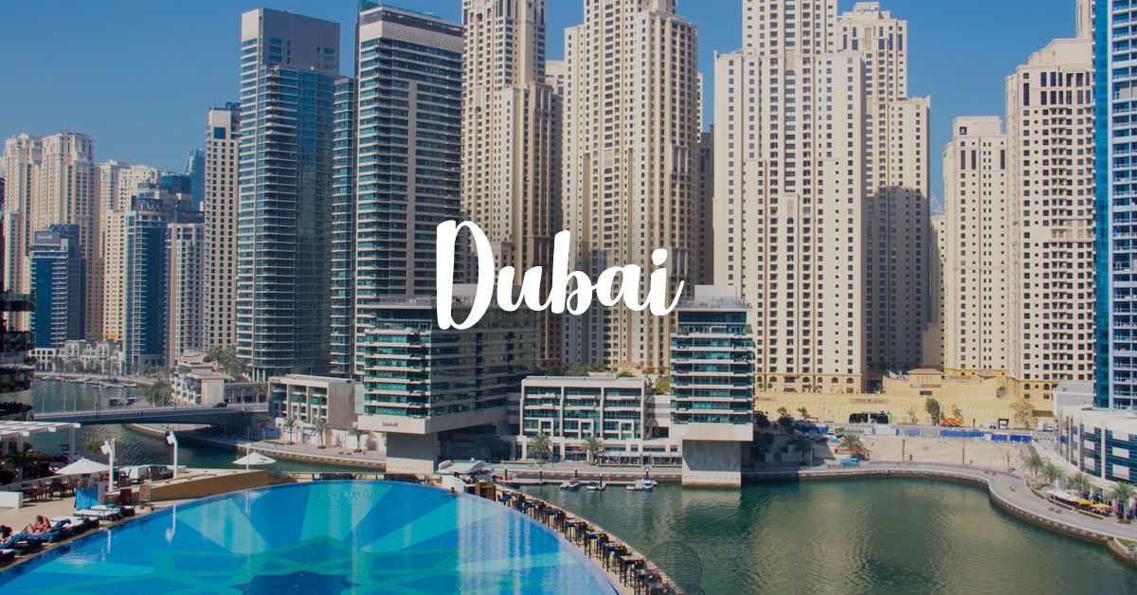
TRIPLE CROWN AMBASSADOR
YOU
1500 PBV
LEFT
RIGHT
10,00,000 GBV
10,00,000 GBV
YOUR REWARD
4N/5D
INTERNATIONAL TOUR OF DUBAI
Fresh BV Per Month
Reward is One-Time

Slide 35
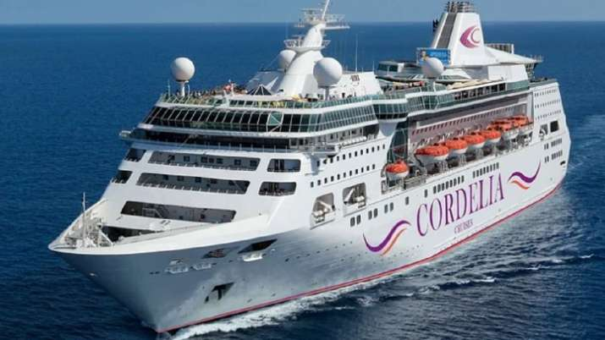
UNIVERSAL CROWN AMBASSADOR
YOU
1750 PBV
LEFT
RIGHT
25,00,000 GBV
25,00,000 GBV
YOUR REWARD
VACATION FOR 1 IN
STAR CRUISE
Fresh BV Per Month
Reward is One-Time

Slide 36
DOUBLE UNIVERSAL CROWN AMBASSADOR
YOU
2000 PBV
LEFT
RIGHT
50,00,000 GBV
50,00,000 GBV
YOUR REWARD
4N/5D
INTERNATIONAL HOLIDAY OF
SWITZERLAND
Fresh BV Per Month
Reward is One-Time

Slide 37
PRESIDENTIAL CLUB DIRECTOR
YOU
2250 PBV
LEFT
RIGHT
100,00,000 GBV
100,00,000 GBV
YOUR REWARD
7N/8D
INTERNATIONAL TOUR OF
EUROPE
Fresh BV Per Month
Reward is One-Time

Slide 38
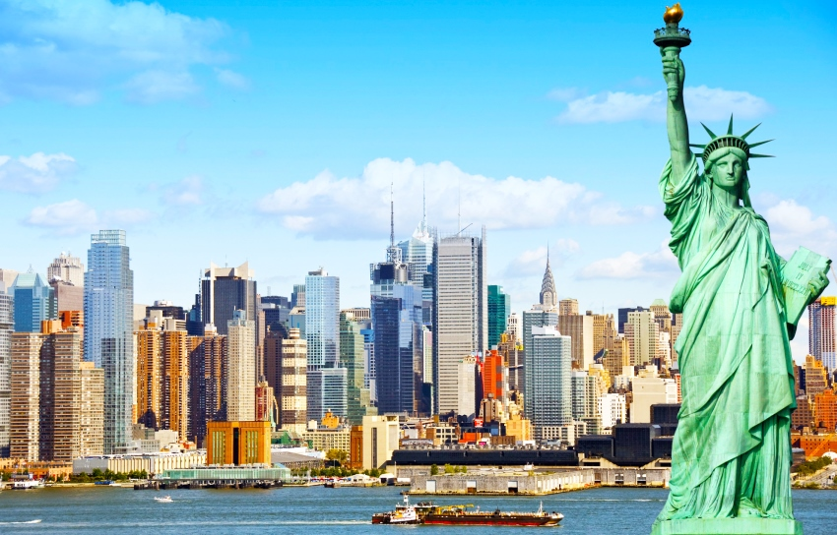
ROYAL PRESIDENTIAL CLUB DIRECTOR
YOU
2500 PBV
LEFT
RIGHT
250,00,000 GBV
250,00,000 GBV
YOUR REWARD
7N/8D
INTERNATIONAL TOUR OF
USA / AUSTRALIA
Fresh BV Per Month
Reward is One-Time

Slide 39
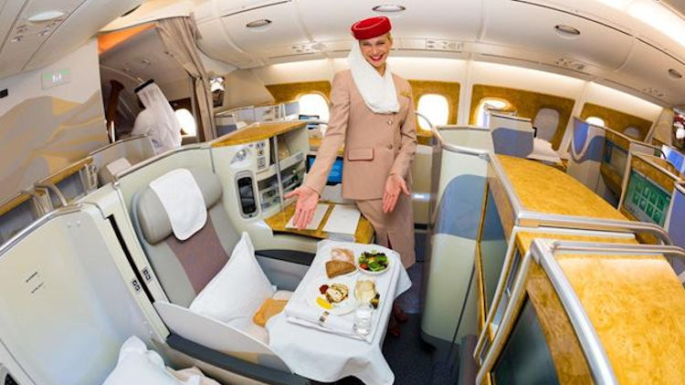
SHPL BRAND AMBASSADOR
YOU
3000 PBV
LEFT
RIGHT
500,00,000 GBV
500,00,000 GBV
YOUR REWARD
12N / 13D
MEMORABLE HOLIDAY OF
WORLD TOUR
Fresh BV Per Month
Reward is One-Time

Slide 40
SHPL FAMILY SAVER SCHEME
If any SHPL Active Independent Business Associate (IBA) meets with an unfortunate casualty and looses his / her life due to An Accidental Death, his/her Nnominee will be compensated with 2% of the Total BV of the Company for that particular month, provided that the distributor should have maintained self Re-purchase of 1000 BV in three consecutive months prior to the month of death.
In case of more than one incident, the same will be distributed among the different member’s nominee.

Slide 41
ABOUT SAARVASRI HERBS
TRAINING PROGRAMS & EVENTS

